Slide 1
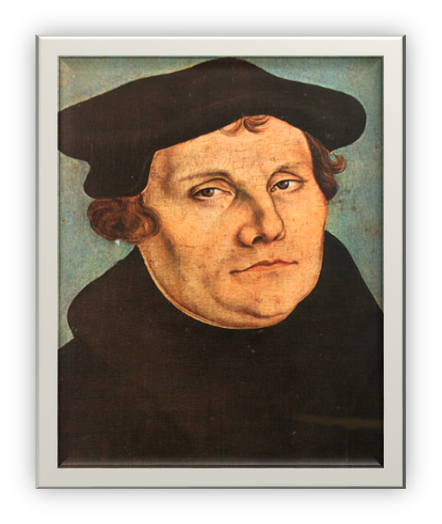
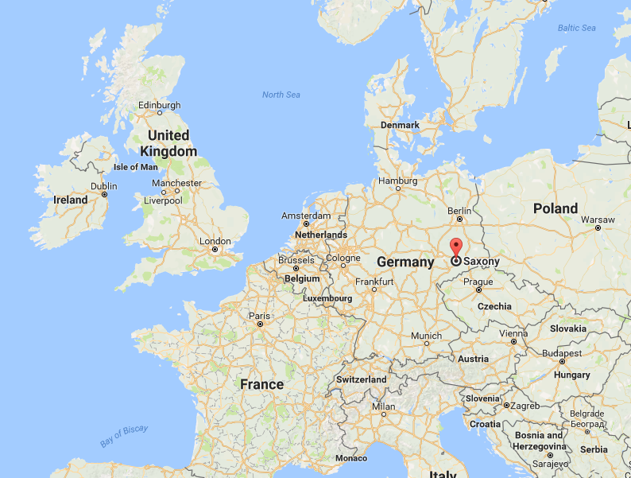


Martin Luther was born in Saxony, Germany in 1483.
How many years ago was that?
_____________
Martin Luther
Click on the pin to view Saxony
Notes:
File: Lucas Cranach d.Ä. - Martin Luther, 1528 (Veste Coburg) (cropped).jpg - Wikimedia commons (1472) Available at: https://commons.wikimedia.org/wiki/File:Lucas_Cranach_d.%C3%84._-_Martin_Luther,_1528_(Veste_Coburg)_(cropped).jpg (Accessed: 1 March 2017).
Google maps (no date) Available at: https://maps.google.ie/ (Accessed: 1 March 2017).

Slide 2
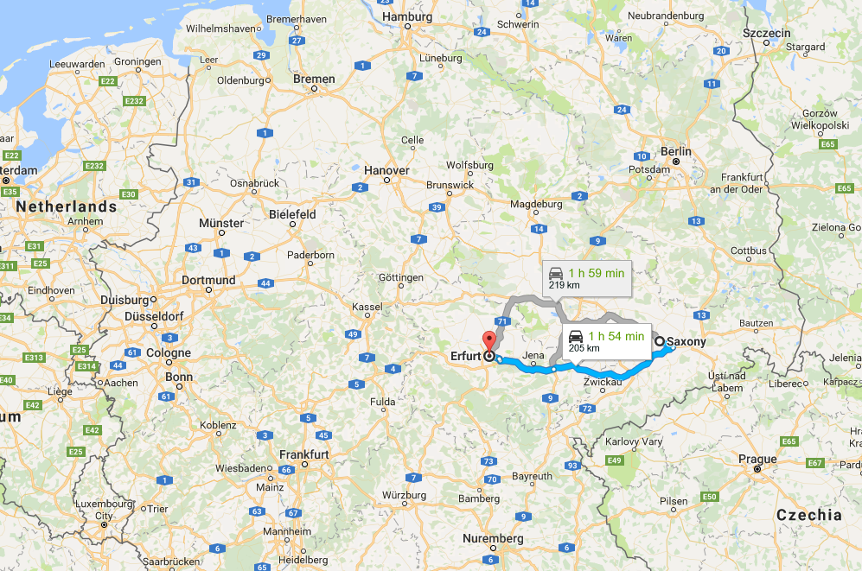

Martin Luther
Martin Luther went to University at Erfurt to study law
He was ordained a priest in 1507. (Augustinian order)
Notes:
File: Lucas Cranach d.Ä. - Martin Luther, 1528 (Veste Coburg) (cropped).jpg - Wikimedia commons (1472) Available at: https://commons.wikimedia.org/wiki/File:Lucas_Cranach_d.%C3%84._-_Martin_Luther,_1528_(Veste_Coburg)_(cropped).jpg (Accessed: 1 March 2017).

Slide 3
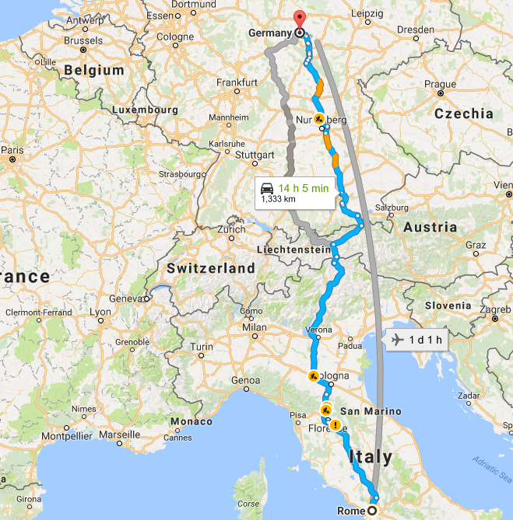
Martin Luther
In 1510, Martin Luther visited Rome.
Notes:
File: Lucas Cranach d.Ä. - Martin Luther, 1528 (Veste Coburg) (cropped).jpg - Wikimedia commons (1472) Available at: https://commons.wikimedia.org/wiki/File:Lucas_Cranach_d.%C3%84._-_Martin_Luther,_1528_(Veste_Coburg)_(cropped).jpg (Accessed: 1 March 2017).

Slide 4
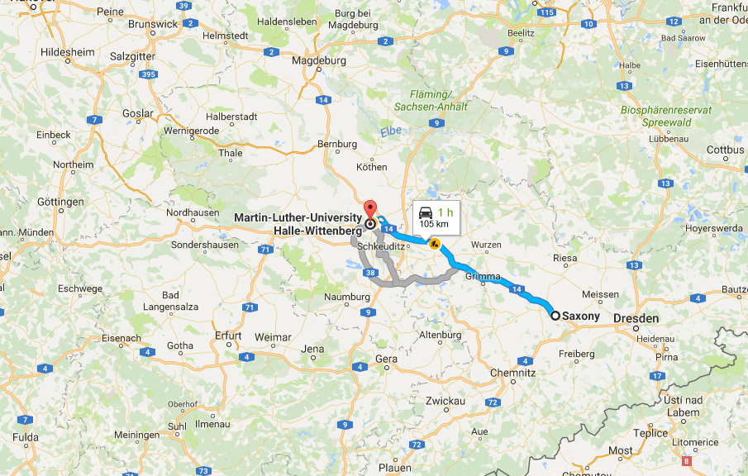
Martin Luther
…the University in which he was a professor.
On October 1517, Martin Luther nailed the Proclamation called the Ninety-Five Theses to the door of the University Church at Wittenberg.
Notes:
File: Lucas Cranach d.Ä. - Martin Luther, 1528 (Veste Coburg) (cropped).jpg - Wikimedia commons (1472) Available at: https://commons.wikimedia.org/wiki/File:Lucas_Cranach_d.%C3%84._-_Martin_Luther,_1528_(Veste_Coburg)_(cropped).jpg (Accessed: 1 March 2017).

Slide 5


What event in Martin Luther’s life led him to challenge the Catholic beliefs.
Record all the events throughout each stage of his life in the following table.

Slide 6
What event in Martin Luther’s life led him to challenge the Catholic beliefs?
Saxony | Erfurt | Rome | Wittenberg
Independent Research

Slide 7
What event in Martin Luther’s life led him to challenge the Catholic beliefs?
Saxony | Erfurt | Rome | Wittenberg
Home life was very strict. Believed in angry God. Father was a member of the local town council. Father wanted him to study Law. | Studied law in University of Erfurt. Decided to become a monk/ priest 1505 in a thunderstorm. ‘Saint Anne, help me, and I will become a monk’ Ordained a priest in 1507 (Augustinian Order.) | Luther thought he was a terrible sinner. In 1510, he visited Rome and was shocked by the bad lives of many churchmen. Developed the idea of Justification by Faith Alone. | Priest and professor at University of Wittenberg. In October 1517, John Tetzel came to preach about the pope’s special indulgences. Luther was so angry. He nailed a proclamation called the Ninety-Five Theses to the door of the University church.
Sample Answers
Self Assess

Slide 8

You are going to be given one of Luther’s ideas.
Decide in pairs whether you both agree or disagree.

Slide 9
The Ninety – Five Theses
A list of arguments condemning indulgences and other abuses in the Church.
Think – Pair – Share then
Christians should be taught that they purchase indulgences voluntarily, and are not under obligation to do so.
Notes:
Pixabay (2017) Free image on Pixabay - thumbs up, thumbs down, right. Available at: https://pixabay.com/en/thumbs-up-thumbs-down-right-wrong-1172213/ (Accessed: 1 March 2017).

Slide 10
The Ninety – Five Theses
A list of arguments condemning indulgences and other abuses in the Church.
Think – Pair – Share then
Christians should be taught that one who gives to the poor, or lends to the needy, does a better action than if he purchases indulgences.
Notes:
Pixabay (2017) Free image on Pixabay - thumbs up, thumbs down, right. Available at: https://pixabay.com/en/thumbs-up-thumbs-down-right-wrong-1172213/ (Accessed: 1 March 2017).

Slide 11
The Ninety – Five Theses
A list of arguments condemning indulgences and other abuses in the Church.
Think – Pair – Share then
Because by works of love, love grows and a man becomes a better man; whereas, by indulgences, he does not become a better man, but only escapes certain penalties.
Notes:
Pixabay (2017) Free image on Pixabay - thumbs up, thumbs down, right. Available at: https://pixabay.com/en/thumbs-up-thumbs-down-right-wrong-1172213/ (Accessed: 1 March 2017).

Slide 12
The Ninety – Five Theses
A list of arguments condemning indulgences and other abuses in the Church.
Think – Pair – Share then
All those who believe themselves certain of their own salvation by means of letters of indulgence, will be eternally damned, together with their teachers.
Notes:
Pixabay (2017) Free image on Pixabay - thumbs up, thumbs down, right. Available at: https://pixabay.com/en/thumbs-up-thumbs-down-right-wrong-1172213/ (Accessed: 1 March 2017).

Slide 13

In groups, discuss the speech bubbles.
Then, decide on a character that represents your opinion on Martin Luther actions.

Slide 14
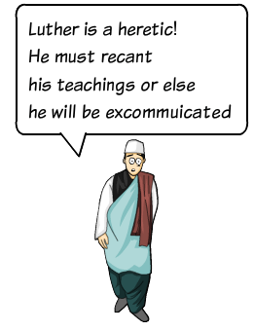
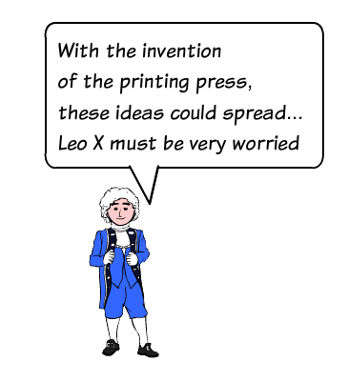
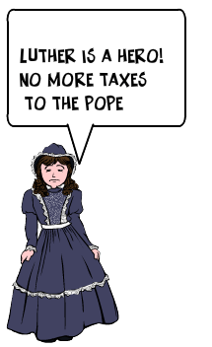
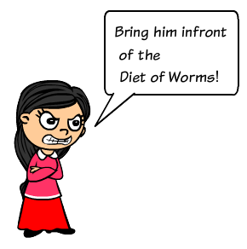

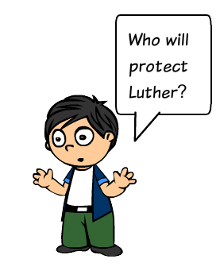
Which opinion do you think people had? Group discussion
Luther is a heretic! He must recant his teachings or else be excommunicated
Notes:
Jambav, T. (2012) Login - register at ToonDoo - world’s fastest way to create cartoons! Available at: http://www.toondoo.com/createToon.jsp (Accessed: 1 March 2017).

Slide 15

Look at who agreed and disagreed with Martin Luther.

Slide 16
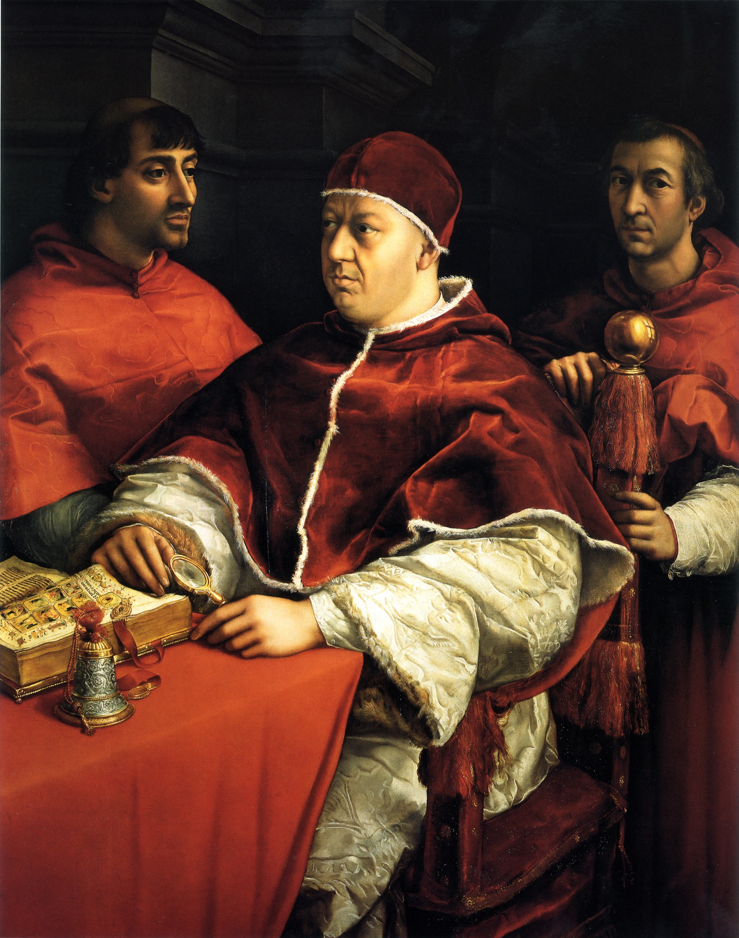
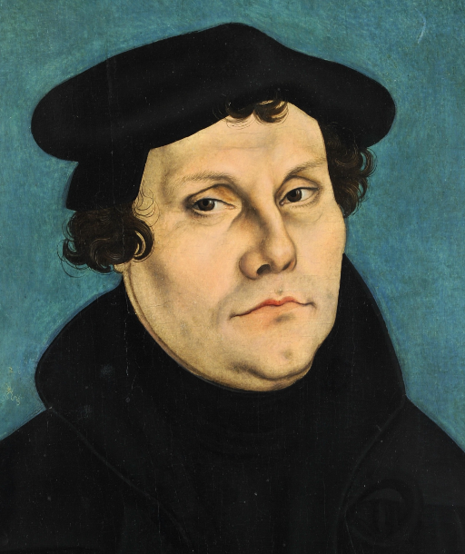
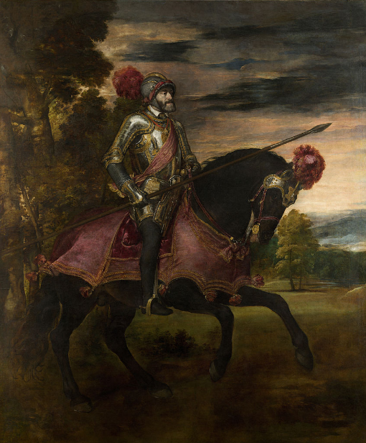
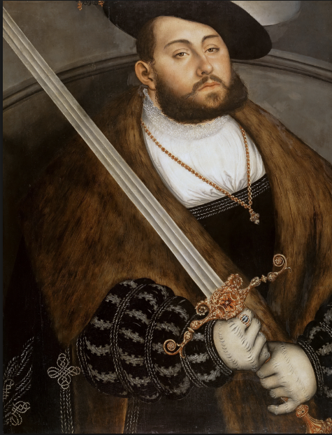
In July 1520, Pope Leo X issued a papal letter (bull) called Exsurge Domine. This gave Martin Luther 60 days to recant his teachings or else he would be excommunicated.
10th December 1920, Luther burnt the pope’s letter along with some Catholic books. He would not change his beliefs unless he was proved wrong by the Bible.
The parliament (known as Diet) in Worms, meet to negotiate what to do with Luther’s Ideas. Emperor Charles V spoke out against Luther. Luther was condemned by the Diet. Luther was now a heretic.
Frederick of Saxony protected Luther by letting him stay in his castle in Wartburg.
Notes:
(No Date) Available at: https://commons.wikimedia.org/wiki/File:Lucas_Cranach_I_-_Johann_Friedrich_I.,_Kurf%C3%BCrst_von_Sachsen_(Gem%C3%A4ldegalerie,_Berlin).jpg (Accessed: 1 March 2017).
(No Date) Available at: https://en.wikipedia.org/wiki/Charles_V,_Holy_Roman_Emperor (Accessed: 1 March 2017).
(No Date) Available at: https://commons.wikimedia.org/wiki/File:Raffael_040.jpg (Accessed: 1 March 2017).

Slide 17

Exit Task
Write a Tweet on what you learnt today about Martin Luther.
Homework Task
Complete the exam questions on the following slides.

Slide 18

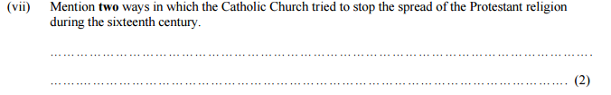
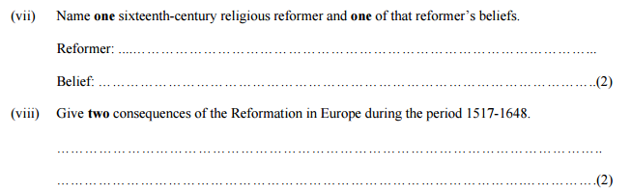
2015 > Higher Level > Junior Certificate
3
2014 > Higher Level > Junior Certificate
3
Notes:
Ireland, E. (no date) State examination commission - exam material archive. Available at: http://www.examinations.ie/exammaterialarchive/?i=109.111.92.100.95.93.110.104 (Accessed: 1 March 2017).

Slide 19
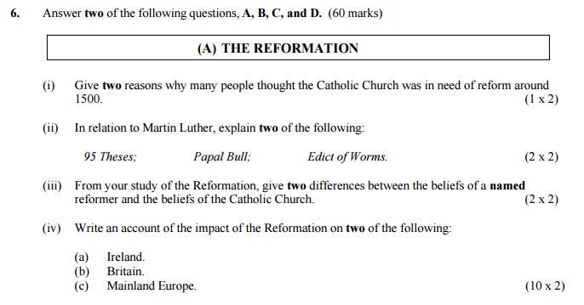
2016 > Higher Level > Junior Certificate

Slide 20
For more resources, visit...

Slide 21
Bibliography
File: Lucas Cranach d.Ä. - Martin Luther, 1528 (Veste Coburg) (cropped).jpg - Wikimedia commons (1472) Available at: https://commons.wikimedia.org/wiki/File:Lucas_Cranach_d.%C3%84._-_Martin_Luther,_1528_(Veste_Coburg)_(cropped).jpg (Accessed: 1 March 2017).
Google maps (no date) Available at: https://maps.google.ie/ (Accessed: 1 March 2017).
Pixabay (2017) Free image on Pixabay - thumbs up, thumbs down, right. Available at: https://pixabay.com/en/thumbs-up-thumbs-down-right-wrong-1172213/ (Accessed: 1 March 2017).
Jambav, T. (2012) Login - register at ToonDoo - world’s fastest way to create cartoons! Available at: http://www.toondoo.com/createToon.jsp (Accessed: 1 March 2017).
95 theses - Luther (no date) Available at: http://www.iclnet.org/pub/resources/text/wittenberg/luther/web/ninetyfive.html (Accessed: 1 March 2017).
The Editors of Encyclopædia Britannica (2017) ‘Martin Luther | biography, reformation, & facts’, in Encyclopædia Britannica. Available at: https://www.britannica.com/biography/Martin-Luther (Accessed: 1 March 2017).
(No Date) Available at: https://commons.wikimedia.org/wiki/File:Lucas_Cranach_I_-_Johann_Friedrich_I.,_Kurf%C3%BCrst_von_Sachsen_(Gem%C3%A4ldegalerie,_Berlin).jpg (Accessed: 1 March 2017).
(No Date) Available at: https://en.wikipedia.org/wiki/Charles_V,_Holy_Roman_Emperor (Accessed: 1 March 2017).
(No Date) Available at: https://commons.wikimedia.org/wiki/File:Raffael_040.jpg (Accessed: 1 March 2017).
Ireland, E. (no date) State examination commission - exam material archive. Available at: http://www.examinations.ie/exammaterialarchive/?i=109.111.92.100.95.93.110.104 (Accessed: 1 March 2017).
Solutions to exam papers are available on the State Examination website:
https://www.examinations.ie/tmp/1488384825_5509391.pdf

