Slide 1

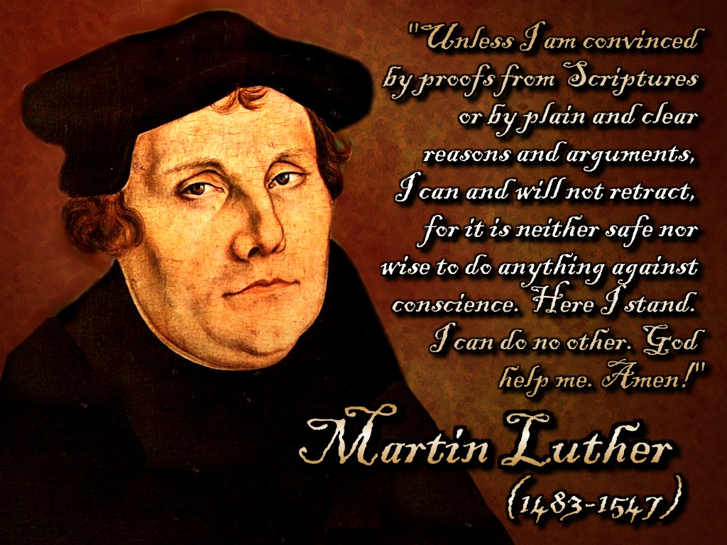
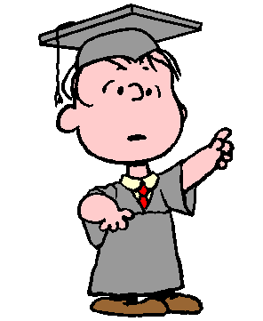

Title: Luther’s Beliefs
To start…
Recap on last lesson using the Edpuzzle video
Notes:
Video can be alternatively viewed on youtube at https://www.youtube.com/embed/ijjbtcAEOnY

Slide 2

Reasons to not support
Reasons
to
support
Pope Leo X
Federick
EmperorCharles V
John Tetzel
Points to consider:
Document the five points on a Padlet discussion board with your name.
Task 1:
If you were Martin Luther, would you recant your teachings?
(Give five reasons to support your opinion.)
Justification by Faith Alone
Exsurge Domine
Indulgences
Printing Press
Excommunication
Confession of Augsburg
Lutheranism
Reformation
Edit of Worms

Slide 3
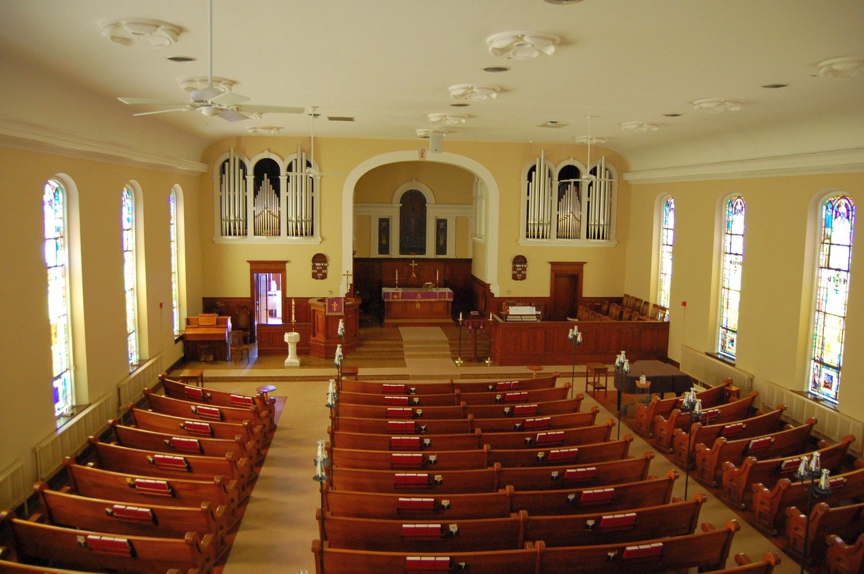

Diamond ranking Activity:
Sort the statements into a diamond shape with the Lutheran belief of highest importance at the top.
The Confession of Augsburg is a statement containing the customs and beliefs of the Lutheran Church

Slide 5
Printable statements for the diamond activity. Label the part of each statement for easy reference.
The Bible should be read. Own meaning should be taken from bible.
Consubstantiation:
At Communion, the bread coexist with the body and blood of Christ
Believing in Christ is more important than elaborate services.
Justification by faith alone: Only faith in God will decide who will be saved.
Bible in your own language.
People cannot be saved from sin by buying indulgences.
Two sacraments:
Baptism and Eucharist.
People do not need priests, bishops or cardinals to find God.
Mass in your own language.

Slide 6


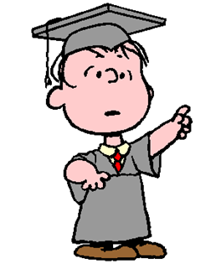

Click on the Kahoot logo to enter the Kahoot Quiz.

Slide 7

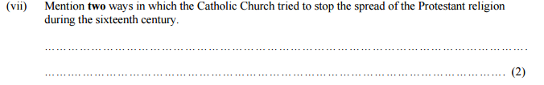
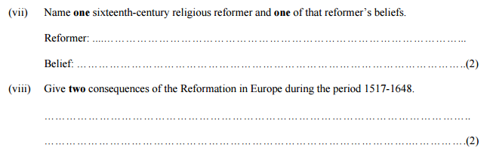
2015 > Higher Level > Junior Certificate
3
2014 > Higher Level > Junior Certificate
3
Notes:
Ireland, E. (no date) State examination commission - exam material archive. Available at: http://www.examinations.ie/exammaterialarchive/?i=109.111.92.100.95.93.110.104 (Accessed: 1 March 2017).

Slide 8
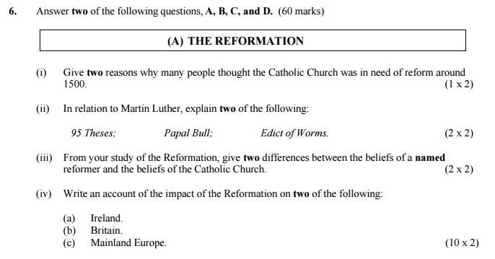
2016 > Higher Level > Junior Certificate

Slide 9
Bibliography
"Edpuzzle Assignment". EDpuzzle. N.p., 2017. Web. 7 Mar. 2017.
“Scoilnet – Martin Luther". kahoot.com. 2017. Web. 7 Mar. 2017.
"Free Image On Pixabay - Question, Quiz, Think, Thinking". Pixabay.com. N.p., 2017. Web. 7 Mar. 2017.
"The Candlelight Program At Gettysburg’S Christ Lutheran Church: The Music | Gettysburg Daily". Gettysburg Daily. N.p., 2017. Web. 7 Mar. 2017.
"Padlet Is The Easiest Way To Create And Collaborate In The World". Padlet. N.p., 2017. Web. 7 Mar. 2017.
Ireland, E. (no date) State examination commission - exam material archive. Available at: http://www.examinations.ie/exammaterialarchive/?i=109.111.92.100.95.93.110.104 (Accessed: 1 March 2017).
Solutions to exam papers are available on the State Examination website:
https://www.examinations.ie/tmp/1488384825_5509391.pdf

