Slide 1


Census

Slide 2

What you will learn

Slide 3

What a Census is
What the information from a Census is used for
What types of questions are asked in a Census
Who collects the Census
Who analyses Census information
What a word splash is

Slide 4
Vocabulary

Slide 5
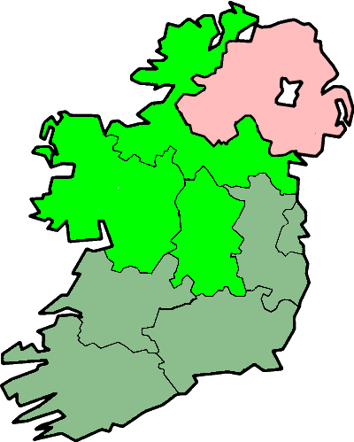

Census
Region
Currency

Slide 6



Statement
Taxes
Infrastructure

Slide 7



Multiple Choice
Signature
Central Statistics Office

Slide 8

Word Splash

Slide 9
What is a Census?

Slide 10

Which of the statements on the next slide do you think explain what a Census is and why?

Slide 11




A Census is where lots of people agree on the same thing.
A Census is where everyone answers the same questions so we get a picture of the country.
A Census is money, a type of currency.
I’m not quite sure but I think that a Census might be ...

Slide 12

The Census is an account of everyone in a country or region on one particular night.

Slide 13

Everyone must fill in the Census form on the same night, sometimes called Census night.

Slide 14
What is a Census used for?

Slide 15
Which of the statements on the next slide do you think explain what a Census is used for?

Slide 16
A Census is used to make sure that everyone is paying taxes.
The information from a Census is used to see what food people are eating.
The Government use the information from a Census to plan for the future.
I’m not quite sure but I think that a Census might be used to ...

Slide 17




Census information is used to help plan for infrastructure such as ...
Hospitals
Schools
Roads and parks

Slide 18
What types of questions are asked on the Census?

Slide 19
Most questions are multiple choice
The first section has general questions in it such as
What type of house do you live in?
Is there a computer in your home?
Does your home have internet?

Slide 20
The next sections are about each person in the house. You must list who is staying in the house on Census night and who normally lives in the house but are not there on Census night. These people may be on holidays or in the hospital for example.

Slide 21
Then there is a section for each person in the house. Here questions like these are asked:
What is your date of birth?
Where do you usually live?
Can you speak Irish?
Do you work?

Slide 22
At the end of the Census you can fill out some information about people who live in the house but are not there on Census night.
Their date of birth
How long they will be away for
If they are a student or in college

Slide 23
The Census form must be signed to say that all information on it is correct.
Click on the signature to see a sample Census form.

Slide 24
Who collects the Census and puts the results together?

Slide 25
The Central Statistics Office or CSO collect and analyse the Census forms.
The CSO is the national statistical office and was established in 1949. They provide information to the Government to to help them create policy. This information is also used by businesses and students for research.

Slide 26
Activity

Slide 27

Create a word splash using words you think are important for the census.

Slide 28
A word splash is where words are written or drawn in a shape. The bigger the word in the word splash the more important it is. Here is an example:

Slide 29
Did you learn?

Slide 30
What a Census is
What the information from a Census is used for
What types of questions are asked in a Census
Who collects the Census
Who analyses Census information
What a word splash is

Slide 31

Visit CensusAtSchool and take a census of your classroom.

Slide 32
For more resources please visit….

