Slide 1

Saint Declan of Ardmore

Slide 2
What do you already know about Saint Declan or the village of Ardmore?

Slide 3
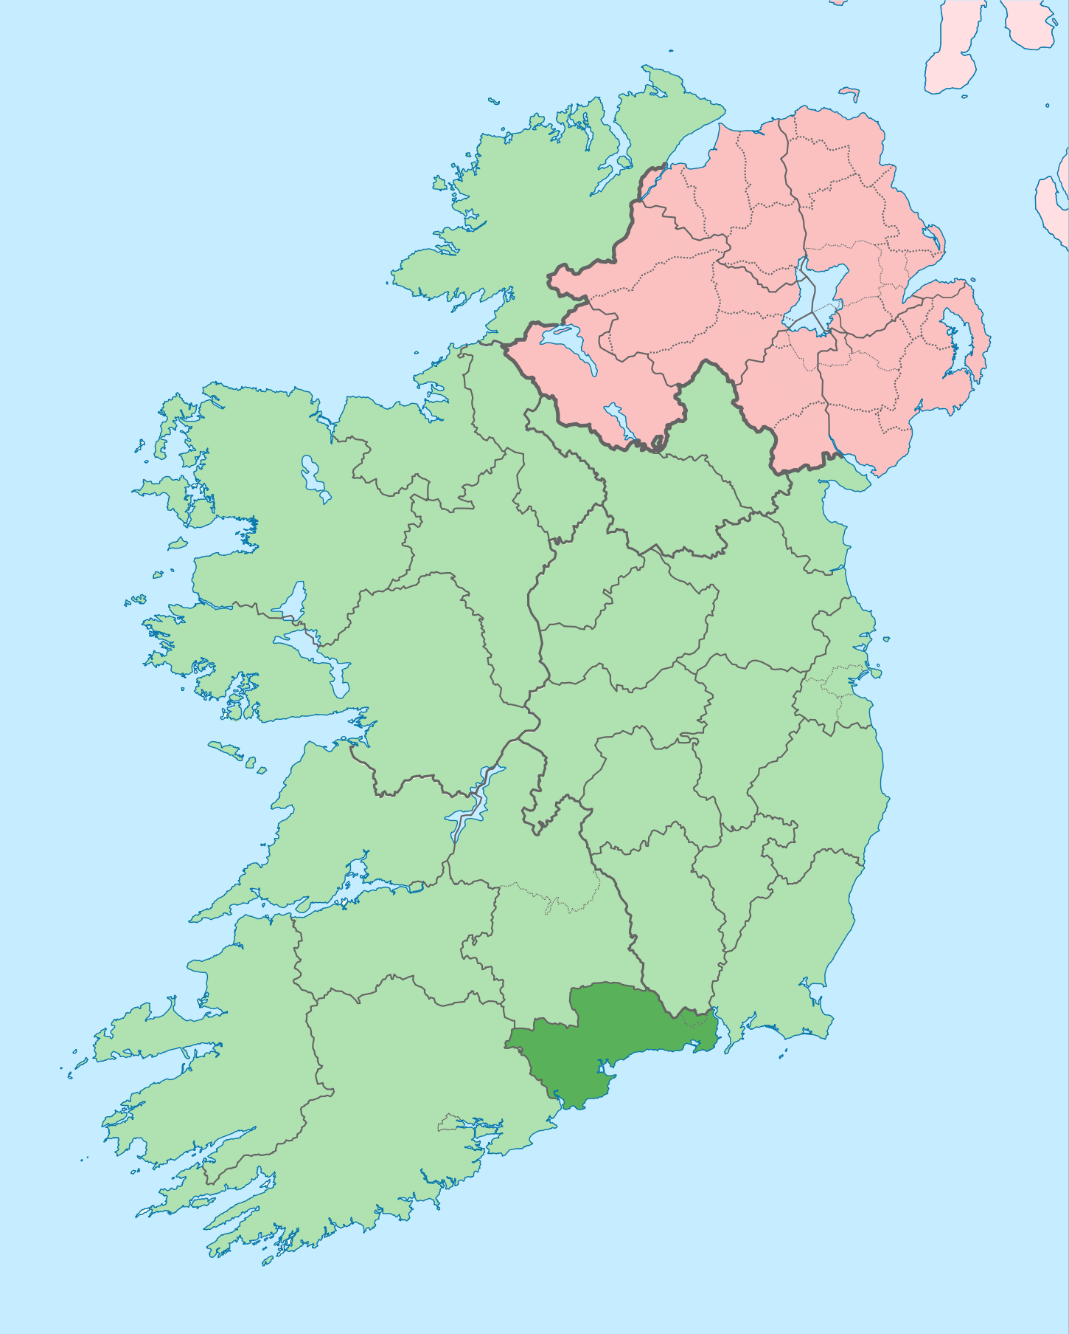
Ardmore (Árd Mór)
Ardmore is a seaside village in County Waterford. The original Irish name is Árd Mór which means ‘great height’.
It was to this part of County Waterford that St Declan arrived from Wales some time during the 5th century.
Several monuments and ruins from Saint Declan’s time can be found at Ardmore. So what is the story of this place?

Slide 4
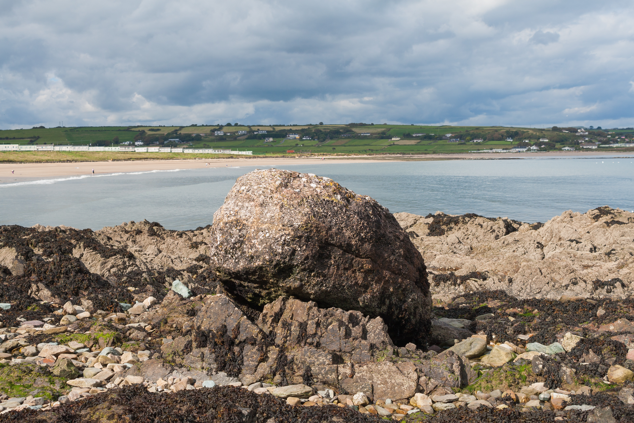

St. Declan’s Stone
St Declan’s Stone in Ardmore
The legend goes as follows:
St. Declan was returning to Ireland but his bell was left in Wales when his servant forgot to pack it. St. Declan’s prayers for the bell's safe return were answered when a boulder carrying the bell came sailing over the water to his boat! From there, it sailed before the boat, guiding the way across the channel. St. Declan decreed that wherever the stone came to rest was where he would set up his monastery and that is how Ardmore became Ireland’s first Christian settlement in the early 5th Century.
St. Declan’s Stone can still be seen on the beach in Ardmore today.

Slide 5
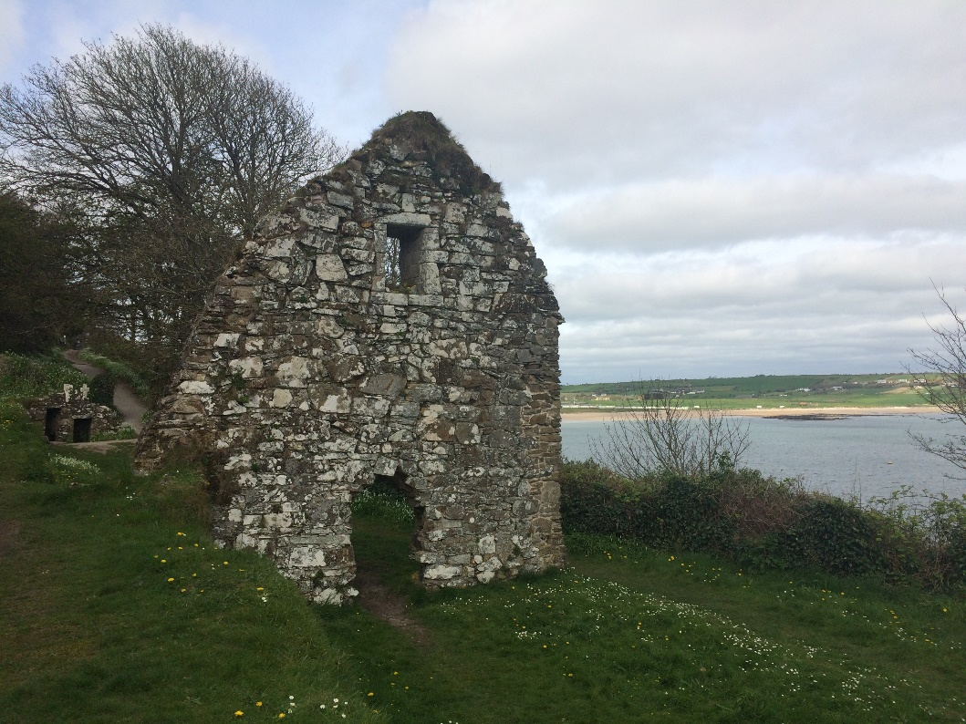
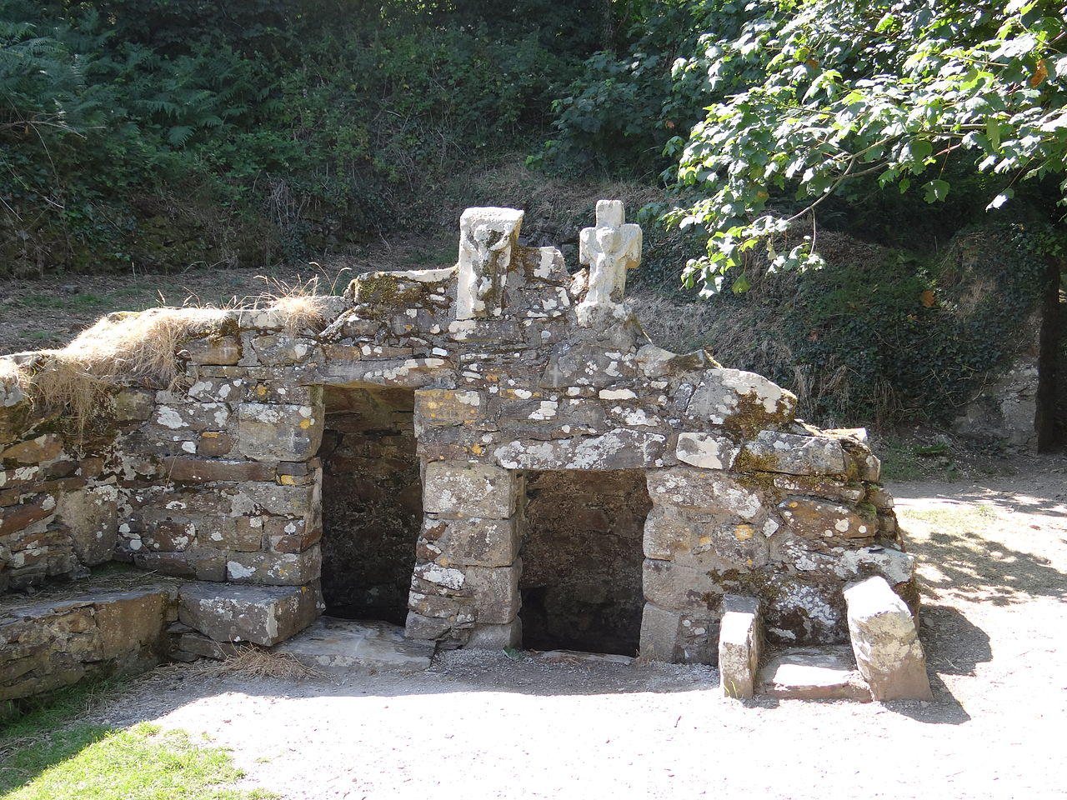
St. Declan’s Well
Another site in Ardmore is St. Declan’s Well.
The well can be found in a small area on the cliffs that overlook the village of Ardmore. It sits beside the ruins of a church and it was thought that this area was somewhere that Declan liked to sit, pray and think.
It is believed that the water in the well has healing properties and many people go there to bathe their hands and feet.
St Declan’s Church with the well in the background.
St Declan’s Well

Slide 6
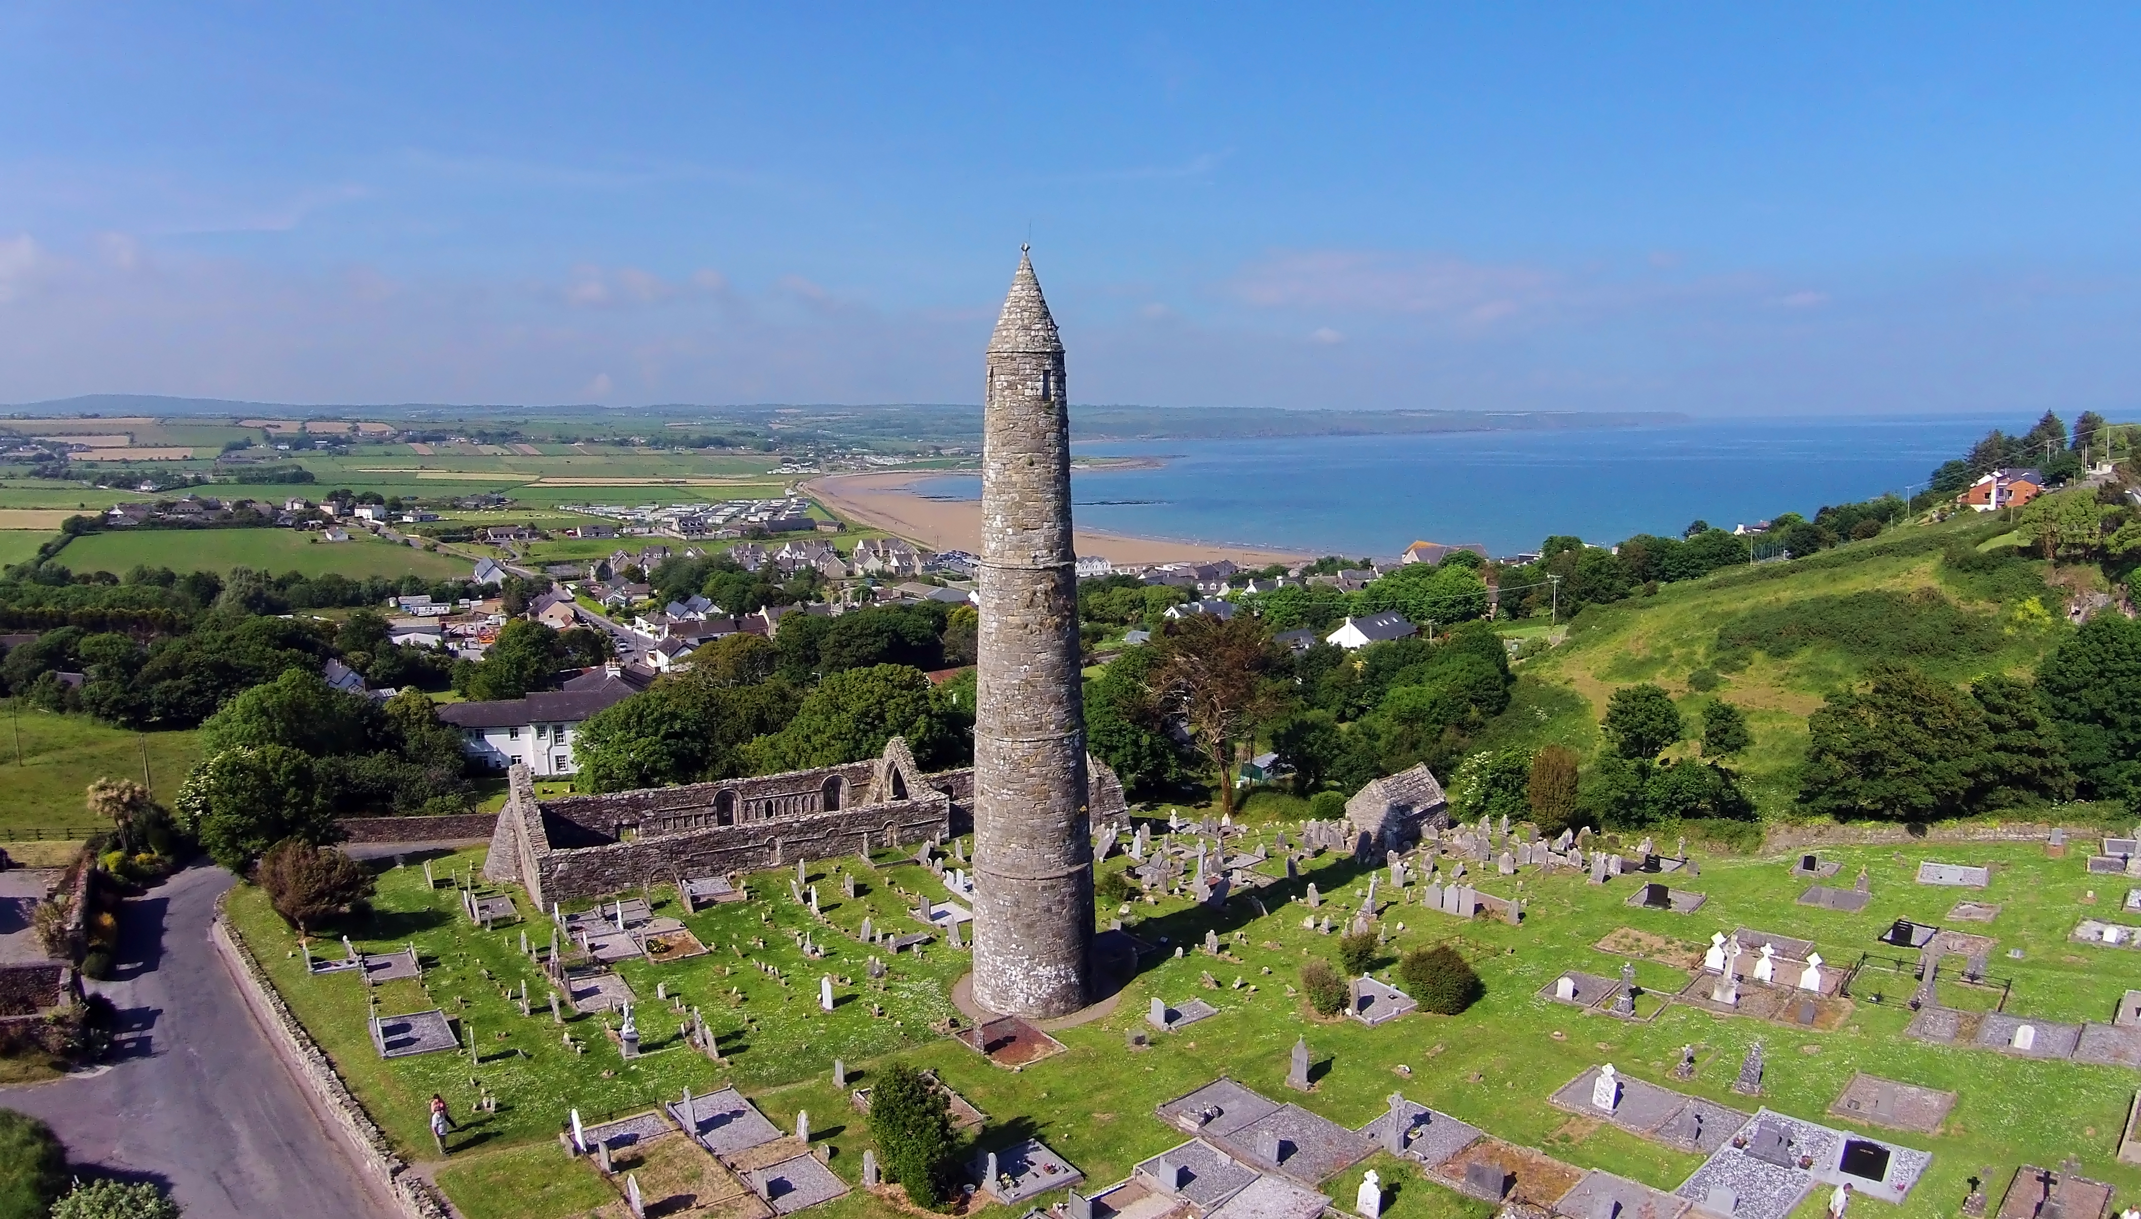
St. Declan’s Monastery
Saint Declan’s Monastery was later founded at another site in Ardmore and it contains several monuments.
These include a round tower, an oratory (a small chapel or place to pray), a ruined 12th century cathedral and two ogham stones from around the 6th century.
Saint Declan is also believed to be buried on the site.
The round tower overlooking the sea in Ardmore.

Slide 7
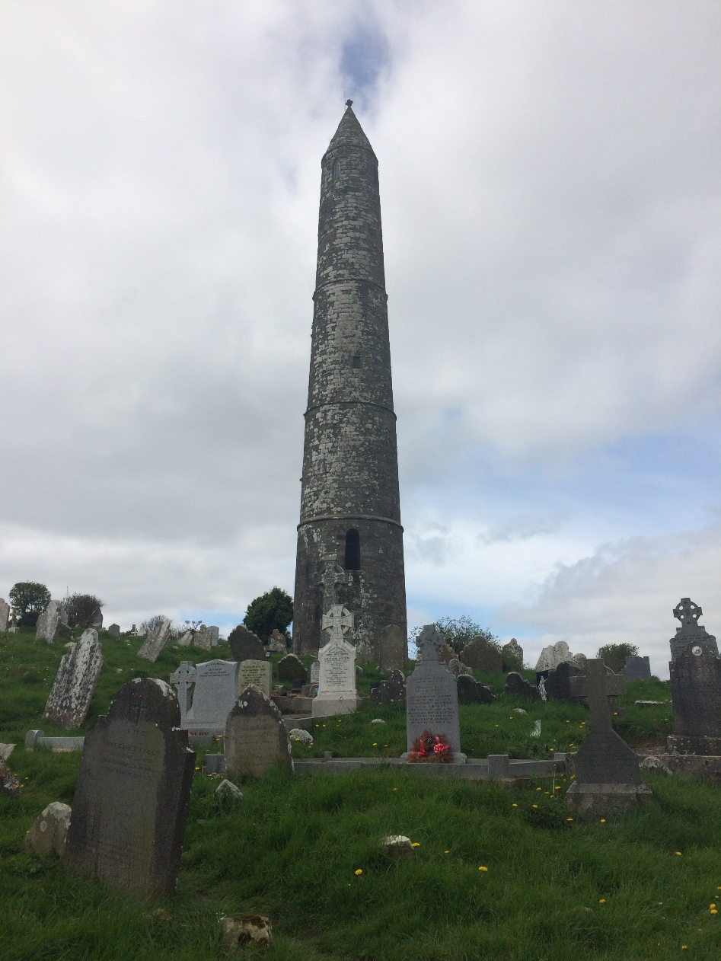
The Round Tower
Possibly the most impressive building at the site is the round tower. Around 30m tall, it was originally a bell tower, as well as being a place of refuge during times of trouble. For extra security the doorway was positioned 4m above ground level and was probably accessed via a wooden ladder that could be withdrawn inside when needed.
The tower has four floors and three small windows along its body, with four more windows located at the very top, one at each of the cardinal points of the compass (N, S, E and W).
What do you think the four windows at the top of the tower were for?

Slide 8
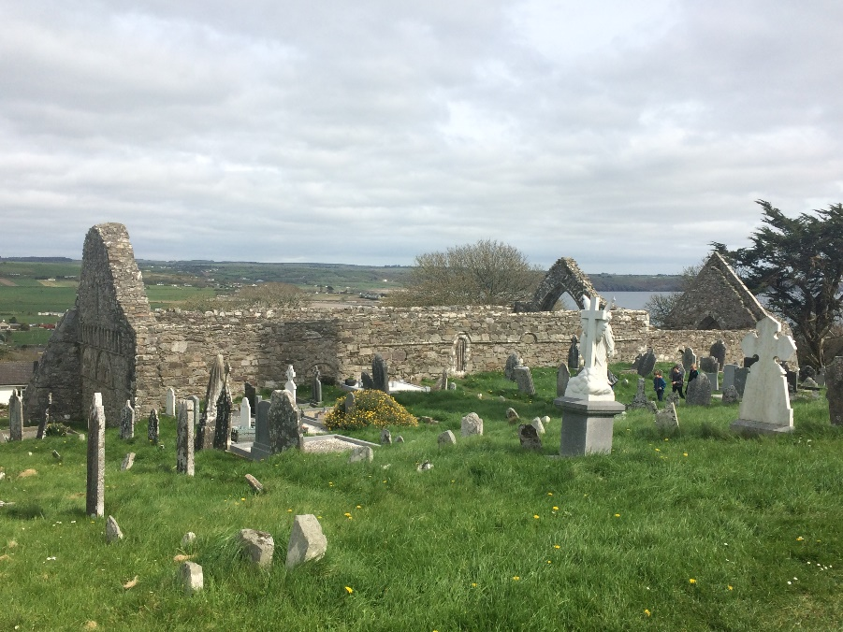
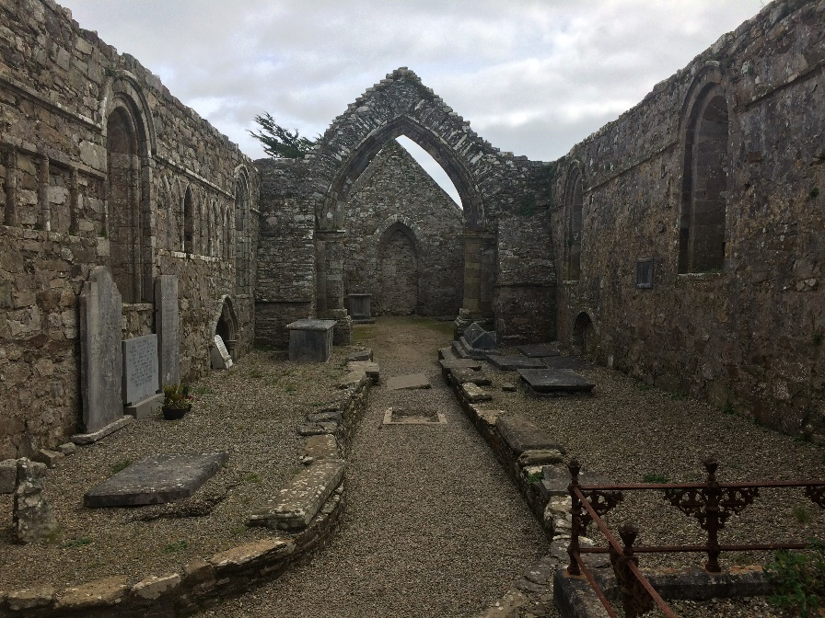
The Cathedral
The ruined cathedral was built around the 12th century.
Inside the cathedral you can find two ogham stones. These contain inscriptions that are written in ogham script, an early Irish style of writing that used lines instead of letters.
At one end of the cathedral there are stone carvings on the wall which show stories from the bible.
Outside the cathedral (above) and inside the cathedral (below).

Slide 9
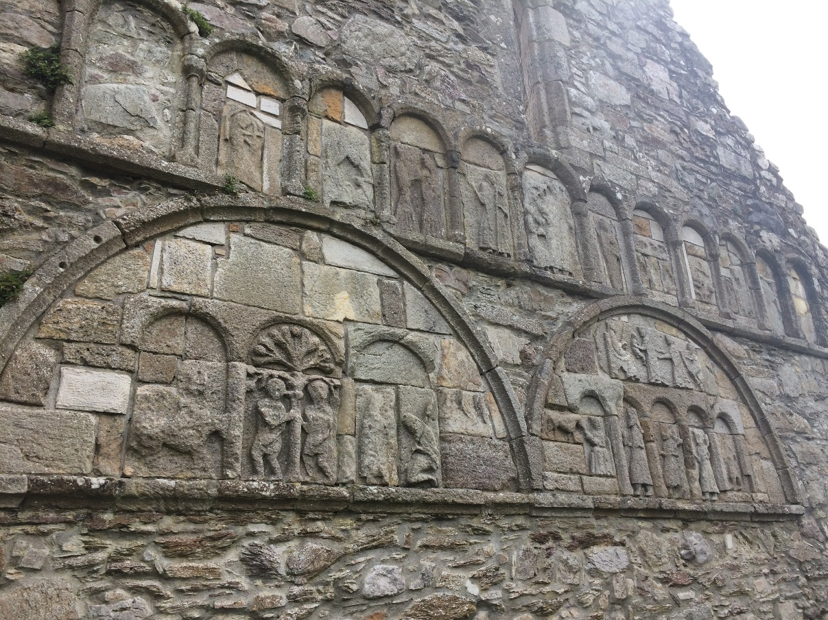
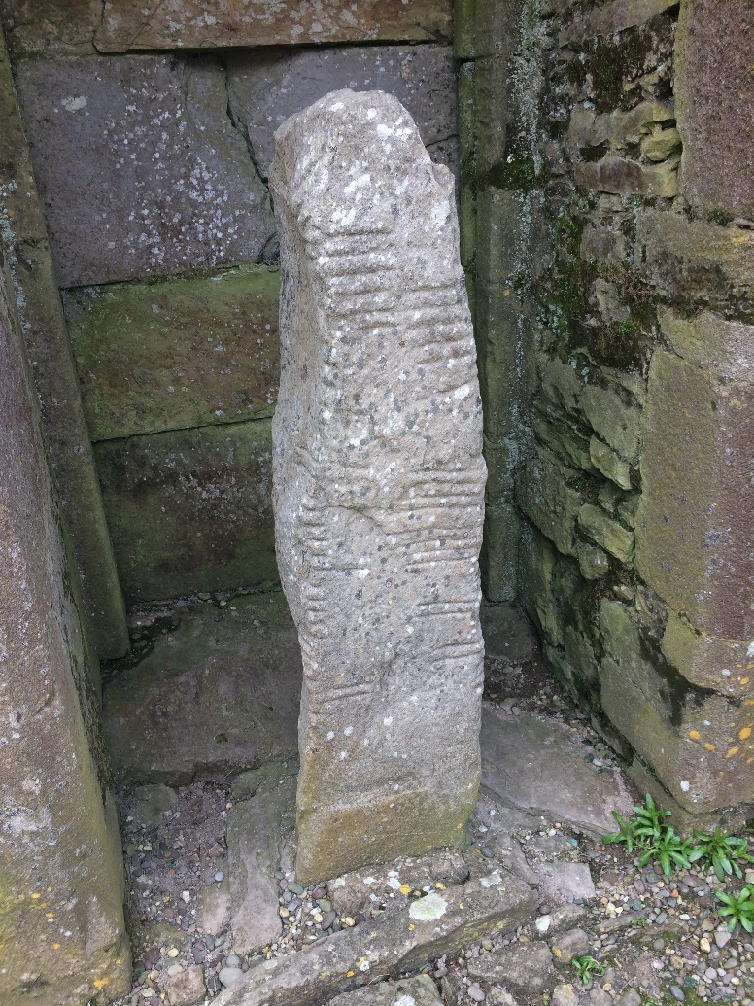
The Cathedral
The stone carvings on the wall of the cathedral.
One of the ogham stones

Slide 10
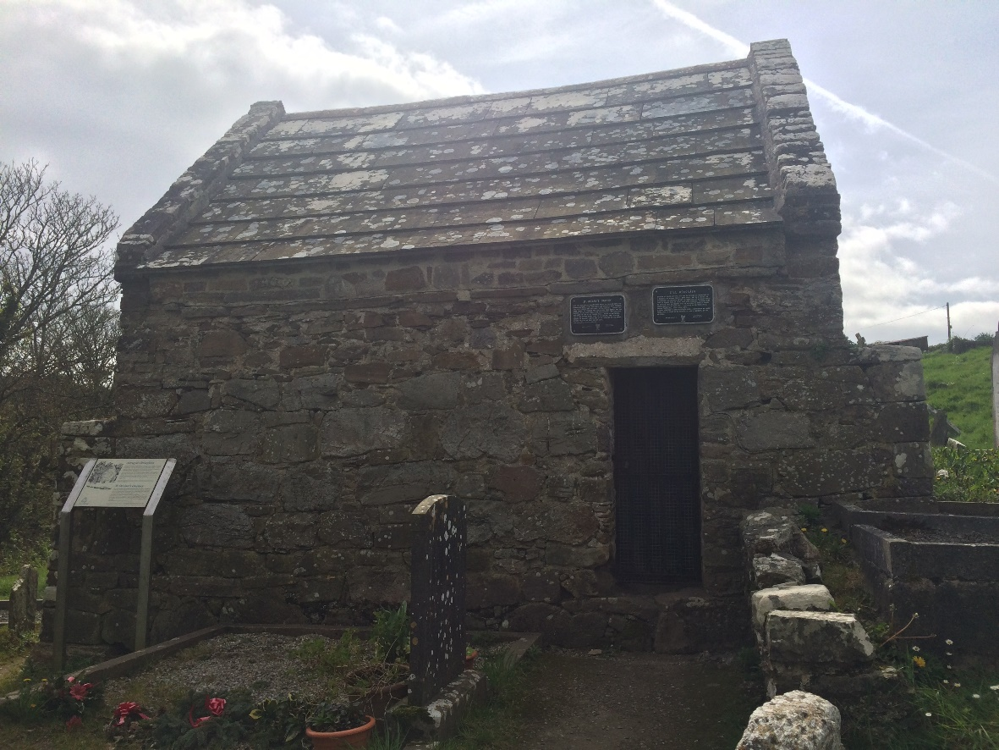
The Oratory
The last building you will find here is a small stone building or oratory that is said to contain the grave of Saint Declan. It is older than the cathedral and tower, possibly dating from 9th or 10th centuries AD.
An important site of pilgrimage, it was traditionally visited on St. Declan’s feast day, the 24th of July. Inside the oratory is what appears to be a empty grave. This is meant to have been the final resting place of Declan.
The oratory in Ardmore.

Slide 11
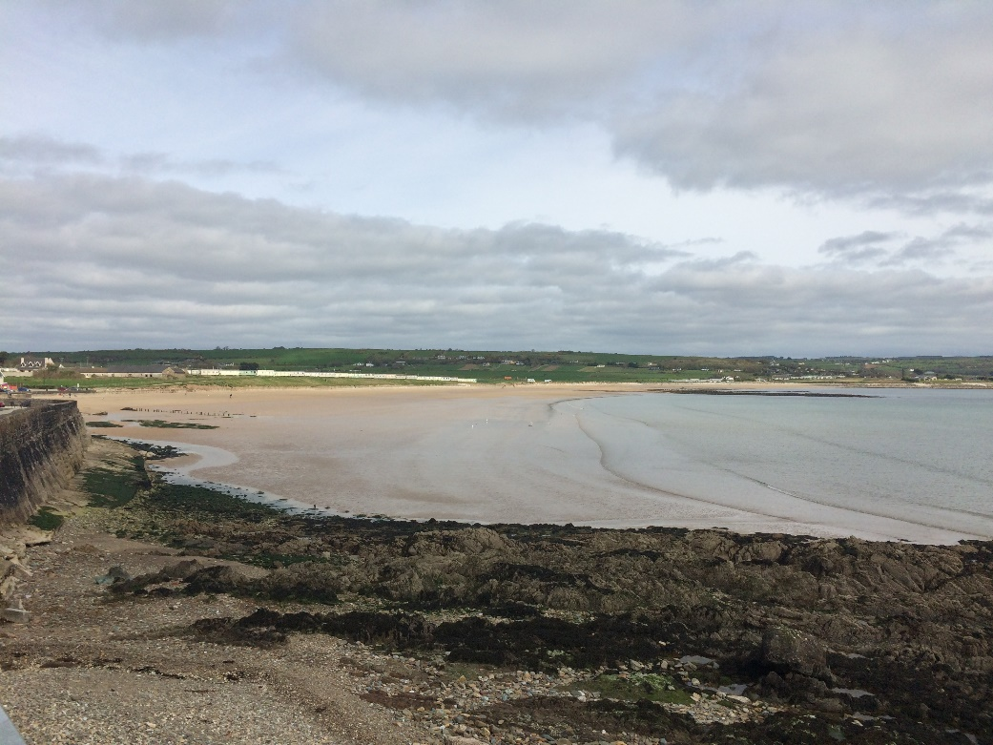
The Pattern Festival
St Declan’s Well is the oldest Christian settlement in Ireland. Did you know St Declan arrived in Ireland even before St Patrick!
People have been visiting the holy well in Ardmore for many years, especially around St Declan’s feast day on 24th July.
This continues today and a big festival happens in the village every year with lots of fun activities for adults and children!
Ardmore beach
http://www.ardmorepatternfestival.ie/

