Slide 1
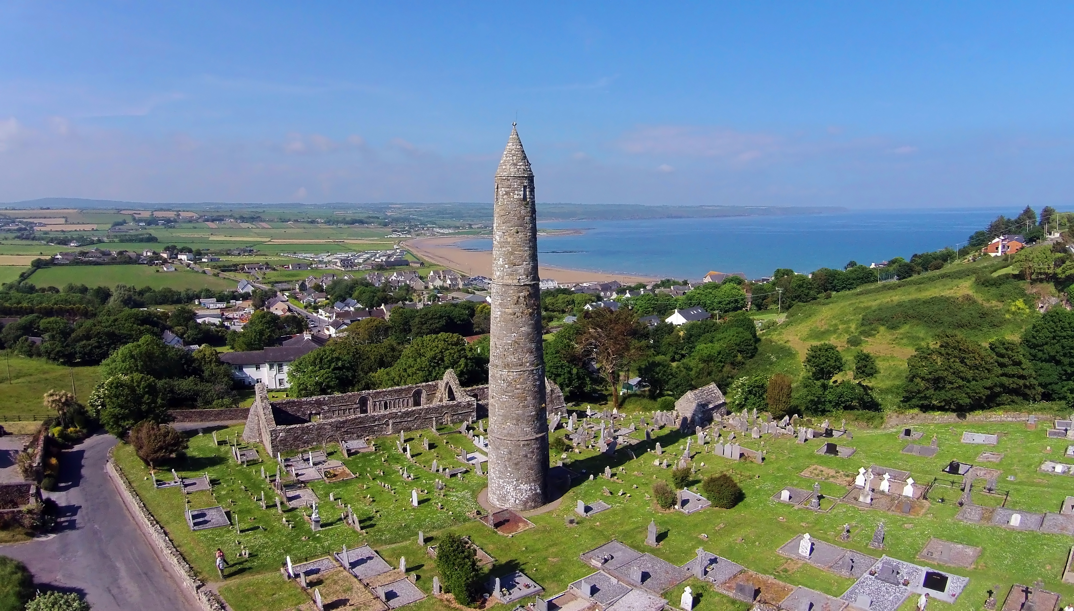
Ardmore, Co. Waterford

Slide 2
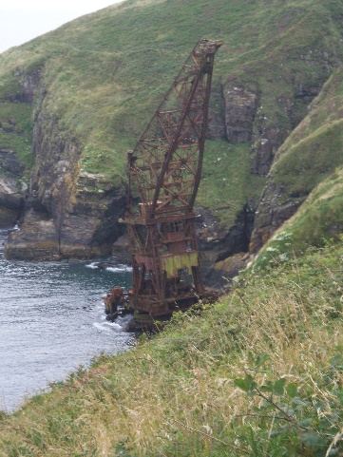
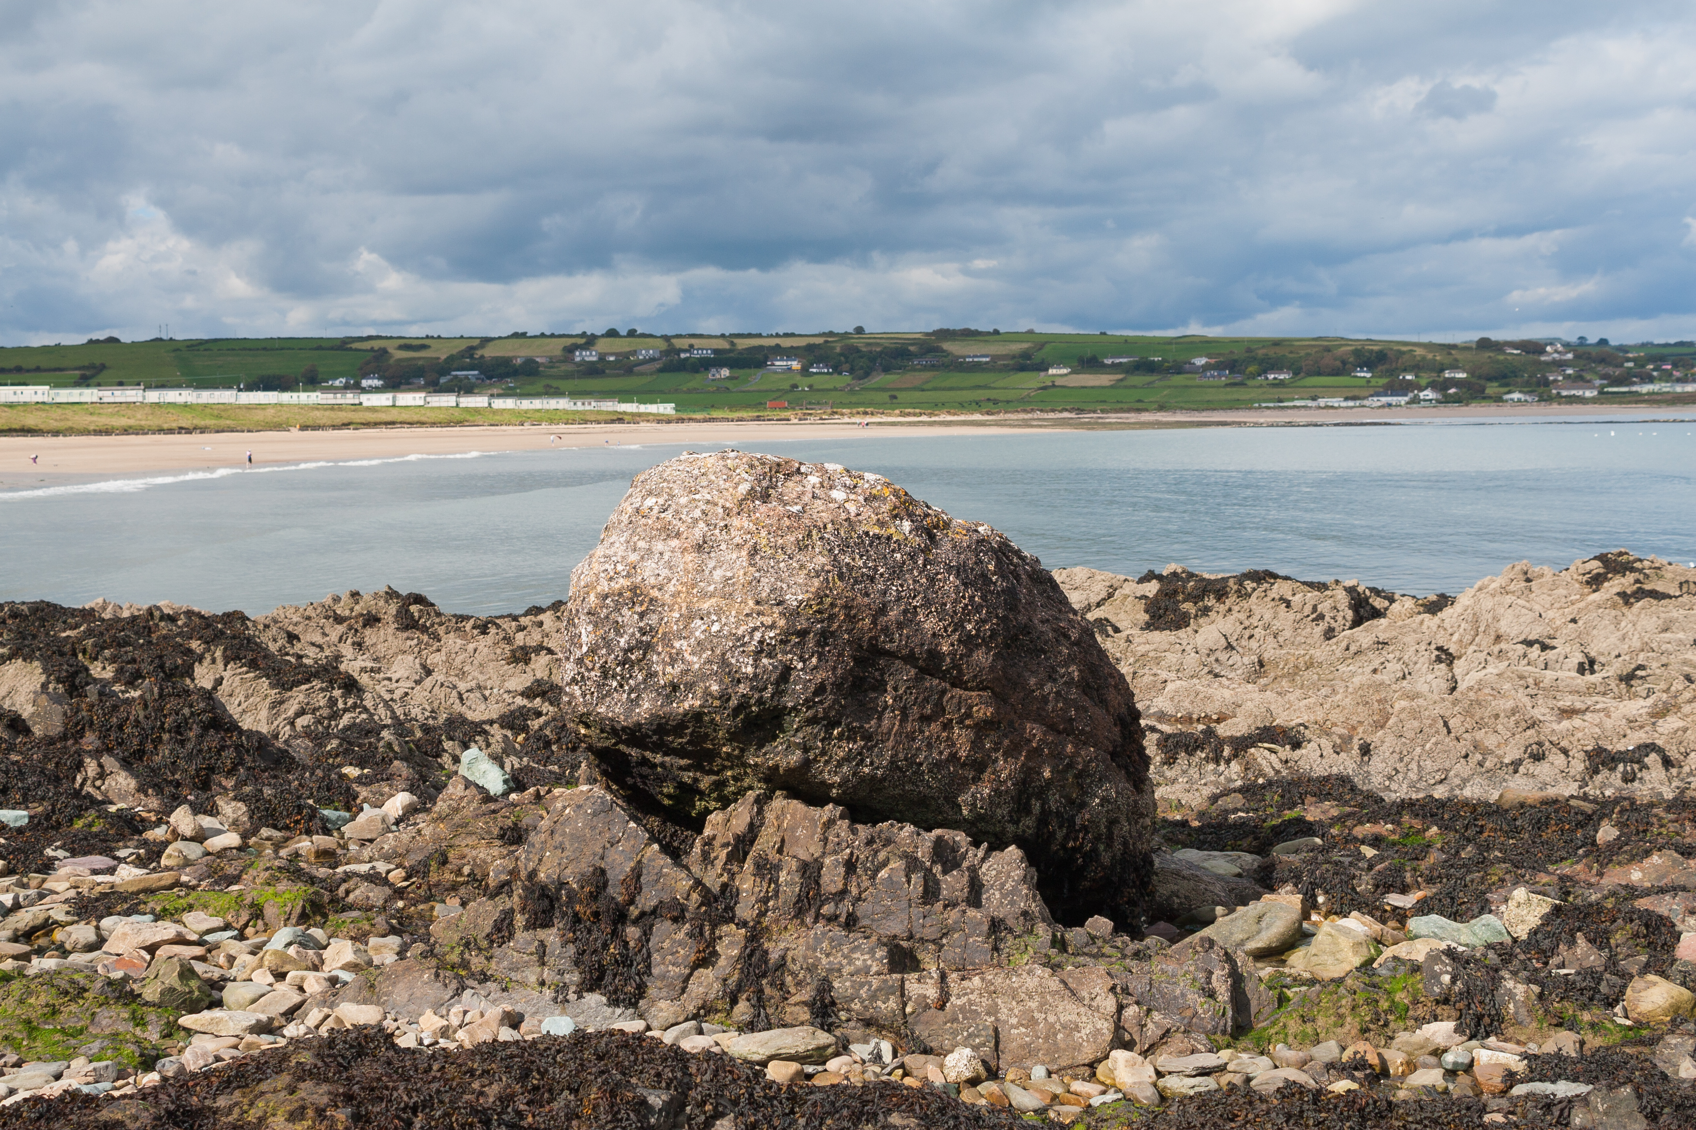
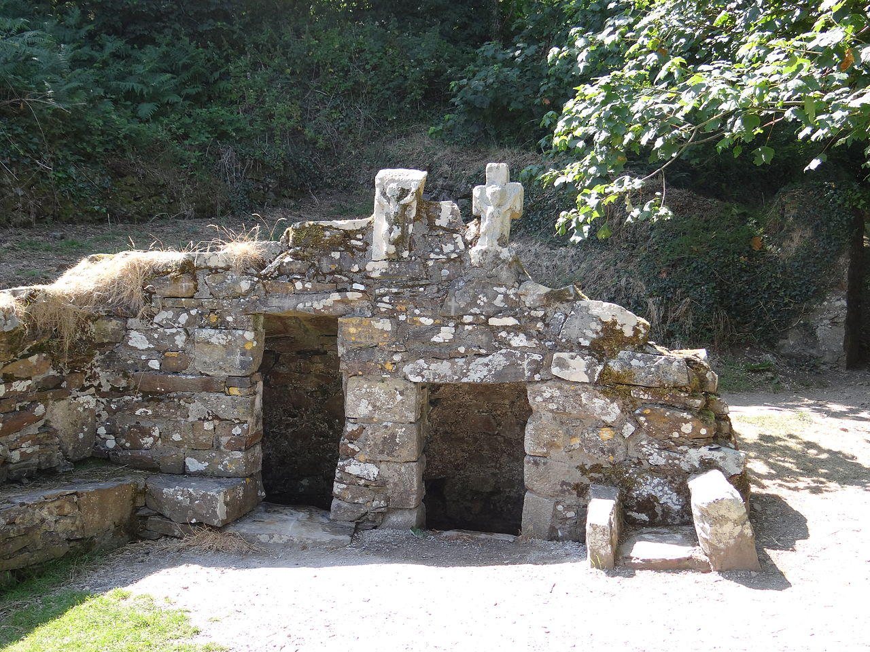
Ardmore, Co. Waterford
Ardmore is a historic village in Co. Waterford with many interesting sites, stories and ruins. These include:
A round tower
St. Declan’s Stone
St. Declan’s Well
A shipwreck
There is a marked walking trail around Ardmore to see all these ancient sites. Look at the map of the walk on the next page and see if you can answer the questions on your worksheet.

Slide 3
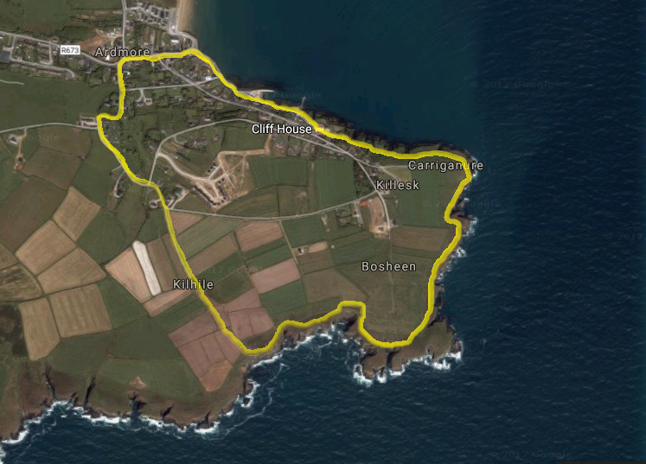
Ardmore
Co. Waterford
3
Parking
Tourist Information
Picnic spot
Watersports
Ruin/Historic Building
Fishing spot
1
2
4
The Cliff Walk
Round Tower and Cathedral
St Declan’s Oratory
St Declan’s Stone
St Declan’s Well
Shipwreck
The Lookout Post
The Watchtower
5
1
7
2
6
3
4
5
6
7

