Slide 1






All About You…
Notes:
A quick Quiz to help us, help you!

Slide 2
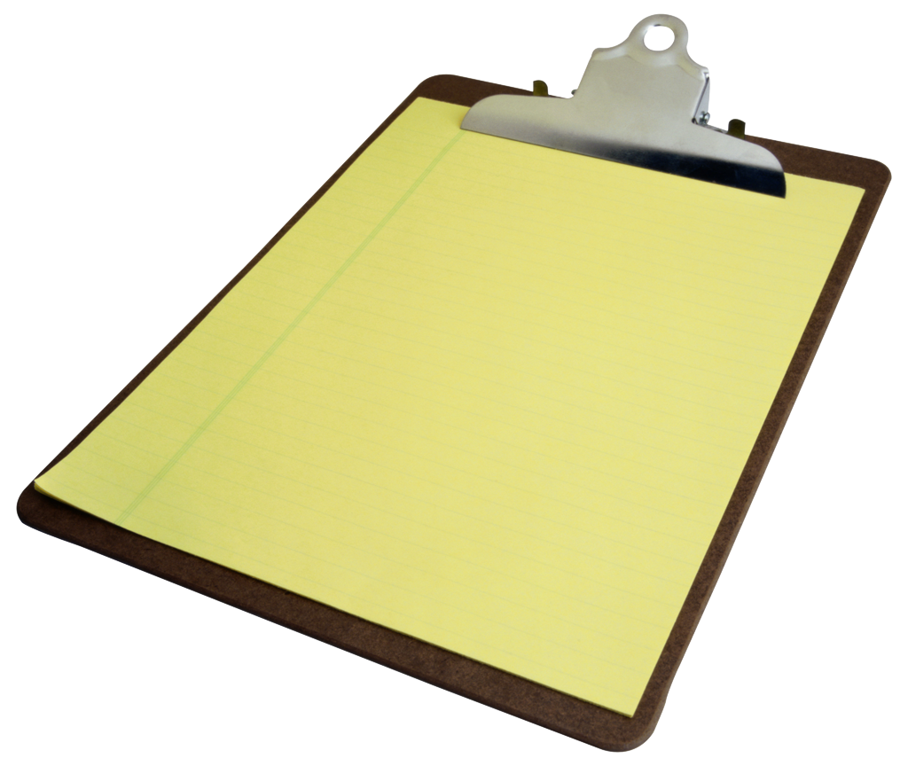
Rules of the Quiz
Answer ALL of the questions – all you have to do is say yes/no
Have a go at the tasks (you have one and only one ‘I’d rather sit out of this task’
Work with different people
Have fun and enjoy!

Slide 3

Round 1
Do you…?
Enjoy telling stories and jokes
Really enjoy maths class
Prefer a map (picture) to directions (written)
Love PE class
Enjoy listening to CD’s and the radio
Get along well with others
Like to work alone without anyone bothering you
Keep an eye on what is going on around you i.e. do you know everyone’s business

Slide 4
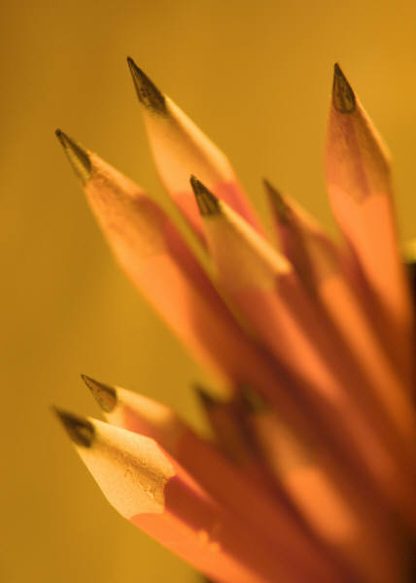
Quick Break 1
4 VOLUNTEERS PLEASE!
One piece of news from your summer holiday
  Everyone else has to draw it on their comic strip

Slide 5

Round 2
Do you…?
Have a good memory for facts
Like maths puzzles/brain teasers
Daydream a lot
Enjoy woodwork, sewing or building things
Hum to yourself when you are working
Like to belong to clubs/organisations
Like to keep a diary
Like to go walking in the woods to look at flowers and trees

Slide 6


Quick Break 2
Write the names of your new classmates
Now swap places with someone
Find out 3 things about the person next to you and write them down on you sheet under the heading ‘Today I Met…’
      Favourite food
      Worst fear
      Most exciting thing that happened to them during summer
Tell me the people you know well in the class and the people you don’t know very well
= HELP US PLEASE!

Slide 7

Round 3
Do you…?
Enjoy word games like scrabble and word searches
Like solving maths puzzles
Enjoy hobbies like photography
Like to touch things when you are looking at them
Play a musical instrument quite well
Have several close friends
Like yourself (most of the time)
Enjoy gardening

Slide 8

Quick Break 3
Can you
  Shake you right arm, left leg, whole body
  Walk backwards
  Stand on one leg
  Jump using both feet
  Rub your belly and pat your head
  Hop on one leg

Slide 9

Round 4
Do you…?
Read books just for fun
Like to find out how things work
Like to draw and create
Have trouble sitting still for long periods of time
Like to have music playing when I’m doing my homework
Like helping to teach other students
Not like crowds
Like to collect things: rocks, stamps, sports cards

Slide 10
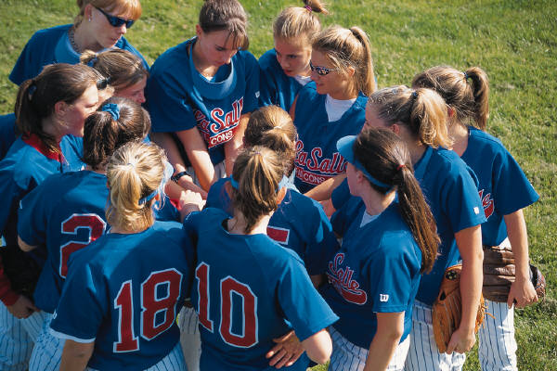
Quick Break 4
Play chinese whispers
Pass a face
Crack the code
Keepie Uppie

Slide 11

Round 5
Do you…?
Like spellings
Enjoy computers and any maths games
Draw pictures to help you remember things
Use a lot of body movements when you are talking
Make up rhymes to help you remember things
Like working with other in groups
Know what you are good at and what you need help with
Prefer the country to the town

Slide 12

Quick Break 5
Name That Tune
Get into pairs (get with someone you don’t know very well!)
Name these tunes….

Slide 13
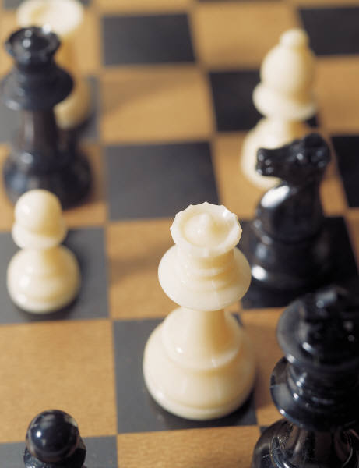
Round 6
Do you…?
Like talking and writing about your ideas
Love playing board games such as checkers, monolopy
Like to doodle on paper
Write things down numerous times if you have to remember something
Move about or shout when arguing
Have friends who ask for your advice
Think you are strong-willed and independent i.e. you don’t follow the crowd
Enjoy learning the names of living things in our environment i.e. flowers and trees

Slide 14
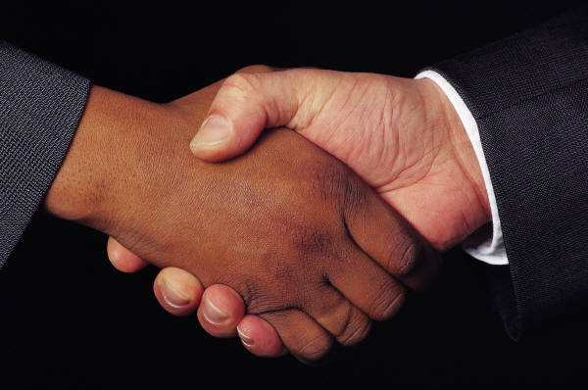
Quick Break 6
Agony Aunt/Uncle
    Listen to the problem
    In 3’s suggest a solution
Greet – Argue – Makeup
Class Contract – in 2’s suggest 1 do and 1 don’t for your time in this class and school
  Design a class rules poster

Slide 15
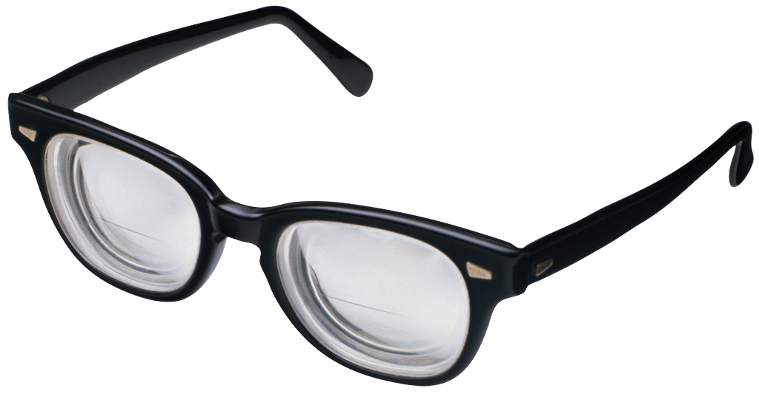
Round 7
Do you…?
Read the instruction book if something breaks or doesn’t work
Try and be fair in an argument
Keep my distance from arguments
Tap your fingers or play with your pencil during class
Know the melodies of a lot of songs
Ask for help from an adult if confronted with an argument
Walk away from an argument until I calm down
Look around to see what you can find to fix a problem

Slide 16
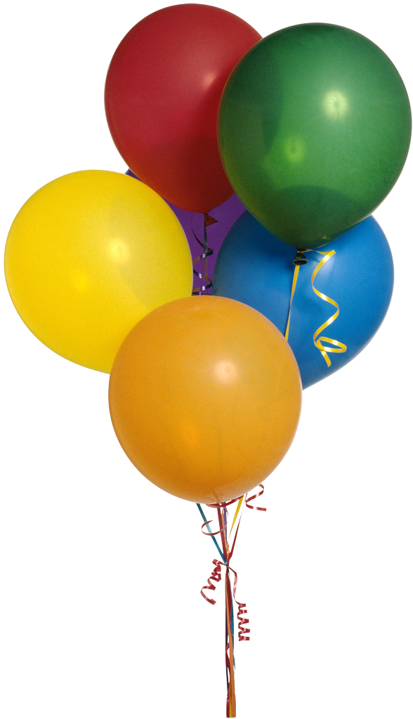
Quick Break 7
Lines
Get into lines
    Tallest to shortest
    Birthday Month
    Ages
    Shoe Size
    Hair length

Slide 17

Round 8
Do you…?
Prefer to do the writing and reading research in a group project
Look at the pieces or something that is broken to try and fix the whole
Look at a diagram to work out how something is supposed to work
Play with the pieces of something that is broken to try and get it back working
Tap your fingers, click your tongue, waggle your foot when trying to fix something
Ask someone for help if something breaks
Wonder if its worth fixing up at all?

Slide 18
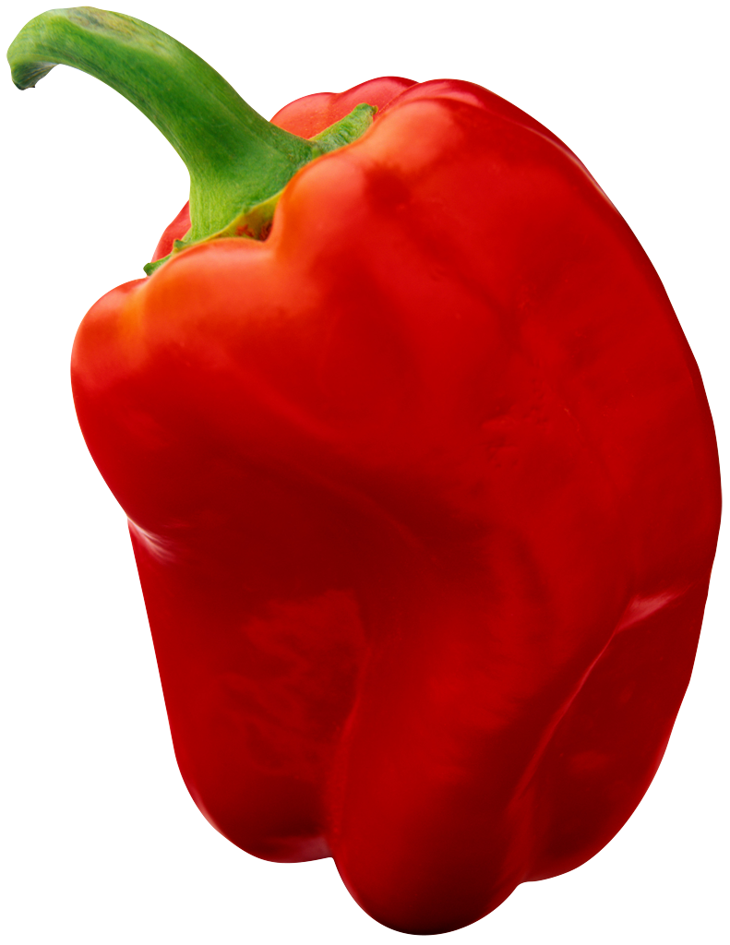
Quick Break 8
Tongue Twisters
      Have a go at these
        Betty Botter Bought some Butter
        Red lorry Yellow Lorry
        Six Swans swam softly
        Many men many men many men many men
        Peter piper picked a pickled pepper
Get into 3’s – who says which the quickest?

Slide 19
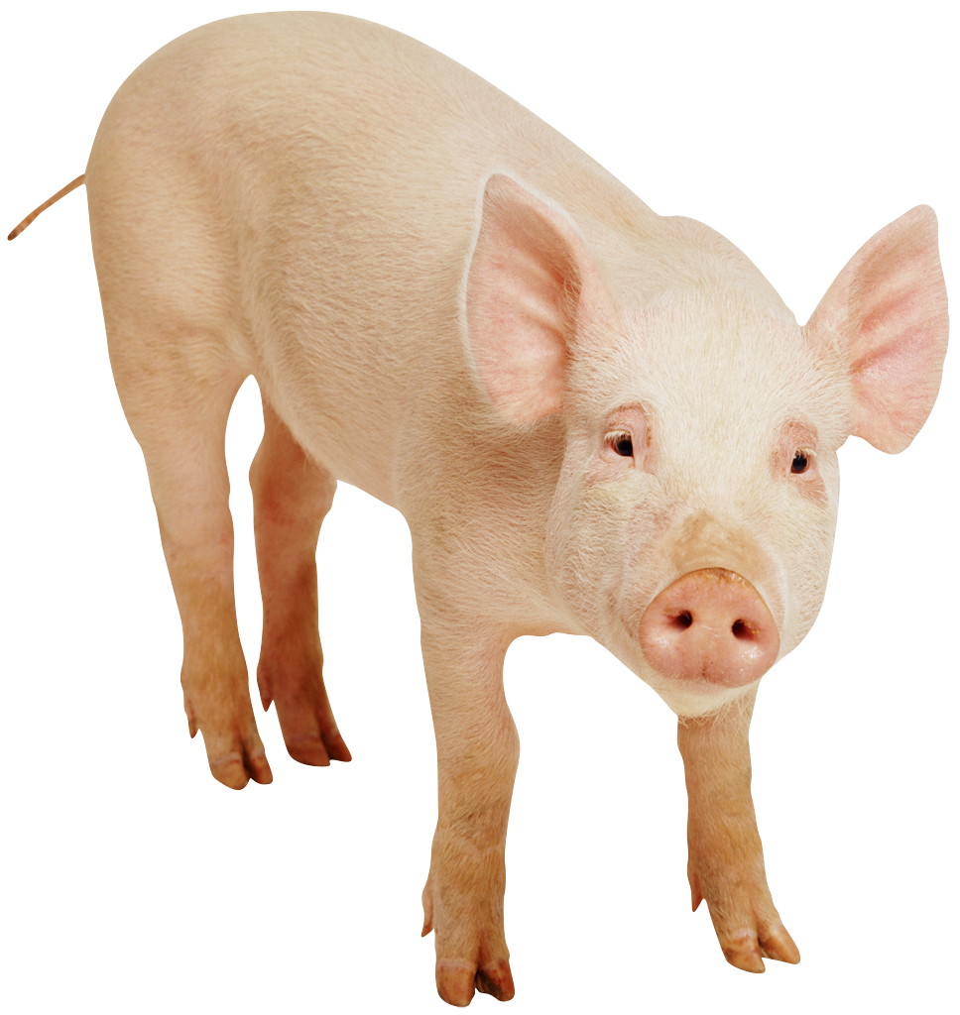
Round 9
Do you…?
Like books
Prefer to make charts and graphs for group projects
Like to draw pictures/posters for group projects
Like to use music in group projects
Like to be the organiser of the group
Like to include your own thoughts on a topic in a group project
Prefer animals to people

Slide 20

Quick Break 9
Charades or Who Am I?
      Who can explain the rules?
      Use the mime cards

Slide 21

Grand Finale
All About Me sheet
    Draw around your partner’s head
    Add visual details – eyes, hair, lips, jewellery etc
    Add personal details around the portrait
        Name
        Age
        Brothers/sisters
        Hobby
        Fave colour
        Fave band/music
        Hopes/dreams
    Prepare a short speech/song/poem/story to introduce yourself

