Slide 1
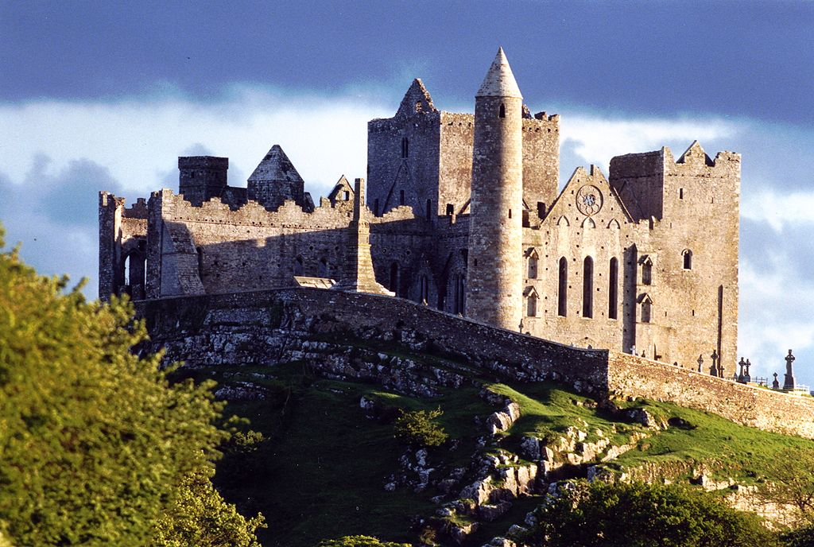
The rock of cashel
Home to the High Kings of Ireland

Slide 2
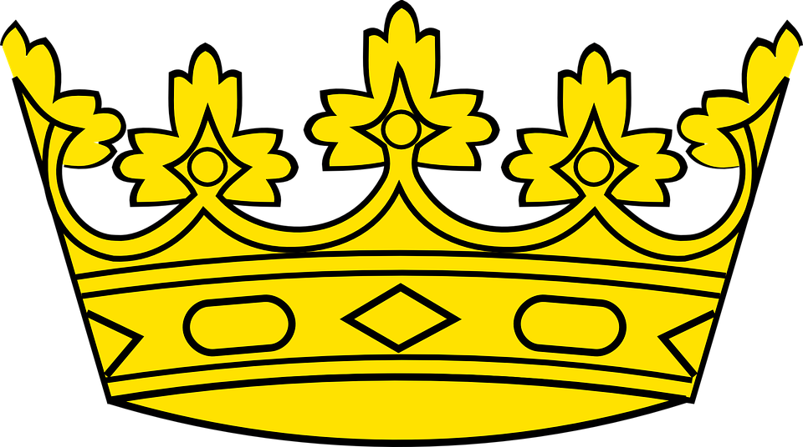
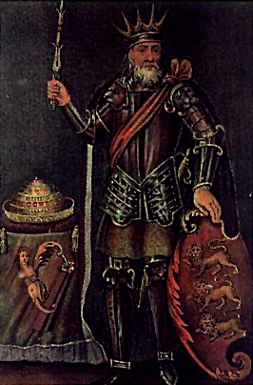
History of the rock
The Rock of Cashel (also known as Cashel of the Kings) in County Tipperary is a very famous historic site in Ireland.
The word ‘Cashel’ is an English version of the Irish word ‘Caiseal’ which means ‘stone fort’ and the Rock of Cashel was originally the home of the High Kings of Munster.
The Rock of Cashel is also known as ‘Carraig Phádraig’ or ‘St. Patrick’s Rock’. According to stories St. Patrick converted Aenghus the King of Munster to Christianity here in the 5th century AD.
Brian Boru was also crowned King of Ireland (or King of Tara) at the Rock of Cashel in the early 11th century.
Brian Boru, who was king of Muster in 978 and who became King of Tara in 1002.

Slide 3
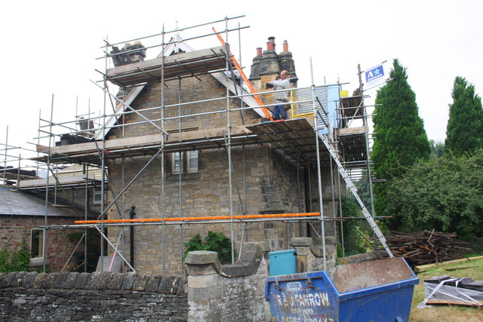
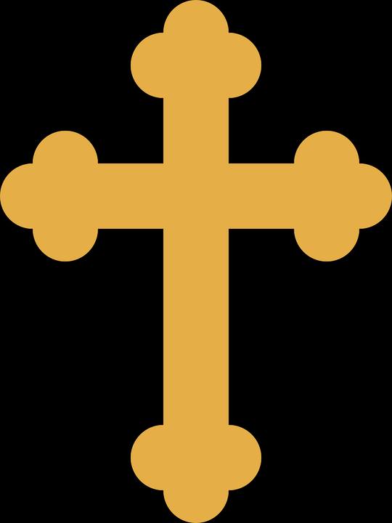
What can you see there?
Have you ever seen a building being extended or renovated? The Rock of Cashel is a little bit like this! Most of the buildings from the time of the High Kings of Munster are now gone, but there are some amazing ruins still left which were built at different times in later years.
In 1101 the king of Cashel Murtough O'Brien, who was the great grandson of Brian Boru, gave the Rock to the Catholic Church as a gift. The buildings you can see there today were built by the Church after receiving that generous gift from the king!
This is what a renovation might look like nowadays.
Why do you think there are no ruins from the time of the High Kings at the Rock of Cashel anymore?

Slide 4
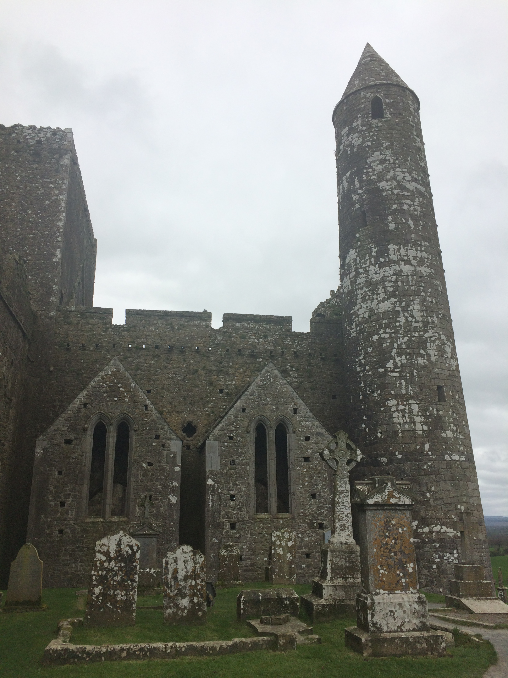
The round tower
The round tower is the oldest building at the Rock of Cashel and was built around 1101 when the Church received the Rock from King Murtough.
It would have been used as a bell tower and would have had wooden floors inside connected by ladders.
The round tower
The entrance to the tower is above ground level and could only be reached by climbing a ladder. If someone tried to attack the tower all you had to do was pull the ladder into the tower and they could not get in!
There were small windows to let in some light and the bell would have been at the top of the tower.

Slide 5
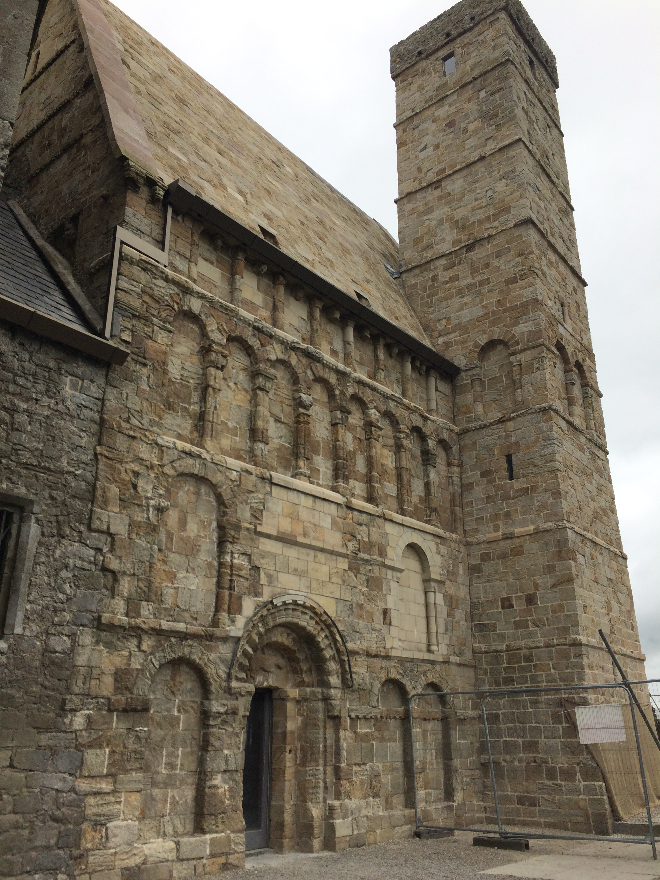
Cormac’s Chapel
The next addition was King Cormac’s Chapel which was built around 1134.
Inside the chapel are some of the oldest wall paintings in Ireland.
The wall paintings are so old that they are beginning to crack and peel off the walls. Historians are trying to save the wall paintings by using special UV light to stop them fading and disappearing from the walls. Scientists and historians working together!
Cormac’s Chapel

Slide 6
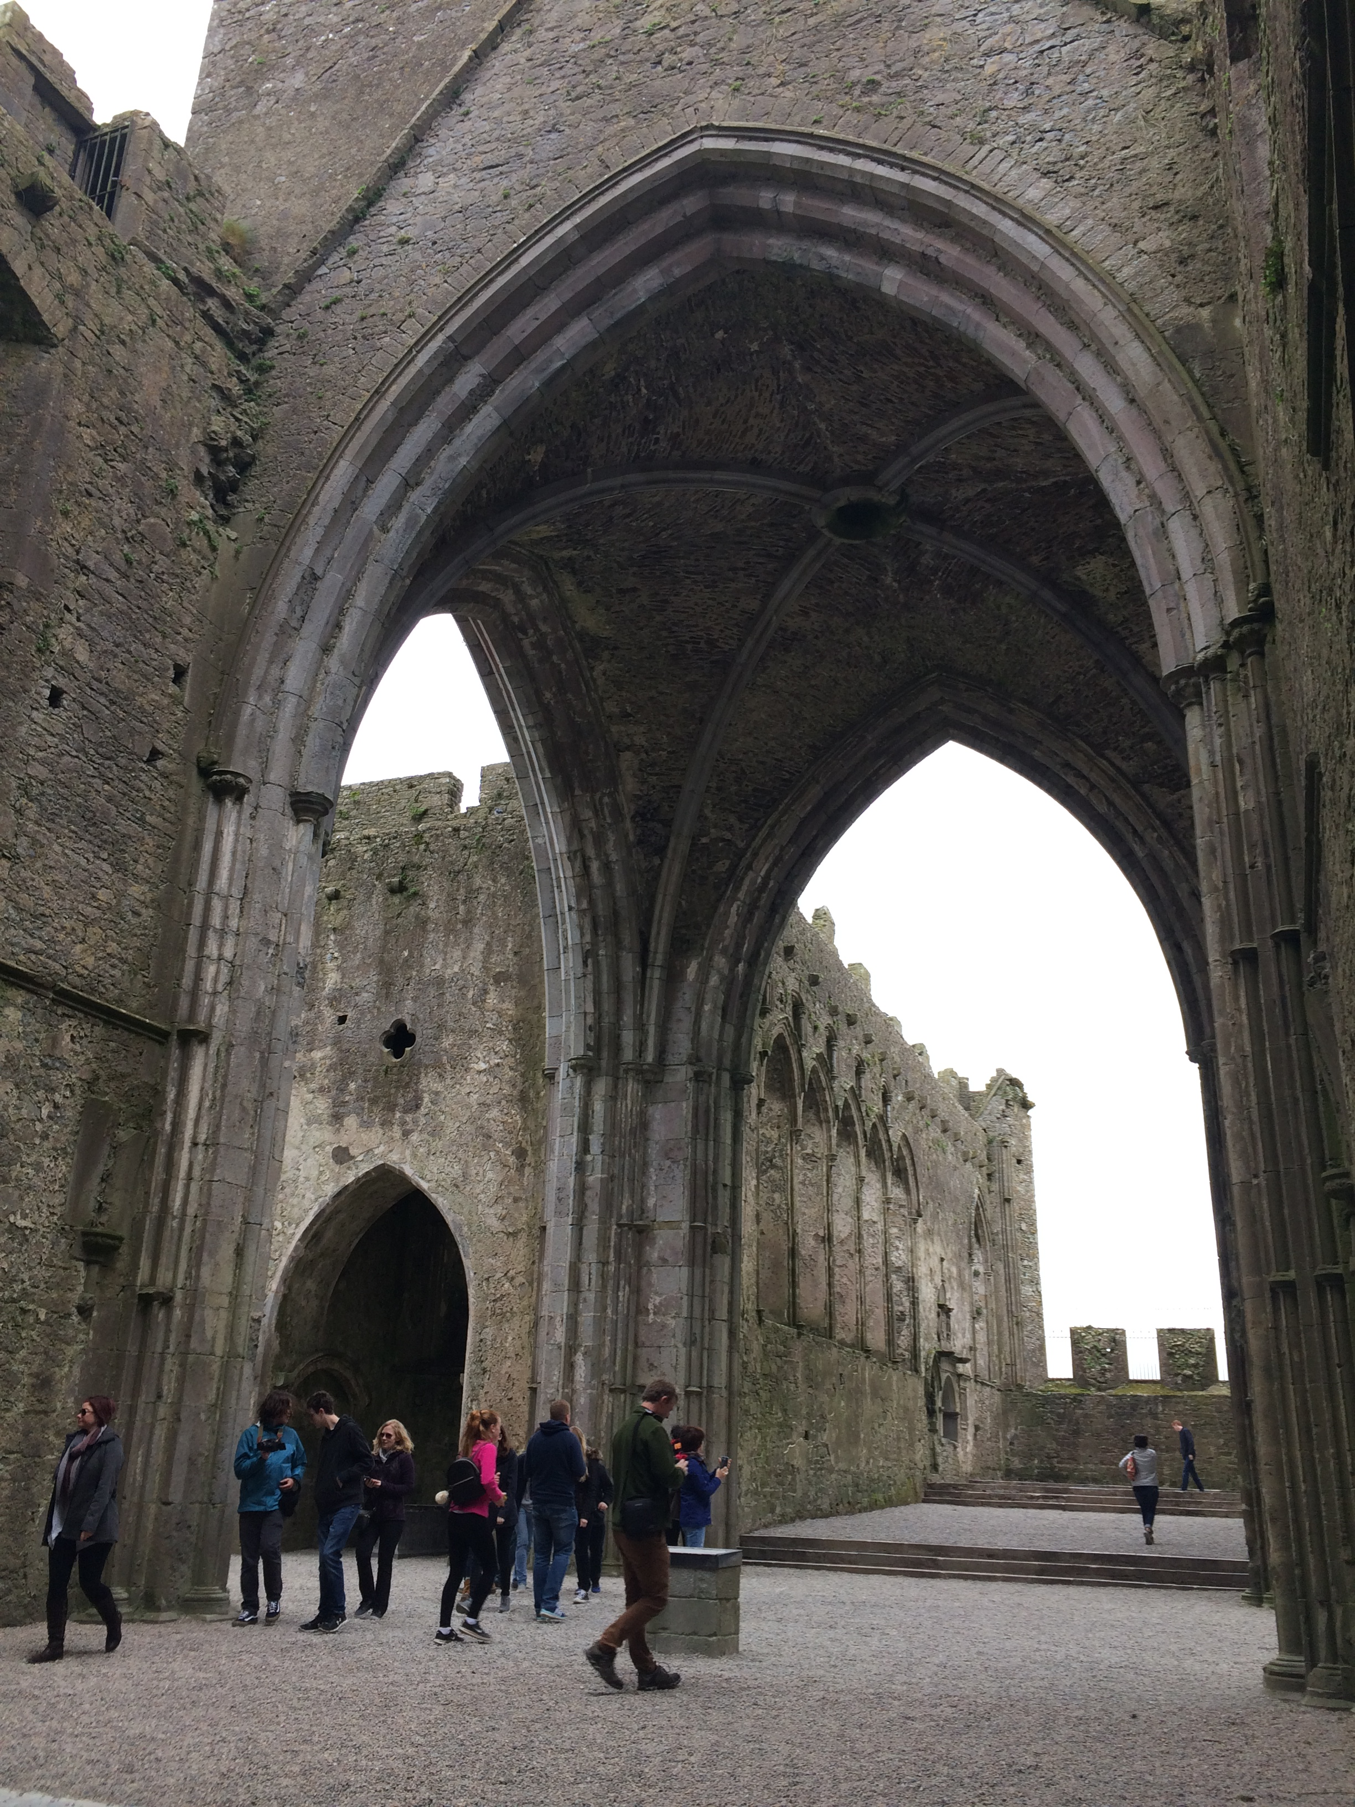
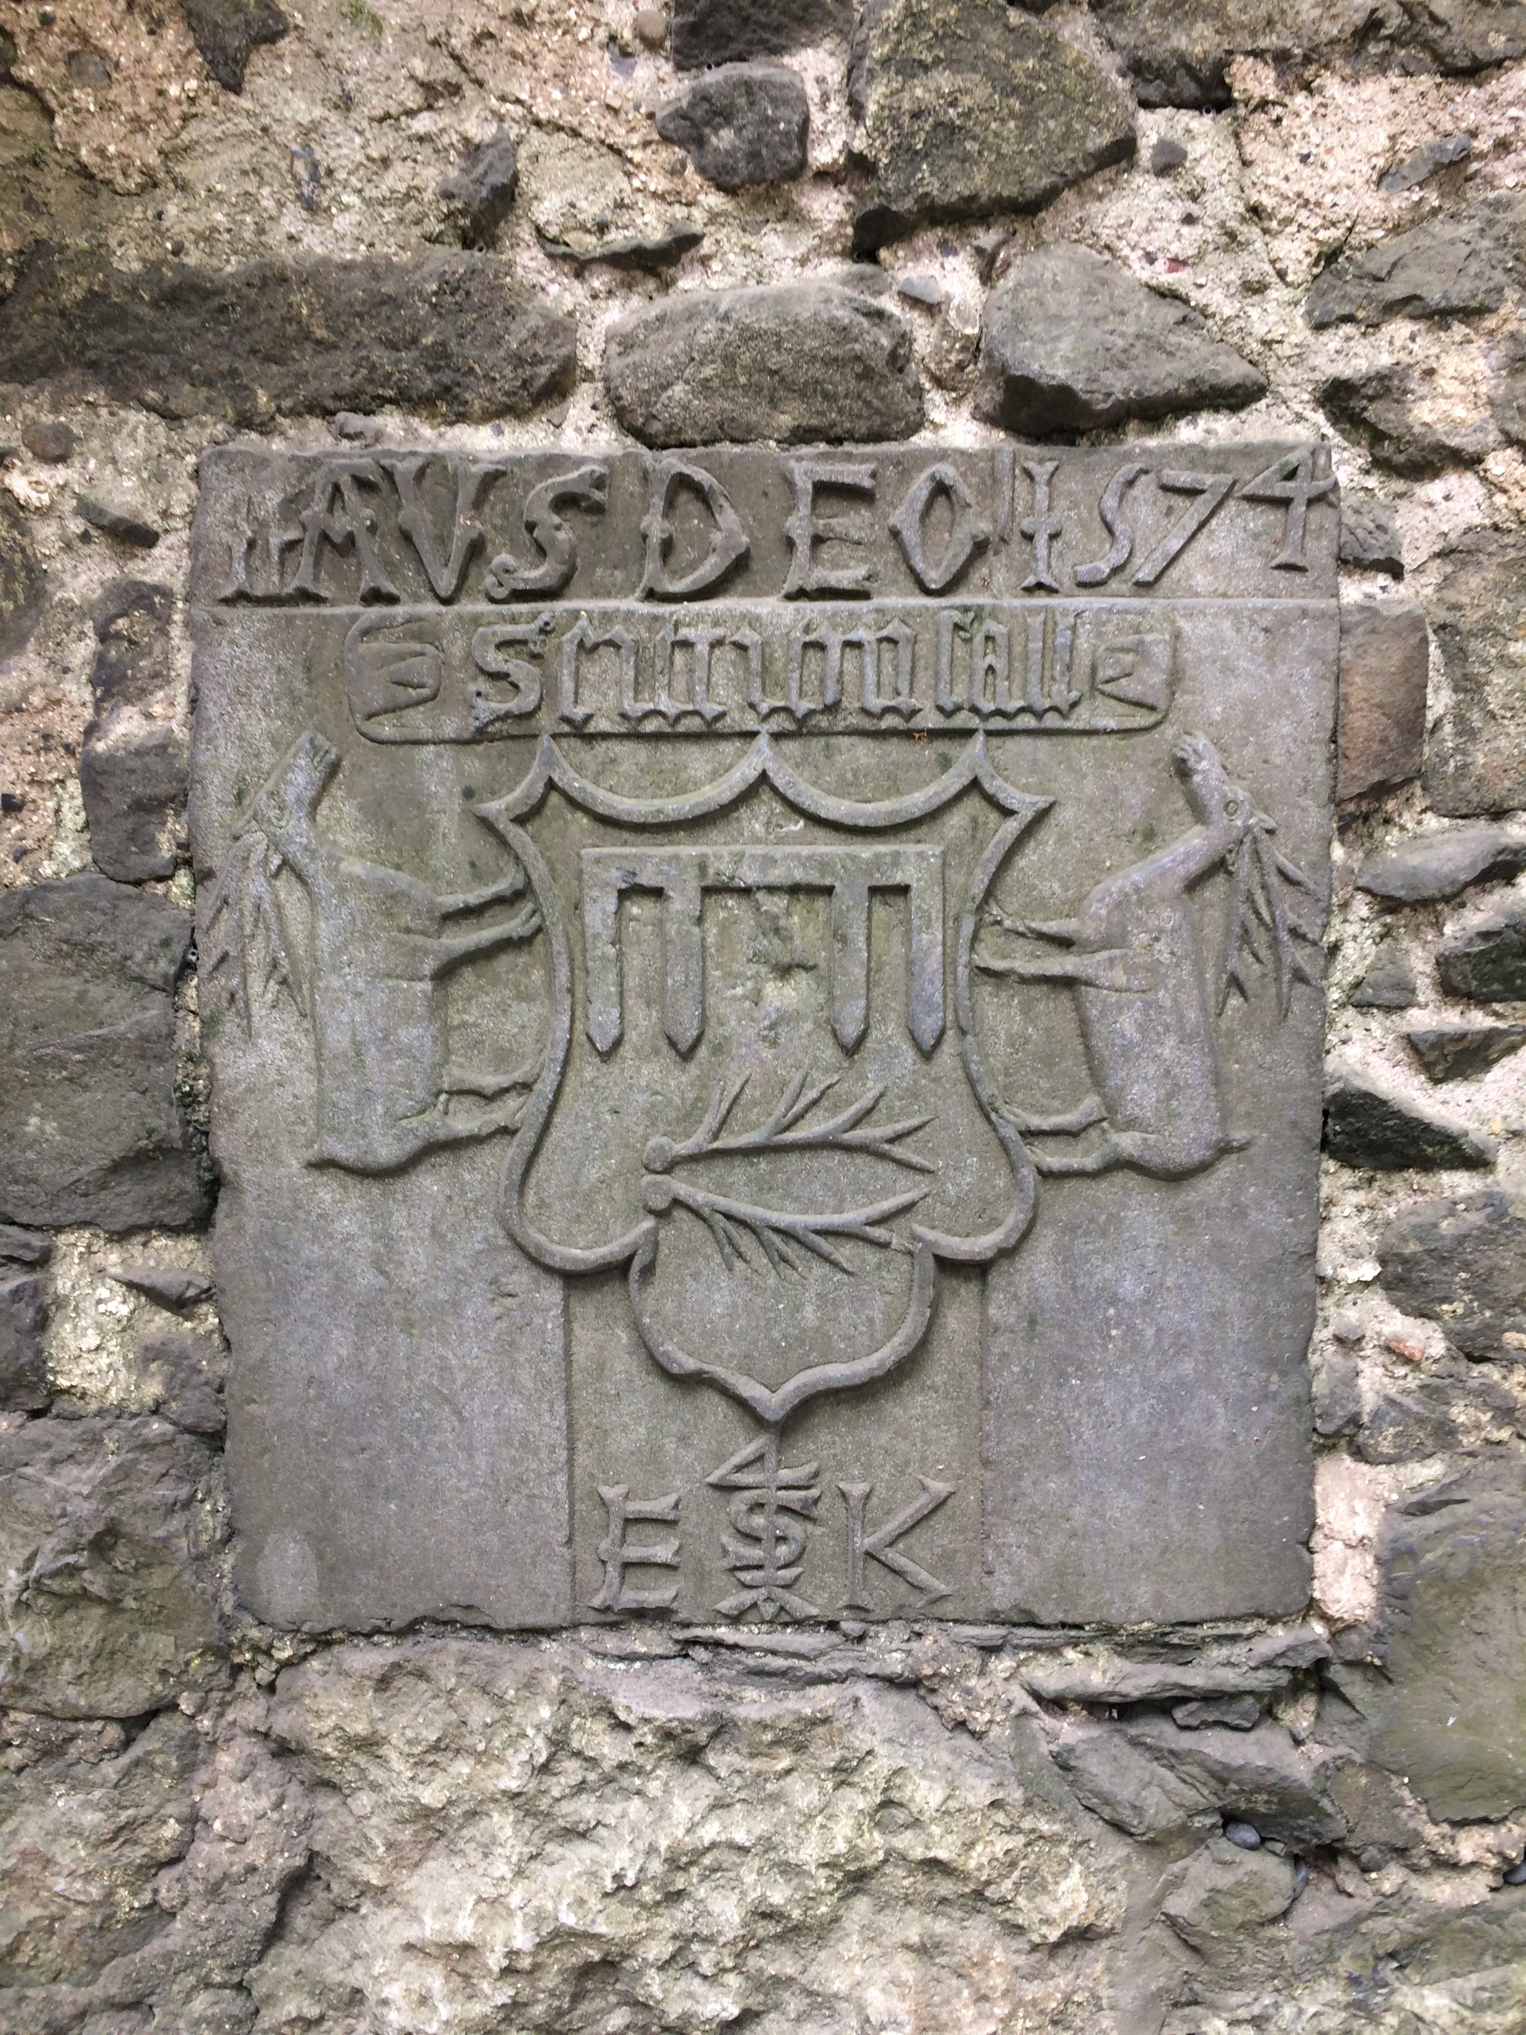
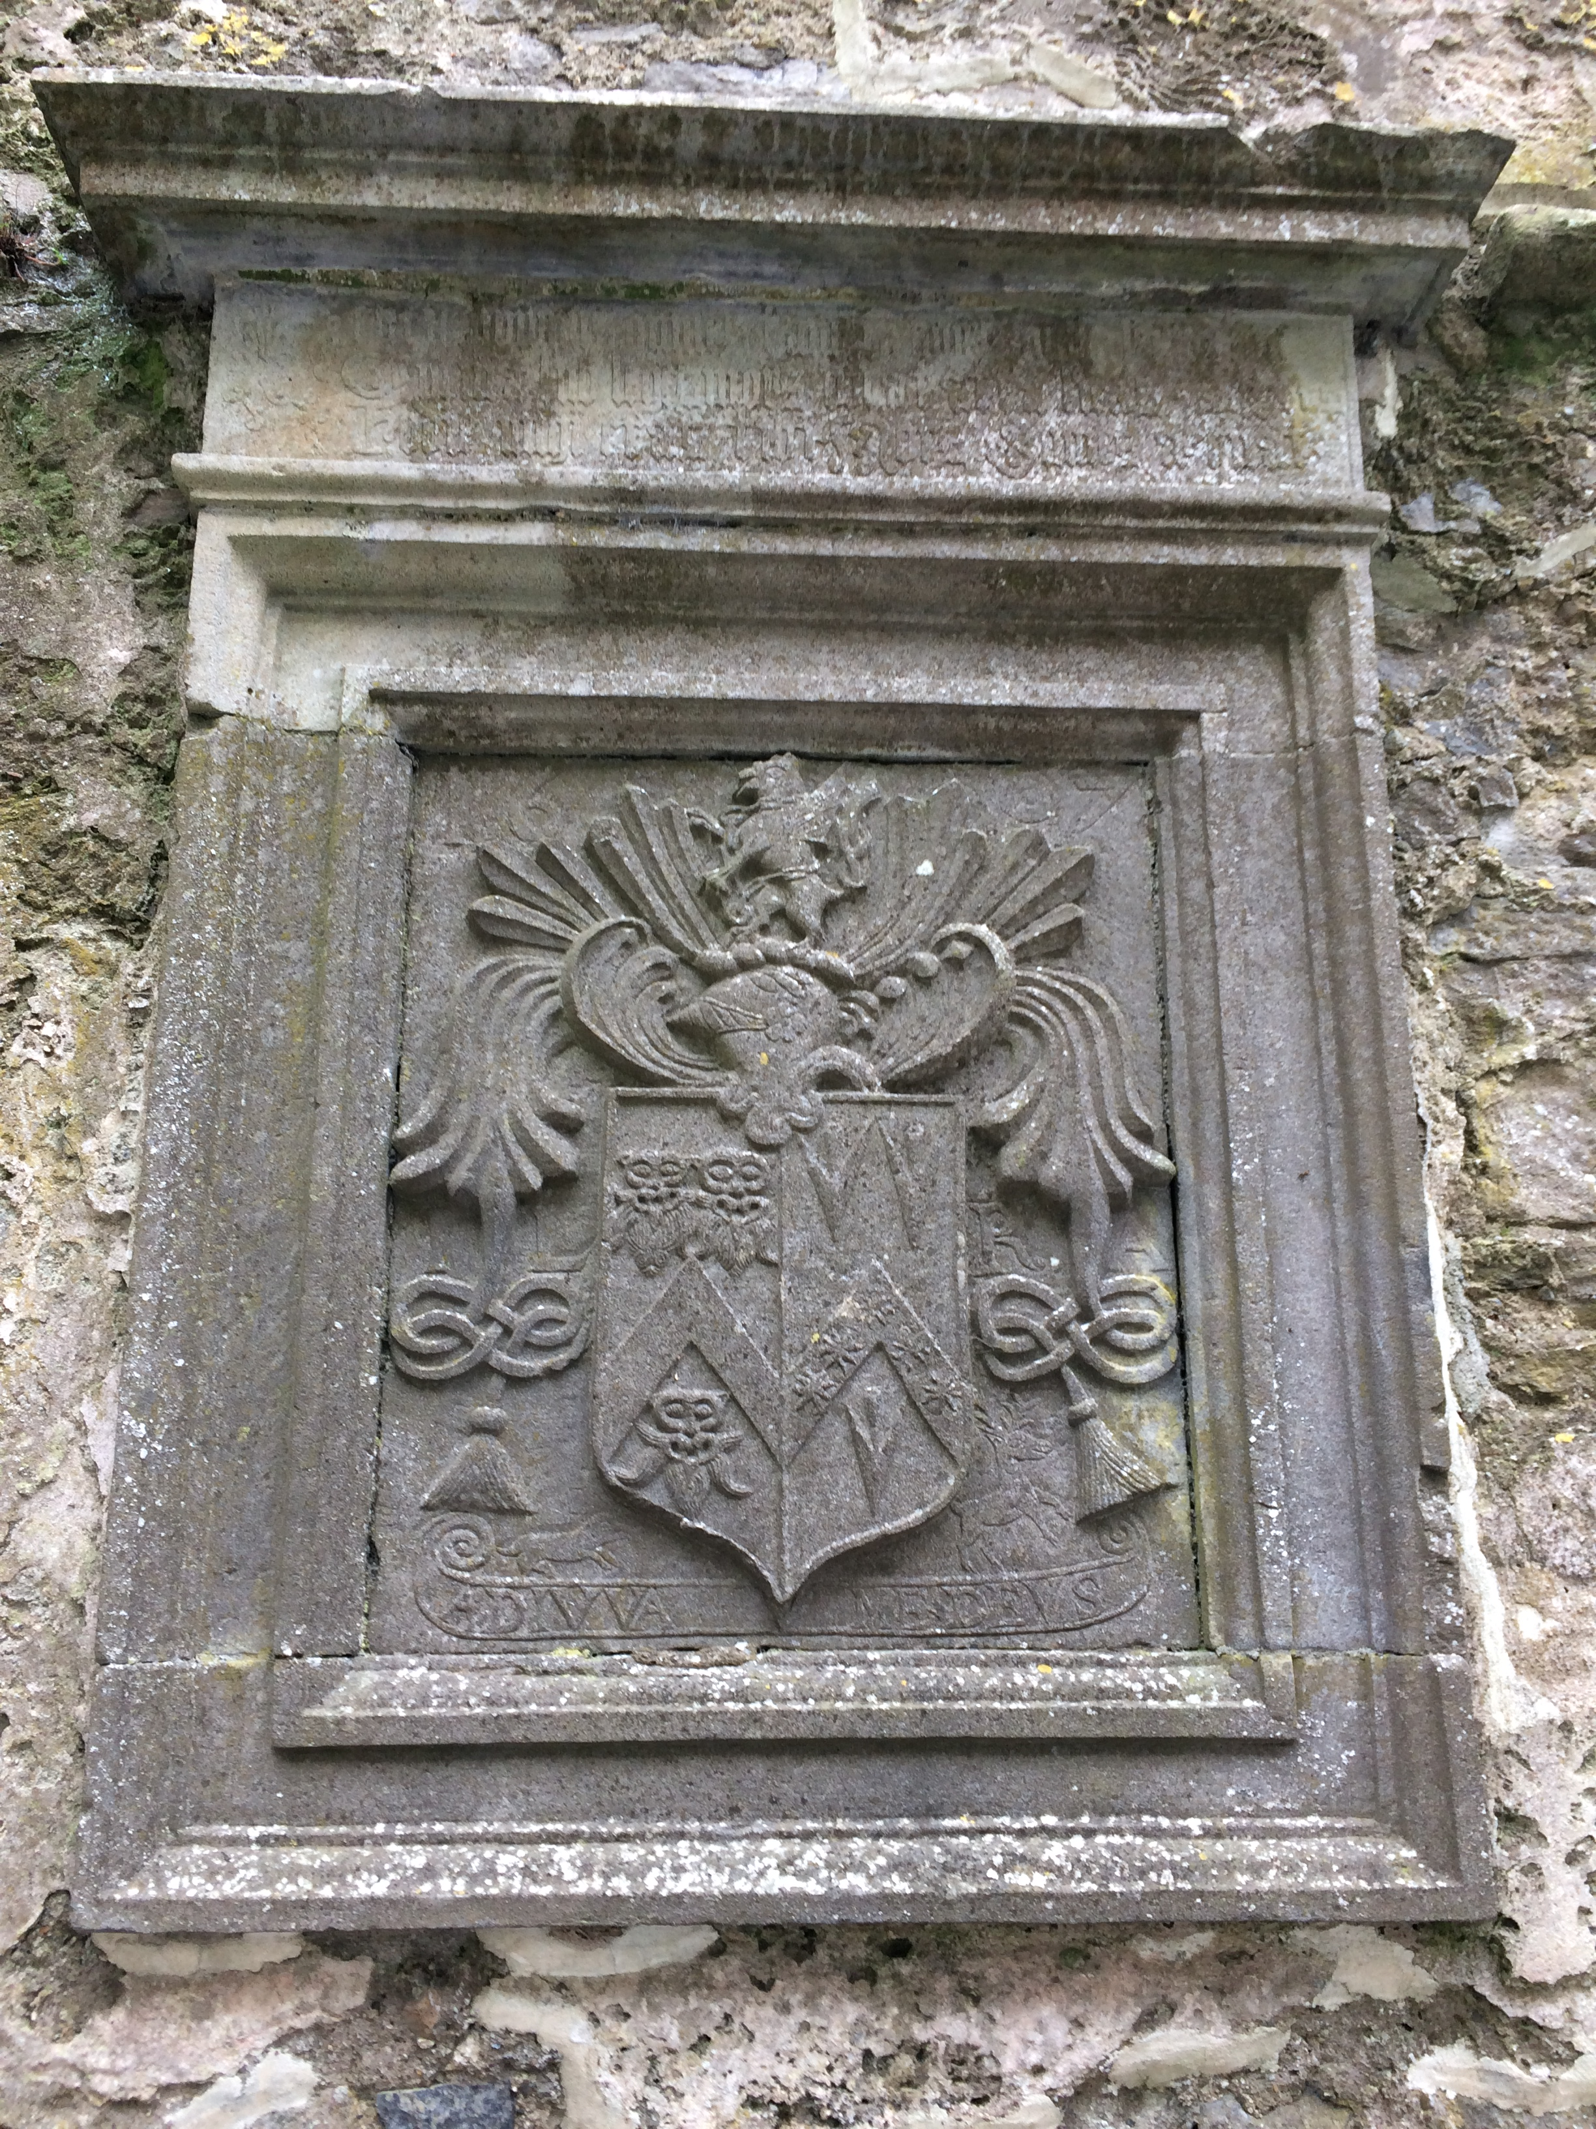
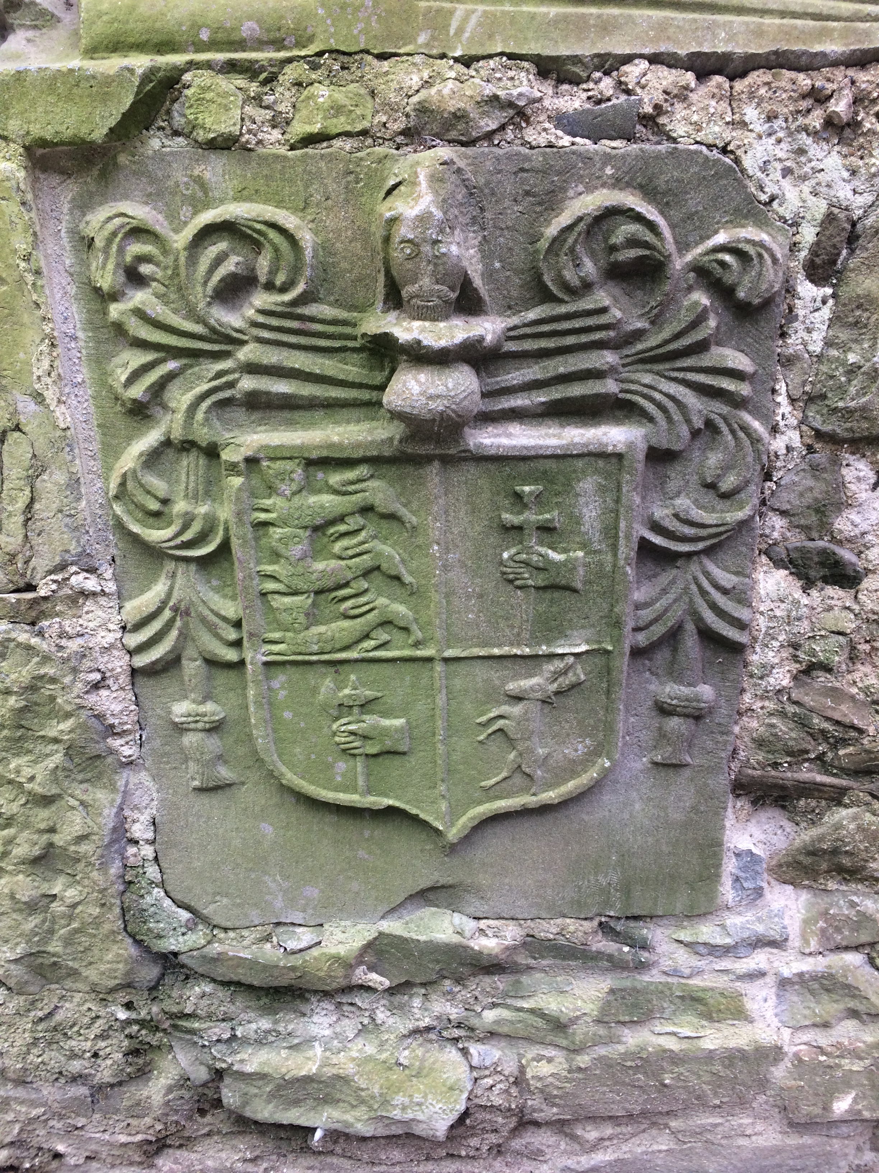
The cathedral
The Cathedral is the biggest building at the Rock of Cashel and was built between 1230 and 1270.
Most of the roof is now gone but the walls are still standing.
Inside there are lots of stone decorations, including several coats of arms. A coat of arms was like a badge for important families and they had different symbols such as lions, crowns and swords.
Inside the Cathedral

Slide 7
Coats of arms
These are some of the coats of arms that can be seen at the Rock of Cashel. They usually represent something about the family, for example a crown would represent a king or deer might mean the family were good hunters.
What can you see in these coats of arms and what do you think they say about the families who owned them?
Find your family’s coat of arms using the internet, or design your own!

