Slide 1
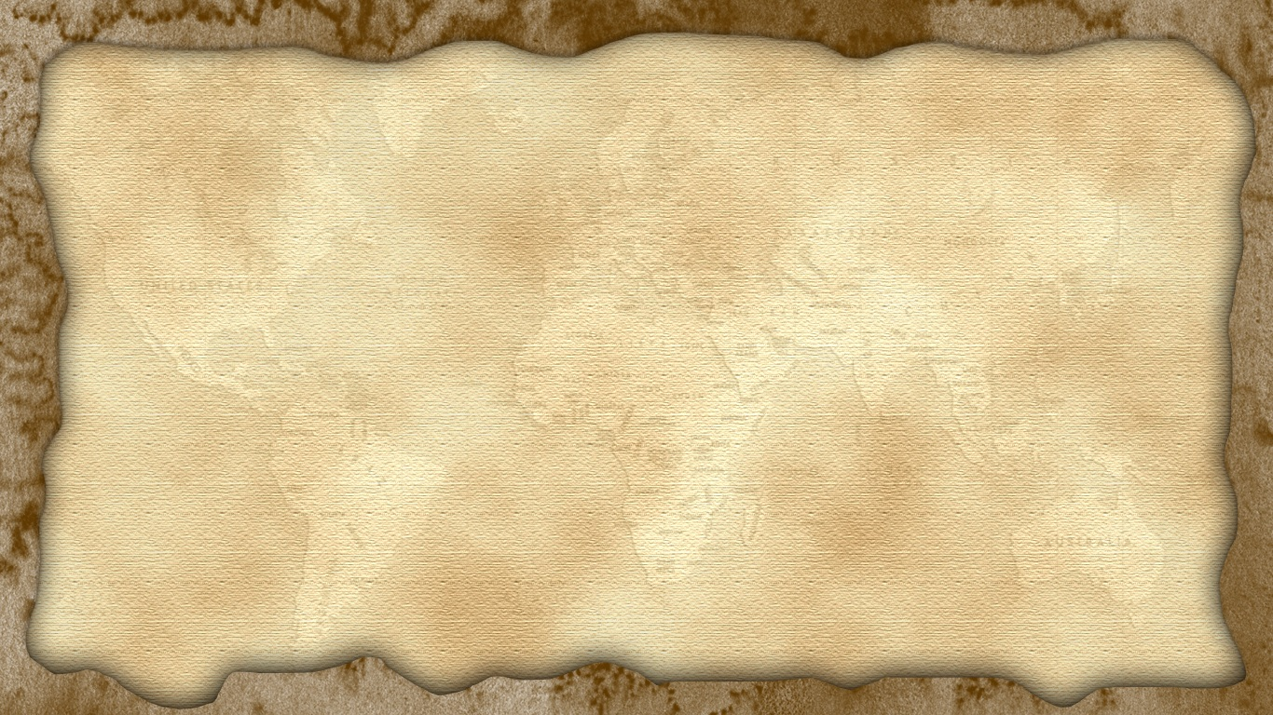
The Butler Family
Exploring Co. Tipperary
Carrick-on-Suir, Clonmel and Cahir

Slide 2
Who were the butler family?
The Butler family were one of the most important families in Co. Tipperary for over 500 years. They had large, powerful armies. They built many fine houses and castles to show their wealth. And they were generous donors to the Church.
We will learn about where they came from, how they became so powerful and some of their most important buildings that you can still see today.

Slide 3
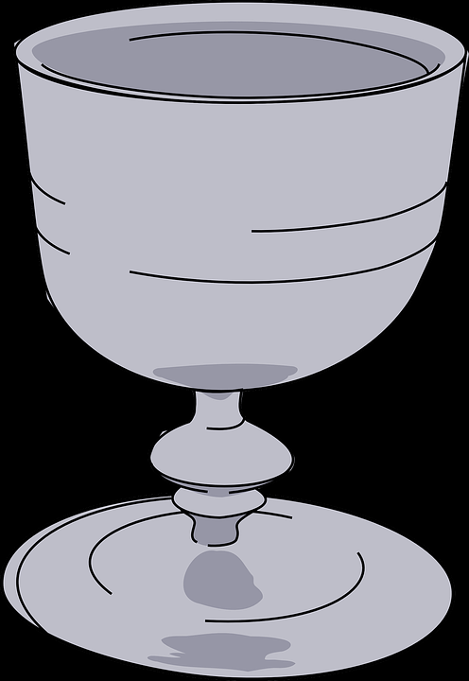
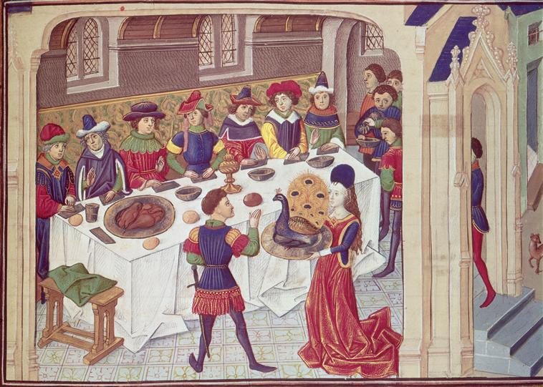
Where did they come from?
In 1185 Theobald Fitzwalter, an English nobleman, came to Ireland with Prince John. The prince gave him the important job of Chief Butler to the King of England. He was given a large area of land in Tipperary and his job was to ensure that there was plenty of food and wine available whenever the king visited Ireland. He was also entitled to 15% of any wine that was imported to Ireland which made him very rich.
A special honour for the Chief Butler was that he had to serve the first glass of wine to the king after he had been crowned. From that time on the family were known as the ‘Butlers’.
A medieval feast

Slide 4
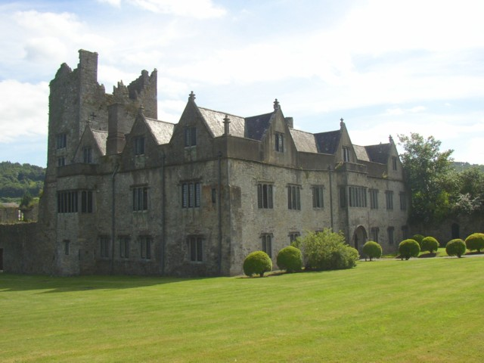
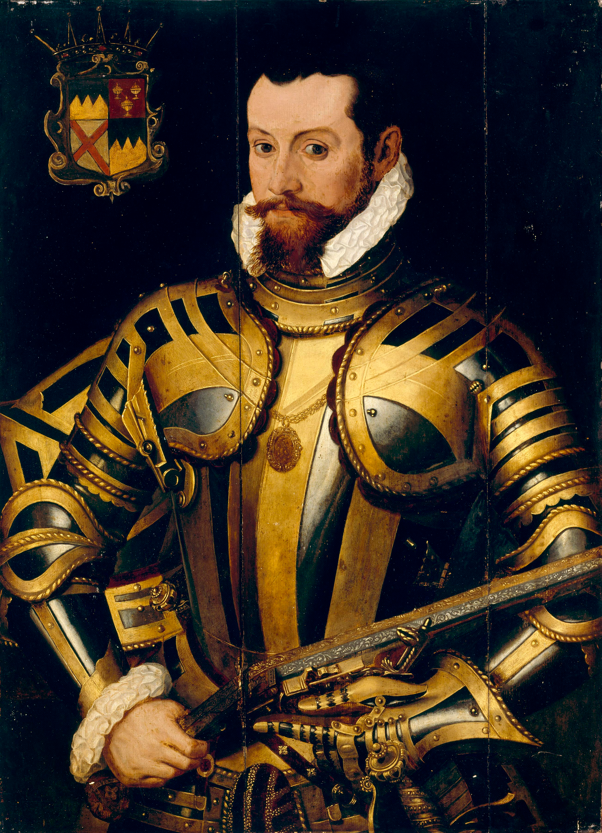
Ormond castle
The town of Carrick-on-Suir is where the Butlers first settled in Ireland in the 13th century.
It was here that Thomas ‘Black Tom’ Butler (1532-1614) built Ormond Castle in the 1560s in expectation of a visit from his cousin Elizabeth I. Elizabeth was the daughter of Anne Boleyn and King Henry VIII (a king who had a nasty habit of beheading his wives!)
Unfortunately Elizabeth never visited the house at all after Thomas built it for her. She would later become one of the greatest Queens of England.
Ormond Castle
Black Tom Butler

Slide 5
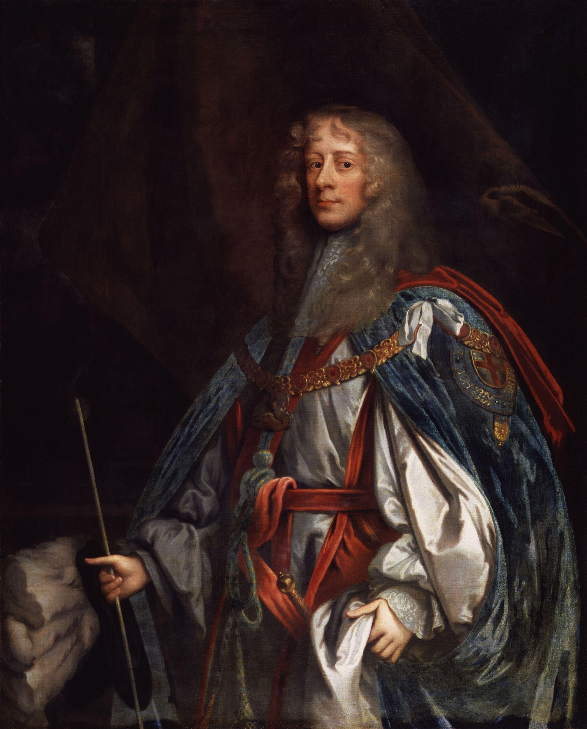
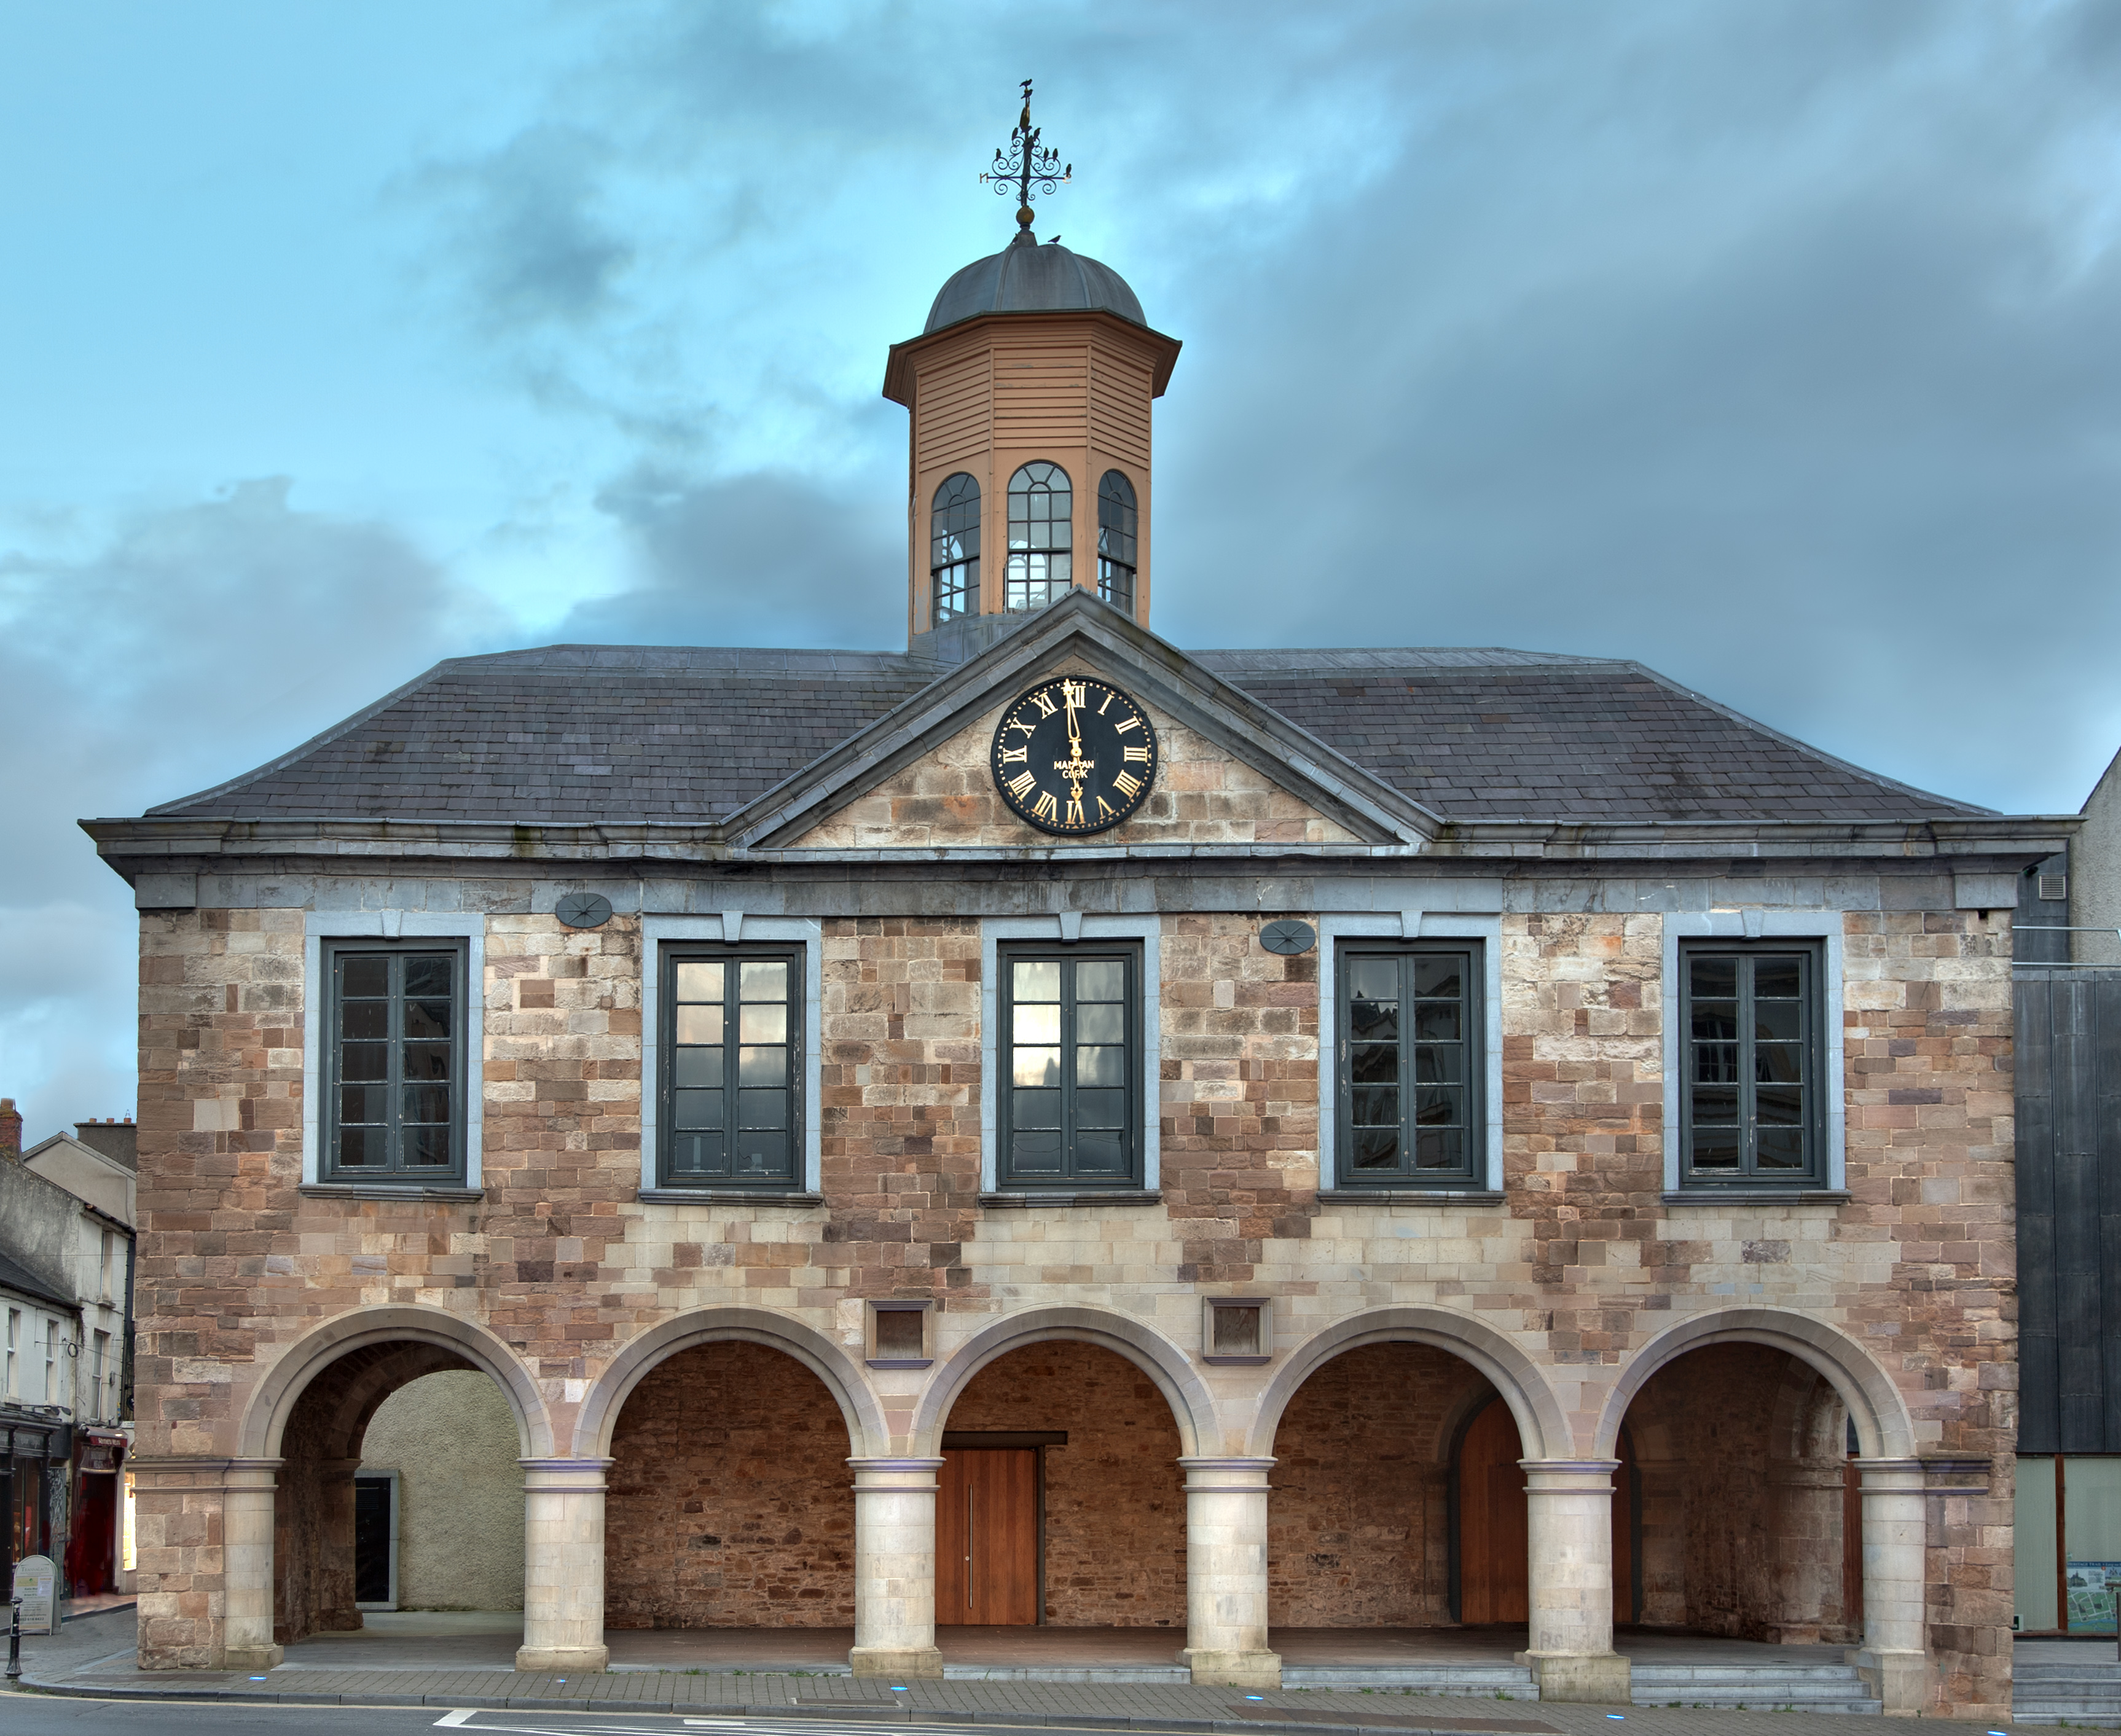
The main guard
Over 100 years later, in 1675, James Butler – a grandnephew of Black Tom – built the Main Guard in Clonmel. It was originally a courthouse, but now it is a museum.
James Butler was a very important member of the Butler family. He was very close to King James II who made him Lord Lieutenant – the highest government position in Ireland at that time. King James even visited him in 1689.
His loyalty to England made him a very powerful man, but didn’t win him many friends among the Irish people who wanted their land back from England.
James Butler
The Main Guard, Clonmel

Slide 6
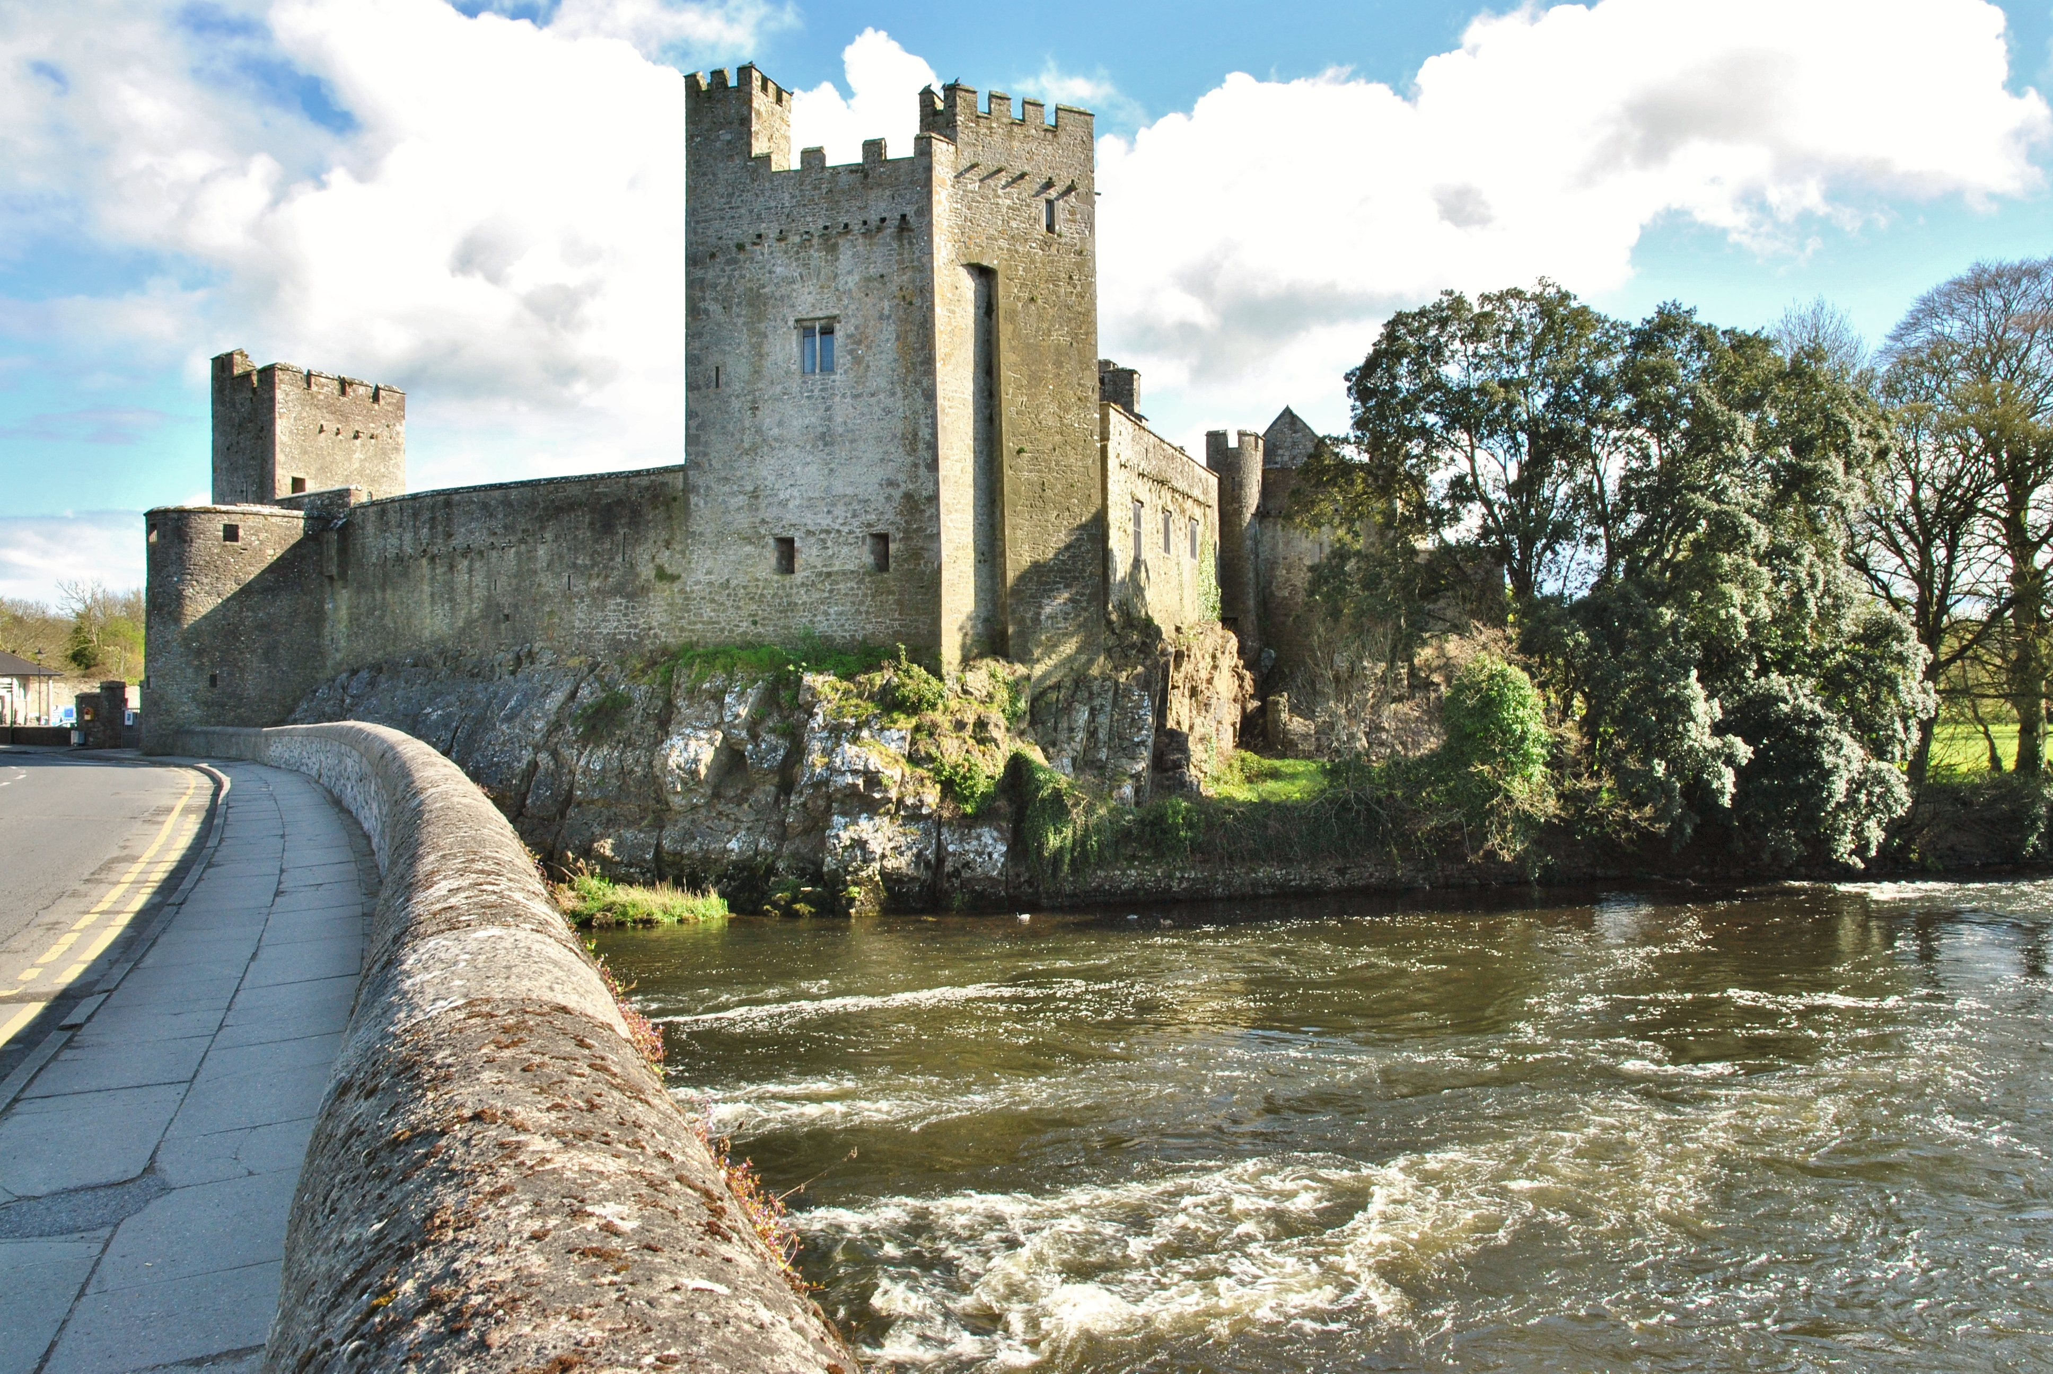
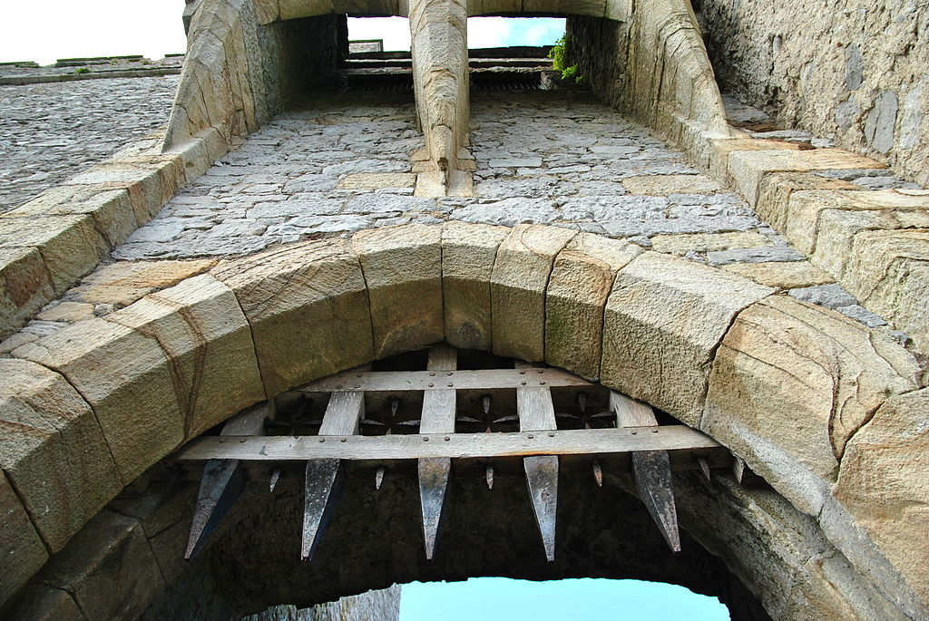
Cahir castle
Cahir Castle is one of Ireland’s largest castles. It was given to the Butlers in 1375 and they owned it until 1961.
The castle was built to be an extremely safe stronghold. It was said to be the most secure castle in Ireland.
Despite this, many armies attacked the castle trying to capture it and a cannonball from one of these sieges can still be seen embedded in one of the walls.
Visitors to the castle today can see real medieval furniture, a working portcullis and several cannons.
Cahir Castle is built on a rock in the river Suir.
The portcullis would have been lowered to keep enemies out and boiling tar poured down on them from above.

Slide 7
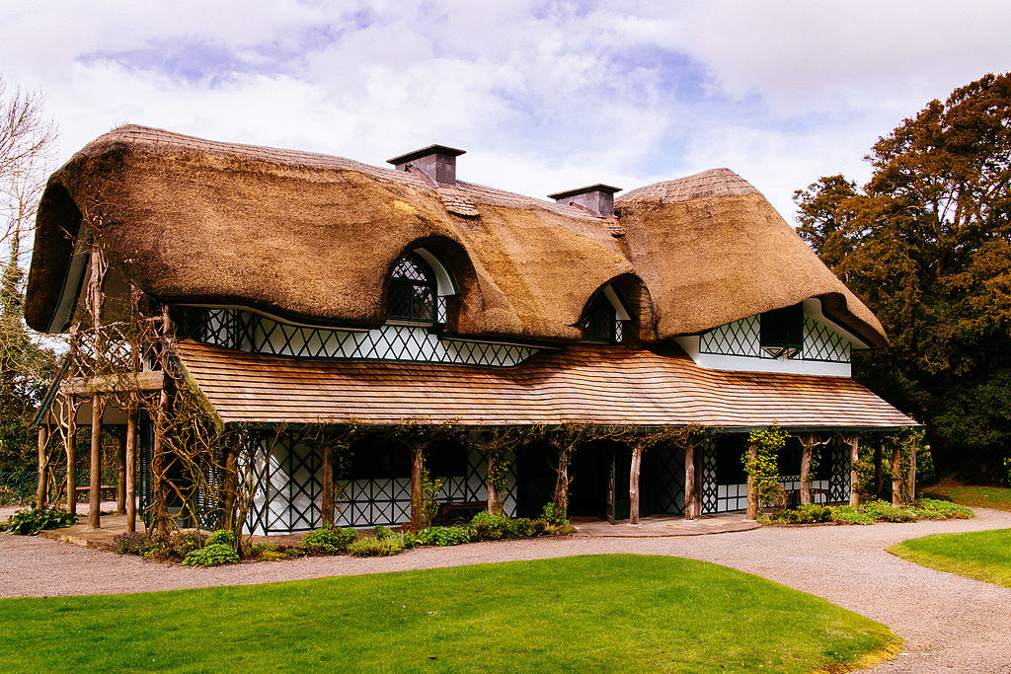
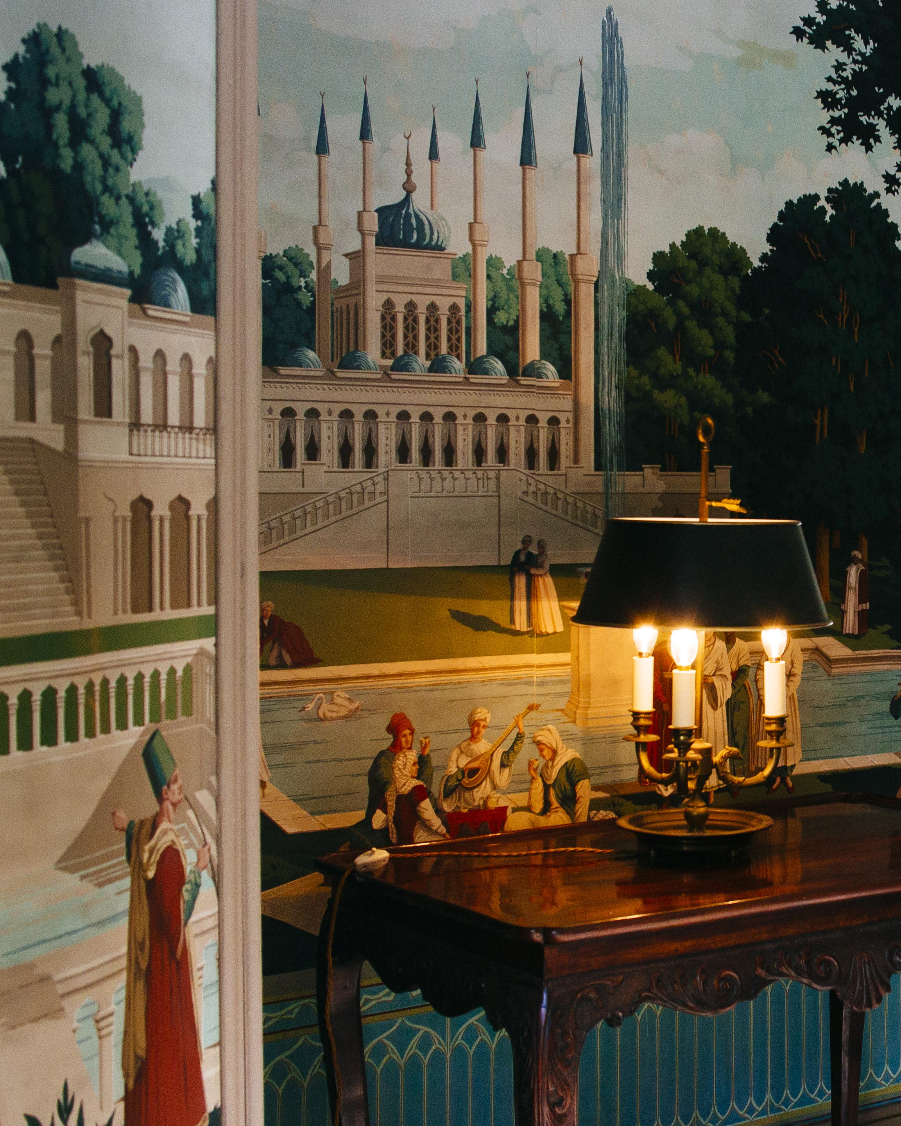
Swiss cottage
The Swiss Cottage is a short walk from Cahir Castle along by the river. It was built in the early 1800s by Richard Butler as a kind of holiday home.
The family would have gone here to relax and to entertain friends. They sometimes even played at being peasants living in the countryside!
The person who designed the house was inspired by nature and this can be seen in the thatched roof, the wooden columns outside which look like trees, and the nature themes on the wallpaper inside the house.
Swiss Cottage
Nature themed wallpaper inside the house.

Slide 8
Learn more about the Butlers
You can still visit all of these buildings today and imagine what life might have been like for the Butlers.
Living in a great house like Ormond Castle…
Defending Cahir Castle during a battle…
Or playing at being peasants in the Swiss Cottage!

