Slide 1
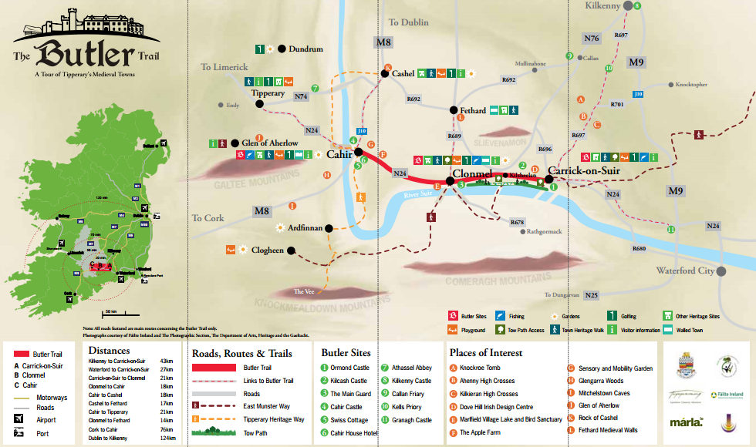
Notes:
Map also available at the following link http://www.tipperary.com/sites/default/files/Butler%20Trail%20Brochure.pdf Accompanying student worksheet on scoilnet.ie

