Slide 1
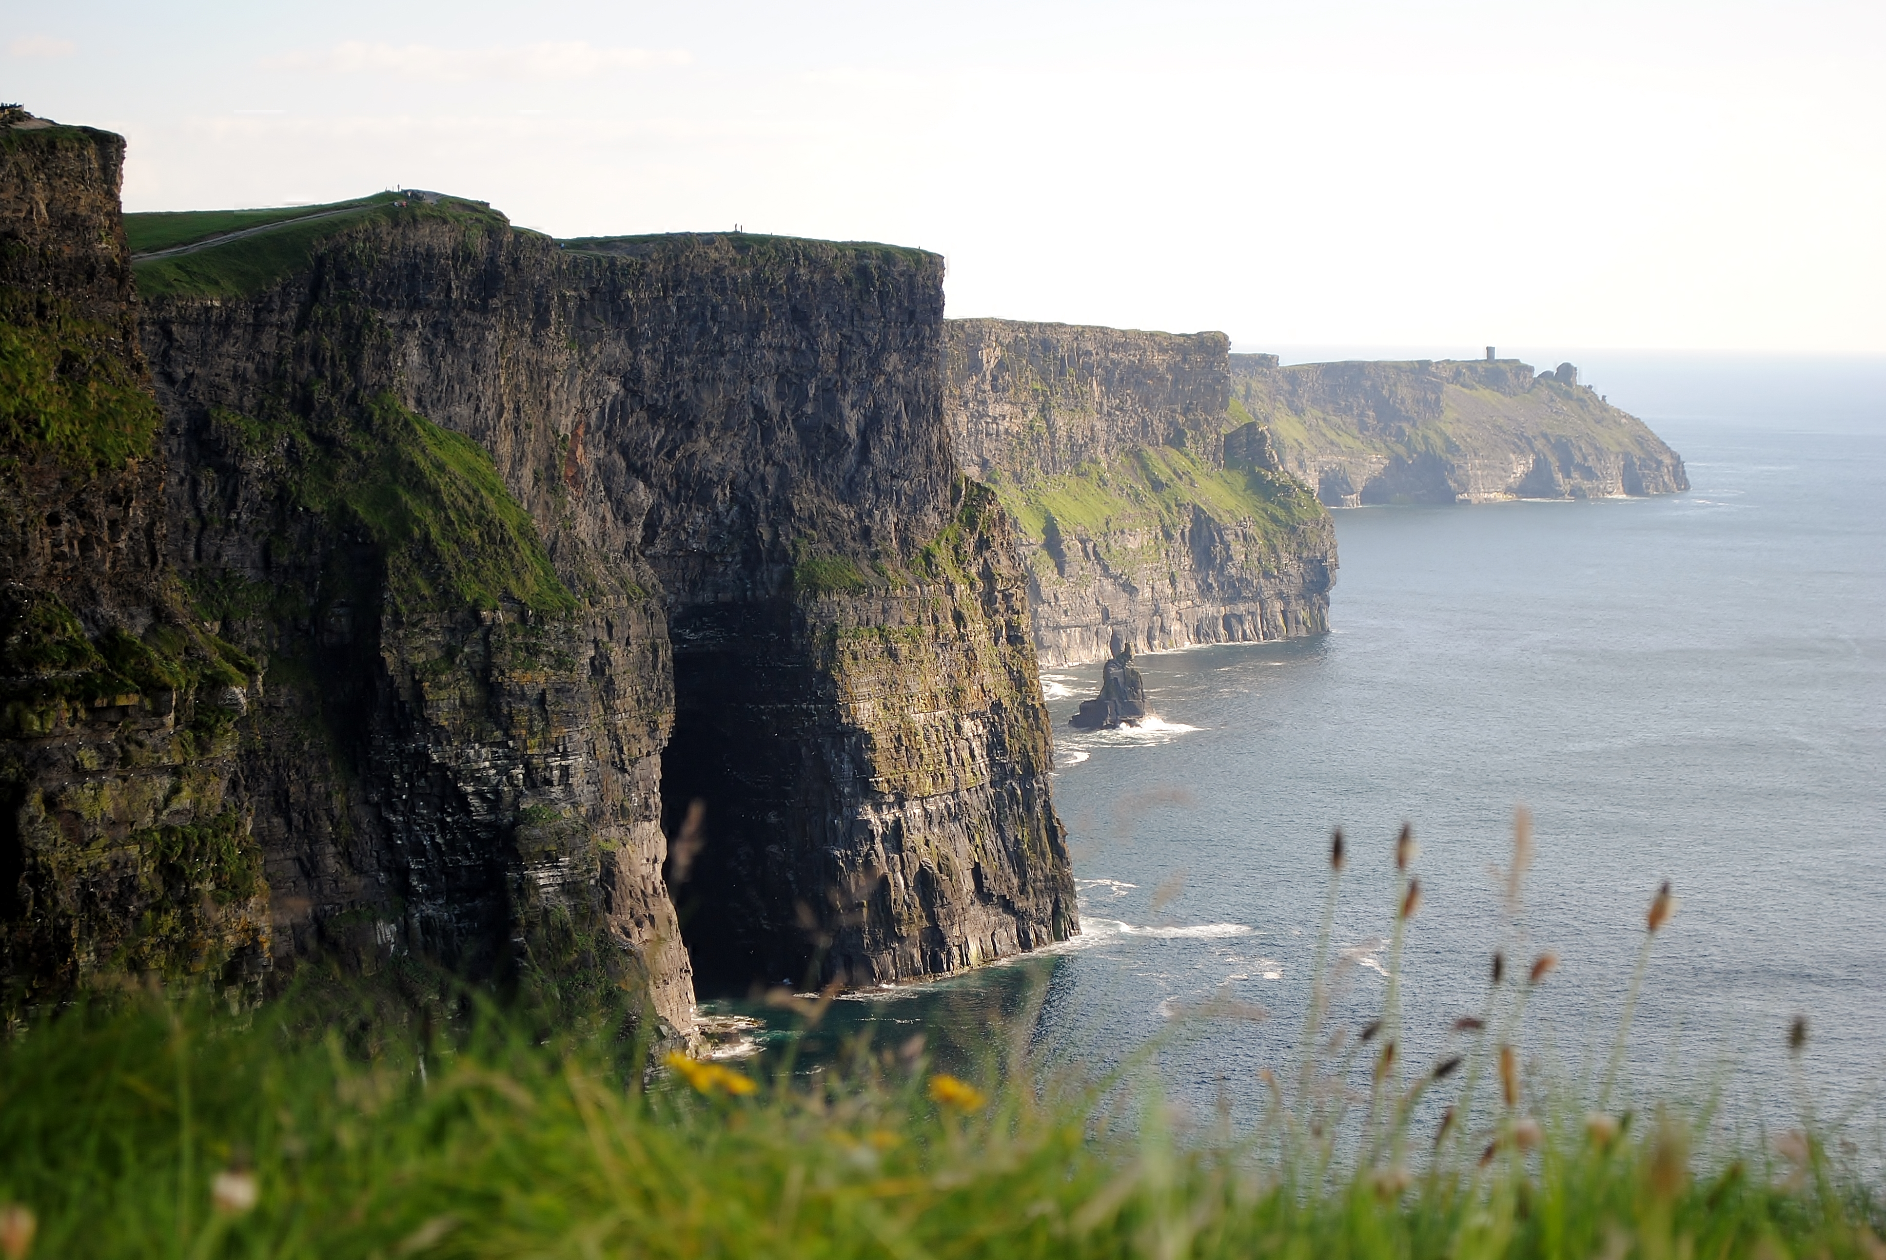
Cliffs of Moher
Co. Clare

Slide 2
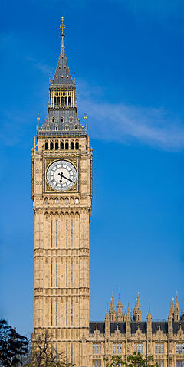
About the cliffs
The Cliffs of Moher are on the west coast of Ireland in Co. Clare and they are one of the natural wonders of Ireland. They were formed about 320 million years ago.
The cliffs are over 213 metres high and nearly 5 miles long. That’s the same height as a 64 story skyscraper, or two Big Ben’s stacked on top of each other!

Slide 3
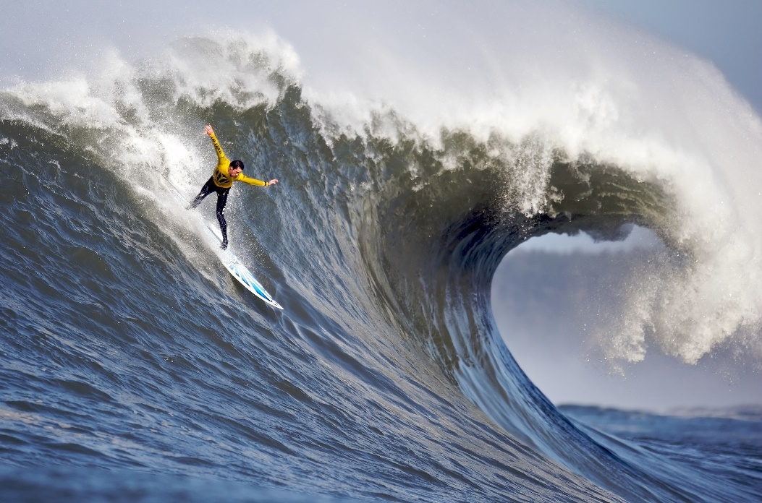
Surfing at the Cliffs of Moher
One of the world’s biggest surfing waves can be found at the Cliffs of Moher and surfers come from all over the world to ride it. It is called Aillenasharragh but it is more commonly known as ‘Aileens’.
It’s name comes from the Irish Aill Na Searrach which means ‘Leap of the Foals’ and the wave can get as big as 30 feet in height.

Slide 4
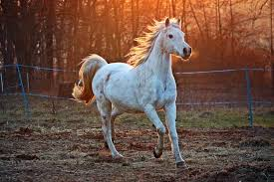
The legend behind the name
Legend has it that when Saint Patrick brought Christianity to Ireland the pagan gods, the Tuatha Dé Danann, used their magic to turn themselves into horses. They galloped to Kilcornan Caves where they hid for centuries until one day seven white foals emerged from the caves into the daylight. Having never seen daylight before they were terrified by the bright light and they galloped in fear straight over the edge cliffs.
This is where the wave got it’s name ‘Leap of the Foals’.

Slide 5
Aillenasharragh
The wave at the Cliffs of Moher is well known around the world and has attracted some of the world’s best known surfers. It has even featured in a television ad.
The ad shows Irish surfer John McCarthy riding the wave and you can watch it here:
https://www.youtube.com/watch?v=zHNk3AYYcM4

Slide 6
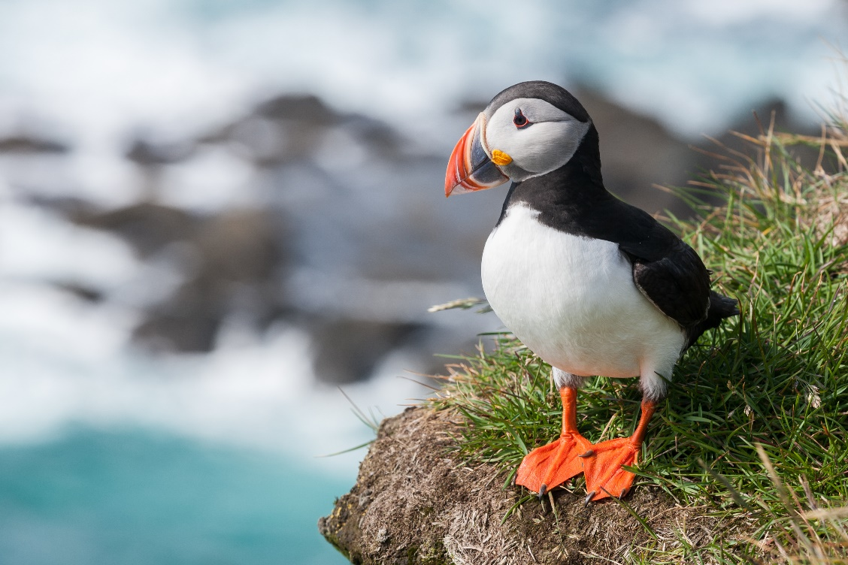
Wildlife at the Cliffs of Moher
The Cliffs of Moher is home to a huge number of seabirds. These include the Atlantic Puffin, Razorbill, Chough and Common Gull. The area is designated as a Special Protection Area for Birds (SPA) since 1989.
This is an Atlantic Puffin. These little birds grow to around 25cm. They are recognisable by their colourful beak, which fades to grey during winter and gets it’s colour back again in the spring!

Slide 7
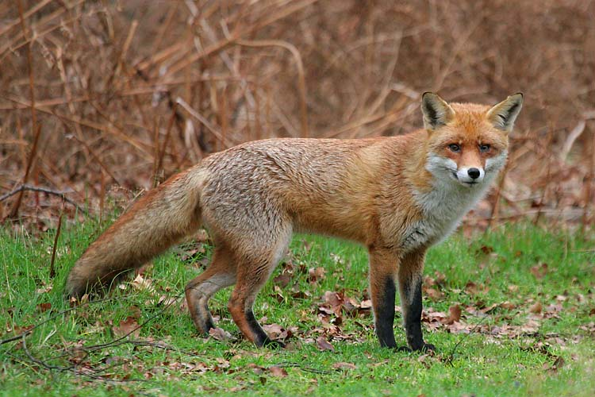
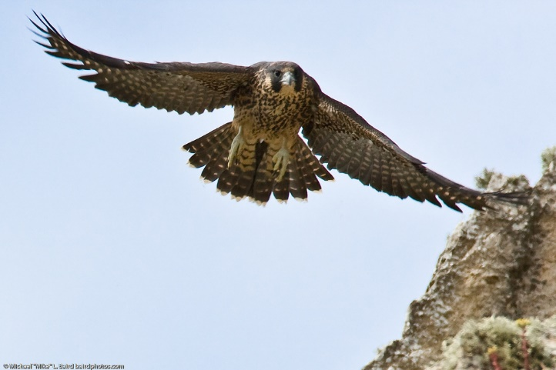
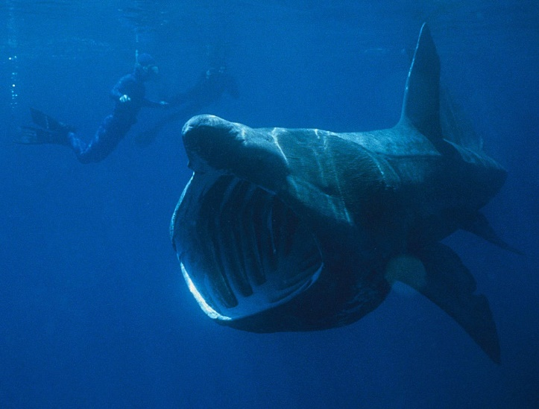
Other wildlife
You might also spot some of these other creatures near the Cliffs of Moher…
The basking shark is the second largest shark in the world.
Peregrine falcons are deadly hunters and can fly at up to 124 miles per hour.
Foxes come out around the cliffs at night to feed on rabbits and birds.

Slide 8
Quick Quiz
In what county will you find the Cliffs of Moher?
How many million years ago were they formed?
  a) 320 million b) 640 million c) 10 million
What is the nickname of the famous wave at the cliffs?
What does Aillenasharragh mean in English?
Can you name three creatures you might find at the Cliffs of Moher?

