Slide 1



Mnemonics - Acronyms
Mnemonics are word games which can act as a memory aid.
.
Acronyms
Acrostics
Rhyming

Slide 2

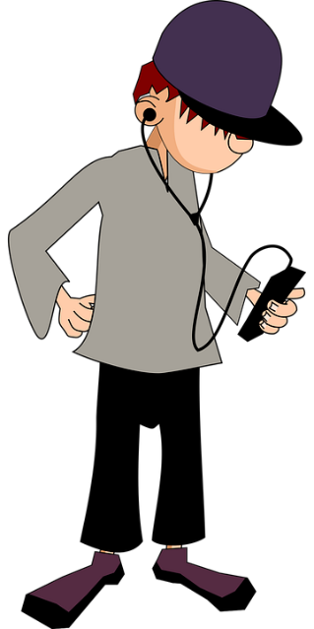
Acronyms
The word is created by using the first letter of each word
that needs to be remembered.
Like BIMDAS
-Brackets
-Indices
-Multiplication
-Division
-Addition
-Subtraction
A WORD
Note: Acronyms help remember order. In maths, complete brackets first, then indices, then x, then $÷$ , then + and finally - .

Slide 3
Acronyms
SKILL
What does the
acronym
stand for?
Click for Answer

Slide 4
Acronyms
What does the
acronym
stand for?
OILRIG
Click for Answer

Slide 5
Acronyms
What does the
acronym
stand for?
LORD
Click for Answer

Slide 6
Acronyms
What does the
acronym
stand for?
SIM
Click for Answer

Slide 7
Acronyms
What does the
acronym
stand for?
MRS.GREN
Click for Answer

Slide 8
Acronyms
What is the
meaning
behind this
acronym?
DNTLES
Click for Answer

Slide 9


Create Your Own Acronyms
Be as creative as you can!
Write your acronyms here!

Slide 10

Printable Templates

Slide 11
Download PPT to Customise
Click here to download the PPT file for this presentation.
Adjust to suit the needs of your class.

Slide 12
Teacher Note
Teacher Note:
The semantic memory is part of the long term memory.
It is the recall of general facts and is knowledge based.
Facts remembered here are not related to personal or emotional experiences.
Mnemonics are a memory aid to help you remember common facts or knowledge.
Mnemonics are useful when remembering facts in a particular order, to anchor facts and to overcome memory block.

Slide 13
Mnemonics
There are more types of mnemonics you can use….Click below.
.
Acronyms
Acrostics
Rhyming

Slide 14
SKILL
Skin, Kidneys, Intestines, Liver, Lungs
Return to Quiz

Slide 15
OILRIG
Chemistry –
Oxidation is loss of electrons,
Reduction is gain of electrons.
Return to Quiz

Slide 16
LORD
Biology / Science –
Left Oxygenated, Right Deoxygenated
Return to Quiz

Slide 17
SIM
Geography –
Sedimentary, Igneous, , metamorphic
Return to Quiz

Slide 18
MR.GREN
(Characteristics of Living Things)
Movement, Reproduction, Sensitivity, Growth, Respiration, Excretion, Nutrition
Return to Quiz

Slide 19
DNTLES
Gaeilge - If one of the dntls is the last letter of one word and the first letter of the other, the second word won't take a h.
Example - an doras
Return to Quiz

