Slide 1
The legend of
Castle Roche and the Black Widow

Slide 2
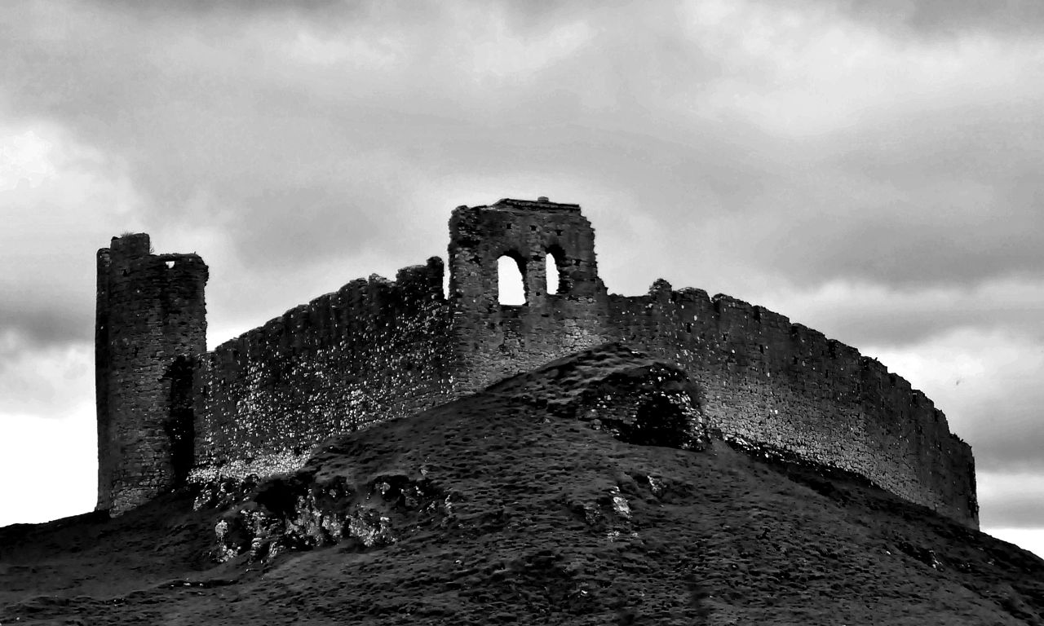
Castle Roche
Castle Roche was built in 1236AD near Dundalk in Co. Louth by the De Verdun family.
It was a very safe and secure castle for the De Verdun family. Its deep moat and strong walls made it very difficult for enemies to attack and capture it.
But although it seemed like a very safe place, danger lurked inside for the man who built it…
Castle Roche in Co. Louth

Slide 3
Rohesia De Verdun
The castle was built at the request of Rohesia de Verdun. After her first husband Theobald le Botiller died suddenly whilst travelling in France, Rohesia moved to their land in Ireland.
Alone as a widow it was essential that she go about securing herself and her land, and she decided the best way to do this would be to build a castle.
However Rohesia had a reputation for being short-tempered so the local architects were afraid to take on the job of building her castle.
So Rohesia decided to offer her hand in marriage to whichever man could build her a worthy castle. This meant that the man who built the castle for her would own half of all her land and wealth, making him a very rich man.

Slide 4
The murder
One man did indeed build the castle for Rohesia and became her husband.
On their wedding night she led him up the stairs of the new castle he had built to look out the window at all the lands he now owned.
As he looked out across the hills, Rohesia pushed him out of the castle window, sending him plummeting to his death.
Rohesia De Verdun would share her lands and her wealth with no one.
Among the ruins the infamous murder window is still visible today, and if you find yourself looking up at them on a misty day you might catch, out of the corner of your eye, something or someone tumbling from it.

Slide 5

Quick Quiz
In what county in Ireland is Castle Roche?
What happened to Rohesia’s first husband in France?
Castle Roche
Why did the local architects not want to build the castle for her?
How did she convince a man to build the castle for her?
Why do you think Rohesia is called the ‘Black Widow’?
Do you know any legends about your local area?

