Slide 1
The legend of
Ireland’s Fairy Trees

Slide 2
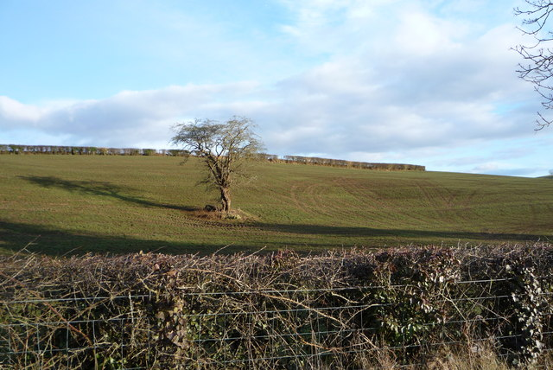
What is a fairy tree?
Fairy trees can be found all over Ireland and they look like this…
They are usually hawthorn trees and are often found at an ancient pagan site or holy well.
Lone hawthorn tree
Many fairy trees are decorated with unusual objects. People leave prayers, gifts or tokens in the hope of receiving healing or good luck from the fairies.
Some objects that can be found decorating fairy trees include children’s toys, socks, photos, ribbons, messages scrawled on scraps of paper, balloons, even strips of fabric torn from their clothing.

Slide 3
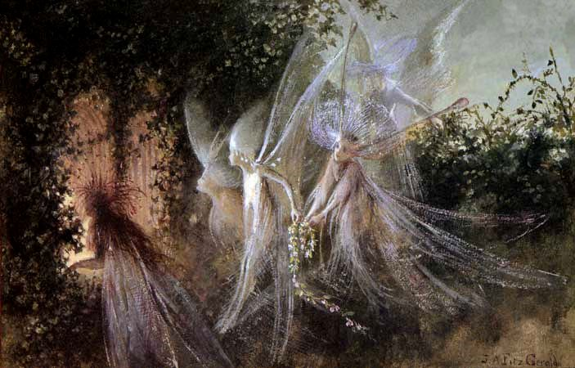
Curse of the fairy tree
The lone hawthorn standing in the middle of a field was treated with much respect, and some suspicion by farming communities.
While it was thought to be a good omen, bringing good luck and prosperity to the landowner, it was also thought to belong to the magical folk of the Otherworld, the Sidhe (otherwise known as the fairy folk).
As such, it was never to be cut or harmed for fear of bringing the wrath of the fairies upon the offender.
Some farmers even piled boulders around the base of the tree so as not to accidentally cause damage to the trunk while ploughing around it.

Slide 4
Legends of Irish fairy trees
It was said that bad luck would befall anyone who damaged or cut a fairy tree as this would offend the tree’s magical owners. It was even believed that witches made their brooms from the branches of the tree.
This is one legend about a fairy tree in Northern Ireland…
“Earlier in this century, a construction firm ordered the felling of a fairy thorn on a building site in Downpatrick, Ulster. The foreman had to do the deed himself, as all of his workers refused. When he dug up the root, hundreds of white mice – supposed to be the faeries themselves – ran out, and while the foreman was carting away the soil in a barrow, a nearby horse shied, crushing him against a wall and resulting in the loss of one of his legs.”
From Druidry.org

Slide 5
Gateway to fairy realm
The hawthorn tree was also believed to be a gateway into the fairy realms. Thomas the Rhymer, a Scottish poet in the 13th century claimed to have met the Fairy Queen by a hawthorn bush from which a cuckoo was calling. She led him into the Otherworld for a short visit, but when he emerged, he found that seven years had passed.
So be careful if you are ever out walking in the countryside and think you may take a nice little nap under that inviting shady hawthorn tree… you may wake to find yourself whisked off to the Otherworld, and it’s highly likely you won’t find your way back…

