Slide 1
The Legend of the Goddess Throne

Slide 2
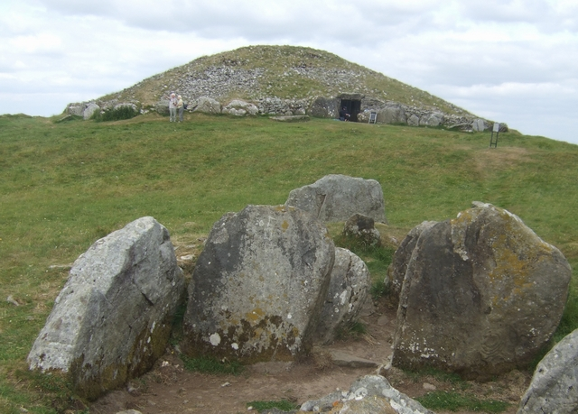
Loughcrew, Co. Westmeath
If you visit Loughcrew in Co. Westmeath you will find a large number of ancient passage tombs or cairns. It is the largest collection of these cairns to be found in Ireland.
There are about 23 tombs at Loughcrew.
The tombs were built around 3500 BC near the summit of Sliabh na Caillaí (The Hill of the Witch) and were used as burial chambers.
Loughcrew Cairns, Co. Westmeath

Slide 3
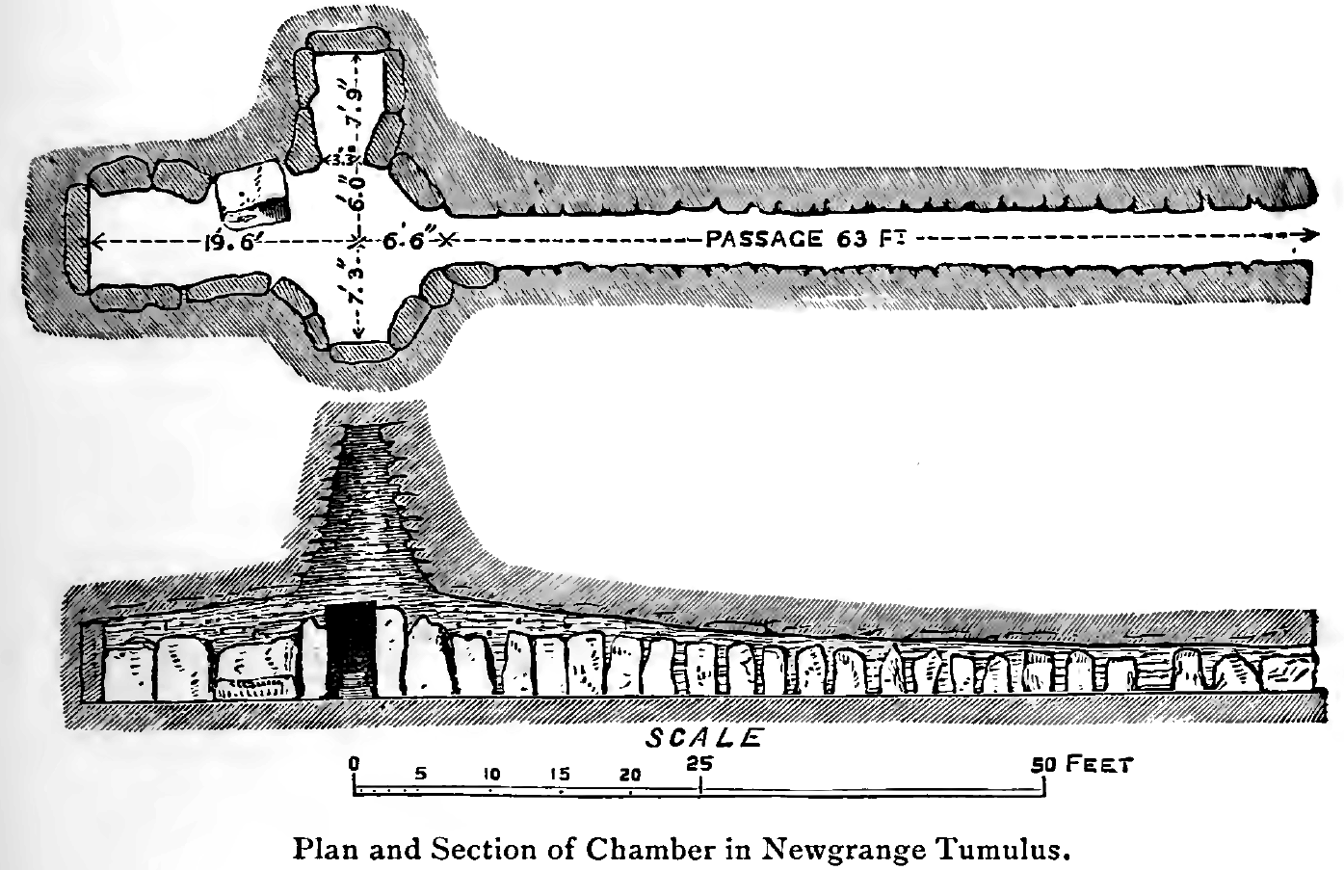
Passage Graves
A passage grave or tomb usually has a narrow passage made of large stones which leads into a burial chamber. All of this is buried under earth or stone.
Some passage tombs are built in a crucifix shape. In these tombs the main burial chamber has smaller chambers extending in three directions, making a cross shape.
Sometimes passage tombs, like Loughcrew, are covered with a cairn. A cairn is a human made pile of stones.
Drawing of a cross shaped passage tomb

Slide 4
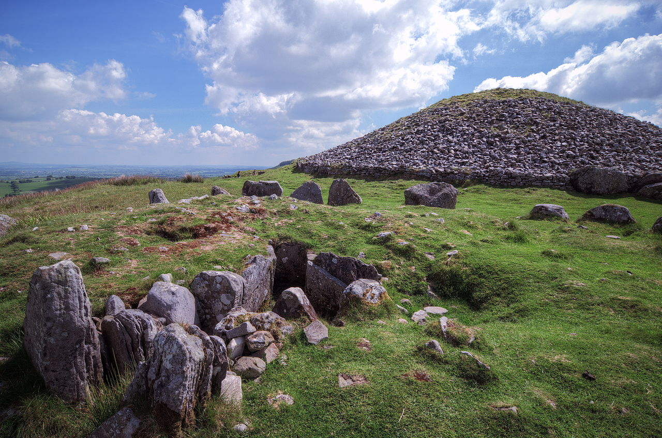
In this picture you can see the cairn (or stones) piled on top of the burial chamber at Loughcrew to bury it.

Slide 5
The legend
Local folklore maintains that the site is the work of a witch who once ruled the area. The name of the ancient hag was Garavogue, known locally as An Cailleach Bhéara. She was a supernatural figure who it was said was responsible for the landscape; placing large boulders in rivers and creating rock formations on hillsides.
Local legend recounts the story of An Cailleach Bhéara jumping from one hill to the next dropping stones from her apron. The fallen stones formed the Cairns we see today. She was attempting this magical feat to gain great power and rule over all of Ireland. She was able to drop her cairns of stones on the first three peaks. As she jumped to the fourth hill she missed her mark and fell to her death on her last leap.
Visitors today can sit on the Hag`s Chair where she fell. It is said that if you make a wish while sitting on this stone the witch will grant it.

Slide 6
Quick Quiz
In what county are Loughcrew Passage Tombs?
What were they used for?
Loughcrew Pasage Tombs
What is a cairn?
What is the name of the hill where Loughcrew Passage Tombs are built?
Do you know any legends about your local area?

