Slide 1


Resolving Conflict
Look at the picture:
What is conflict?

Slide 2

Classroom Rules
Rule | Agree ☺ | Disagree ☹
Only one person talks at a time. No interrupting.
Be respectful when someone is talking by listening to them.
Be respectful in how you speak about someone/ someone's opinion
If someone doesn’t want to talk, that is okay.
The classroom is a safe place to talk about conflict.
Can your class create three more rules for their class?

Slide 3
As a class, record your understanding of what causes ‘conflict’.
What are the
causes of Conflict

Slide 4
Look up the definition of ‘Conflict’ in your dictionary.
“____________________________________________________________”
Click here to access an online dictionary.

Slide 5
Look up the definition of ‘Conflict’ in your dictionary.
Collins Online Dictionary:
“Conflict is serious disagreement and argument about something important. If two people or groups are in conflict, they have had a serious disagreement or argument and have not yet reached agreement.”

Slide 6
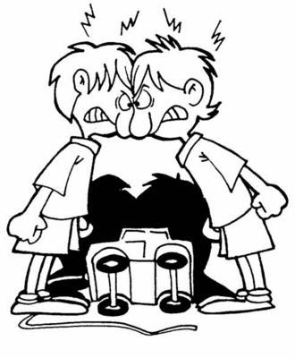
Scenarios: How does each person feel?
What should she/he do next?
☺
☹
IT’S MY TURN!
I’ve been waiting for the computer this last 30 minutes.
MOVE OUT OF MY WAY!
It’s still my go on the computer.
Upset
Disappointed
Angry
Scared
Revengeful
Jealous
Lonely
Heart broken
Nervous
Worried
Offended
Threatened
Provoked
Ashamed
Aggressive

Slide 7
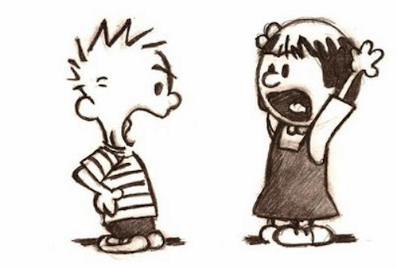
Scenarios: How does each person feel?
What should she/he do next?
☺
☹
YOU TOLD ON ME!
I’VE GOT DETENTION NOW AND NIAMH IS MAD AT ME…
YOU DESERVE IT!
Upset
Disappointed
Angry
Scared
Revengeful
Jealous
Lonely
Heart broken
Nervous
Worried
Offended
Threatened
Provoked
Ashamed
Aggressive

Slide 8
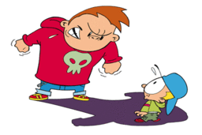
Scenarios: How does each person feel?
What should she/he do next?
☺
☹
YOU ARE SO BAD.
I passed the ball straight to you and you lost it.
You are never playing again!
Upset
Disappointed
Angry
Scared
Revengeful
Jealous
Lonely
Heart broken
Nervous
Worried
Offended
Threatened
Provoked
Ashamed
Aggressive
You were going for goal yourself.
You didn’t pass the ball to me.

Slide 9
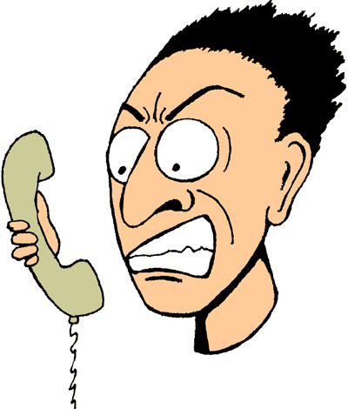
Scenarios: How does each person feel?
What should she/he do next?
☺
☹
STOP YELLING AT ME
STOP IGNORING ME
Upset
Disappointed
Angry
Scared
Revengeful
Jealous
Lonely
Heart broken
Nervous
Worried
Offended
Threatened
Provoked
Ashamed
Aggressive

Slide 10

Scenarios: How does each person feel?
What should she/he do next?
☺
☹
Can’t believe he said that…
Wait till I tell Roísin what he said.
He started it first.
I’m not apologising.
Upset
Disappointed
Angry
Scared
Revengeful
Jealous
Lonely
Heart broken
Nervous
Worried
Offended
Threatened
Provoked
Ashamed
Aggressive

Slide 11
Scenarios: How does each person feel?
What should she/he do next?
☺
☹
Can’t believe he said that…
Wait till I tell Roísin what he said.
He started it first.
I’m not apologising.
Upset
Disappointed
Angry
Scared
Revengeful
Jealous
Lonely
Heart broken
Nervous
Worried
Offended
Threatened
Provoked
Ashamed
Aggressive

Slide 12

Scenarios: How does each person feel?
What should she/he do next?
☺
☹
WHAT ARE YOU LOOKING AT?
STOP LOOKING ME.
LEAVE ME ALONE
WHAT?
WHAT DO YOU WANT?
Upset
Disappointed
Angry
Scared
Revengeful
Jealous
Lonely
Heart broken
Nervous
Worried
Offended
Threatened
Provoked
Ashamed
Aggressive

Slide 13

✓
X
Which of the following conflict resolution skills have you mentioned during the scenario task.
STOP!
Give time for both of you to calm down.
You won’t be able to resolve the disagreement when some-one is very angry.

Slide 14
✓
X
Which of the following conflict resolution skills have you mentioned during the scenario task.
?
ASK!
Ask the other person what is wrong, what they want or why said what they did.

Slide 15

✓
X
Which of the following conflict resolution skills have you mentioned during the scenario task.
LISTEN!
Don’t react to what they say.
Listen to their side of why they are upset.

Slide 16
✓
X
Which of the following conflict resolution skills have you mentioned during the scenario task.
THINK!
Think about how you can make this situation better.
How could you meet them half way?
If you need more time, ask for more time to think.

Slide 17

✓
X
Which of the following conflict resolution skills have you mentioned during the scenario task.
EXPLAIN!
Tell the person how you felt and why you said/ did what you did.

Slide 18


