Slide 1

Can you find the initial sound?
Click on the letter that matches the initial sound for each picture.
Covers group 2 JP sounds: ckehrmd

Slide 2
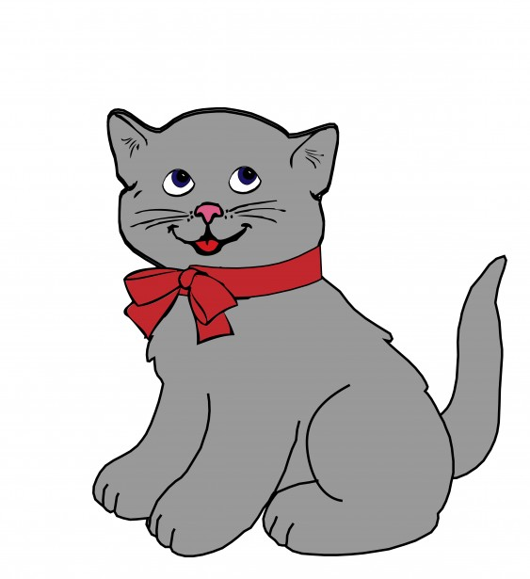
c t e

Slide 3



well done!

Slide 4


try again!

Slide 5
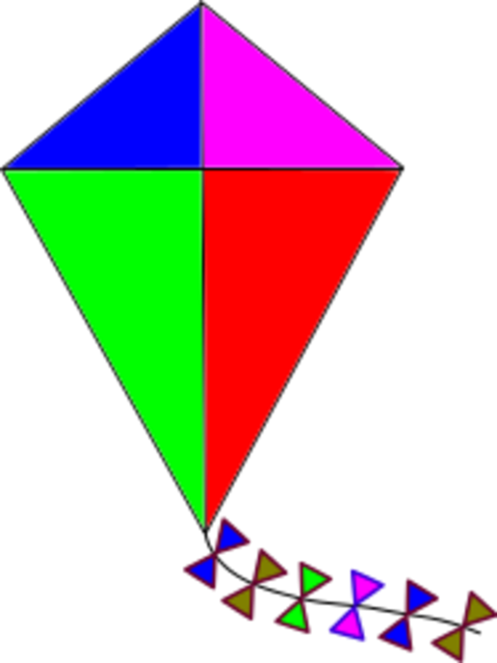
s k t

Slide 6
well done!

Slide 7
try again!

Slide 8

a i e
This Photo by Unknown Author is licensed under CC BY-SA

Slide 9
well done!

Slide 10
try again!

Slide 11

n h p

Slide 12
well done!

Slide 13
try again!

Slide 14

r n a
This Photo by Unknown Author is licensed under CC BY-SA

Slide 15
well done!

Slide 16
try again!

Slide 17

n m r

Slide 18
well done!

Slide 19
try again!

Slide 20

a h d
This Photo by Unknown Author is licensed under CC BY-SA

Slide 21
well done!

Slide 22
try again!

