Slide 1

Can you find the initial sound?
Click on the letter that matches the initial sound for each picture.
Covers group 3 JP sounds: goulfb

Slide 2

c g s

Slide 3



well done!

Slide 4


try again!

Slide 5
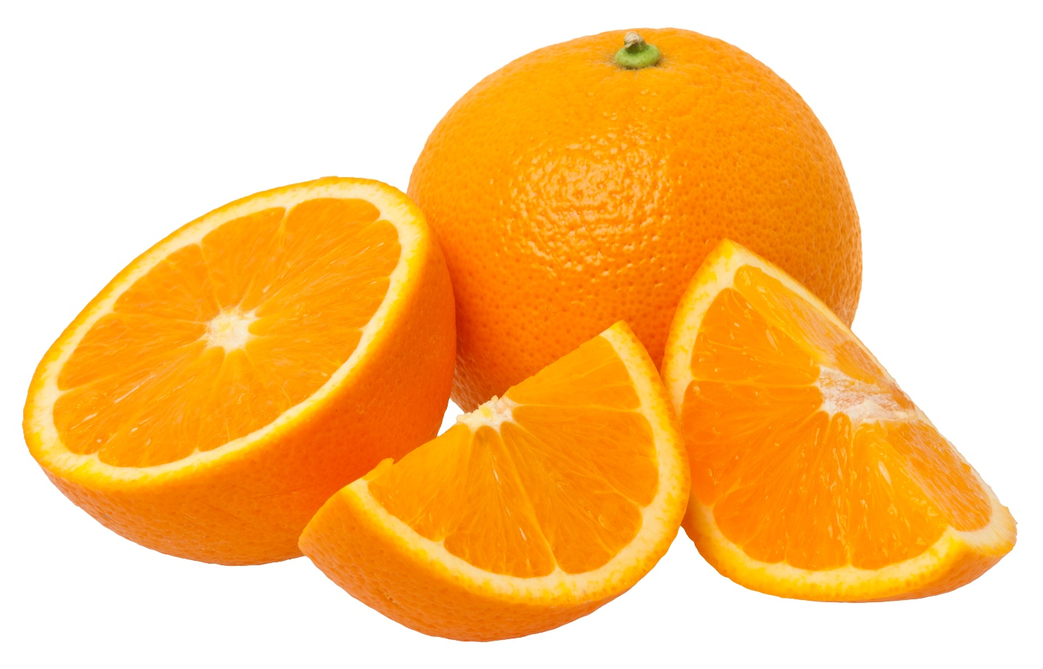
e a o
This Photo by Unknown Author is licensed under CC BY-SA

Slide 6
well done!

Slide 7
try again!

Slide 8

u n i

Slide 9
well done!

Slide 10
try again!

Slide 11

i l t
This Photo by Unknown Author is licensed under CC BY-NC

Slide 12
well done!

Slide 13
try again!

Slide 14

f g t
This Photo by Unknown Author is licensed under CC BY-SA

Slide 15
well done!

Slide 16
try again!

Slide 17

s g b

Slide 18
well done!

Slide 19
try again!

