Slide 1

Can you find the initial sound?
Click on the letter that matches the initial sound for each picture.
Covers sounds: j, z, w, v, x, y, qu

Slide 2

t i j

Slide 3



well done!

Slide 4


try again!

Slide 5
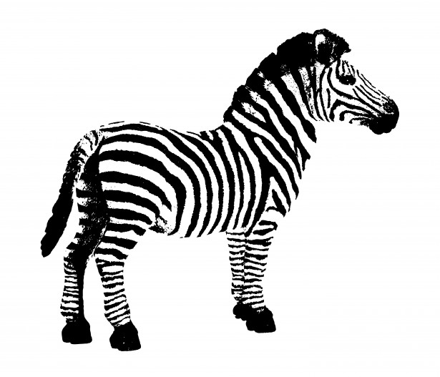
z n r

Slide 6
well done!

Slide 7
try again!

Slide 8

m w p

Slide 9
well done!

Slide 10
try again!

Slide 11

w v k

Slide 12
well done!

Slide 13
try again!

Slide 14
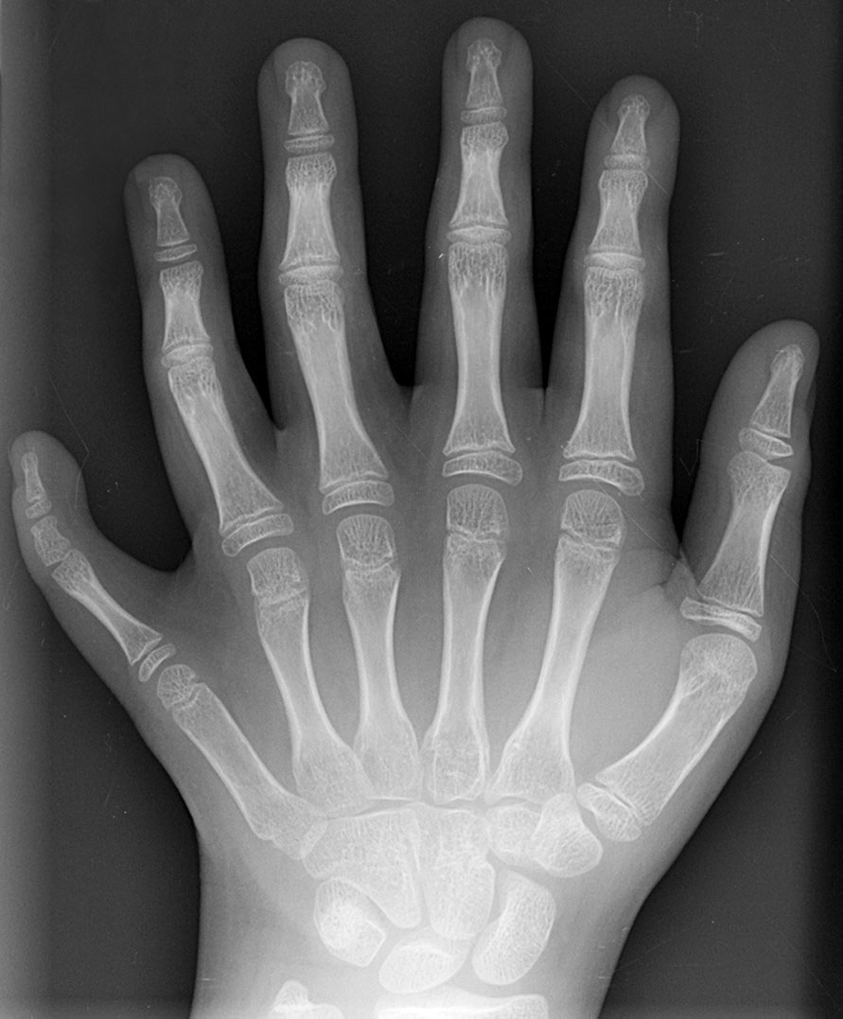
z r x
This Photo by Unknown Author is licensed under CC BY-SA

Slide 15
well done!

Slide 16
try again!

Slide 17
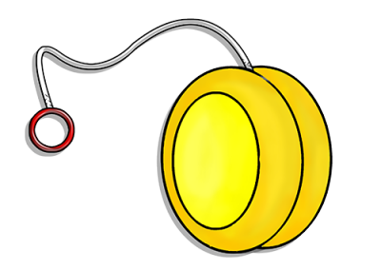
y j g
This Photo by Unknown Author is licensed under CC BY-NC

Slide 18
well done!

Slide 19
try again!

Slide 20
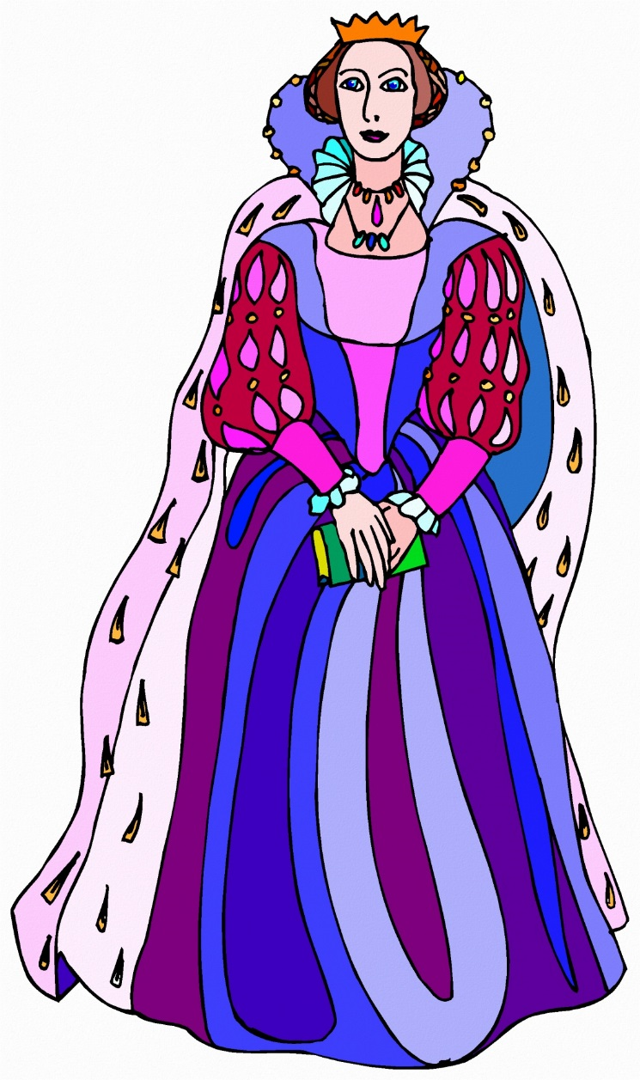
o l qu

Slide 21
well done!

Slide 22
try again!

