Slide 1
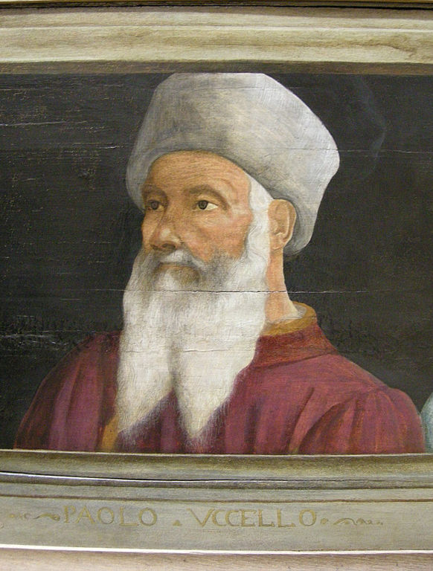

UCCELLO
(1397- 1475) Florentine Artist
Caroline Mc Corriston

Slide 2
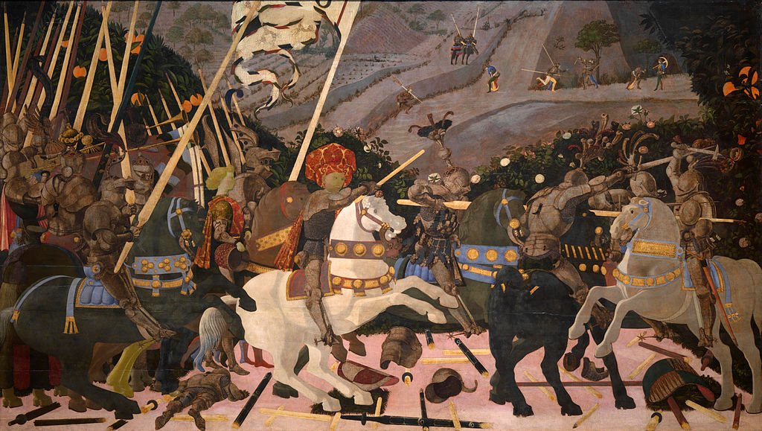
Niccolò Mauruzi da Tolentino at the Battle of San Romano (probably c. 1438–1440), egg tempera with walnut oil and linseed oil on poplar, 182 × 320 cm National Gallery, London.^{[2]}

Slide 3
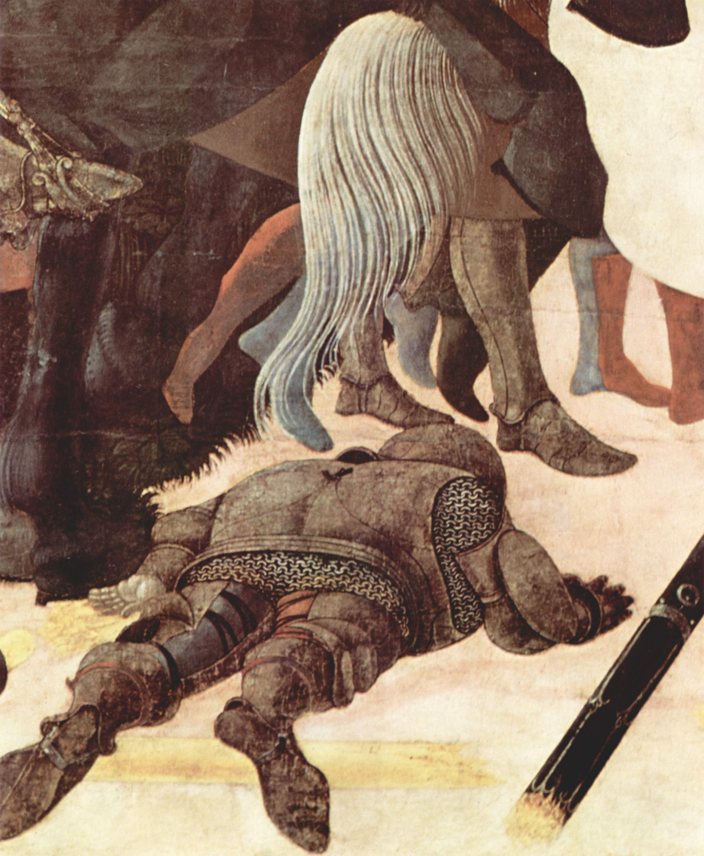

Slide 4
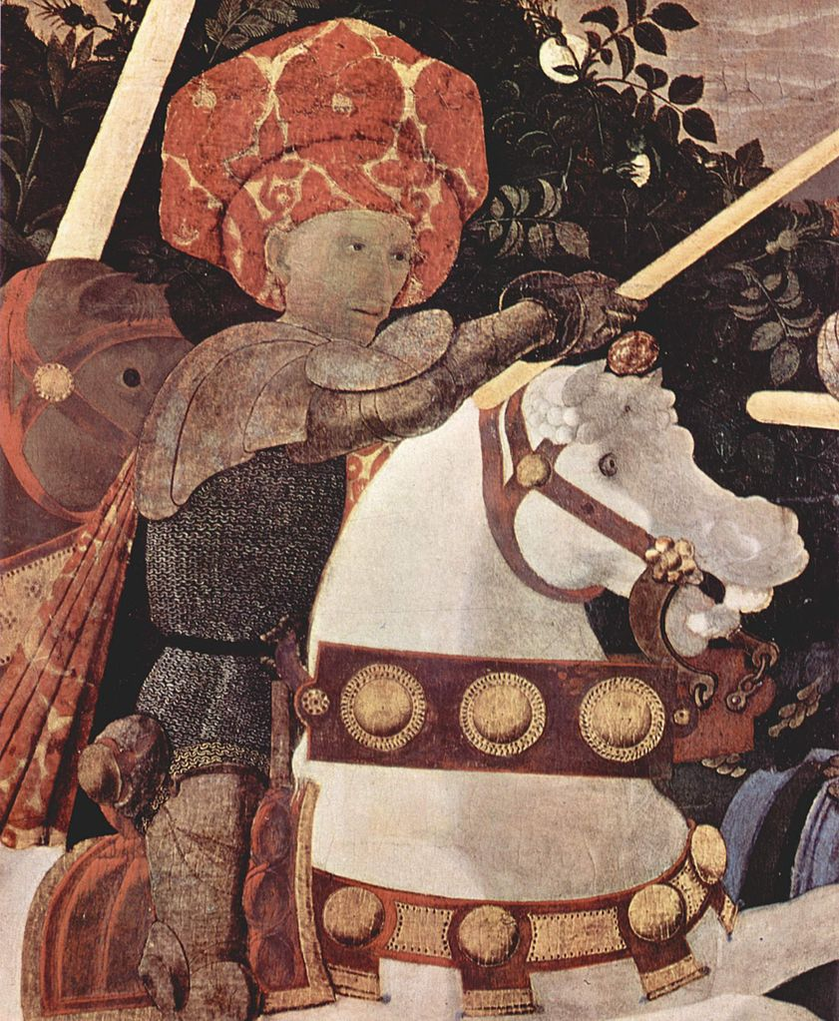
No helmet

Slide 5
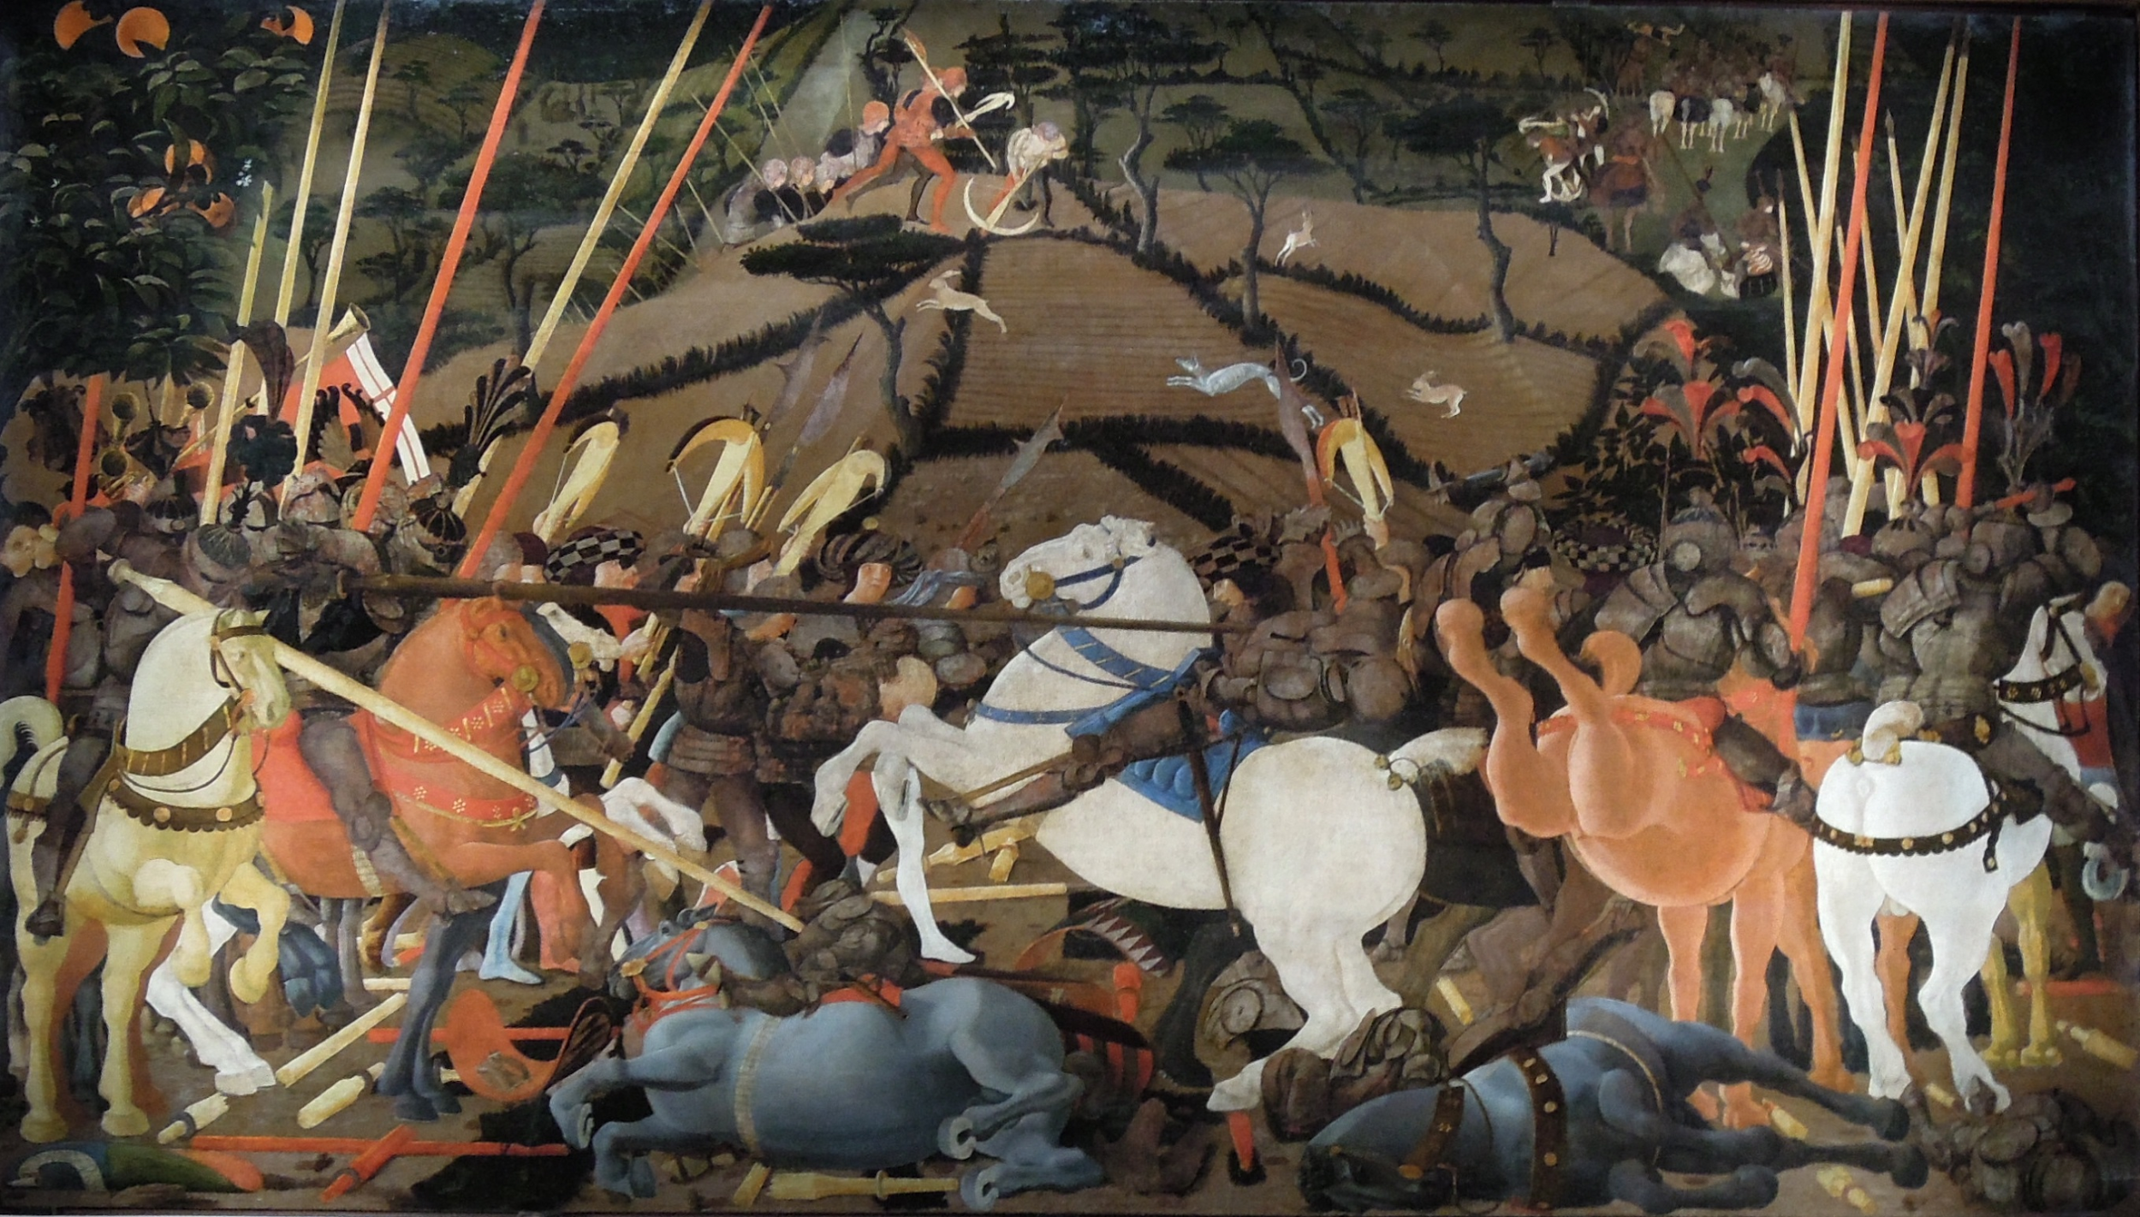
Niccolò Mauruzi da Tolentino unseats Bernardino della Ciarda at the Battle of San Romano (dating uncertain,c. 1435–1455), tempera on wood, 182 × 320 cm Galleria degli Uffizi, Florence

Slide 6
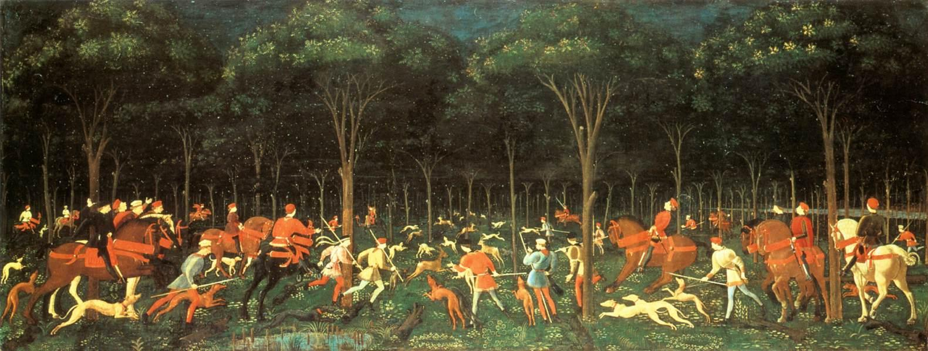
Hunt in the Forest
1470
Oil on canvas
65x165cm

