Slide 1
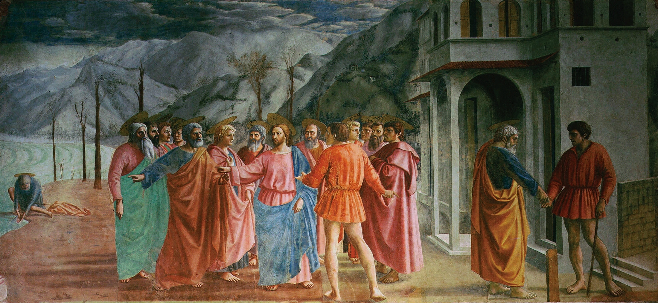

Masaccio
(1401- 1428)
Early Renaissance
Italian Artist
Caroline Mc Corriston

Slide 2
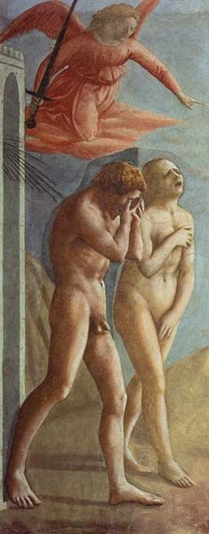
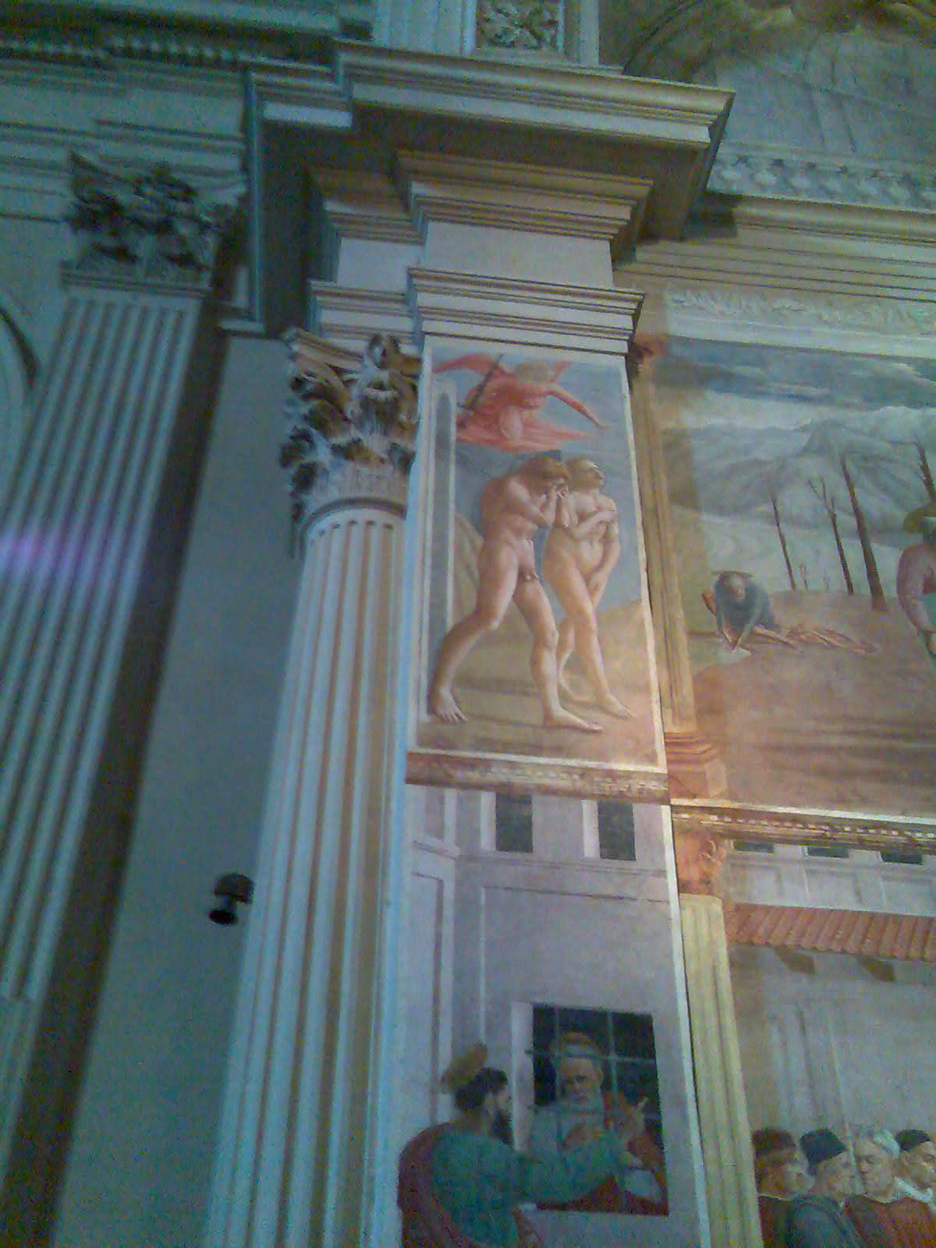
The Expulsion from Paradise, c. 1425

Slide 3
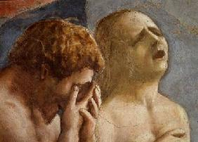

Slide 4
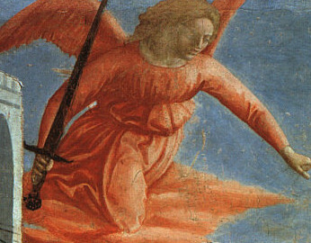
http://www.artble.com/artists/tommaso_cassai_masaccio/paintings/expulsion_from_the_garden_of_eden

Slide 5
The Tribute Money, c.1425

Slide 6
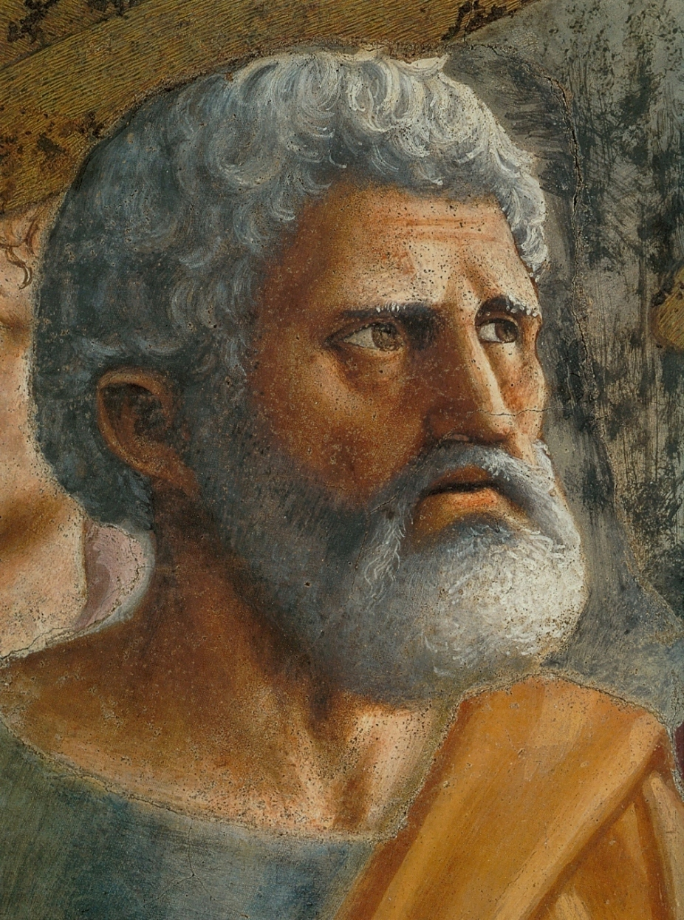
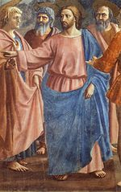
Christ and his apostles >
<Peter

Slide 7
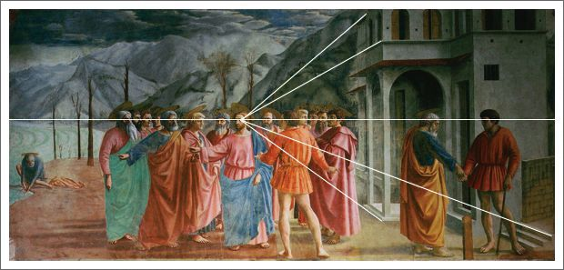
http://www.artyfactory.com/art_appreciation/art_movements/italian-renaissance/italian-renaissance-art.html

Slide 8
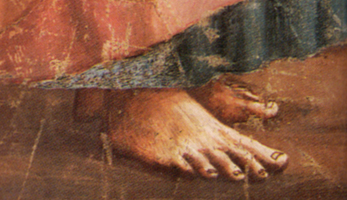
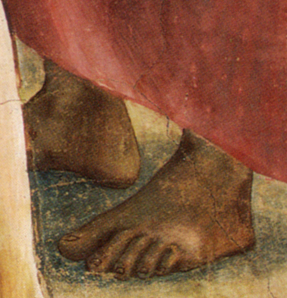
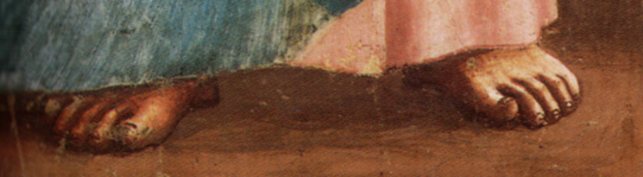

Slide 9
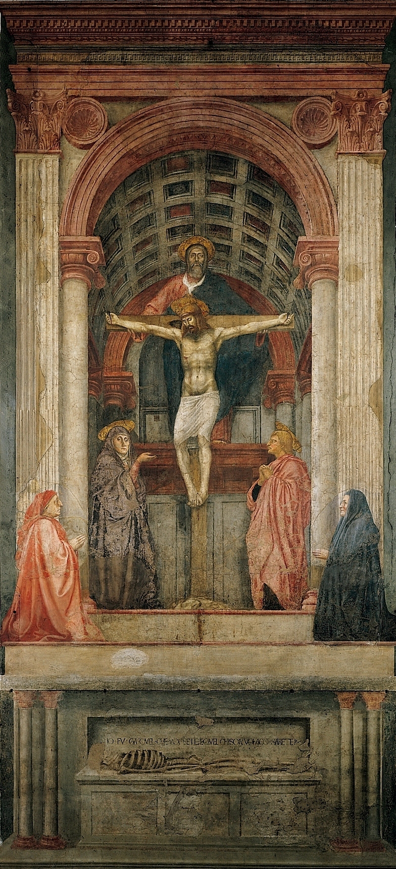
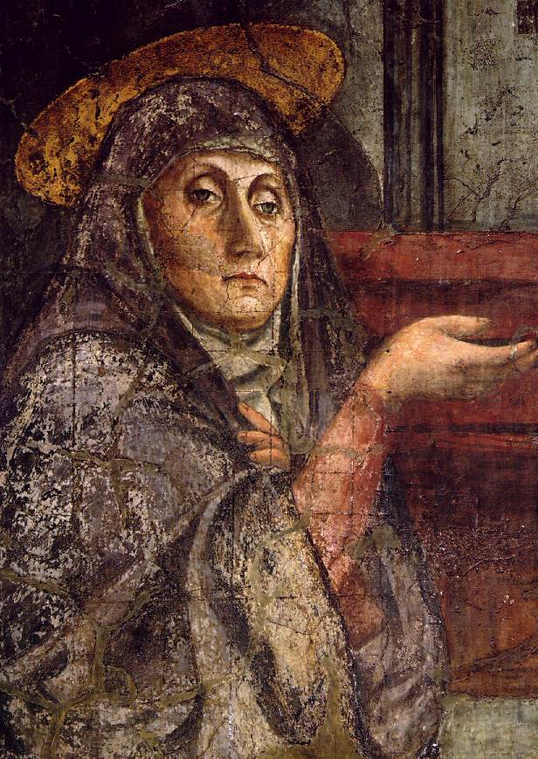
The Holy Trinity, c.1427

Slide 10
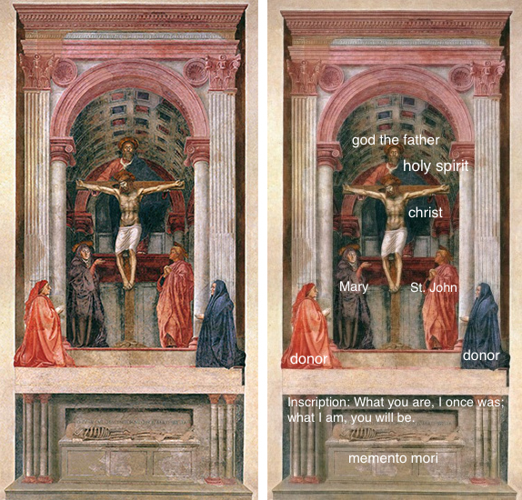
https://www.khanacademy.org/humanities/renaissance-reformation/early-renaissance1/painting-in-florence/a/masaccio-holy-trinity

Slide 11
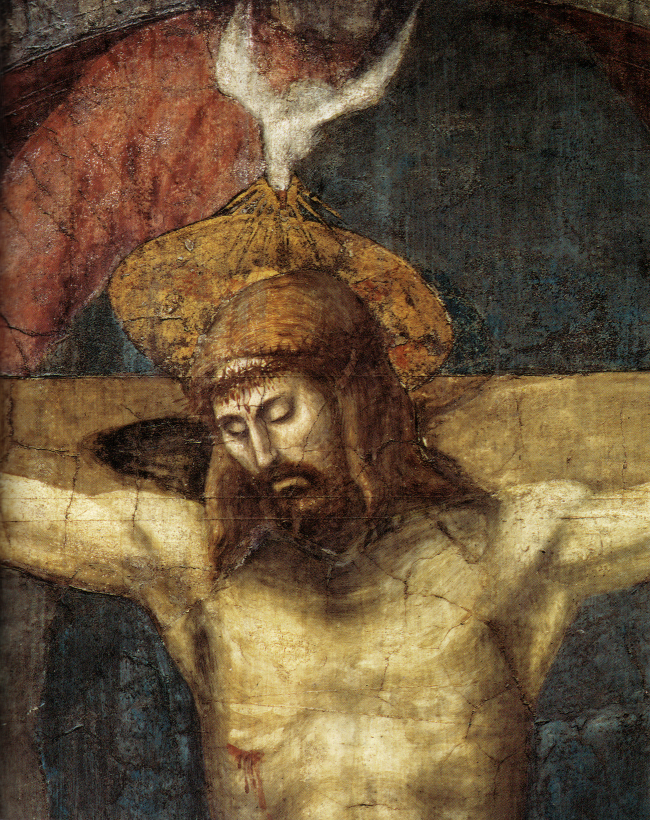
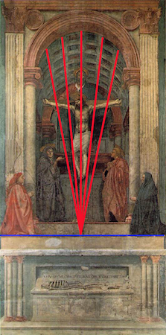
https://www.khanacademy.org/humanities/renaissance-reformation/early-renaissance1/painting-in-florence/a/masaccio-holy-trinity

Slide 12
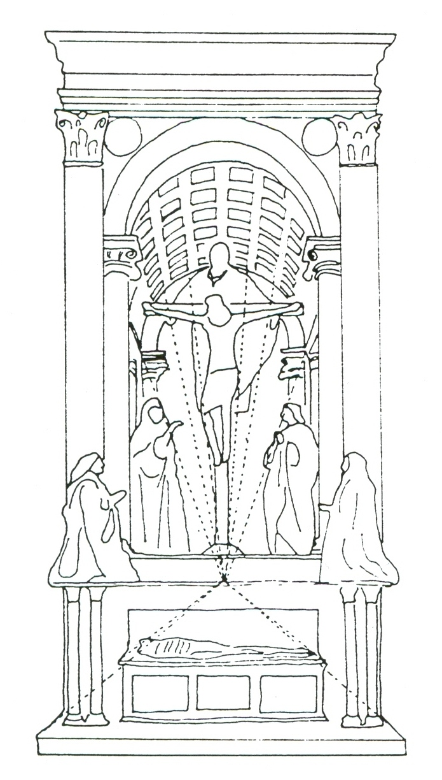
Perspective

Slide 13
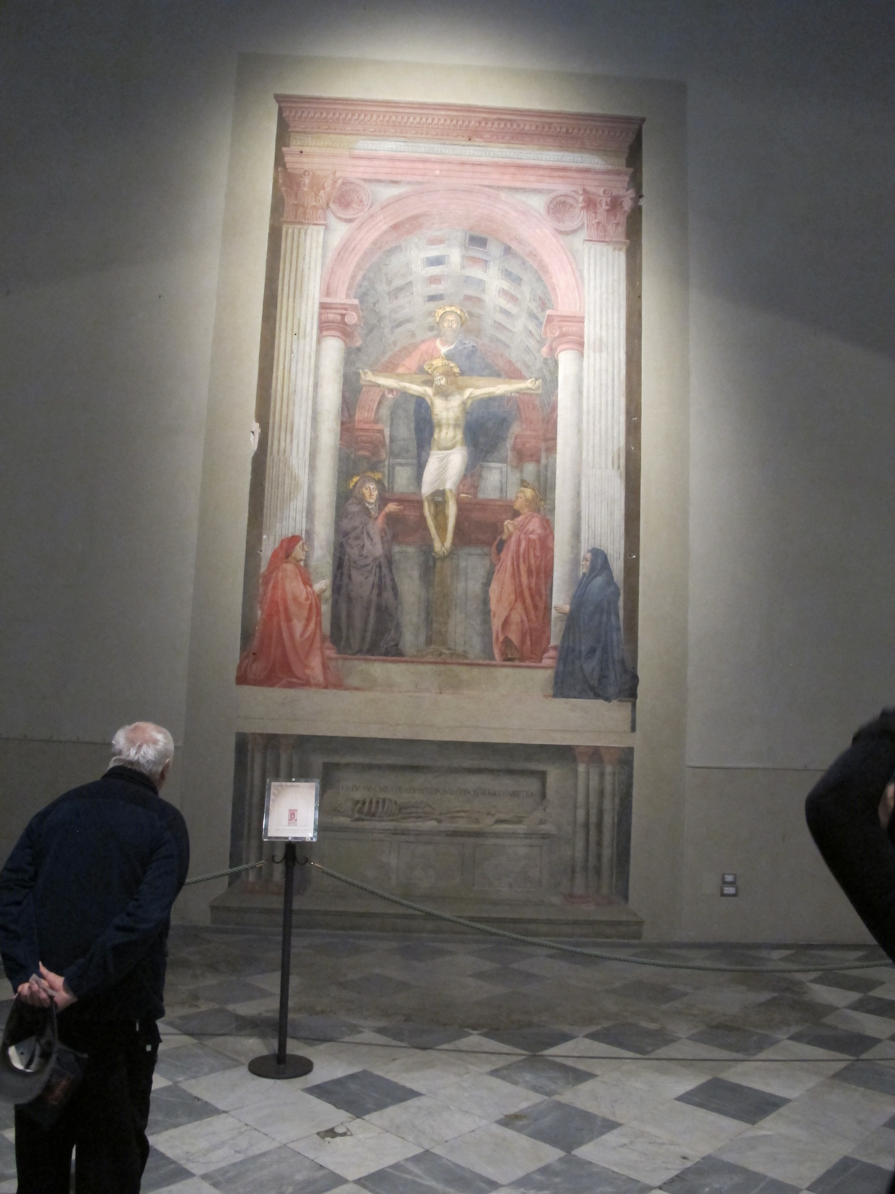
Scale

