Slide 1
Bertie & elizabeth

Slide 2
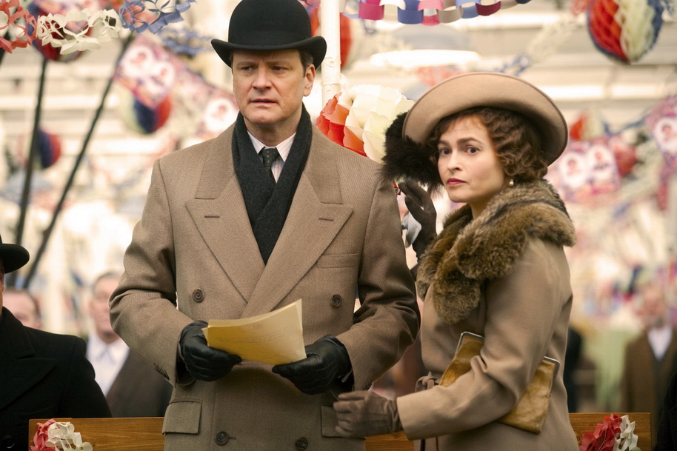

Slide 3
Search for other shots of Bertie and Elizabeth.
What is happening in each shot?
What do you notice about where Elizabeth appears in the frame?
Why do you think the Director/Cinematographer have done this?
What does it tell us about the relationship between Bertie and Elizabeth?

Slide 4

Key Moment

Slide 5
RELATIONSHIPS
‘A supportive and loving relationship can make all the difference to a character’s life .’
Describe a supportive and loving relationship which you encountered in one of the texts you have studied for your comparative course and explain how this supportive and loving relationship made a difference to a character’s experience of life. (30)

Slide 6
credits
All images and clips from
‘The King’s Speech’
directed by Tom Hooper,
distributed by Momentum Pictures, 2010

