Slide 1
John Wesley & the Methodist Church
The History & Beliefs of the Methodist Church

Slide 2
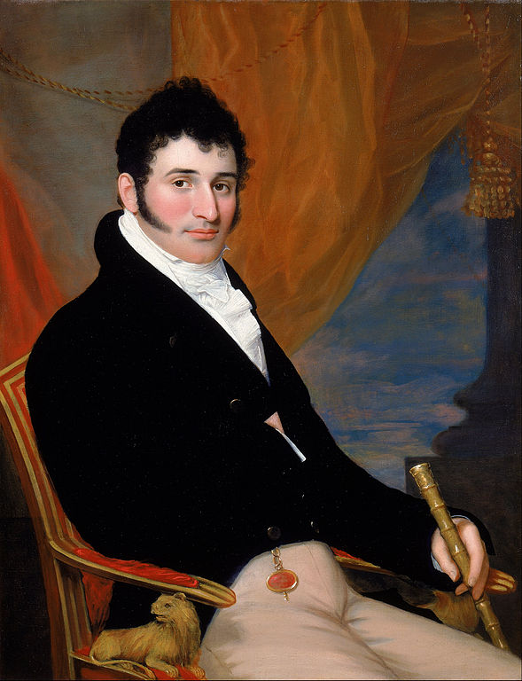
John Wesley
1703-1791
A founder of the Methodist Church.
Passionate encourager of others to live a Christian life.
Leader of a great revival of faith.
https://commons.wikimedia.org/wiki/File:John_Wesley_Jarvis_-_Portrait_of_Solomon_Isaacs_-_Google_Art_Project.jpg

Slide 3
John Wesley’s Early Life
John Wesley was born in 1703 in Epworth, Lincolnshire (near Doncaster) in North East England
His father, Samuel, was a rector (Church of England priest/minister) and his mother, Susanna, raised nine children. Susanna provided for all the primary and spiritual education of the children. From their fifth birthdays, she taught them for six hours daily
John went to study in London at the age of 11 and entered Oxford University at the age of 17
Prayer and study of the bible were at the centre of his life. He also enjoyed tennis, reading and going to plays

Slide 4
John Wesley - student and Rector
Although his father was a Rector it was his mother’s early influence that had great impact on John
Susanna Wesley insisted on discipline and study. She examined her children’s learning twice daily, before lunch and before supper.
John learned sections of the New Testament off-by-heart
A year after his graduation from Oxford he was ordained a deacon and continued to study for a Masters degree
He worked as a Rector under his father in a local parish for two years before returning to Oxford
It was there that his personal faith story really begins

Slide 5
John Wesley’s Faith Journey
John’s younger brother, Charles, had founded the ‘Holy Club’ in Oxford while John was away. John joined it on his return and became its natural leader
The Holy Club met daily for three hours of prayer, bible study and helping the sick and the poor. They fasted until 3pm every Wednesday and Friday
It was at this time that their way of living the Christian life became known as ‘Methodist’ for they followed a method of prayer and Christian living
John kept a list of ‘General Questions’ which he answered daily about how he had lived as a Christian that day
Eventually this became an hourly journal of his activities, whether he had kept his commitments and how was his ‘temper’

Slide 6
Journey to Savannah, Georgia and his return
John & Charles Wesley travelled to Savannah, Georgia, USA in 1735.
They had been invited to minister in the newly formed Savannah parish
Although they wished to minister to native Americans they had to give most of their time to European settlers due to a lack of clergy
After some personal differences they returned to England
While travelling to and in Savannah, John Wesley was touched by the faith and humility of the Moravian (German) Christians that he met
Wesley was depressed on his return from the USA
He turned to the Moravians in London for encouragement
At a Moravian meeting in Aldersgate St. London, in May 1738, Wesley heard preaching about the Letter to the Romans
It was this talk which helped Wesley realise that he was truly saved from sin & death through his faith in Jesus Christ
He left the Moravians in 1739 and formed the Methodist Society of England
He wished to remain part of the Church of England

Slide 7
Methodist Society
Encouraged by his Oxford friend, George Whitfield, Wesley began to travel around England to preach
Often he was not allowed to preach in the local Church of England as faith and views were seen as leading people astray with their ‘methods’
As a result Wesley began to preach in fields and town squares. Many who would not otherwise have entered a church heard his message of repentance and salvation through faith in Jesus Christ
He could not travel to some parts regularly so Wesley began to appoint Lay Preachers, which became an important part of Methodism
He travelled on horseback throughout Britain and Ireland, establishing new chapels as he went
Every three months members would renew their Methodist Ticket based on their good standing with God and their chapel

Slide 8
The Methodist Church
Methodists believe that Scripture (the bible) is the supreme rule of faith and practice
Some Methodists meet regularly as part of a small Cell group or a Band. These groups may have about 12 members and they can encourage and support each others’ faith
According to their doctrine, all can be saved by faith, and not just a select few (see Calvinism)
The call to personal holiness is central to Methodism
This holiness involves regular:
  Prayer
  Study of the bible
  Group meetings
In addition to
  Wanting faith to be central to every part of life
  Working for social justice
There are over 70 million Methodists worldwide

Slide 9
Methodists in Ireland
There are 212 Methodist Churches on the island of Ireland with a total of approximately 53,000 members of which 5847 live in the Republic (Census 2016)
John Wesley visited Ireland 21 times and preached in 31 out of the 32 counties
The headquarters of Methodism in Ireland are in Belfast
The Methodist church run four schools and colleges in Ireland, two secondary schools, one theology college (connected to Queen’s Belfast) and one agricultural college (Gurteen, Co Tipperary)
More information can be found here: https://www.irishmethodist.org/

