Slide 1

Comparison between two Atlantic coastal towns in Celtic regions
Westport, Co Mayo, Ireland compared with
Pont-Aven, Finistere, Brittany, France

Slide 2
Wesport, Co Mayo & Pont-Aven, Brittany
Westport was developed by John Browne in the 1780s as a place for his labourers and tenants to live.
He commissioned James Wyatt to design the town in Georgian architectural style.
The original village, called Cathair na Mart was cleared to make way for gardens for his home, Westport House.
Westport is Mayo’s and one of Ireland’s most popular tourist destinations
In 2012 Westport won The Irish Times ‘Best Place to Live in Ireland’ competition.
The village of Pont-Aven is first described* in 1636 as a village where a bridge (French: Pont) of 15-20 steps crosses the river Aven. There was a rocky port there at the time.
Until the mid-19th century was known as a milling town and a port. However that all changed with the arrival of American painters. In the late 1800s Paul Gauguin and Émile Bernard also came to the town and the School of Pont-Aven Art Movement was born.
Still beautifully preserved Pont-Aven is popular with artists and tourists alike.
*https://fr.wikipedia.org/wiki/Pont-Aven

Slide 3
Comparing both towns
This presentation will look at differences in a variety of areas between the coastal towns of Westport and Pont-Aven
Each slide will present Westport on the left and Pont-Aven on the right
In some ways Westport will appear more modern due to its younger history. There are some very modern elements to Pont-Aven too. However, Pont-Aven has retained much of its older character too.
We will begin by looking at maps of the areas in which the towns are located...

Slide 4
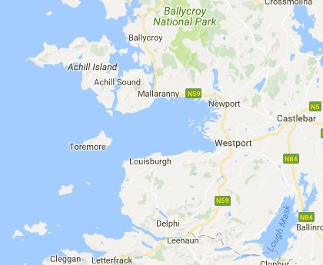
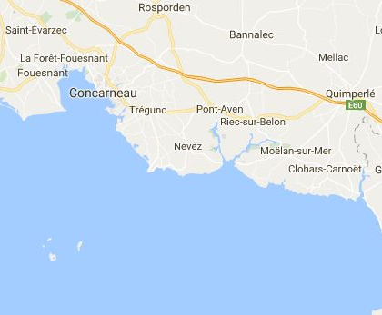
Maps

Slide 5
Statistics
Westport has a population of 6200 (Census 2016). Over previous 10 years the population of Westport grew by 1000 (Census 2006)
Westport has four churches
Roman Catholic
Church of Ireland
Evangelical
Pentecostal
Pont-Aven has a population of 2930 (2008). This has been declining steadily since World War II when it had its peak population of 4060 (1946).
Pont-Aven has one church
Roman Catholic

Slide 6
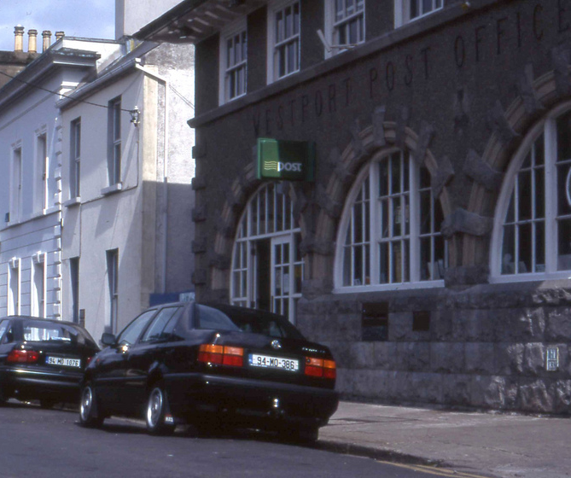
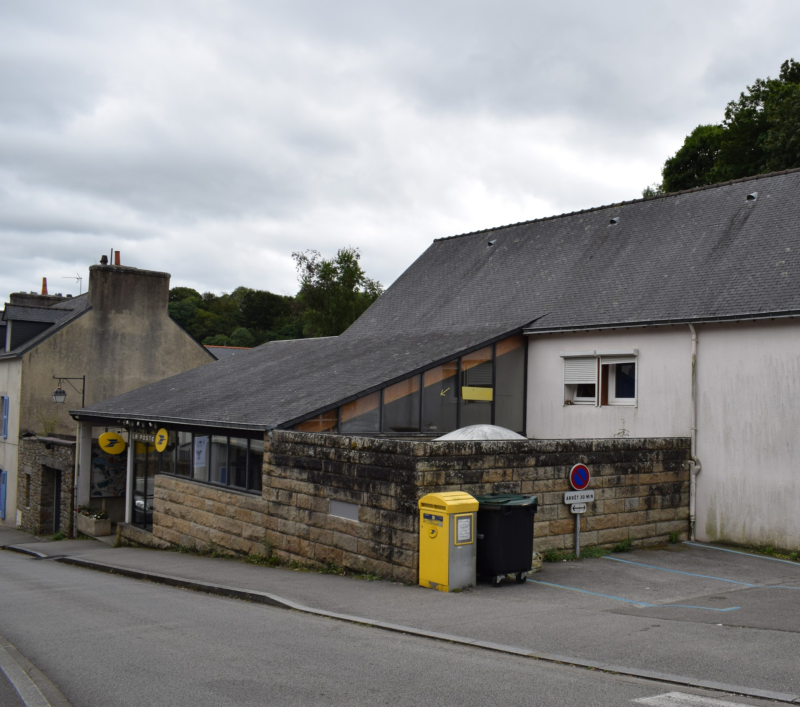
Post Office

Slide 7
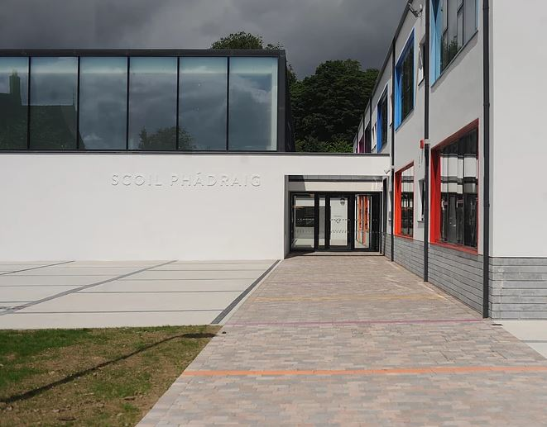
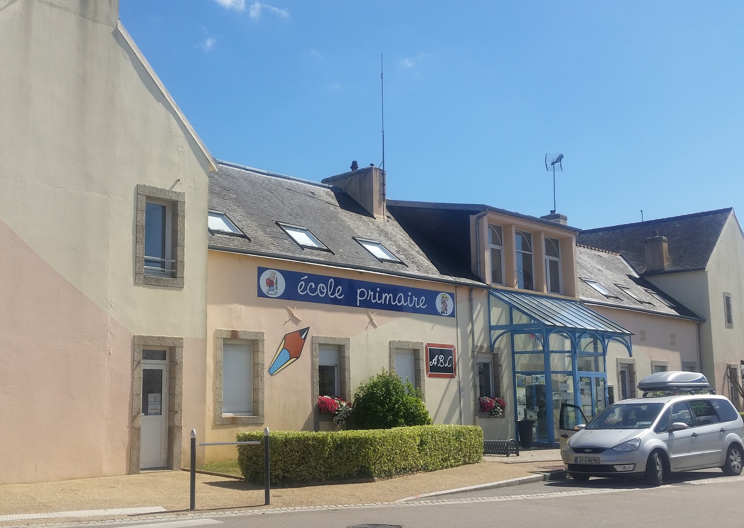
Primary School

Slide 8
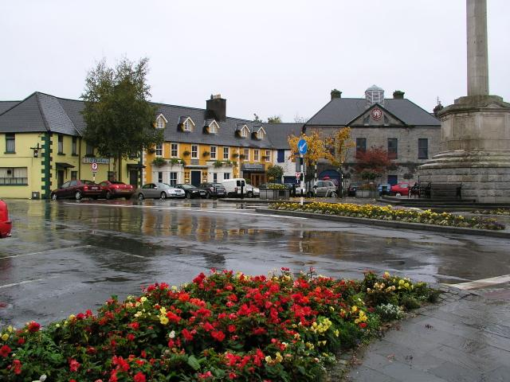
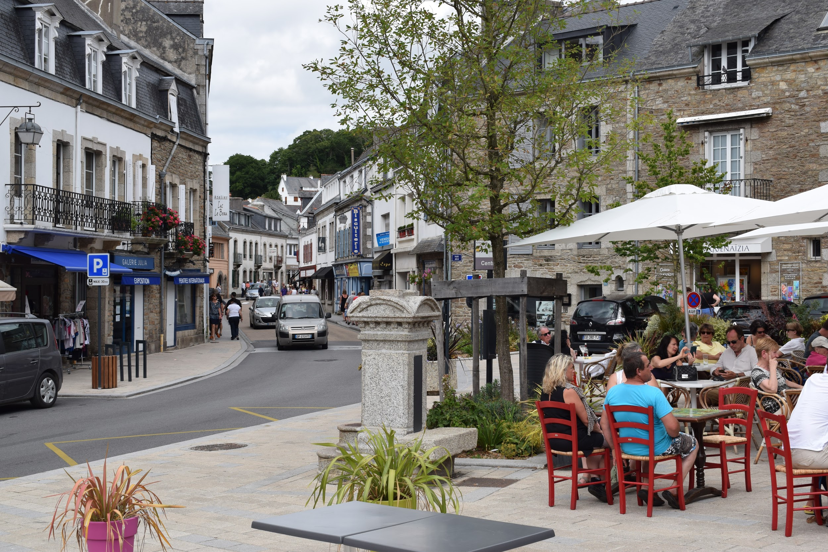
Westport Octagon - Pont-Aven Triangle

Slide 9
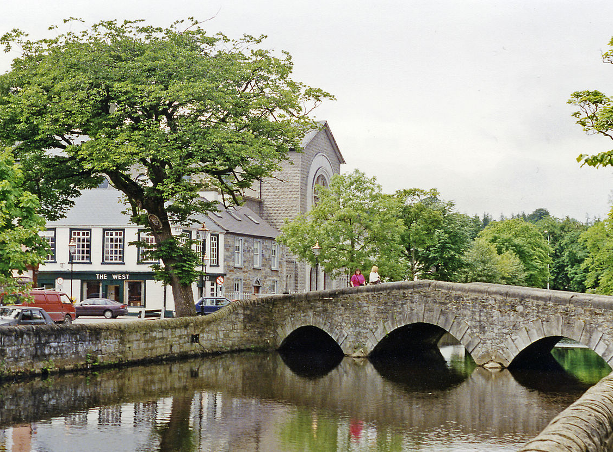

Rivers

Slide 10
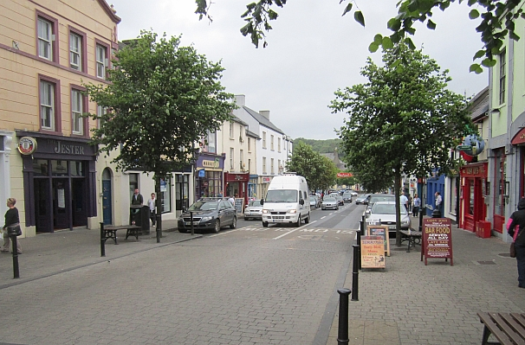
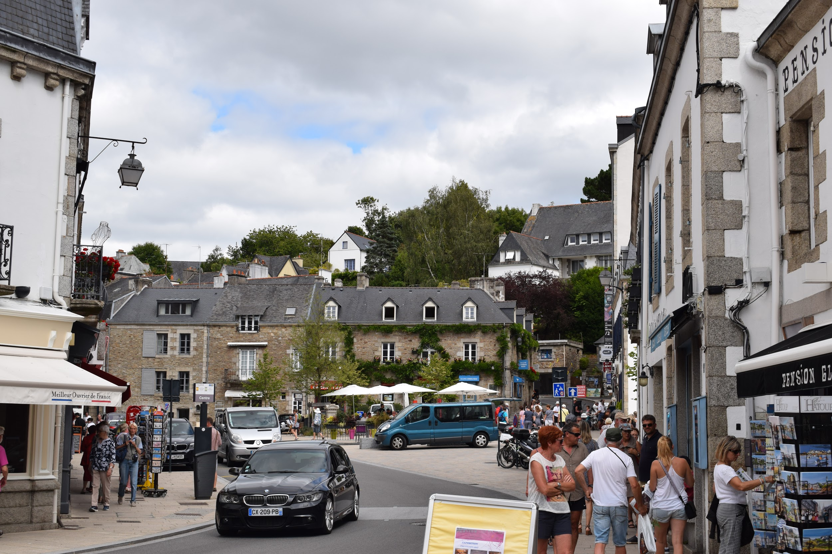
Main Street

Slide 11
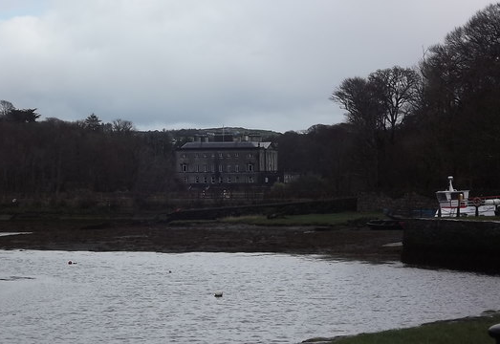

Port

Slide 12
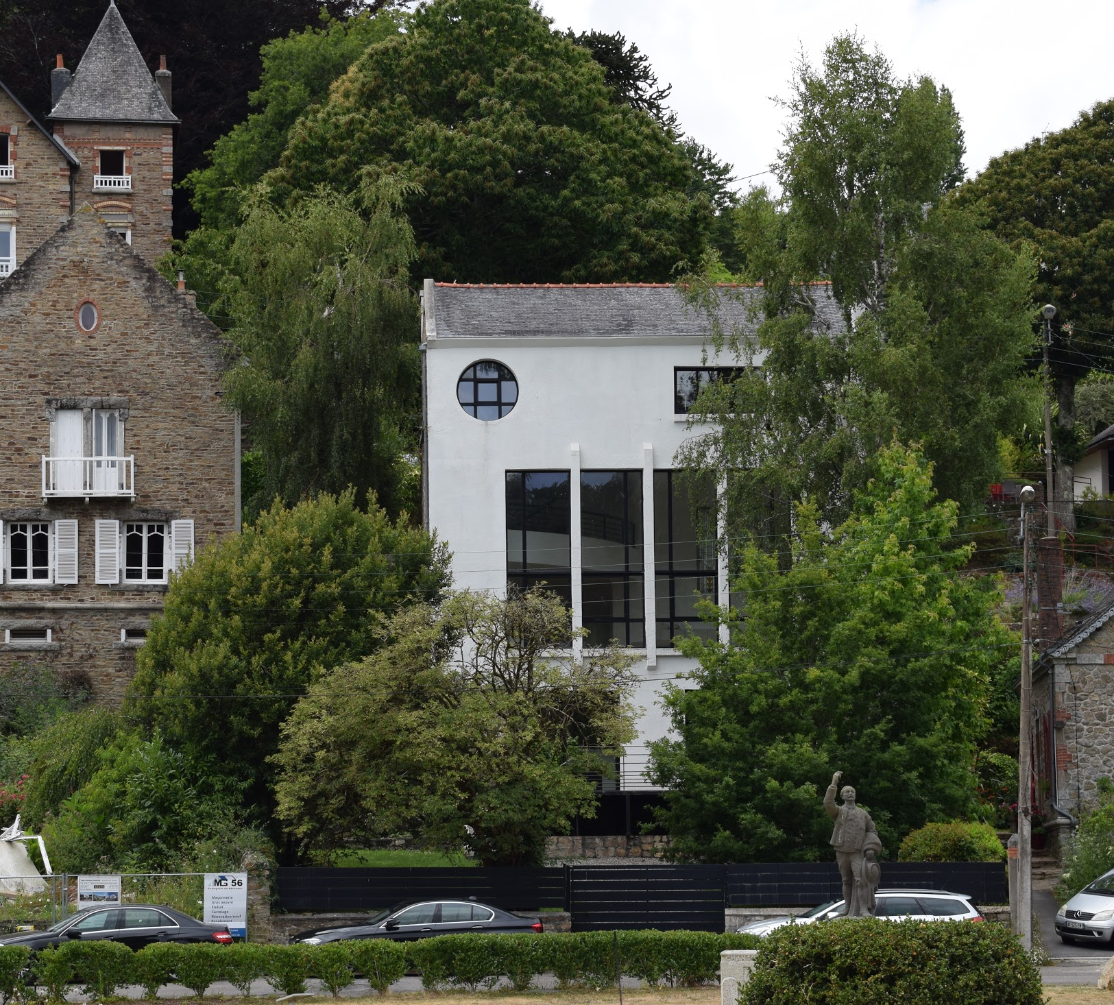

Modern Buildings

Slide 13
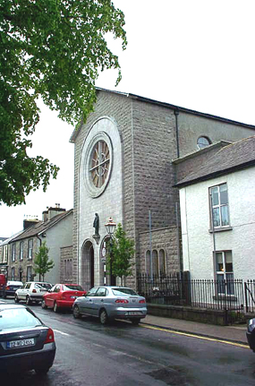
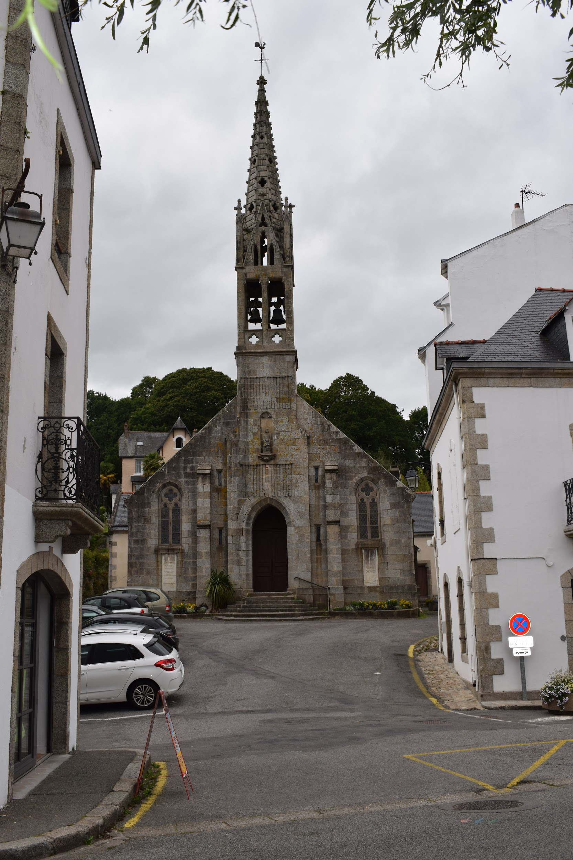
Roman Catholic Churches

Slide 14
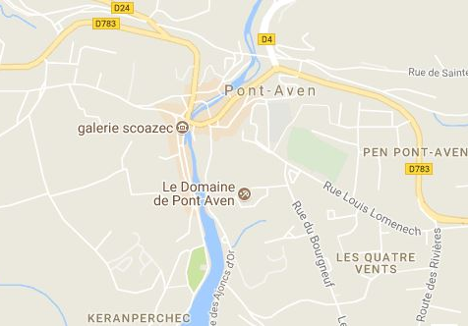
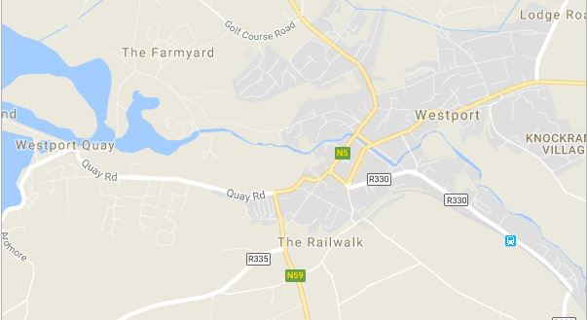
Town Plans

