Slide 1
LCHL Strand 5 Functions/Calculus Stationary Points
Turning Points, Points of Inflection, Horizontal Points of Inflection
Culan O’Meara – Ballinrobe Community School

Slide 2
Stationary Points
Three types:
  Turning points
  Inflection Points
  Horizontal Inflection Points

Slide 3
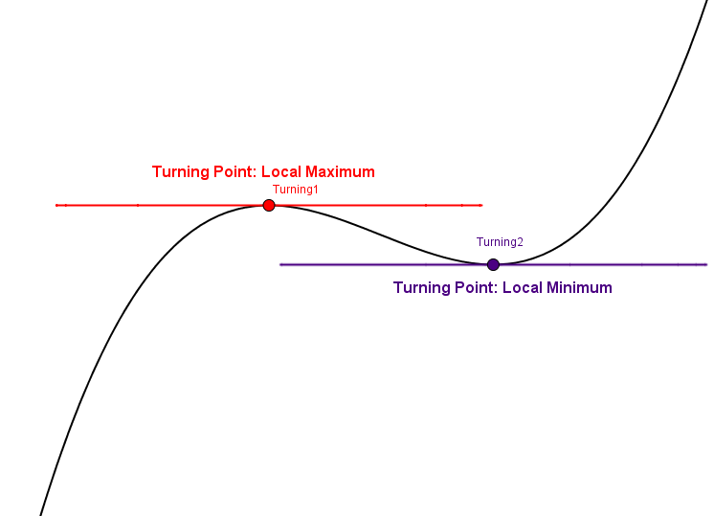
Turning Points
Can either be local maximum or minimum points of function f(x)
At both points, slope of f = 0 [f’(x) = 0]

Slide 4
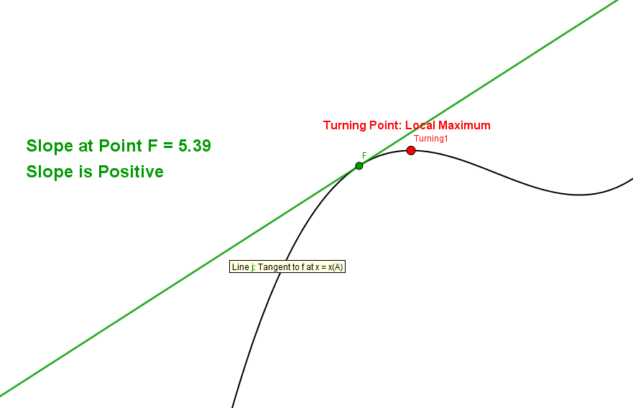
Turning Points
Local Maximum = Point where slope goes from positive to negative

Slide 5
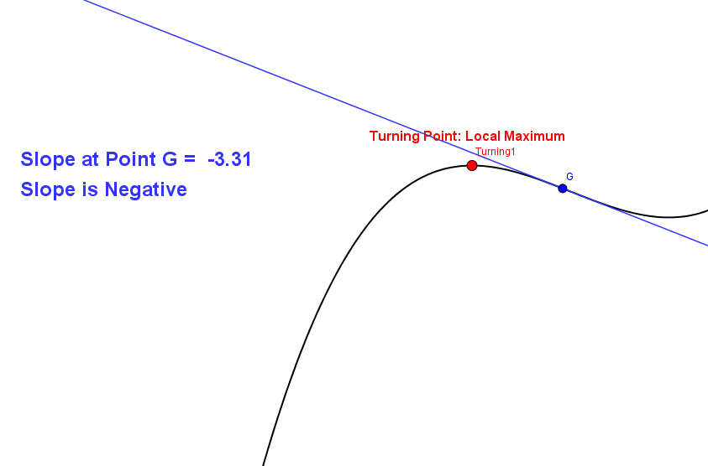
Turning Points
Local Maximum = Point where slope goes from positive to negative

Slide 6
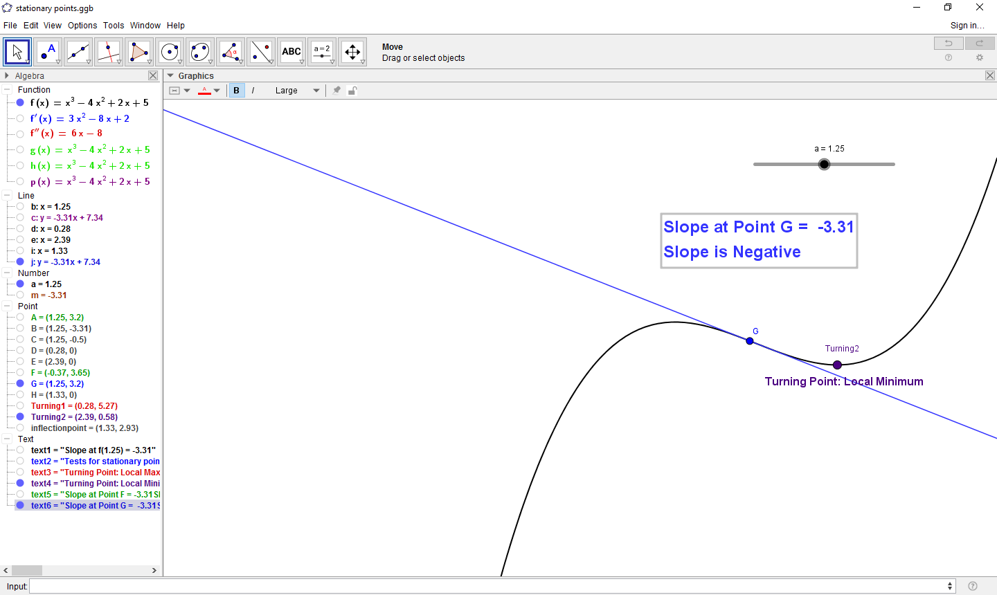
Turning Points
Local Minimum = Point where slope goes from negative to positive

Slide 7
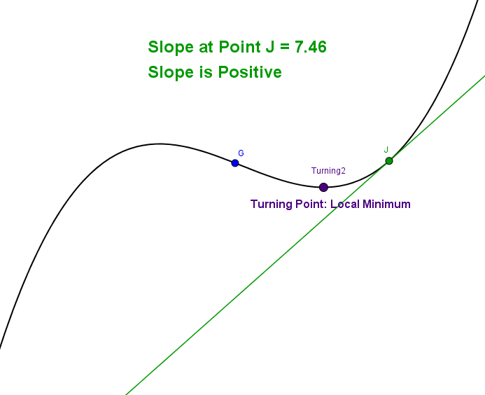
Turning Points
Local Minimum = Point where slope goes from negative to positive

Slide 8
Turning Points
Local Minimum = Point where slope goes from negative to positive

Slide 9
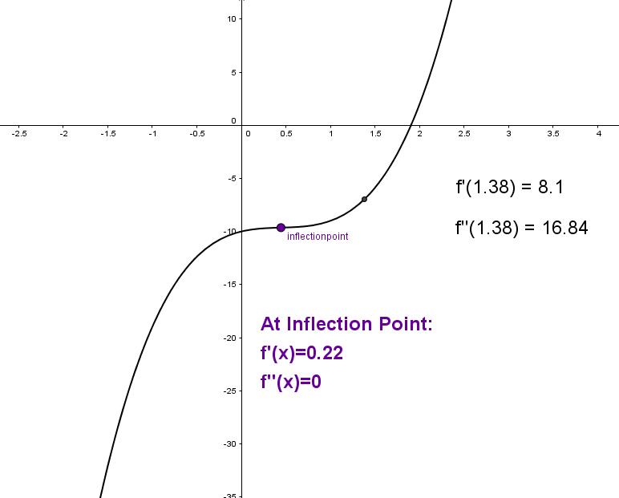
Turning Points
On this graph there are no turning points but it does have an inflection point

Slide 10
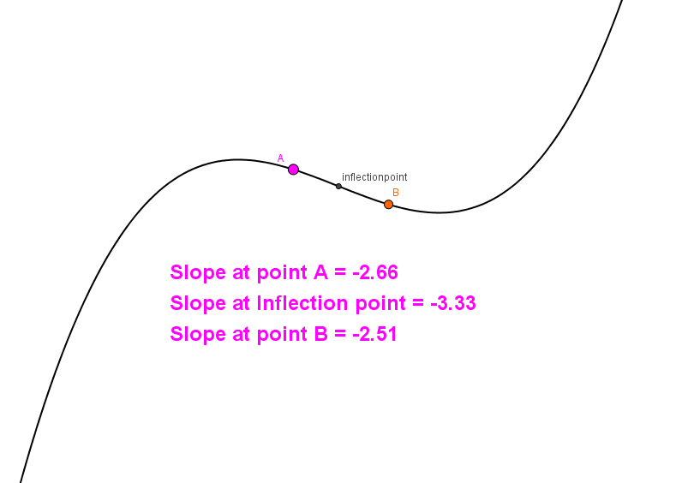
Inflection Points
Point where slope of curve goes from increasing in steepness to decreasing (or vice versa)

Slide 11
Inflection Points
Point where Slope of f’(x) =0 [f’’(x)=0]

Slide 12
Horizontal Inflection Points
Special case where the point is both a stationary point and an inflection point
Two conditions must be met:
  f’(x)=0
  f’’(x)=0

Slide 13
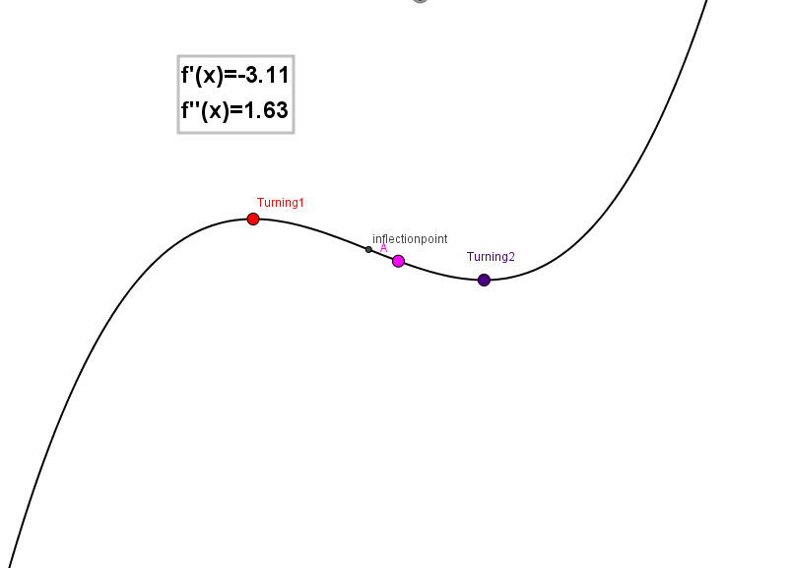
Horizontal Inflection Points
There are none on the graph we have been using as at no point is f’(x) = f’’(x)=0

Slide 14
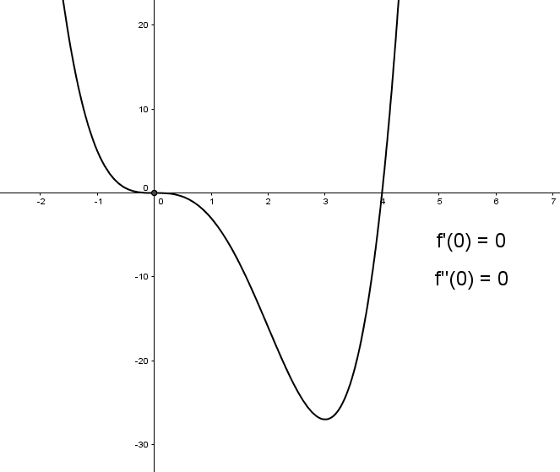
Horizontal Inflection Points
On this graph, both f’(x) and f’’(x) = 0 at x = 0

Slide 15
Turning Points
From earlier, this graph, this point can’t be a horizontal inflection point because it doesn’t meet the two conditions outlined

