Slide 1
LCHL Strand 5 Functions: Relations and Functions
Recap of functions and Vertical Line test for Functions
Culan O’Meara – Ballinrobe Community School

Slide 2
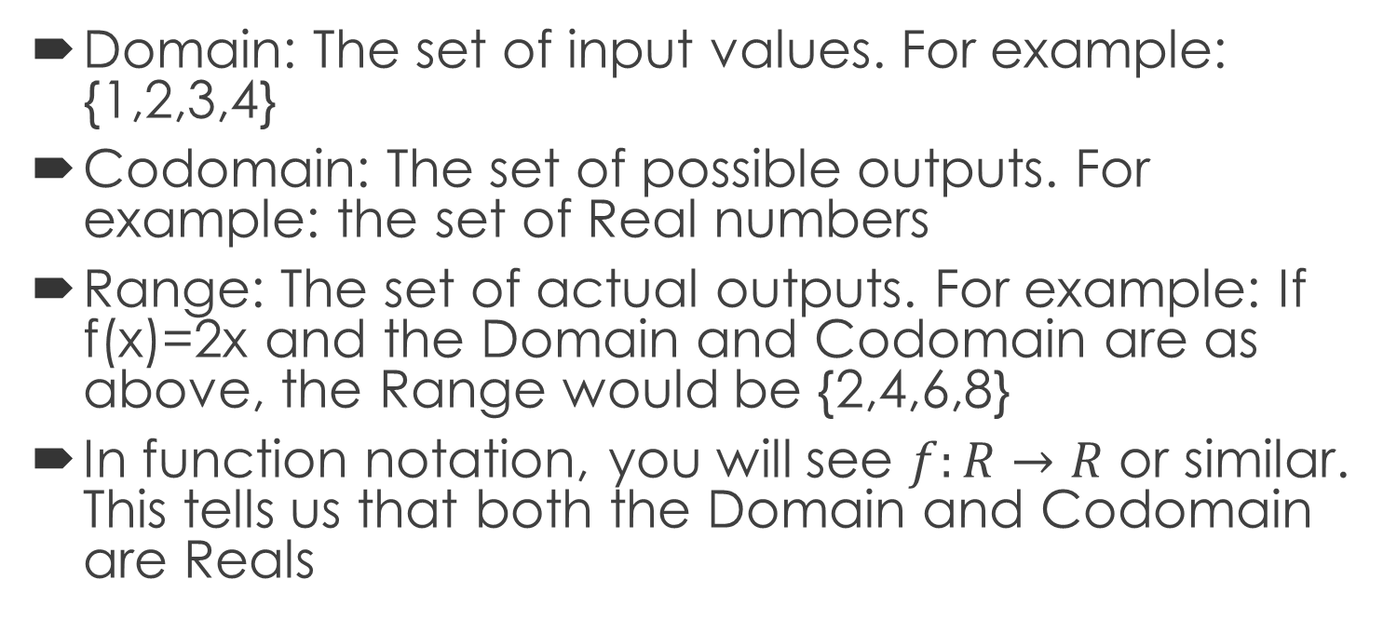
Recap: Functions
Domain: The set of input values. For example: {1,2,3,4}
Codomain: The set of possible outputs. For example: the set of Real numbers
Range: The set of actual outputs. For example: If f(x)=2x and the Domain and Codomain are as above, the Range would be {2,4,6,8}
In function notation, you will see $f:R→R$ or similar. This tells us that both the Domain and Codomain are Reals

Slide 3
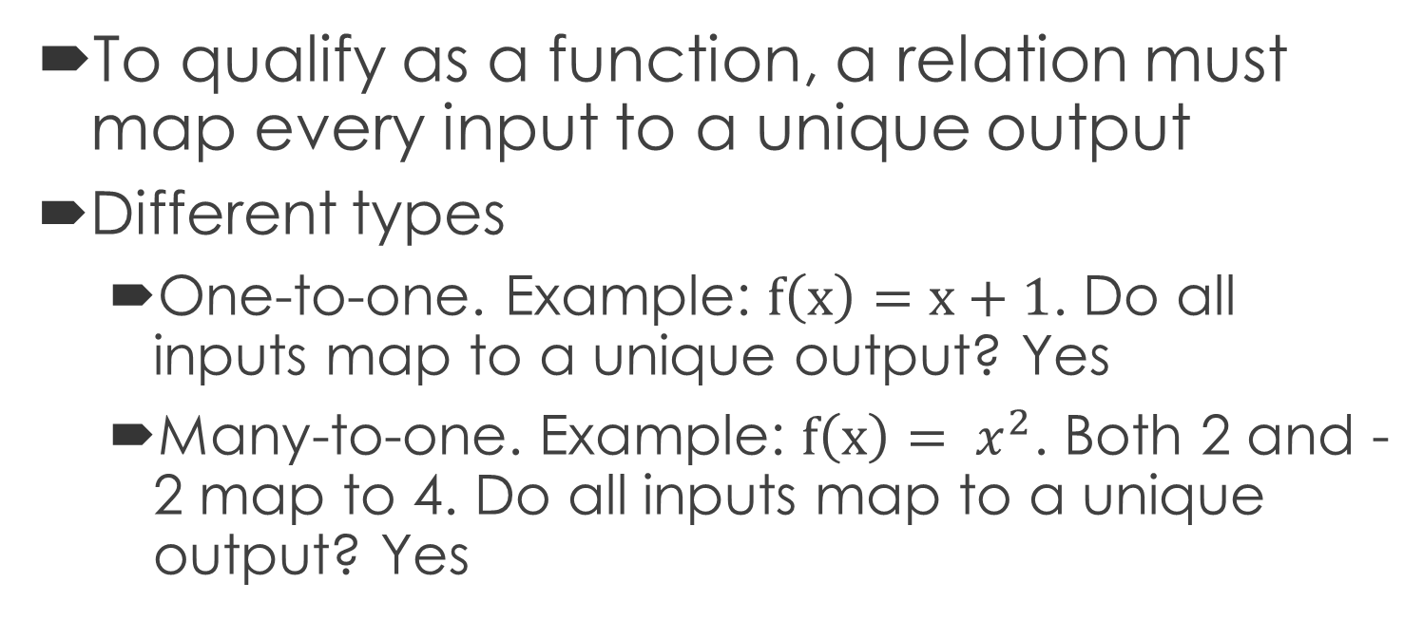
Recap: Functions
To qualify as a function, a relation must map every input to a unique output
Different types
  One-to-one. Example: $f\left(x\right)=x+1$. Do all inputs map to a unique output? Yes
  Many-to-one. Example: $f\left(x\right)= x^{2}$. Both 2 and -2 map to 4. Do all inputs map to a unique output? Yes

Slide 4
Recap: Functions
You can have a relation that is not a function. Any circle is not a function because one input can be mapped to more than one output
This is an example of a “One-to-many” case. Where this exists, it is not a function

Slide 5
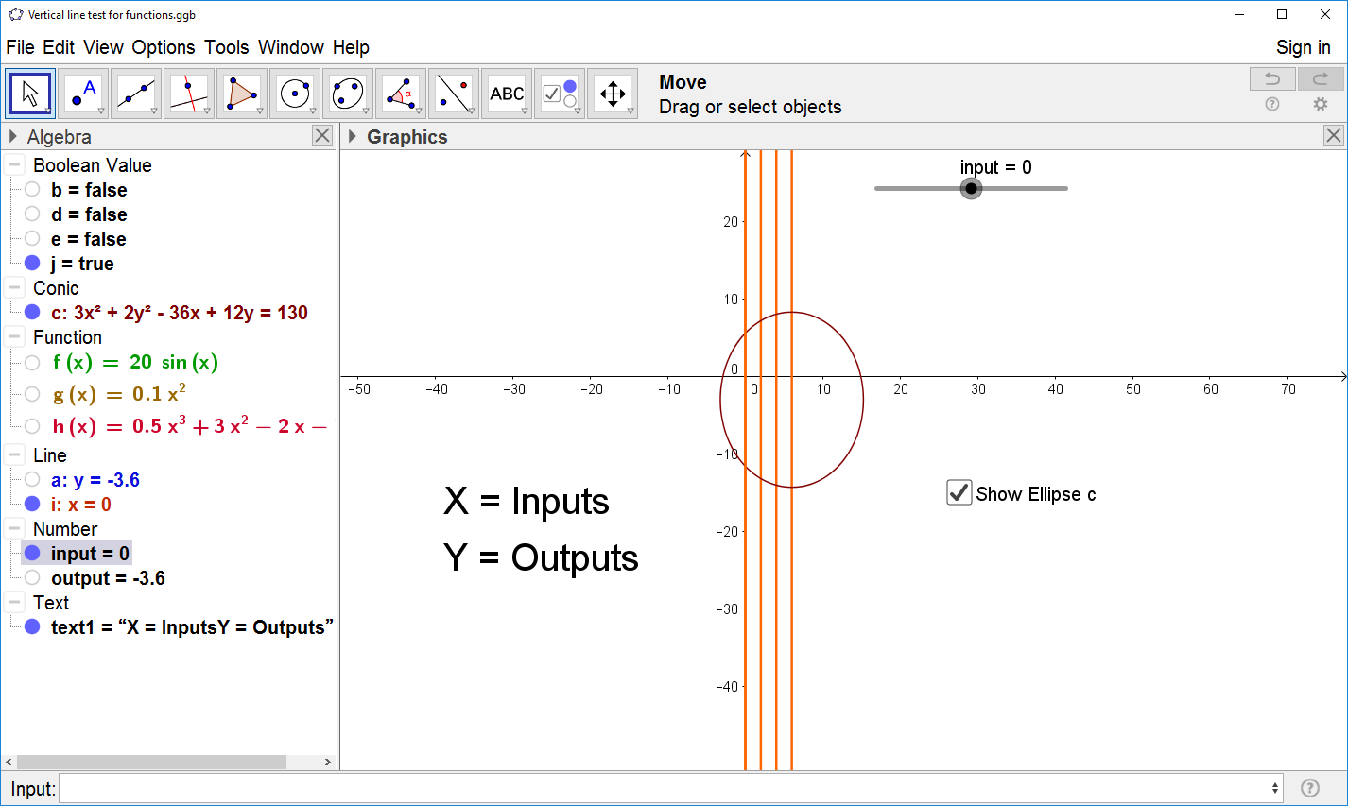
Vertical Line test
When you are given a graph of a relation and you need to determine whether it’s a function or not, you can use the Vertical Line Test
If you draw a vertical line through various parts of the relation(as shown) and your line crosses it more than once, then it is a one-to-many relationship which is not a function
In the diagram, this is NOT a function

Slide 6
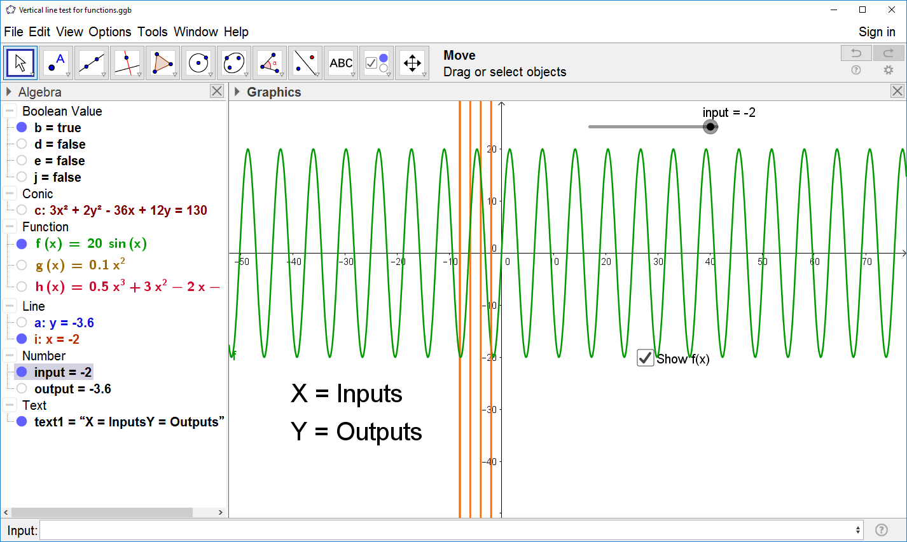
Vertical Line test
In the diagram, this IS a function
At no point do any of our vertical lines cross the graph more than once
It’s the trigonometric function 20sin(x)

Slide 7
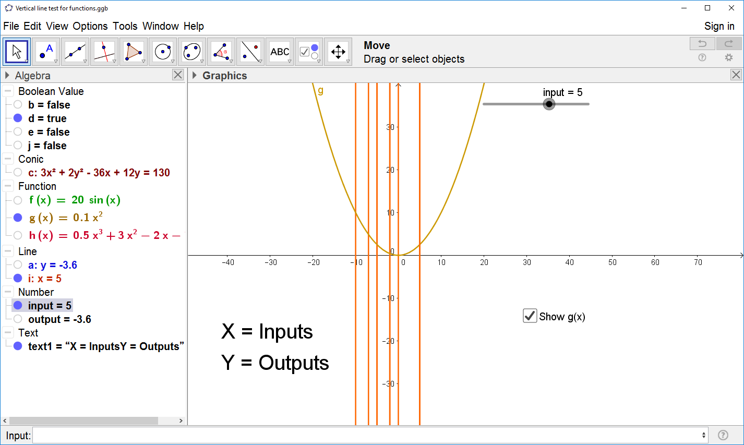
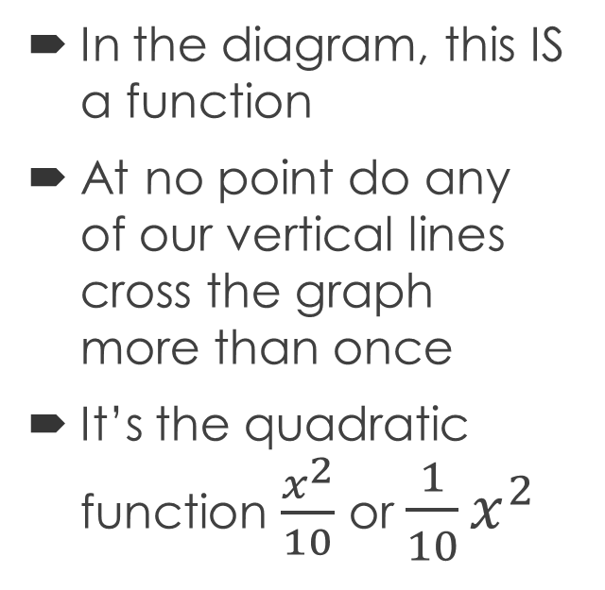
Vertical Line test
In the diagram, this IS a function
At no point do any of our vertical lines cross the graph more than once
It’s the quadratic function $\frac{x^{2}}{10}$ or $\frac{1}{10}x^{2}$

