Slide 1

SNAP!
A game of precision, quick reaction and observation.
Uimhreacha

Slide 2
SNAP! Teacher Guide
Print out one set of cards for each player.
Laminate cards.
Shuffle cards.
Divide class into groups of 4-6 students.
Give each student 10 cards.
Players must not look at their cards.
Demonstrate the game to students using one group of students.
When cards match, student must shout SNAP and the NUMBER on the matched cards.

Slide 3
SNAP! Student Rules
You must not look at cards handed to you.
First player, place your top card, face up onto the middle of your table.
Second player, place your top card, face up onto the first card.
Third player, place your top card, face up onto the pile of cards in the middle of the table.
Fourth player, place your top card, face up onto the pile of cards in the middle of the table.
Repeat until two cards match, any player can shout SNAP and place hand over the cards before another card is added.
Player who shouts SNAP can add the entire pile of cards to their pack.

Slide 4
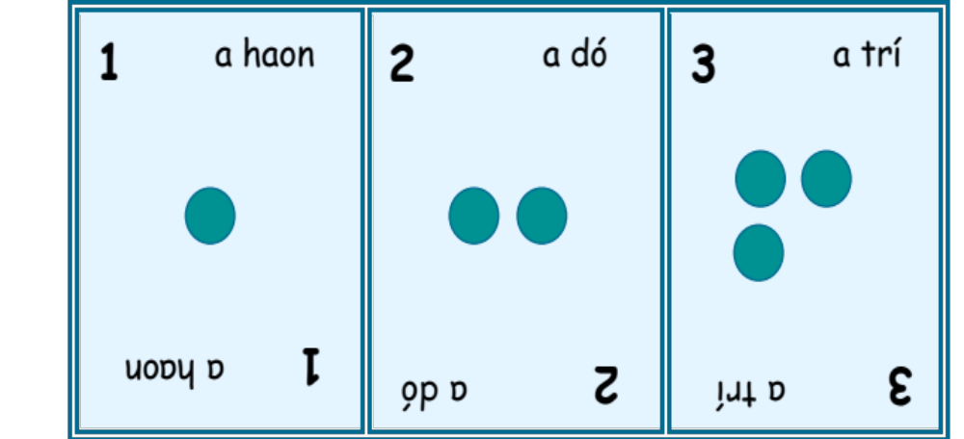

Slide 5
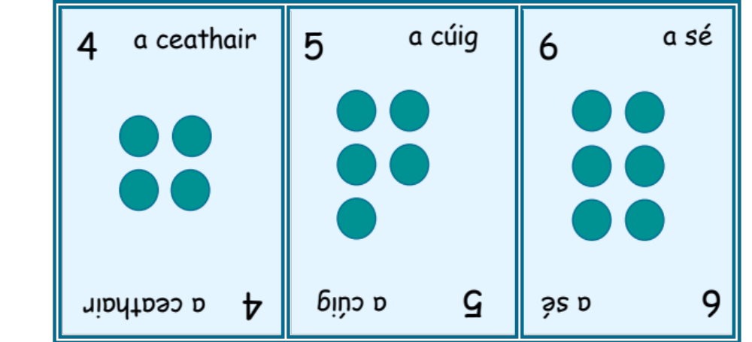

Slide 6
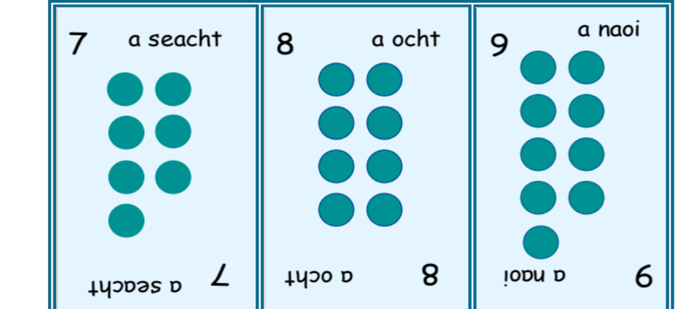

Slide 7
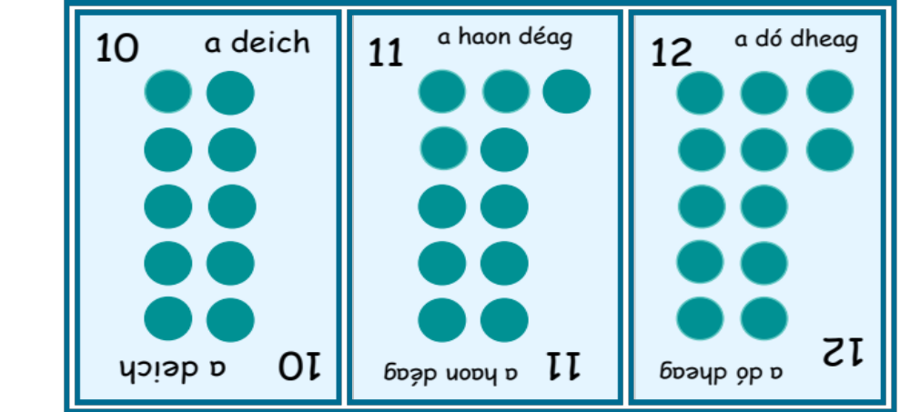

Slide 8
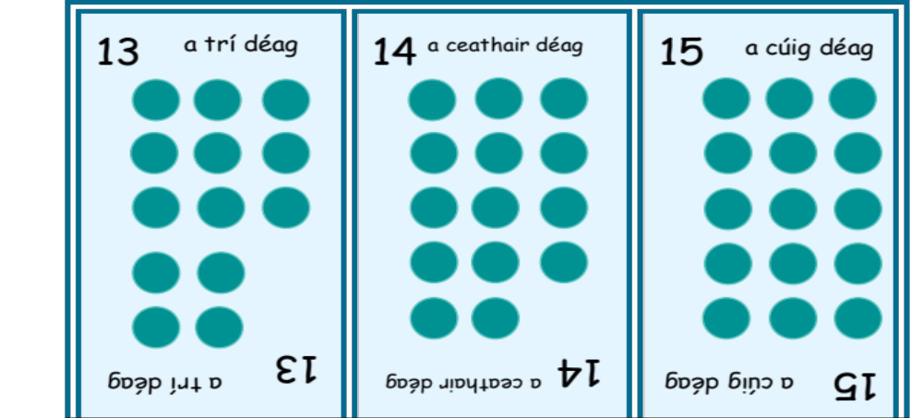

Slide 9
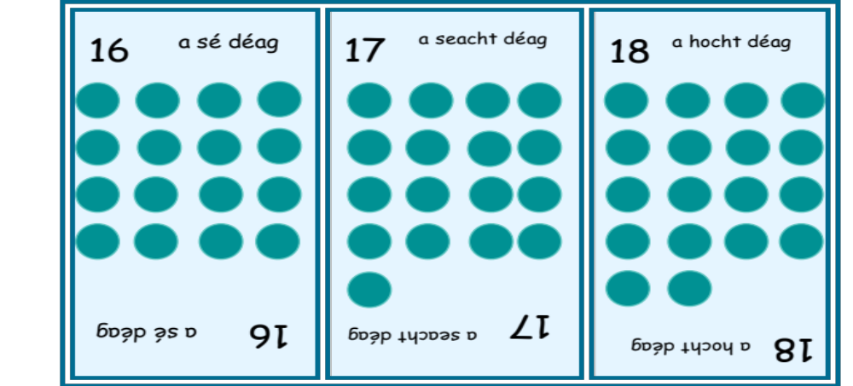

Slide 10
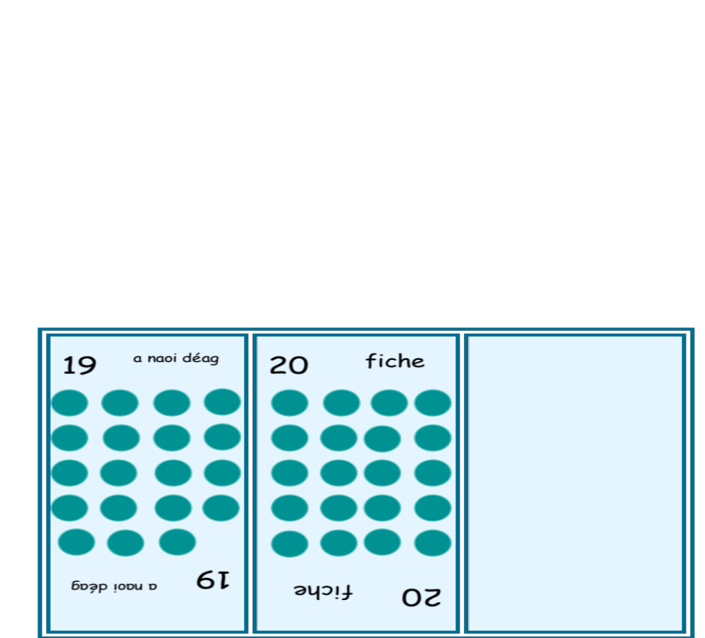

Slide 11
SNAP! Calculations
Bonds to 10: Addition
This time, students can only shout SNAP if the numbers on the cards add up to 10.
SNAP

Slide 12
SNAP! Calculations
Bonds to 10: Subtraction
This time, students can only shout SNAP if the numbers on the cards add up to 10.
SNAP

