Slide 1
LCHL Strand 5 Functions:
Injective, Surjective and Bijective Functions
Culan O’Meara – Ballinrobe Community School

Slide 2
Relations and Functions
Relations
Injective
Bijective
Surjective
Functions

Slide 3
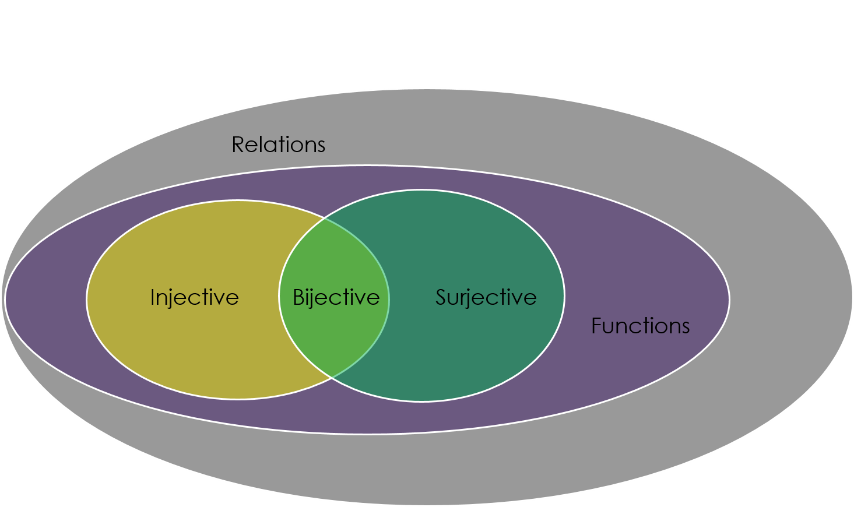
Relations and Functions
If we have the set of relations, within that set we have relations that are not functions and ones that are
Within the set of functions, we have some that are functions but neither injective, surjective nor bijective
We then have functions that are both injective and surjective which are called bijective

Slide 4
Injective Functions
Function f(x)=2x
1
2
3
4
2
4
6
8
1
These are functions who have one-to-one relationships between inputs and outputs
All unique inputs must be mapped to a unique output
In the diagram, we have f(x)=2x with Domain {1,2,3,4}, Codomain {1,2,4,6,8,19} and Range {2,4,6,8}. All inputs map onto one and only one output and vice versa
For injectivity, It’s not relevant that 1 and 19 are unmapped
Codomain ≠ Range
19
Domain
Codomain

Slide 5
Surjective Functions
Function f(x)=2x
1
2
3
4
2
4
6
8
1
These are functions who have an ‘onto’ relationship between inputs and outputs
All elements of the Codomain must be ‘mapped onto’.
If Surjective then Codomain = Range
In the diagram from last slide, we can see that 1 and 19 are NOT ‘mapped onto’ so therefore this example is not surjective
19
Domain
Codomain

Slide 6
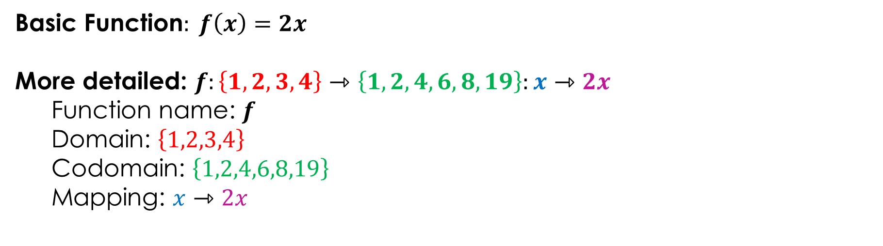
Surjective Functions
When determining whether a function is surjective or not, it is very important you are aware of what the Domain and Codomain are
These are given in the more formal description of the function
Basic Function$: f\left(x\right)=2x$
More detailed: $f:\left\{1,2,3,4\right\}⇾\left\{1,2,4,6,8,19\right\}:x⇾2x$
  Function name: $f$
  Domain: $\left\{1,2,3,4\right\}$
  Codomain: $\left\{1,2,4,6,8,19\right\}$
  Mapping: $x⇾2x$

Slide 7
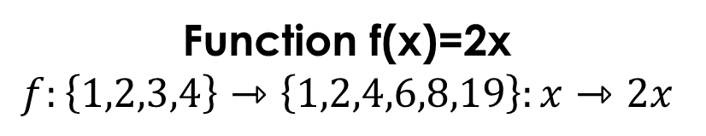
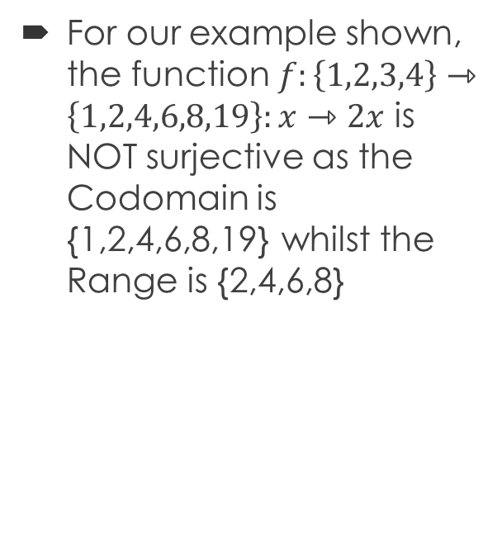
Surjective Functions
Function f(x)=2x
$$f:\left\{1,2,3,4\right\}⇾\left\{1,2,4,6,8,19\right\}:x⇾2x$$
1
2
3
4
2
4
6
8
1
For our example shown, the function $f:\left\{1,2,3,4\right\}⇾\left\{1,2,4,6,8,19\right\}:x⇾2x$ is NOT surjective as the Codomain is {1,2,4,6,8,19} whilst the Range is {2,4,6,8}
19
Domain
Codomain

Slide 8
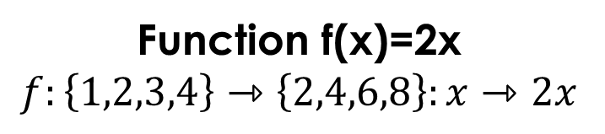
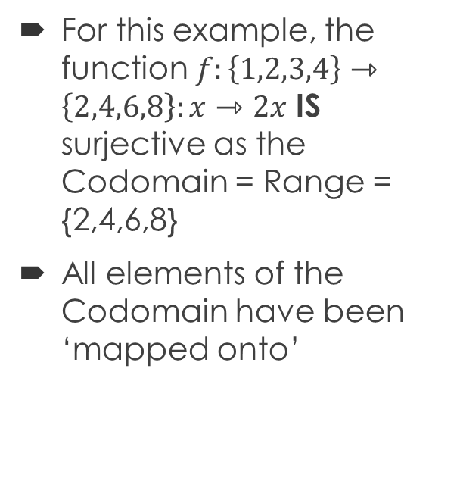
Surjective Functions
Function f(x)=2x
$$f:\left\{1,2,3,4\right\}⇾\left\{2,4,6,8\right\}:x⇾2x$$
1
2
3
4
2
4
6
8
For this example, the function $f:\left\{1,2,3,4\right\}⇾\left\{2,4,6,8\right\}:x⇾2x$ IS surjective as the Codomain = Range = {2,4,6,8}
All elements of the Codomain have been ‘mapped onto’
Domain
Codomain

Slide 9
Bijective Functions
Function f(x)=2x
$$f:\left\{1,2,3,4\right\}⇾\left\{2,4,6,8\right\}:x⇾2x$$
1
2
3
4
2
4
6
8
Bijective functions are those which are BOTH injective AND surjective.
The example shown IS bijective
Injective? YES
Surjective? YES
Therefore it must also be bijective
Domain
Codomain

