Slide 1
LCHL Strand 5 Functions:
Horizontal Line Test for Injectivity and Surjectivity
Culan O’Meara – Ballinrobe Community School

Slide 2
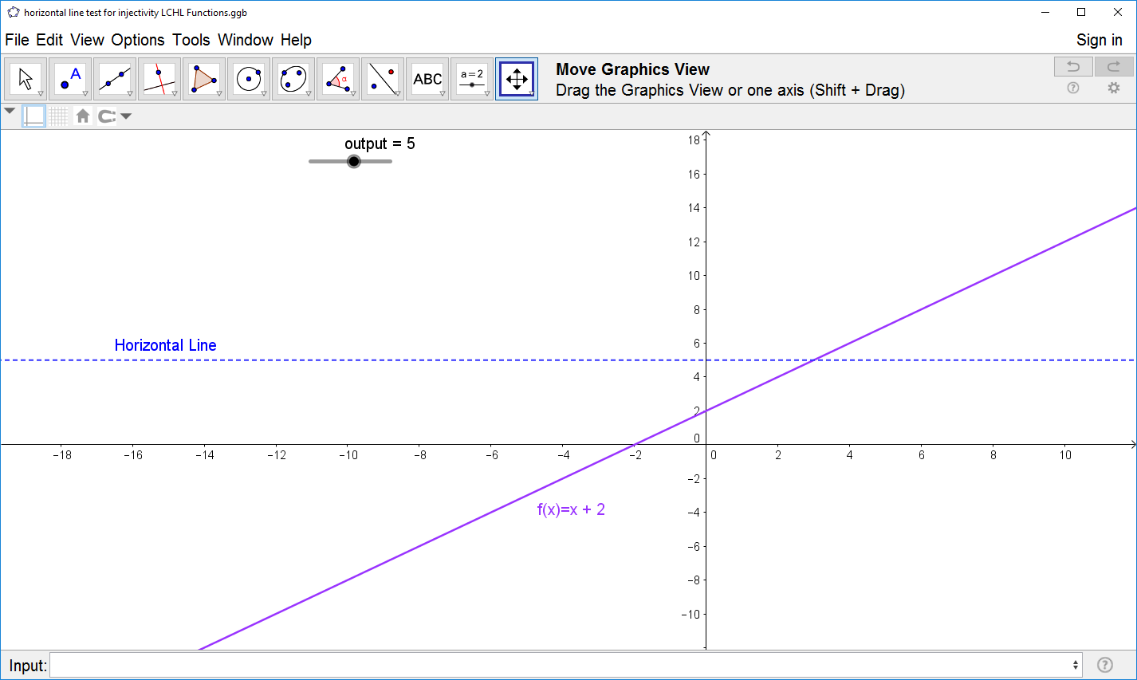
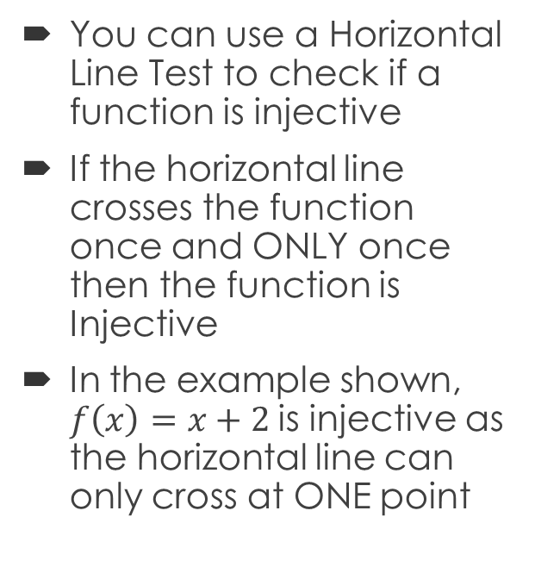
Horizontal Line Testing for Injectivity
You can use a Horizontal Line Test to check if a function is injective
If the horizontal line crosses the function once and ONLY once then the function is Injective
In the example shown, $f\left(x\right)=x+2$is injective as the horizontal line can only cross at ONE point

Slide 3
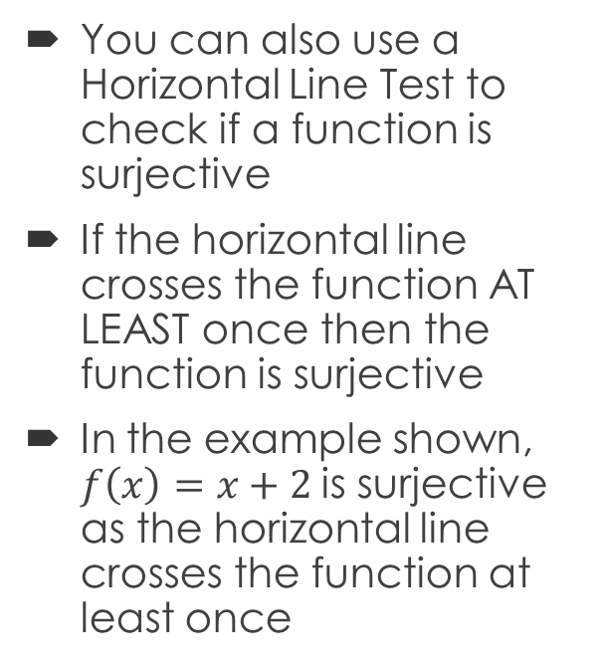
Horizontal Line Testing for Surjectivity
You can also use a Horizontal Line Test to check if a function is surjective
If the horizontal line crosses the function AT LEAST once then the function is surjective
In the example shown, $f\left(x\right)=x+2$is surjective as the horizontal line crosses the function at least once

Slide 4
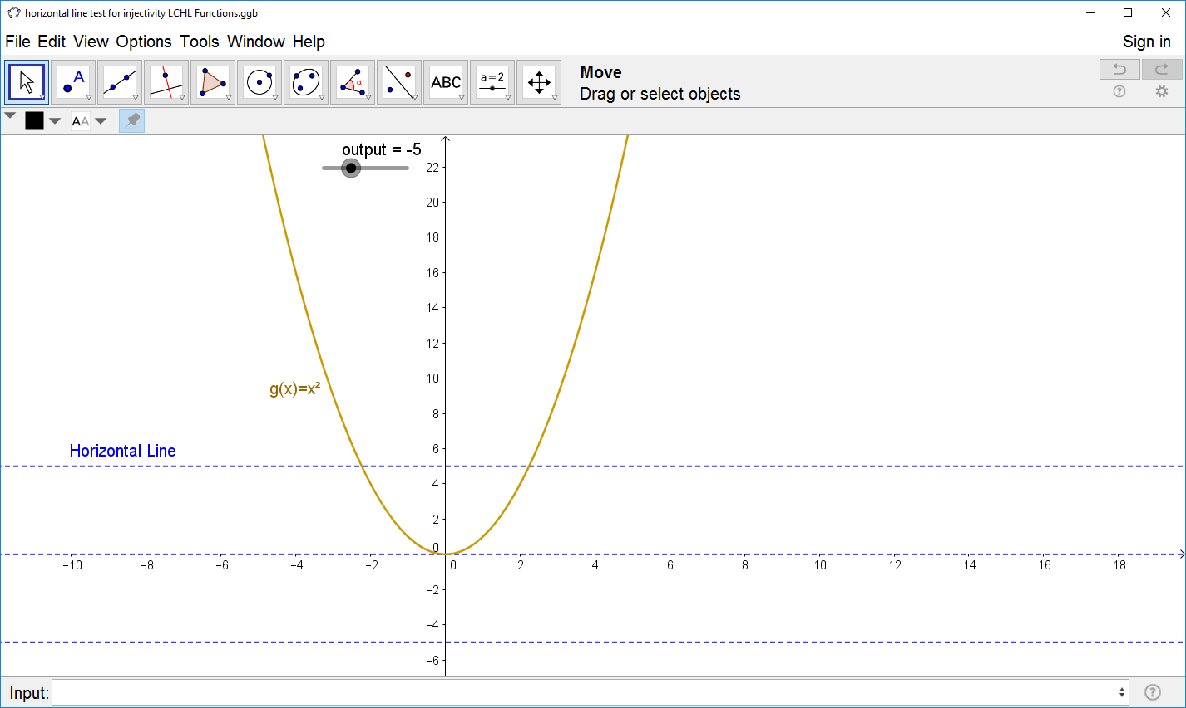
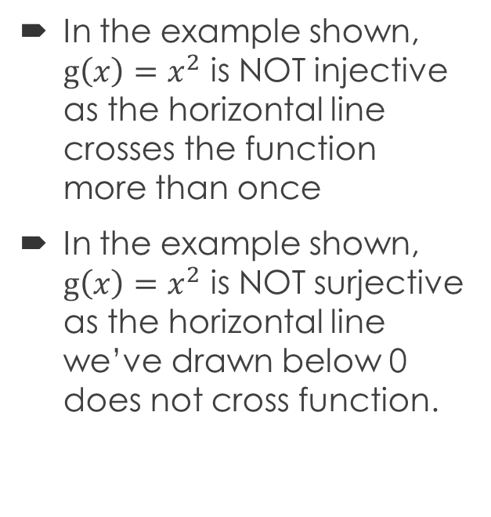
Horizontal Line Testing
In the example shown, $g\left(x\right)=x^{2}$ is NOT injective as the horizontal line crosses the function more than once
In the example shown, $g\left(x\right)=x^{2}$ is NOT surjective as the horizontal line we’ve drawn below 0 does not cross function.

Slide 5
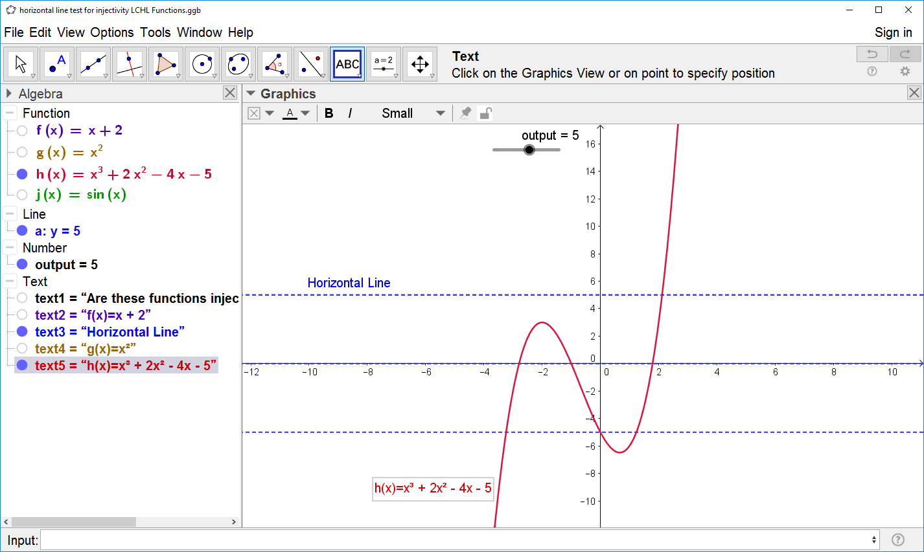
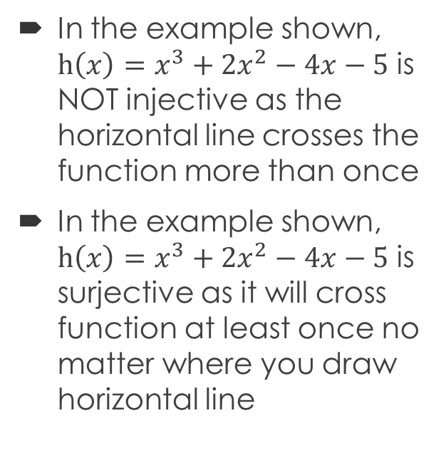
Horizontal Line Testing
In the example shown, $h\left(x\right)={x^{3}+2x}^{2}−4x−5$ is NOT injective as the horizontal line crosses the function more than once
In the example shown, $h\left(x\right)={x^{3}+2x}^{2}−4x−5$ is surjective as it will cross function at least once no matter where you draw horizontal line

