Slide 1
LCHL Strand 5 Functions:
Transformations: Linear Functions
Culan O’Meara – Ballinrobe Community School

Slide 2
Functions: Key words Recap
Variable: A symbol(often x,y,z) we use to describe a number we don’t know the value of or where value can change
Constant: A number that doesn’t change e.g 11, -2, 54. Not attached to any variable.
Coefficient: this is a number attached to a variable(normally in front) e.g. with the term 2x….2 is the coefficient of x
Y-intercept: Where the function crosses y-axis
X-intercept: Where function crosses x-axis…also called a Root

Slide 3
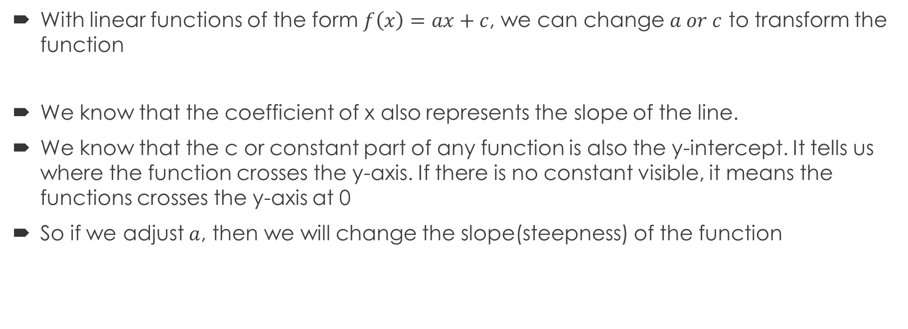
Linear Functions: Transformations
With linear functions of the form $f\left(x\right)=ax+c$, we can change $a or c$ to transform the function
We know that the coefficient of x also represents the slope of the line.
We know that the c or constant part of any function is also the y-intercept. It tells us where the function crosses the y-axis. If there is no constant visible, it means the functions crosses the y-axis at 0
So if we adjust $a$, then we will change the slope(steepness) of the function

Slide 4
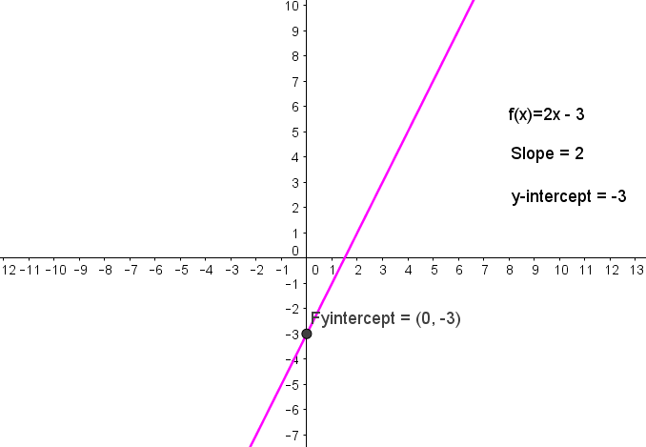
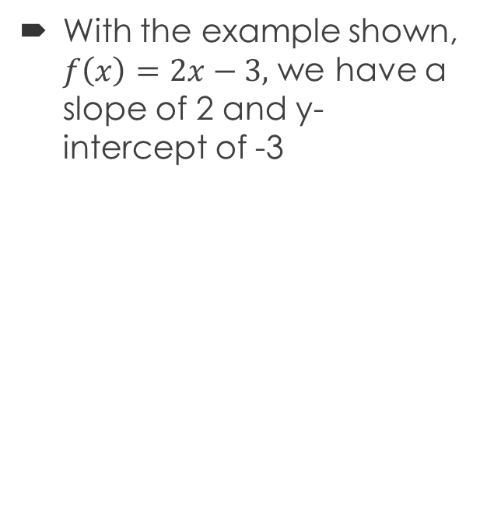
Linear Functions: Transformations
With the example shown, $f\left(x\right)=2x−3,$ we have a slope of 2 and y-intercept of -3

Slide 5
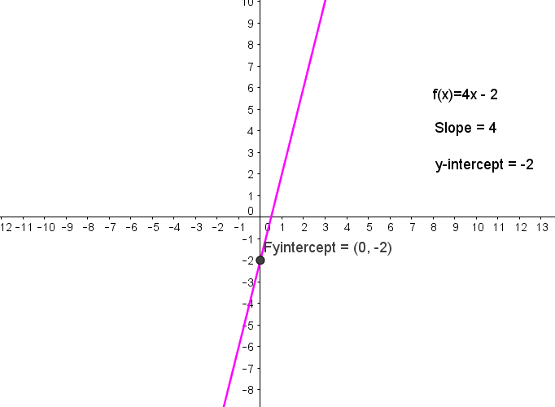
Linear Functions: Transformations
When we increase a, the x-coefficient, we can see that the function is steeper.
When we change c, the line moves up

Slide 6
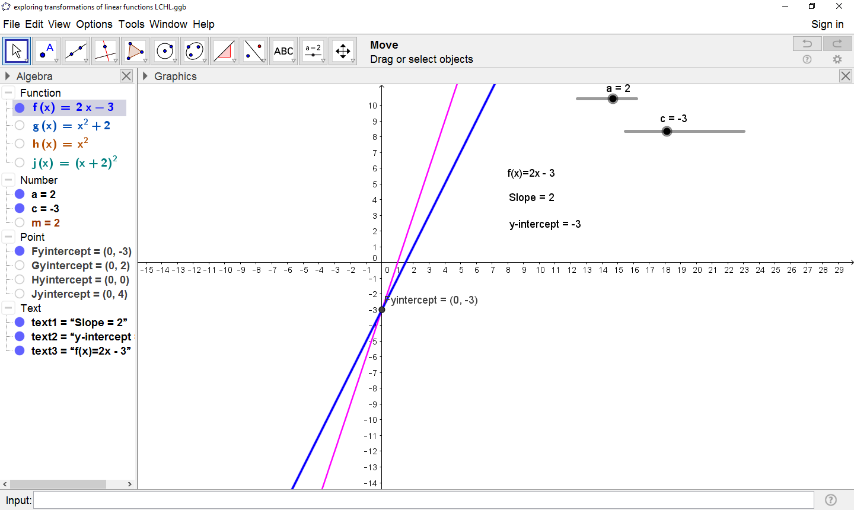
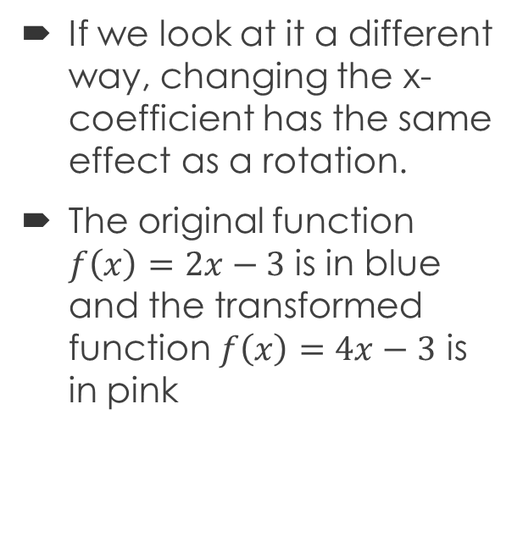
Linear Functions: Transformations
If we look at it a different way, changing the x-coefficient has the same effect as a rotation.
The original function $f\left(x\right)=2x−3$ is in blue and the transformed function $f\left(x\right)=4x−3$ is in pink

Slide 7
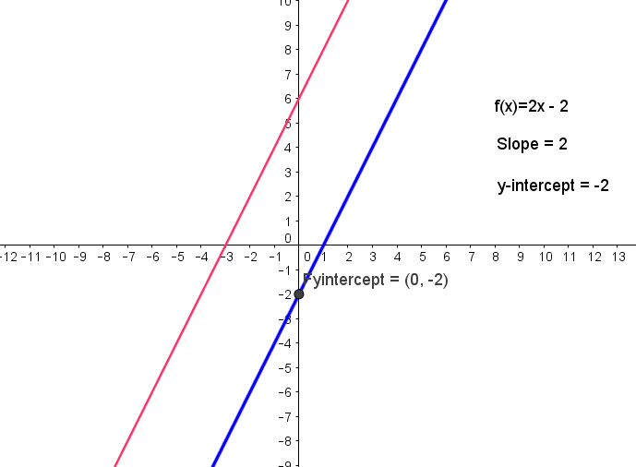
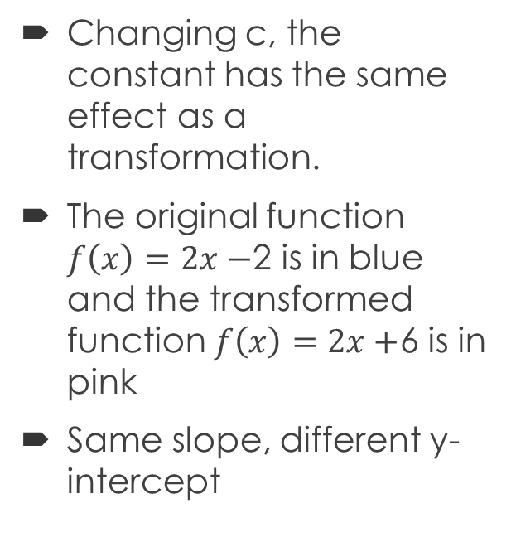
Linear Functions: Transformations
Changing c, the constant has the same effect as a transformation.
The original function $f\left(x\right)=2x−$2 is in blue and the transformed function $f\left(x\right)=2x+$6 is in pink
Same slope, different y-intercept

