Slide 1
LCHL Strand 5 Functions:
Transformations: Quadratic Functions
Culan O’Meara – Ballinrobe Community School

Slide 2
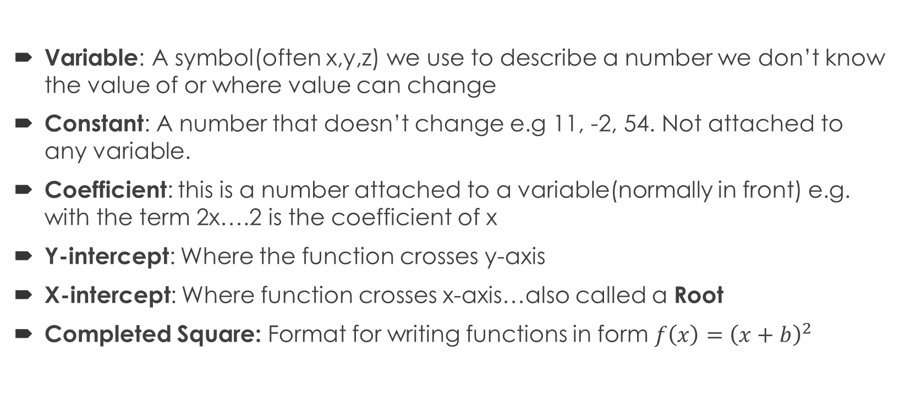
Functions: Key words Recap
Variable: A symbol(often x,y,z) we use to describe a number we don’t know the value of or where value can change
Constant: A number that doesn’t change e.g 11, -2, 54. Not attached to any variable.
Coefficient: this is a number attached to a variable(normally in front) e.g. with the term 2x….2 is the coefficient of x
Y-intercept: Where the function crosses y-axis
X-intercept: Where function crosses x-axis…also called a Root
Completed Square: Format for writing functions in form $f\left(x\right)={\left(x+b\right)}^{2}$

Slide 3
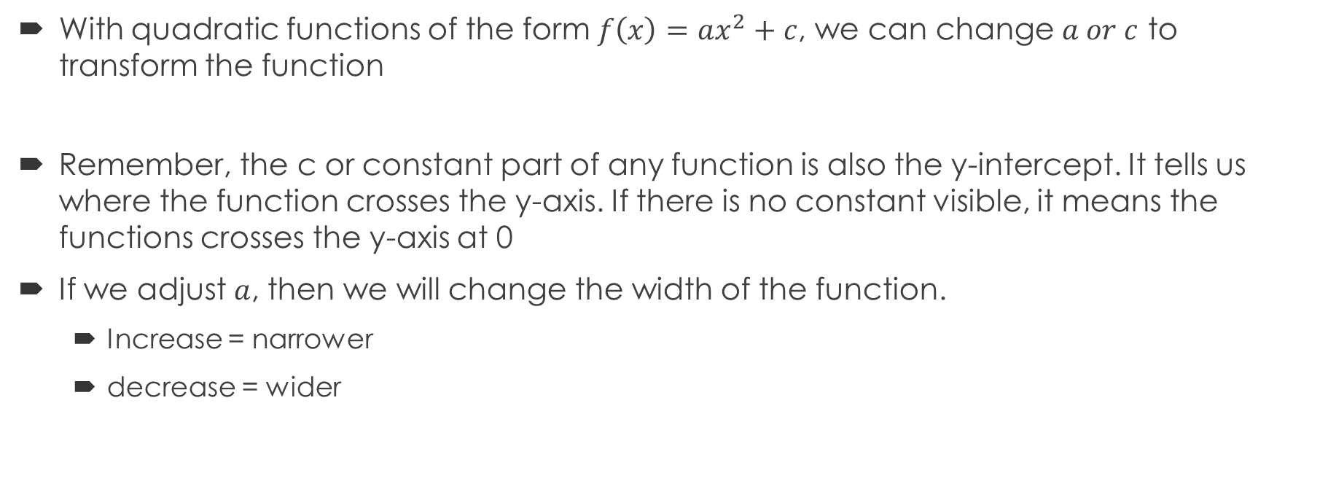
Quadratic Functions: Transformations
With quadratic functions of the form $f\left(x\right)=ax^{2}+c$, we can change $a or c$ to transform the function
Remember, the c or constant part of any function is also the y-intercept. It tells us where the function crosses the y-axis. If there is no constant visible, it means the functions crosses the y-axis at 0
If we adjust $a$, then we will change the width of the function.
  Increase = narrower
  decrease = wider

Slide 4
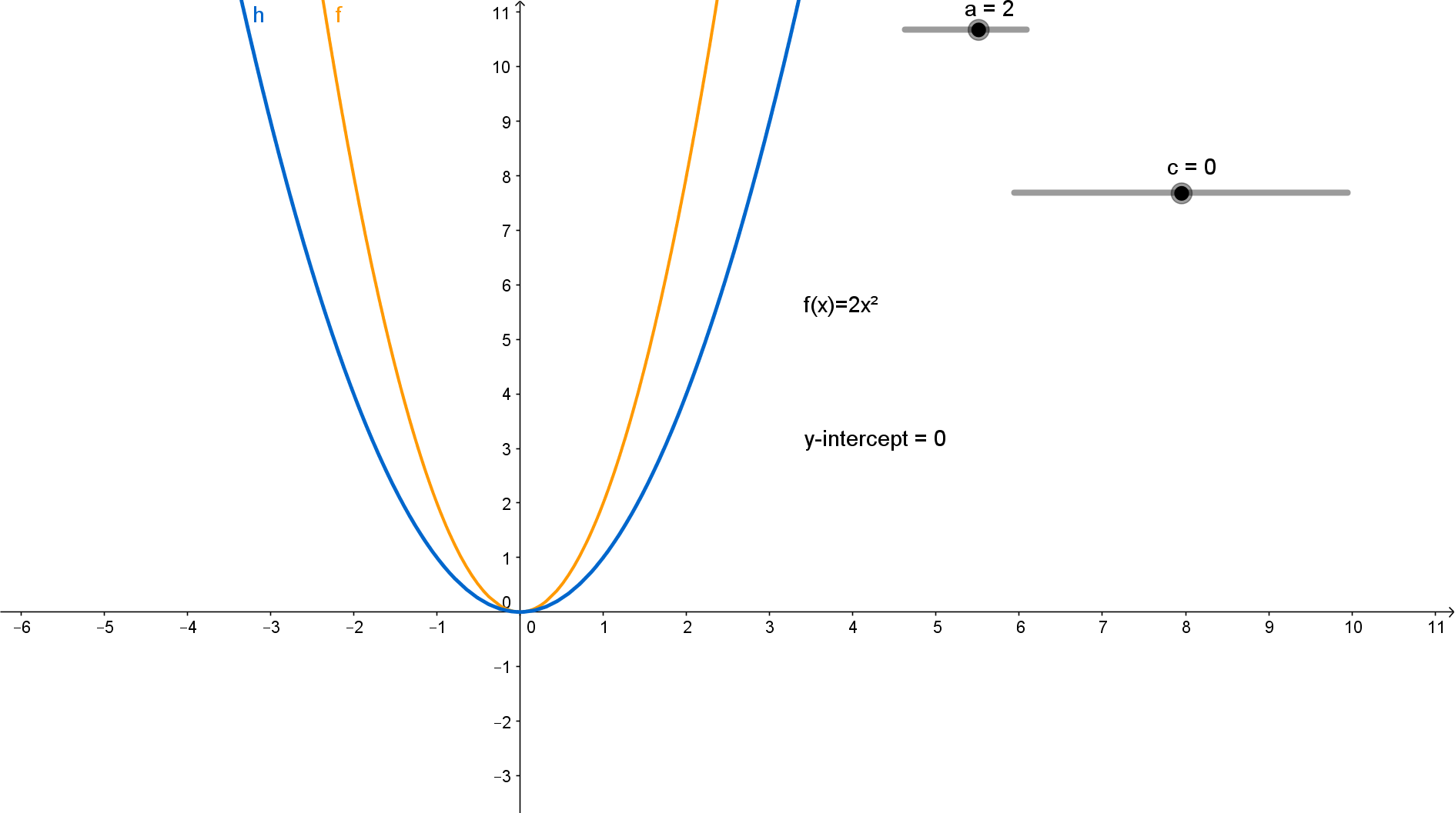
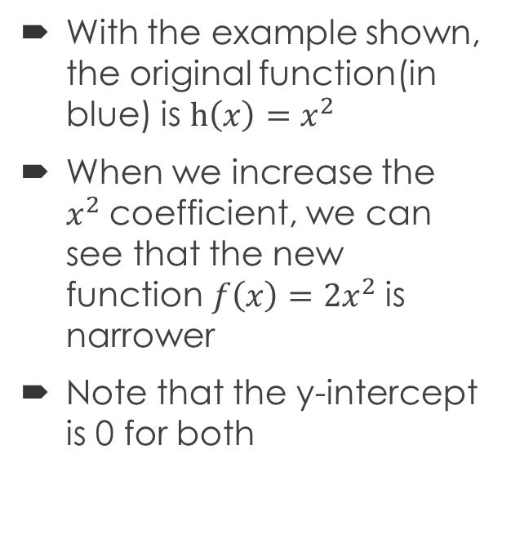
Quadratic Functions: Transformations
With the example shown, the original function(in blue) is $h\left(x\right)=x^{2}$
When we increase the $x^{2}$coefficient, we can see that the new function$f\left(x\right)=2x^{2}$ is narrower
Note that the y-intercept is 0 for both

Slide 5
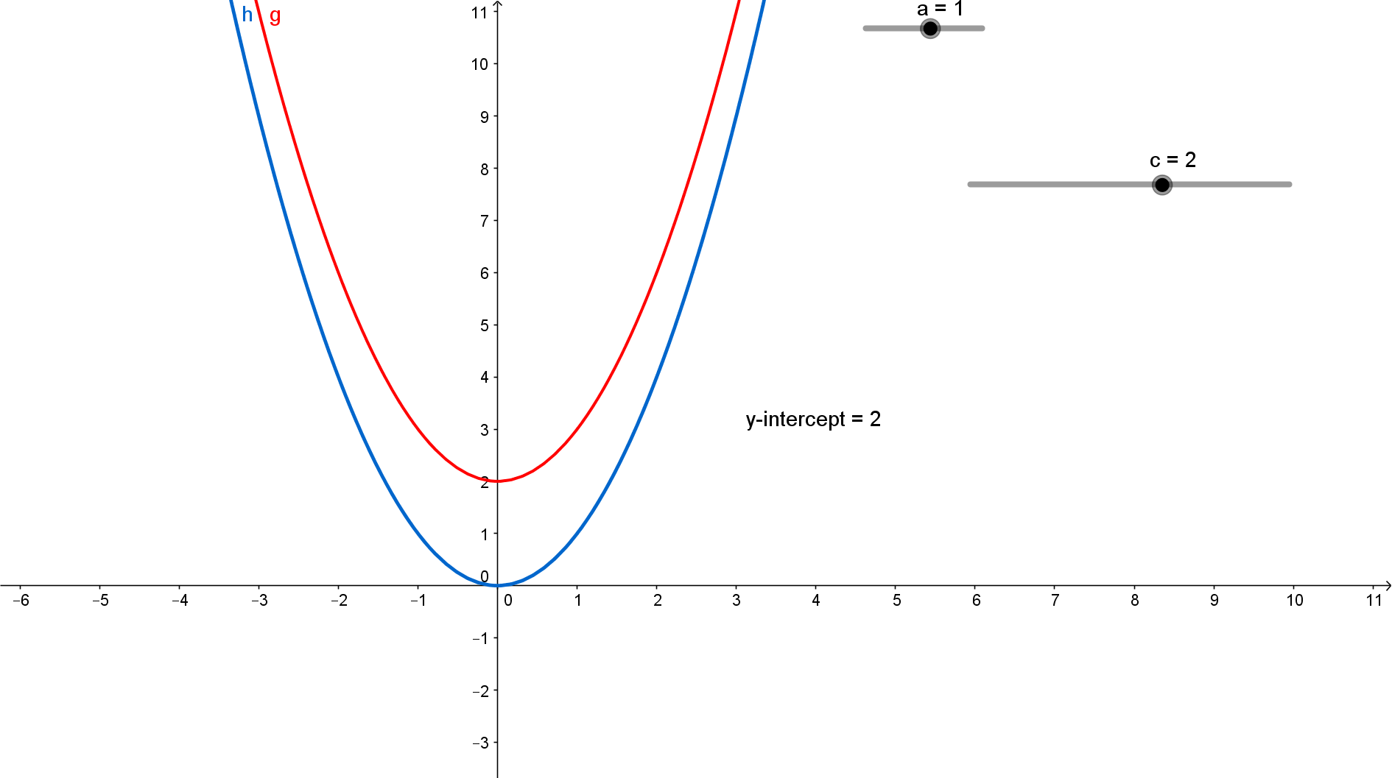
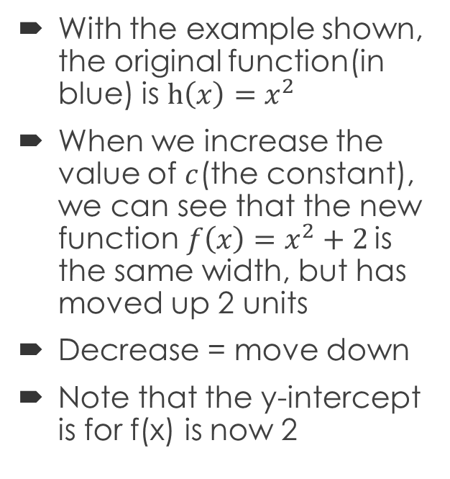
Quadratic Functions: Transformations
With the example shown, the original function(in blue) is $h\left(x\right)=x^{2}$
When we increase the value of $c$(the constant), we can see that the new function$f\left(x\right)=x^{2}+2$ is the same width, but has moved up 2 units
Decrease = move down
Note that the y-intercept is for f(x) is now 2

Slide 6
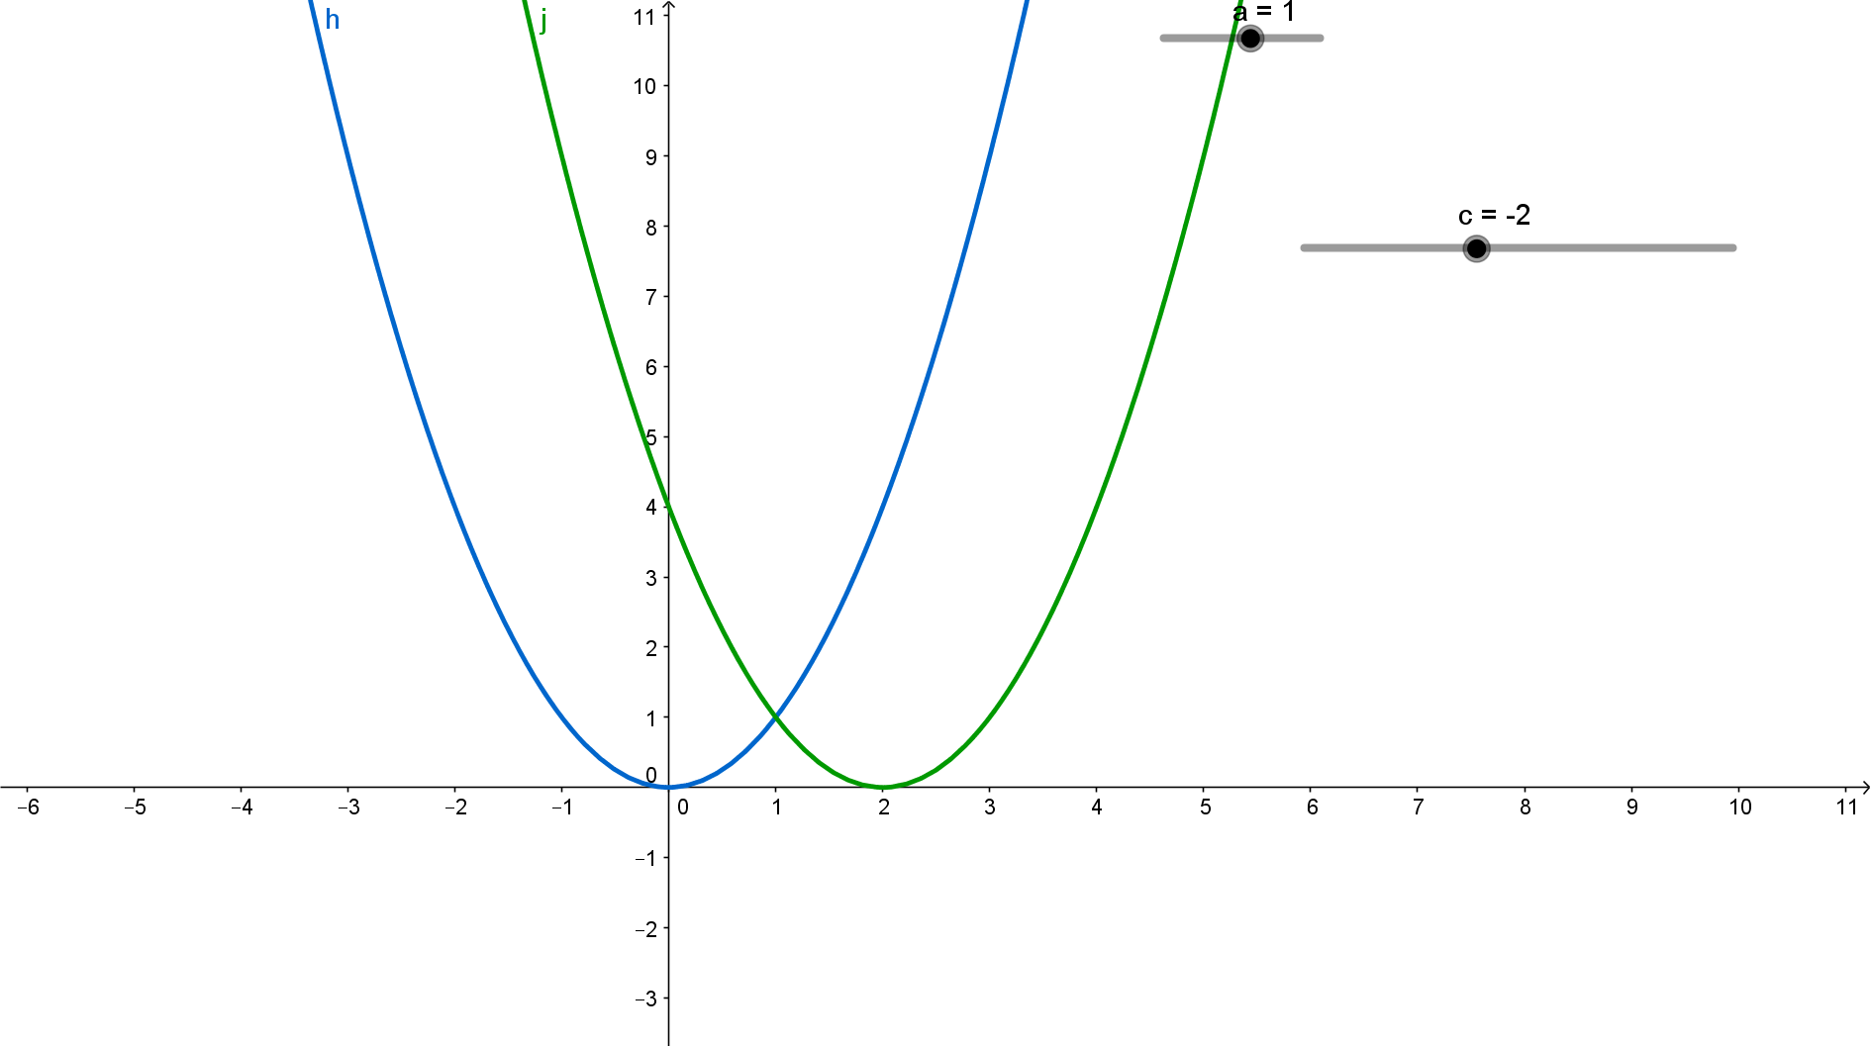
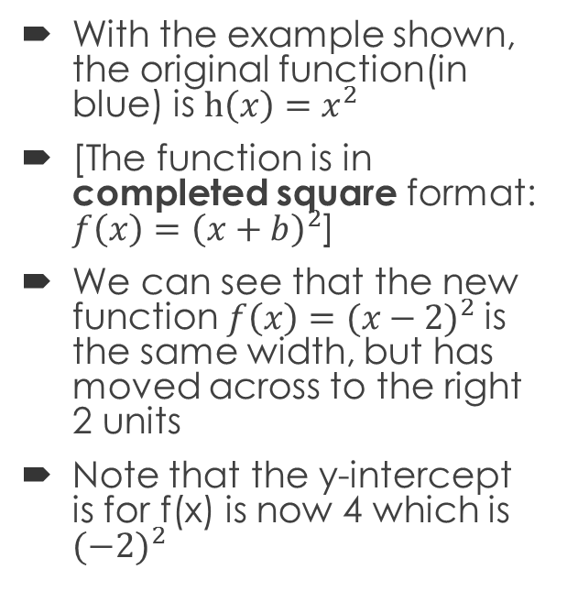
Quadratic Functions: Transformations
With the example shown, the original function(in blue) is $h\left(x\right)=x^{2}$
[The function is in completed square format: $f\left(x\right)={\left(x+b\right)}^{2}$]
We can see that the new function$f\left(x\right)={(x−2)}^{2}$ is the same width, but has moved across to the right 2 units
Note that the y-intercept is for f(x) is now 4 which is ${(−2)}^{2}$

Slide 7
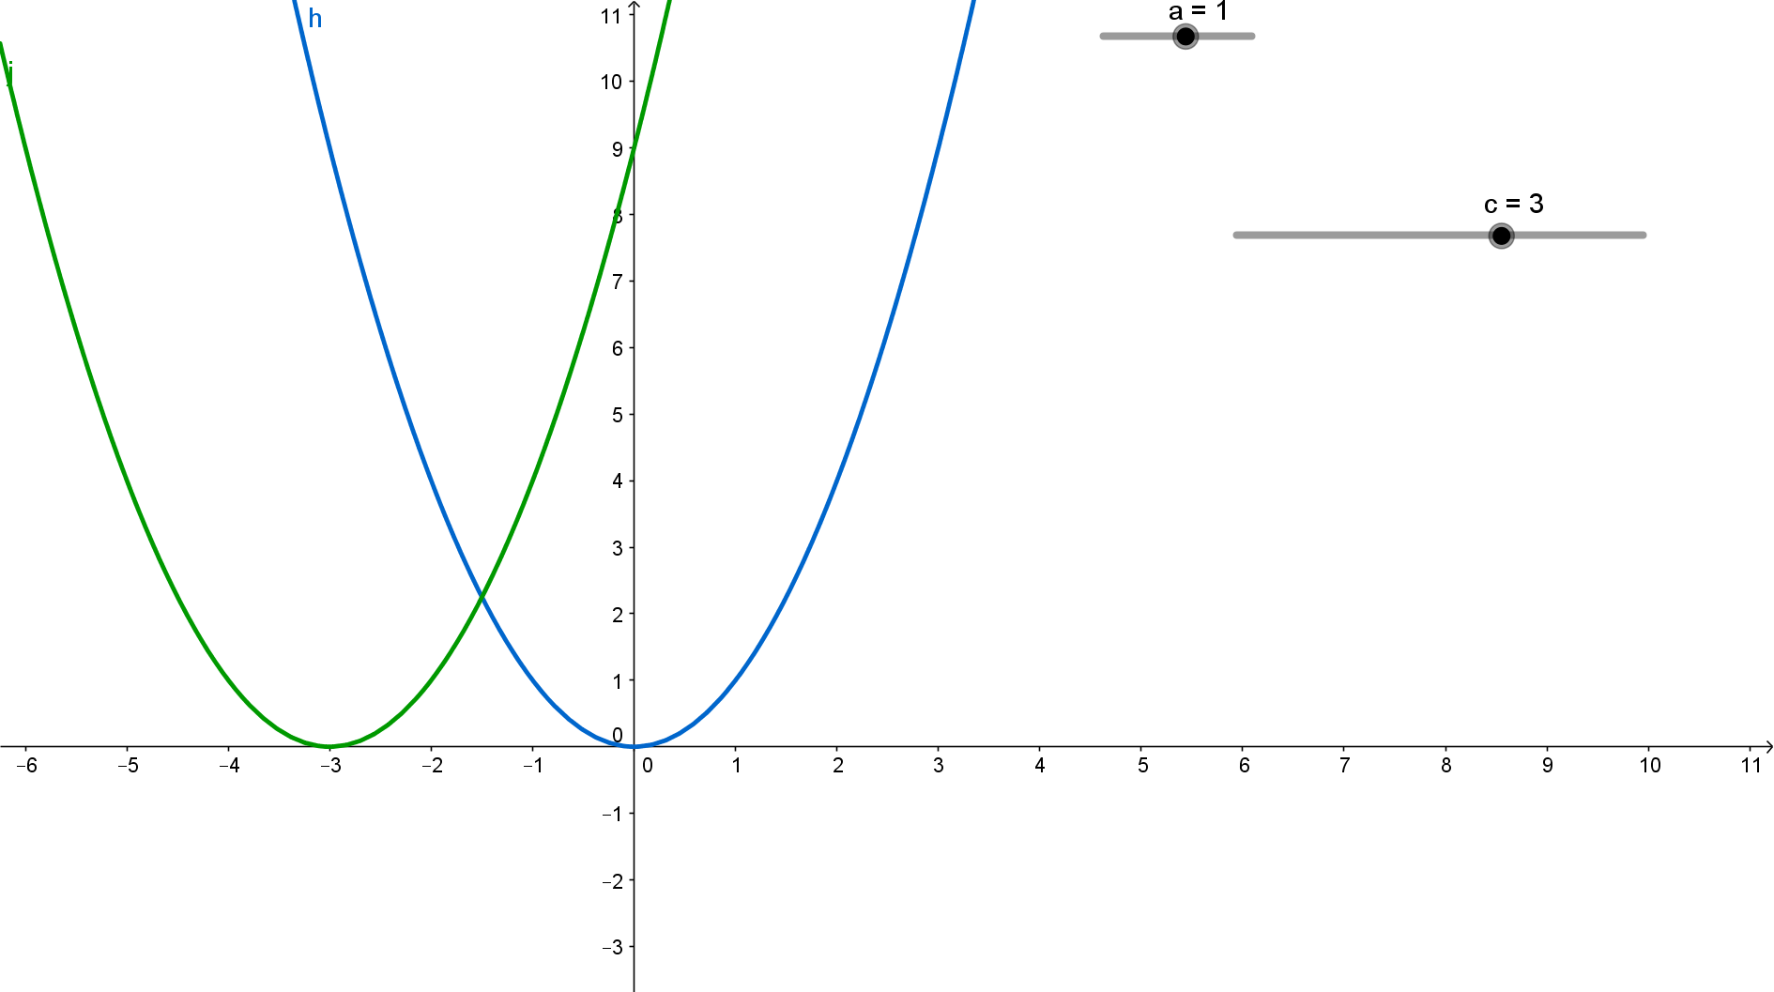
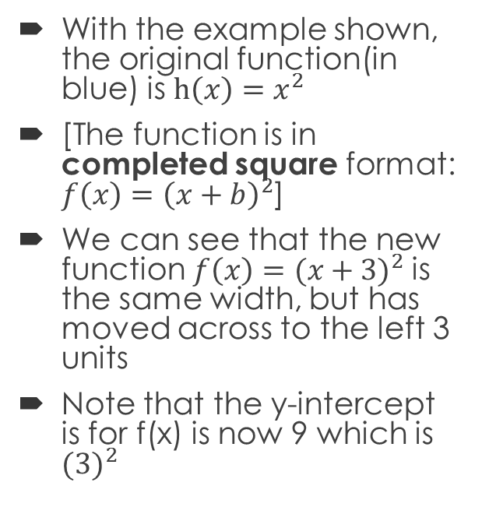
Quadratic Functions: Transformations
With the example shown, the original function(in blue) is $h\left(x\right)=x^{2}$
[The function is in completed square format: $f\left(x\right)={\left(x+b\right)}^{2}$]
We can see that the new function$f\left(x\right)={(x+3)}^{2}$ is the same width, but has moved across to the left 3 units
Note that the y-intercept is for f(x) is now 9 which is ${(3)}^{2}$

