Slide 1
LCHL Strand 5 Functions:
Transformations: Cubic Functions
Culan O’Meara – Ballinrobe Community School

Slide 2
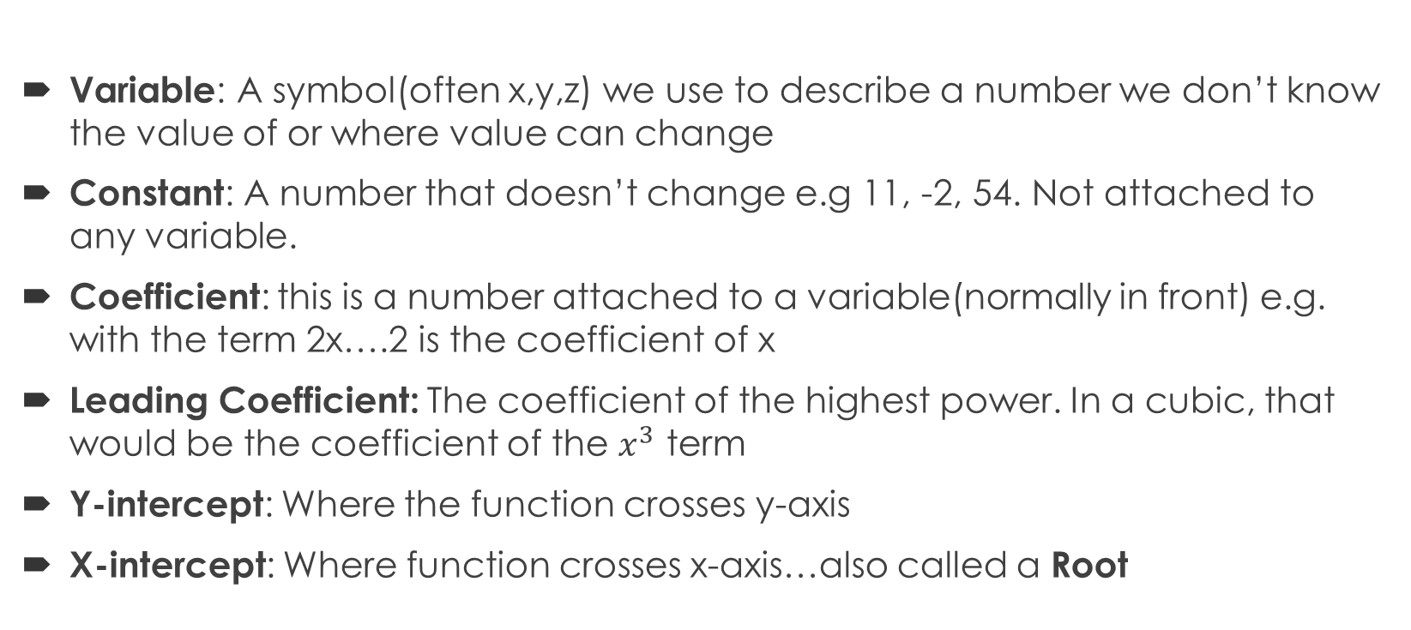
Functions: Key words Recap
Variable: A symbol(often x,y,z) we use to describe a number we don’t know the value of or where value can change
Constant: A number that doesn’t change e.g 11, -2, 54. Not attached to any variable.
Coefficient: this is a number attached to a variable(normally in front) e.g. with the term 2x….2 is the coefficient of x
Leading Coefficient: The coefficient of the highest power. In a cubic, that would be the coefficient of the $x^{3}$ term
Y-intercept: Where the function crosses y-axis
X-intercept: Where function crosses x-axis…also called a Root

Slide 3
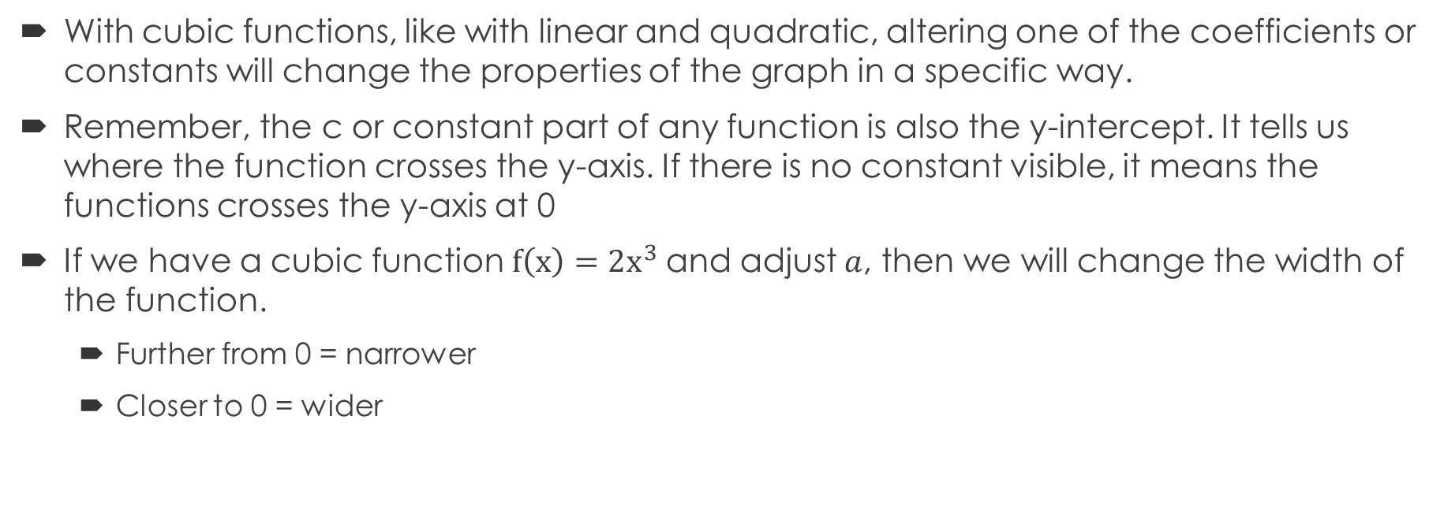
Cubic Functions: Transformations
With cubic functions, like with linear and quadratic, altering one of the coefficients or constants will change the properties of the graph in a specific way.
Remember, the c or constant part of any function is also the y-intercept. It tells us where the function crosses the y-axis. If there is no constant visible, it means the functions crosses the y-axis at 0
If we have a cubic function $f\left(x\right)=2x^{3}$and adjust $a$, then we will change the width of the function.
  Further from 0 = narrower
  Closer to 0 = wider

Slide 4
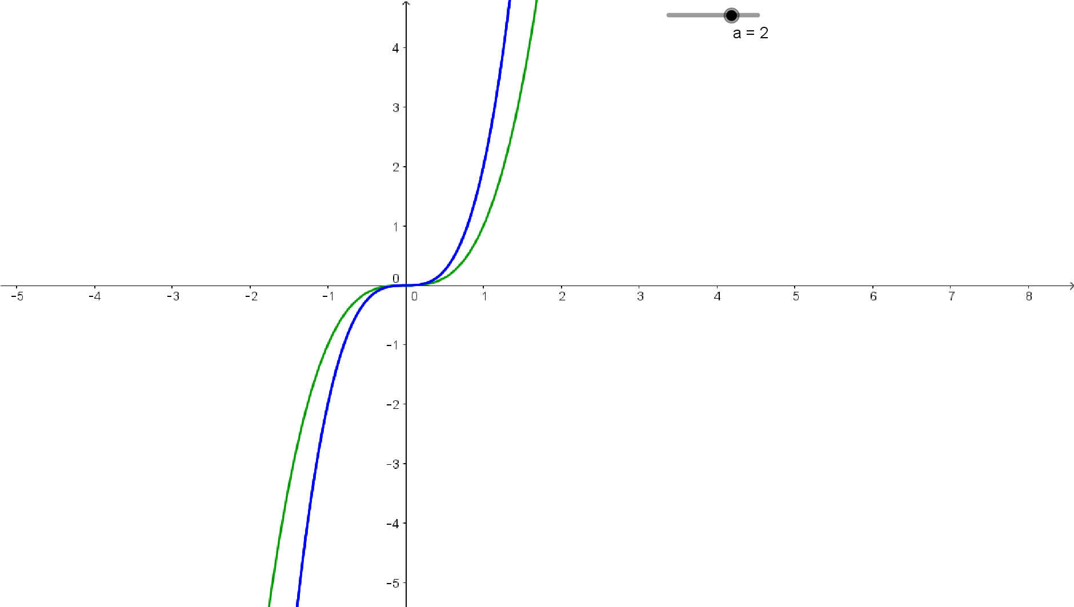
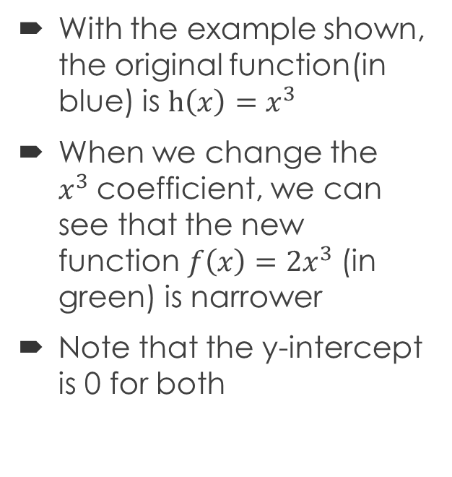
Cubic Functions: Transformations
With the example shown, the original function(in blue) is $h\left(x\right)=x^{3}$
When we change the $x^{3}$coefficient, we can see that the new function$f\left(x\right)=2x^{3}$ (in green) is narrower
Note that the y-intercept is 0 for both

Slide 5
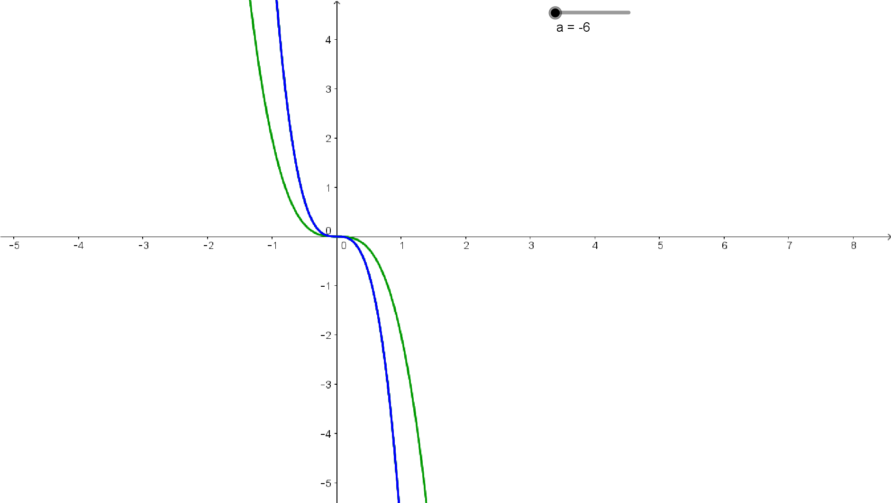
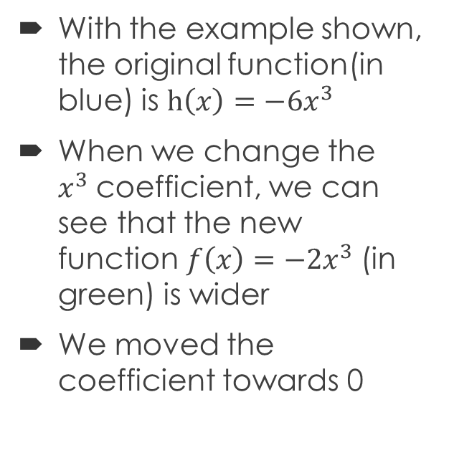
Cubic Functions: Transformations
With the example shown, the original function(in blue) is $h\left(x\right)={−6x}^{3}$
When we change the $x^{3}$coefficient, we can see that the new function$f\left(x\right)=−2x^{3}$ (in green) is wider
We moved the coefficient towards 0

Slide 6
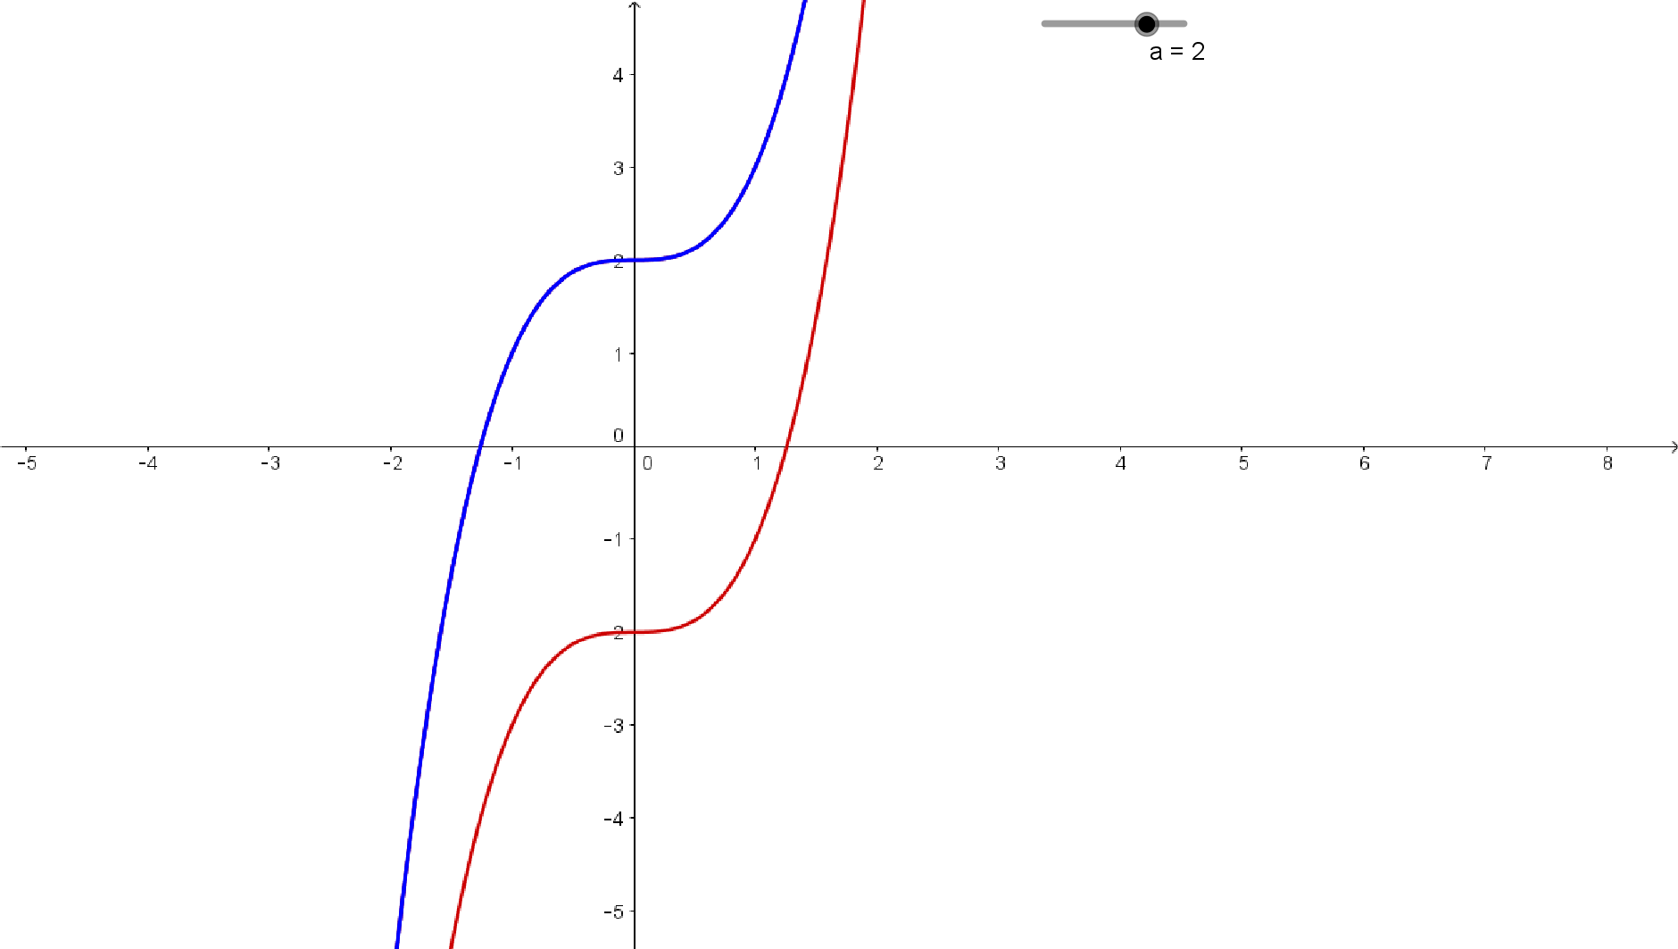
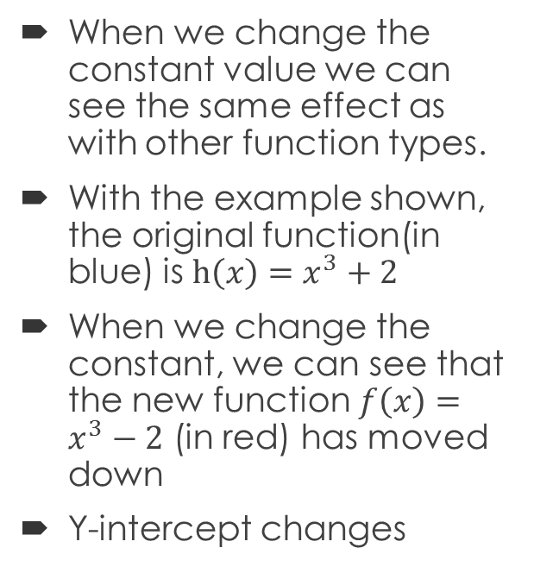
Cubic Functions: Transformations
When we change the constant value we can see the same effect as with other function types.
With the example shown, the original function(in blue) is $h\left(x\right)=x^{3}+2$
When we change the constant, we can see that the new function$f\left(x\right)=x^{3}−2$ (in red) has moved down
Y-intercept changes

Slide 7
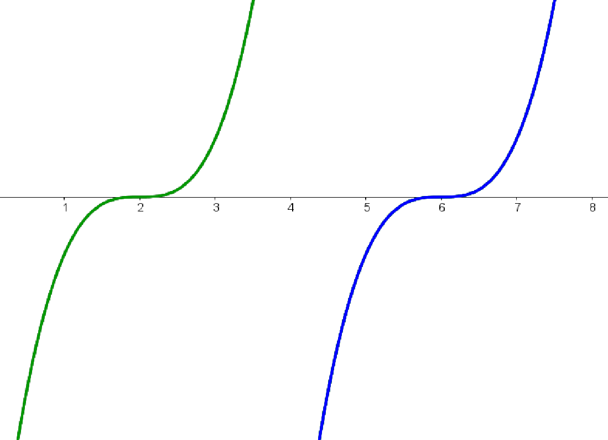
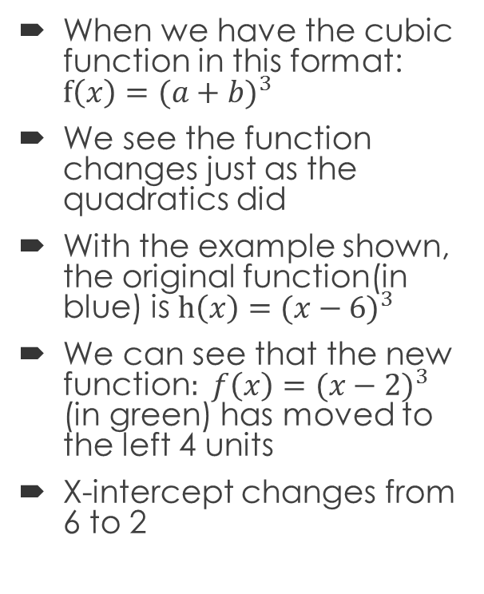
Cubic Functions: Transformations
When we have the cubic function in this format: $f\left(x\right)={(a+b)}^{3}$
We see the function changes just as the quadratics did
With the example shown, the original function(in blue) is $h\left(x\right)={(x−6)}^{3}$
We can see that the new function$: f\left(x\right)={(x−2)}^{3}$ (in green) has moved to the left 4 units
X-intercept changes from 6 to 2

