Slide 1
LCHL Strand 5 Functions:
Transformations: Exponential Functions
Culan O’Meara – Ballinrobe Community School

Slide 2
Functions: Key words Recap
Variable: A symbol(often x,y,z) we use to describe a number we don’t know the value of or where value can change
Constant: A number that doesn’t change e.g 11, -2, 54. Not attached to any variable.
Exponent: Another word for power or order or index
Coefficient: this is a number attached to a variable(normally in front) e.g. with the term 2x….2 is the coefficient of x
Leading Coefficient: The coefficient of the highest power
Y-intercept: Where the function crosses y-axis
X-intercept: Where function crosses x-axis…also called a Root

Slide 3
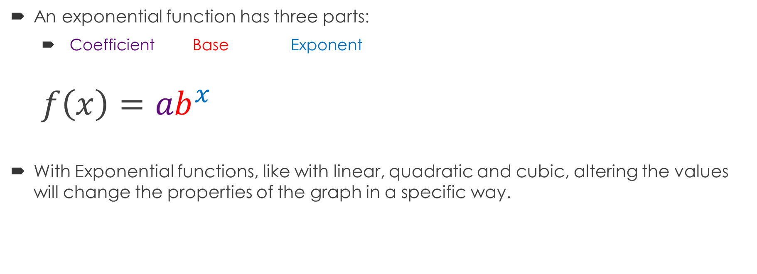
Exponential Functions: Transformations
An exponential function has three parts:
  Coefficient Base Exponent
  $$f\left(x\right)={ab}^{x}$$
With Exponential functions, like with linear, quadratic and cubic, altering the values will change the properties of the graph in a specific way.

Slide 4
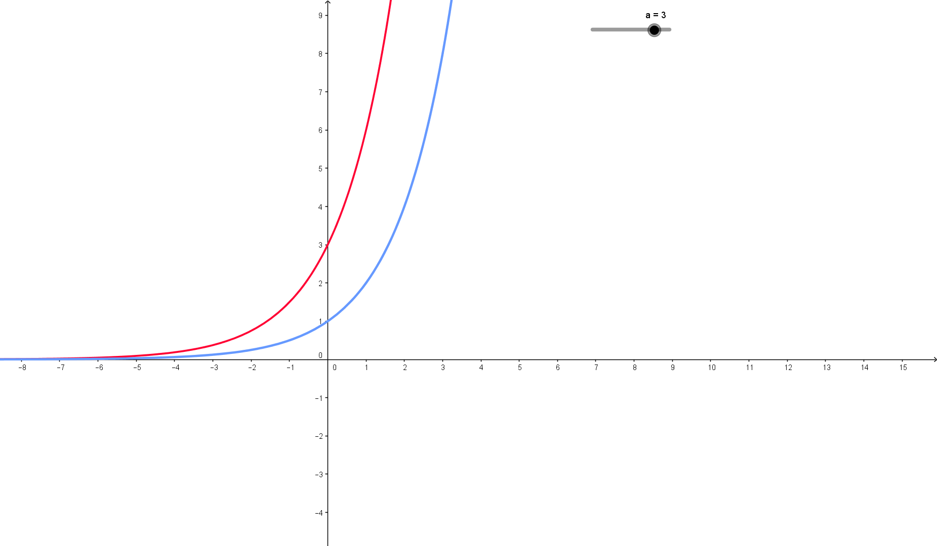
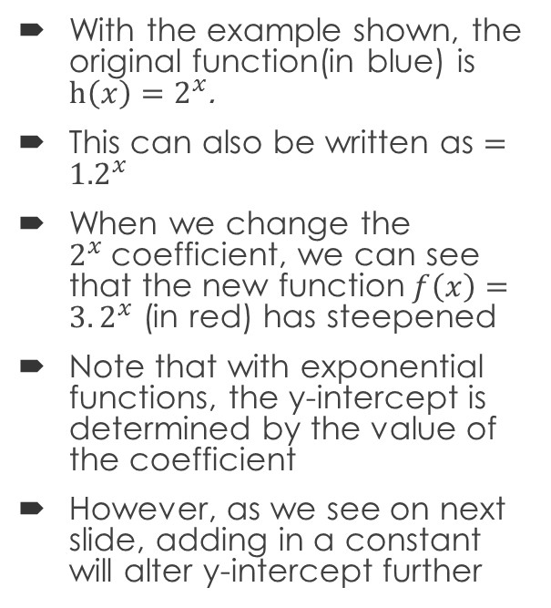
Exponential Functions: Transformations
With the example shown, the original function(in blue) is $h\left(x\right)=2^{x}$.
This can also be written as $={1.2}^{x}$
When we change the $2^{x}$coefficient, we can see that the new function$f\left(x\right)=3.2^{x}$ (in red) has steepened
Note that with exponential functions, the y-intercept is determined by the value of the coefficient
However, as we see on next slide, adding in a constant will alter y-intercept further

Slide 5
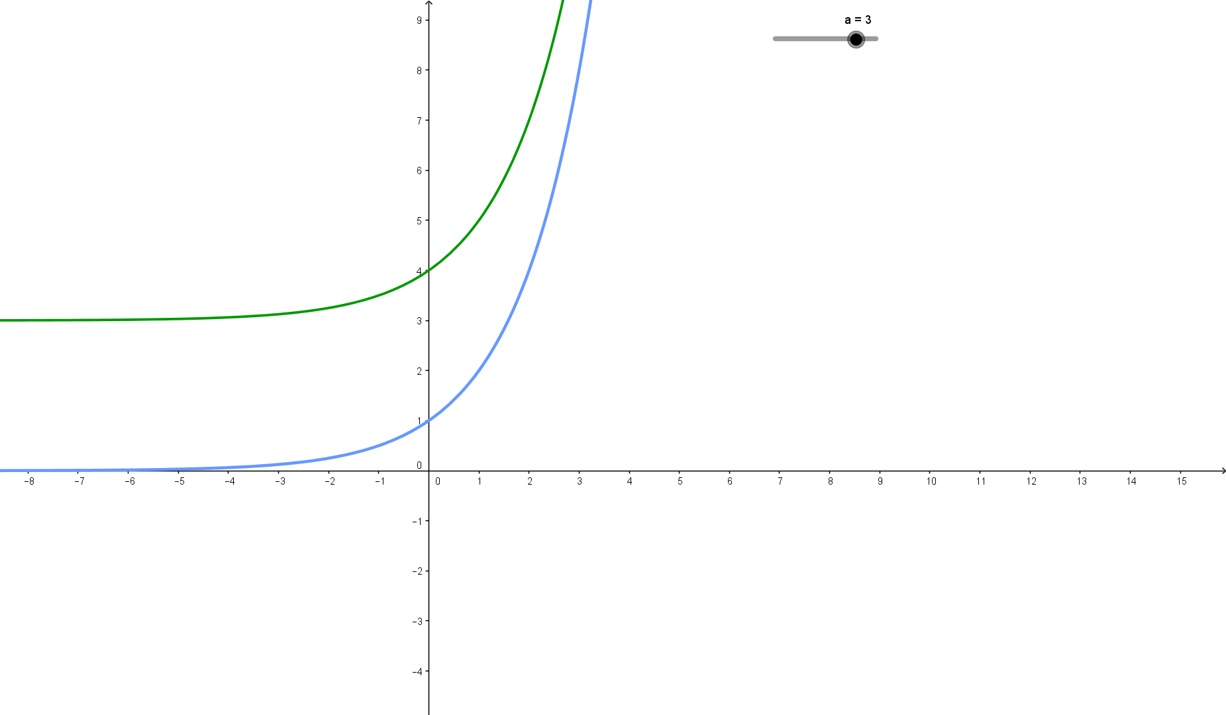
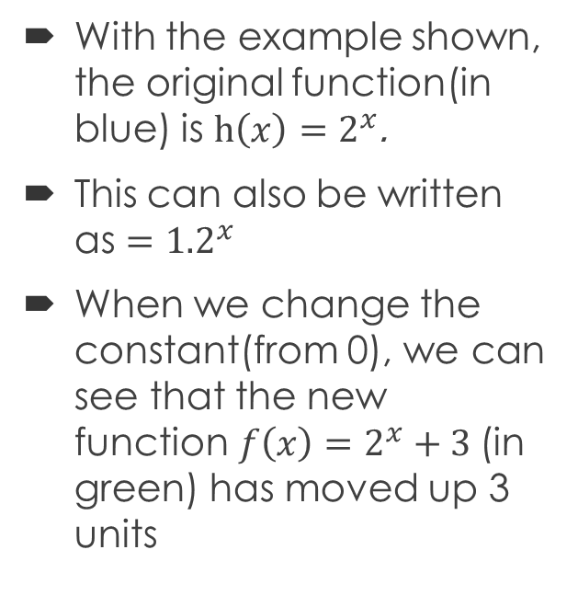
Exponential Functions: Transformations
With the example shown, the original function(in blue) is $h\left(x\right)=2^{x}$.
This can also be written as $={1.2}^{x}$
When we change the constant(from 0), we can see that the new function$f\left(x\right)=2^{x}+3$ (in green) has moved up 3 units

Slide 6
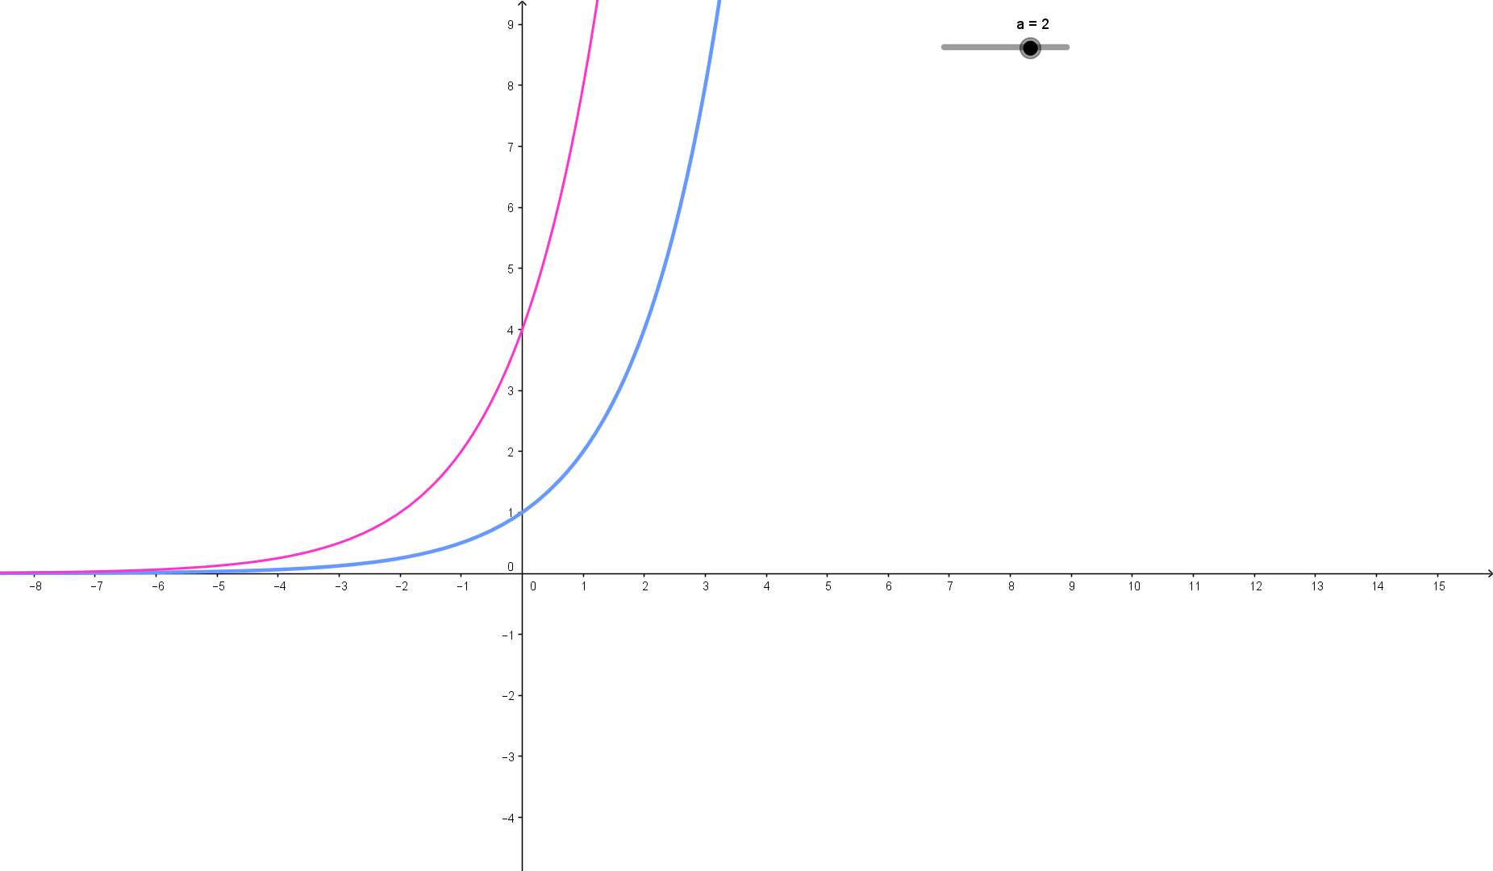
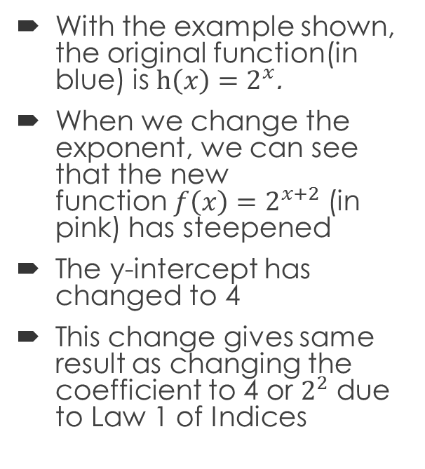
Exponential Functions: Transformations
With the example shown, the original function(in blue) is $h\left(x\right)=2^{x}$.
When we change the exponent, we can see that the new function$f\left(x\right)=2^{x+2}$ (in pink) has steepened
The y-intercept has changed to 4
This change gives same result as changing the coefficient to 4 or $2^{2}$ due to Law 1 of Indices

