Slide 1
Vision and Viewpoint
Casablanca

Slide 2
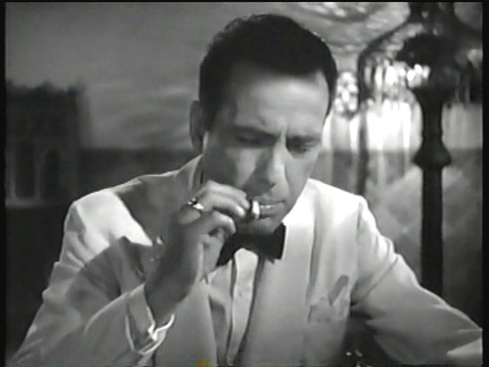
Casablanca - Beginning
Bleak opening – a city of despair
Refugees are trapped in Casablanca – rounded up in the street – shot while escaping etc
Rick is also trapped – trapped in the past
Isolated – won’t drink with the customers – will stick his neck out for no-one –
Describes himself as a drunkard
Alone
Bitter

Slide 3
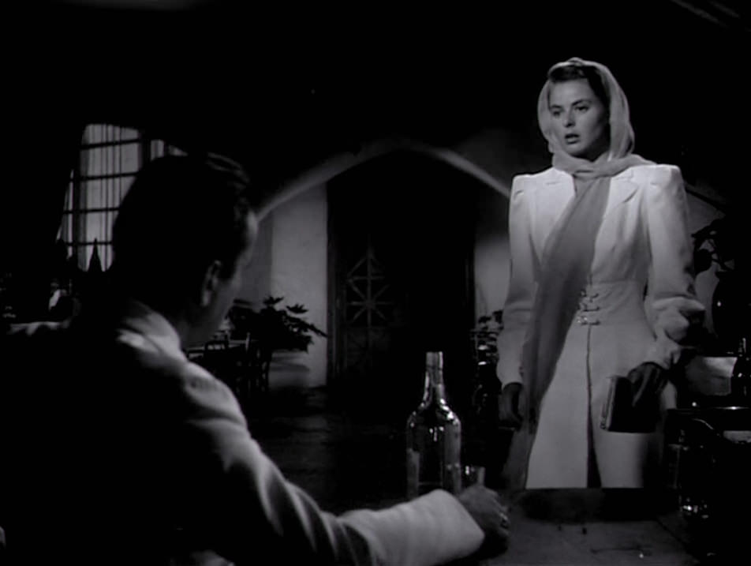
Casablanca - Crisis
We learn that Rick wasn’t always like this
Paris flashback shows the real Rick – in love, romantic, carefree
Embittered when Ilsa leaves him
Hurt in the past – sees no future
Ilsa returns – challenges him to let go off the past
He refuses – goes deeper into darkness

Slide 4
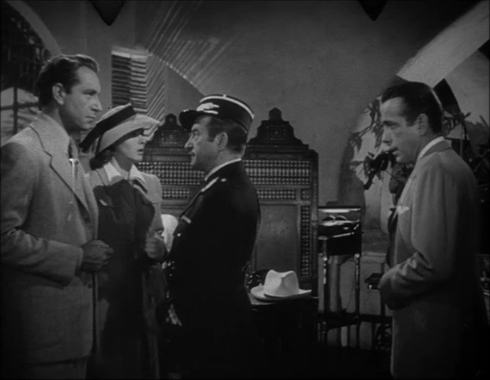
Casablanca - Hope
Small signs that Rick has found his true self
Rescues the young Bulgarian woman from Renault
Allows the band to join the singing of La Marseilles and suffers the consequences
Declares his love for Ilsa and assures her he will help Lazlo escape

Slide 5
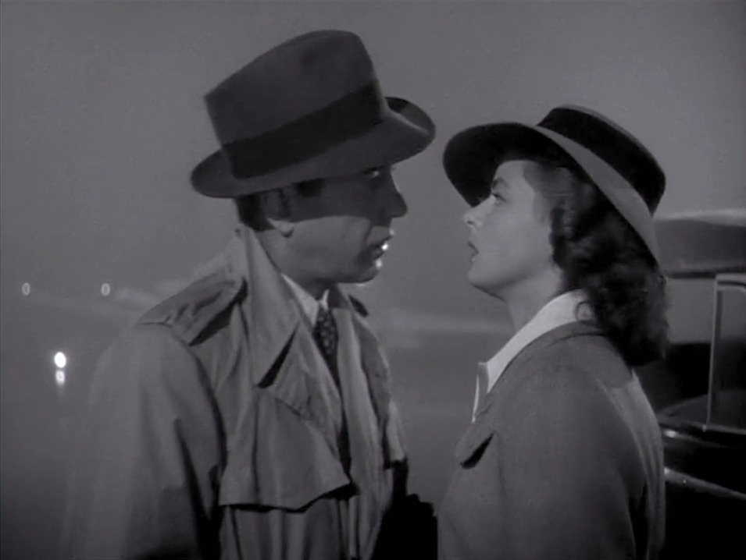
Casablanca – The End
Redemption
Rick has redeemed himself
By killing Strasser and helping Lazlo escape he has joined the struggle
‘This time I know we will win’
Noble – self sacrificing – gives up the woman he loves
‘There are things I have to do’

Slide 6
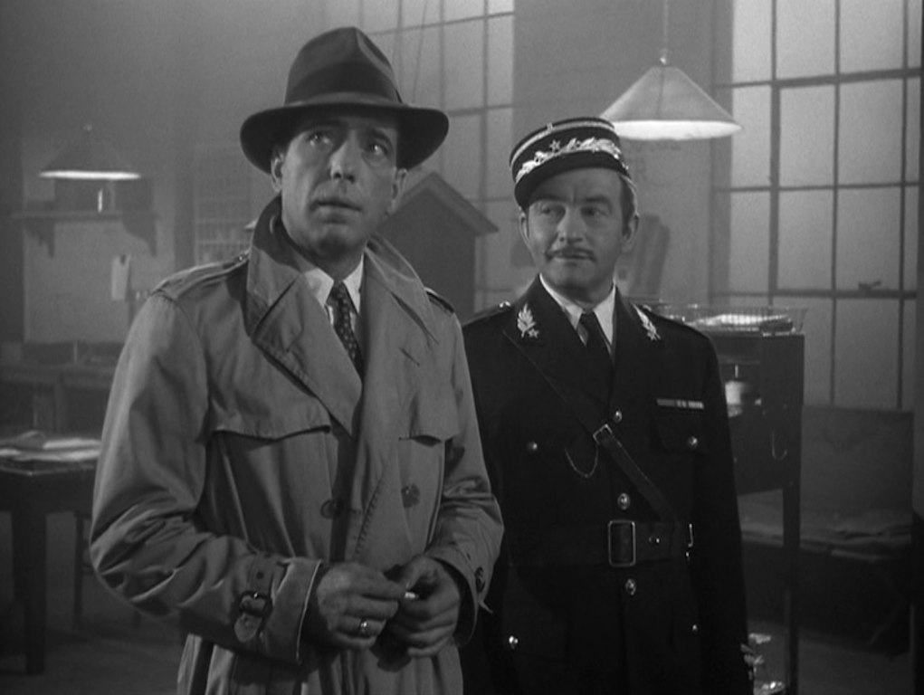
Casablanca – The End
Rick and Renault head off to win the war – ‘The start of a beautiful friendship’
Rick has grown as a person and reached a level of personal fulfillment
Good has conquered evil

Slide 7
Casablanca – The End

