Slide 1
Casablanca
Cultural Context

Slide 2
Role of Women
The film occurs in a very male dominated world.
The women are either victims or trophies to be competed for between men.
Yvonne
Ilsa

Slide 3
Yvonne
Rejected and dismissed by Rick
Sasha - ‘Yvonne I love you, but he pays me.’
Captain Renault– ‘How very extravagant of you to be throwing away a woman like that – they may become scarce’.
Accompanies a German officer, provoking a fight.
Her only independent action is to join in the singing of the French national anthem.
Yvonne is almost a prop – she exists only in relation to men and has no identity of her own.

Slide 4
Renault and women
‘This is the customary roundup of refugees. Liberals , and of course , a beautiful young girl for Monsieur Renault, the Prefect of Police.
‘Another visa problem has come up’, ‘Show her in’.
Renault uses his position of power to force women to prostitute themselves.
‘Why do you interfere with my little romances?’

Slide 5
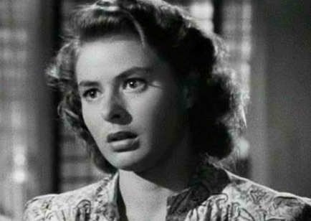
Ilsa
Beautiful
Passive
Torn between two men
Trophy

Slide 6
Beautiful
  Constantly defined by her beauty.
  ‘so beautiful..that people turn to stare.’
  lingering close-ups,, soft focus and lighting.
  ‘I was informed that you were the most beautiful woman ever to visit Casablanca. That was a gross understatement’.
  her beauty defines her and limits her.

Slide 7
Passive
  portrayed as a passive character.
  behaves in a timid manner, telling Lazlo that ‘I’m afraid for you’ and to ‘Be careful’.
  In t Paris she tells Rick that ‘You are in danger and you must leave Paris.
  In both cases her fear and timidity serve to emphasise and enhance the masculinity of Rick and Lazlo.

Slide 8
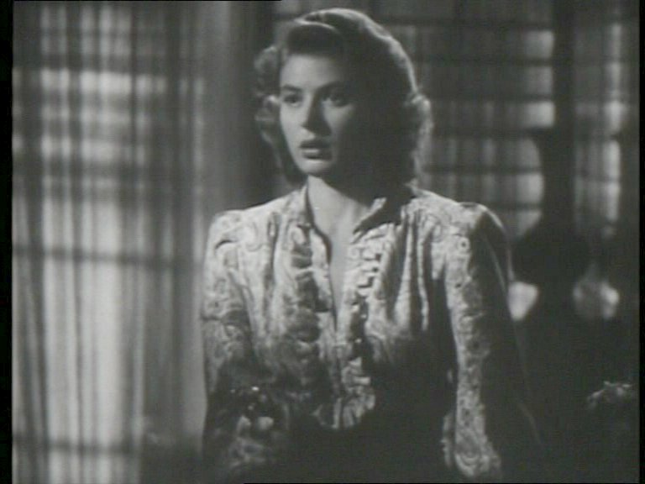
Passive
  ‘Go ahead and shoot you’ll be doing us both a favour.’
  ‘her hand drops down, and there are tears in her eyes again’.
  ‘Oh I don’t know what’s right any longer. You’ll have to think for both of us.’
  unable to control her own fate

Slide 9
Torn between two men
  torn between Lazlo and Rick
  leaves it to Rick to decide her fate.
  relationship with Lazlo seems e based on hero worship
  ‘And she looked up to him and worshipped him with a feeling she supposed was love’
  ‘I’ll never have the strength to leave you again”.

Slide 10
Trophy
Two dominant males fighting over a female.
Rick – ‘I suggest that you ask your wife’
Lazlo – ‘is perhaps strange that we both should be in love with the same woman’
Rick not only ‘gives’ Ilsa to Lazlo but also creates a fiction to save his pride.
‘She did her best to convince me that she was still in love with me, but that was all over long ago. For your sake, she pretended it wasn’t, and I let her pretend’.

Slide 11
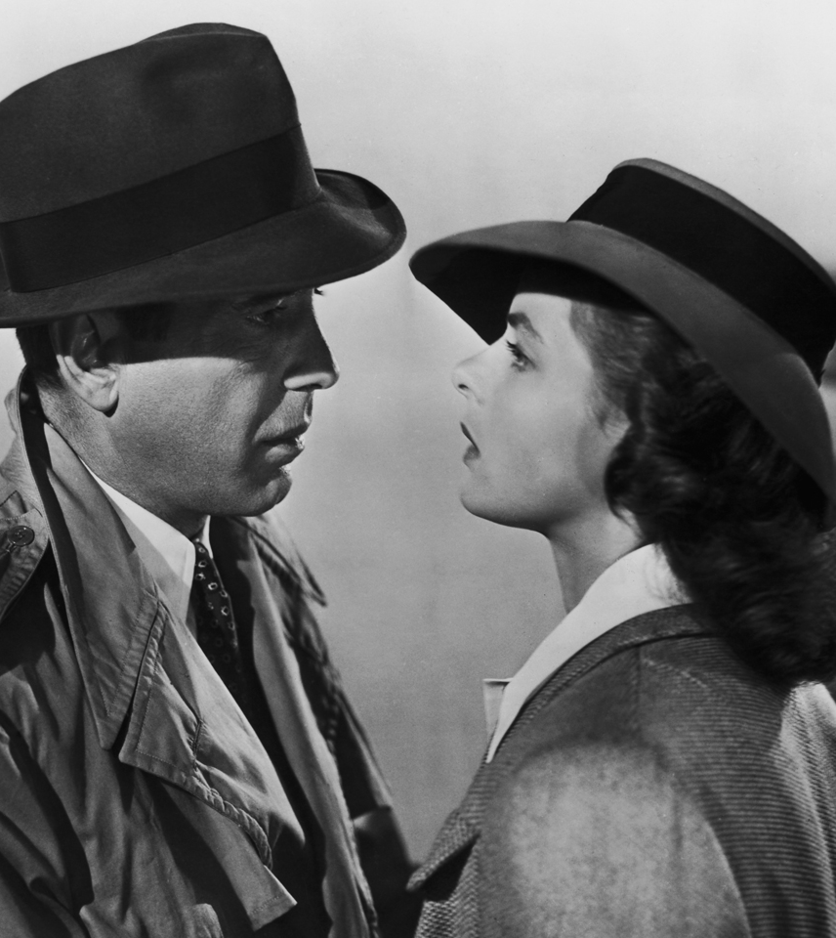
Ilsa
  Rick makes the decision for her to get on the plane
  is not for her but for Lazlo
  ‘We both know that you belong with Victor. You’re part of his work, the thing that keeps him going.

Slide 12
Think about your other texts
Do men dominate women in these texts?
Are the women active or passive?
Are women victims or trophies?
Are women bought, sold, exploited or controlled?
Are women admired for their beauty but nothing else?

