Slide 1
Casablanca
Cultural Context

Slide 2
Power
Highly Hierarchical Society
Power concentrated in hands of the few
Power used corruptly
Violence
Challenges to authority suppressed

Slide 3
Highly Hierarchical Society
Power concentrated in hands of the few
As a colony of unoccupied France control and authority should lie with the French authorities - Renault
Renault at times claims to be autonomous
  He welcomes General Strasser to ‘Unoccupied France’
  He tells Rick that ‘In Casablanca I am master of my fate.’ but immediately runs to attend to Major Strasser.

Slide 4
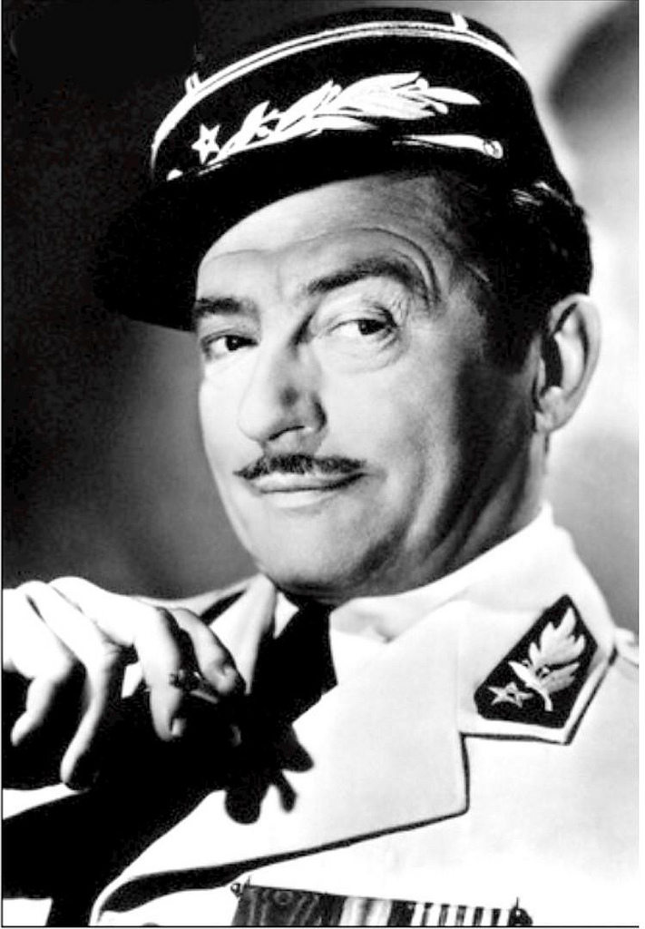
Power used corruptly
Renault uses his power corruptly
Sells exit visas at extortionate prices
Forces women to sleep with him in exchange for visas
Gambles illegally – doesn’t pay for drinks

Slide 5
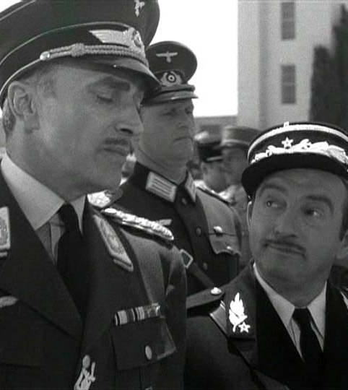
Real Power
in the hands of the Germans in the person of Major Strasser
‘We Germans must get used to all climates, from Russia to the Sahara’
‘I have already given him the best table, knowing he is German and would take it anyway’

Slide 6
Violence
Violence is used to enforce conformity and obedience
Two German messengers are killed for the exit visas
The roundup of ‘the usual suspects’ causes panic and terror
A resistance fighter is gunned down in the street
Ugarte is gunned down in Ricks café
All challenges to authority are ruthlessly suppressed

Slide 7
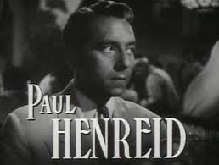
Challenges to authority suppressed
The main challenge to authority is Czech Resistance leader Victor Lazlo
‘He’s succeeded in impressing half the world’
‘this is the end of the chase’

Slide 8
Lazlo
Lazlo refuses to recognise German authority and domination
  ‘I’m sure you ‘ll excuse me if I’m not gracious, but you see Major Stasser, I’m a Czechoslovakian’
  ‘Captain Renault I am under your authority’
Lazlo’s challenge to authority must be suppressed

Slide 9
  Key Moment – The singing of the Marseillaise
The Germans aim to dominate the café as they have dominated Europe
Lazlo leads the crowd in defiance
Rick, in the first indication of where his sympathies lie, nods to the orchestra and allows them to continue
Even Yvonne who had accompanied a German officer to the café is moved to shout ‘Vive la France, Vive la democracie’
The whole café is closed
‘You have observed that in Casablanca, human life is cheap.’

Slide 10
Rick – Resistance to Authority
Not until the final scene does Rick finally ‘stick his neck out’ for others
Challenges the Nazi’s authority
Signals his intention to finally (like America) join the fight and defeat the Nazis
‘I’ve got a job to do, too. Where I’m going you can’t follow. What I’ve got to do you can’t be a part of.’
By shooting Strasser he directly confronts and defeats Nazi authority

Slide 11
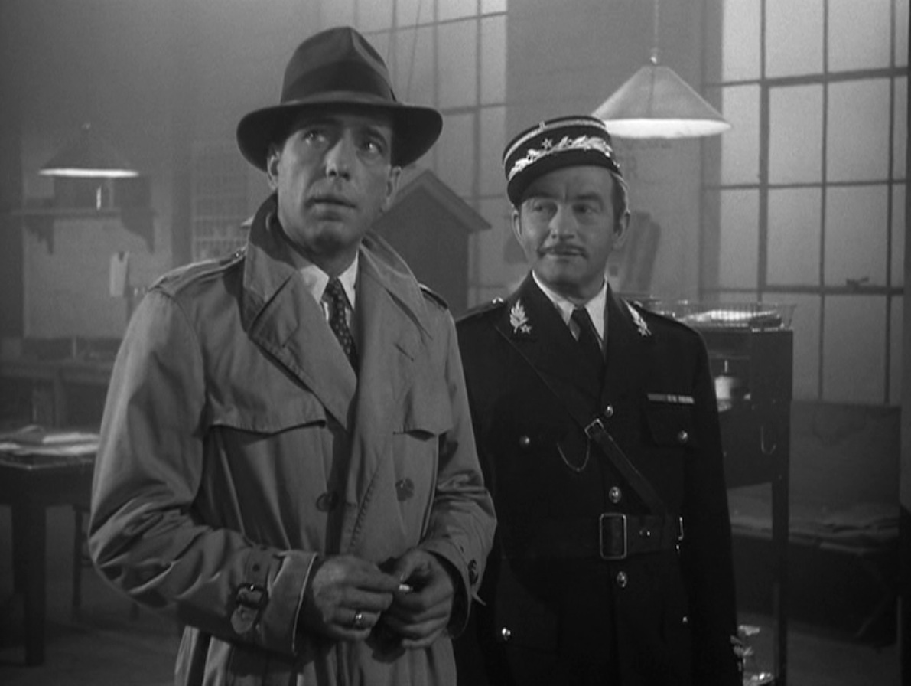
Renault – Resistance to Authority
‘Round up the usual suspects’ which before was a motto of collaboration is now a sign of defiance
Renault symbolically throws away a bottle of Vichy water – a symbol of collaboration
Czechoslovakia, America and Unoccupied France unite to challenge and defeat the German Authority
‘Louis, I think this is the beginning of a beautiful friendship.

Slide 12
Think about your other texts
Who has power in your other texts?
Is that power used corruptly?
How are challenges to authority suppressed in the other texts?
At the end of your other texts has authority been successfully challenged?

