Slide 1
Rainforests

Slide 2
What do you already know about rainforests?
Think Pair Share with your partner about any facts you know about Rainforests.
Next we will fill out our KWL charts – what we Know, what we Want to know and when we are finished learning about rainforests we will fill in what we Learnt.

Slide 3
We are going to use some posters to help us learn about the rainforests.
Where are the rainforests?
How would you describe a rainforest?
How is a rainforest different/similar to where you live?
What different animals live in the rainforest?
What different plants grow in the rainforest?
Why are rainforests important?
How can we help save the rainforest?
What is the weather like in a rainforest? How is different/similar to where you live?
Who lives in rainforests?

Slide 4
What are the rainforests & where are they?
Rainforests are large, warm, wet, dense forests.
The rainforests are located in a band around the equator. The equator is like an imaginary line around the middle of the earth.
At the equator the temperatures are very high. Because it is so warm, a lot of water is evaporated which means there is a lot of rain.
This is why rainforests are both very warm and rainy.
There are rainforests in South and Central America, in parts of Africa, in Oceania (the islands around Australia) and in Asia.
Rainforests only cover about 7% of the Earth’s surfaces.
The Amazon rainforest in Brazil is the biggest rainforest in the world.

Slide 5
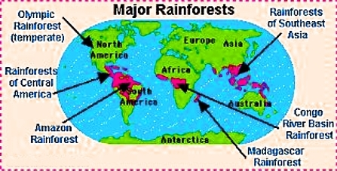

Slide 6
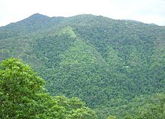

Slide 7
Why are rainforests important?
People often call the rainforests ‘the lungs’ of the planet because of the amount of carbon dioxide they absorb.
They then breathe out large amounts of oxygen, which both humans and animals need to survive.
Without rainforests we would have too much carbon dioxide in the atmosphere and this would affect climate change.
Rainforests are important because they provide homes for many different plants and animals.
They are important because they provide lots of rain which the earth needs.
Tribes of people live in rainforests – they are their homes.
Rainforests are beautiful, interesting places to visit.

Slide 8
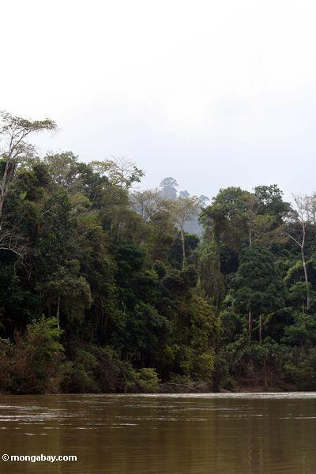
Rainforest in Malaysia, Asia

Slide 9
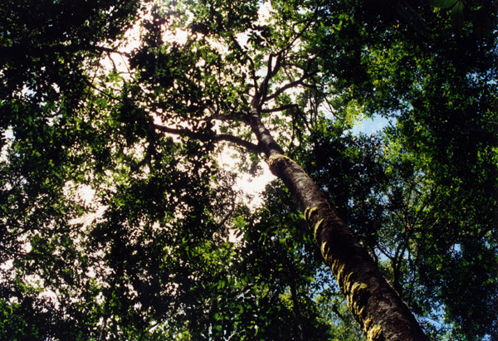
View of the Amazon rainforest

Slide 10
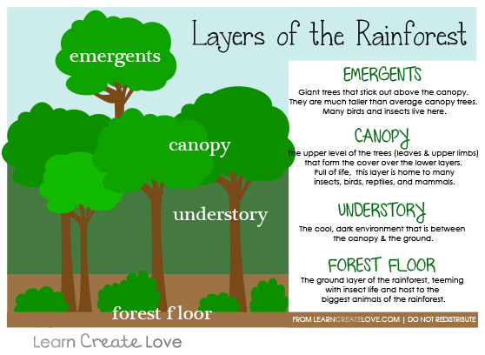
Layers of the Rainforest

Slide 11
What different animals live in the rainforests?
Although rainforests only cover a small area on earth, they are homes to at least half of all animal species in the world!
Rainforests are home to so many different types of animals for lots of reasons.
Because there is so much sunlight, there is a lot of energy in the rainforest which is helpful for both plants and animals.
The ‘Canopy’ of the rainforest provides great shelter, homes, food and hiding places for different animals.
Colourful, unusual animals live in the rainforest, from different types of insects to larger mammals.

Slide 12
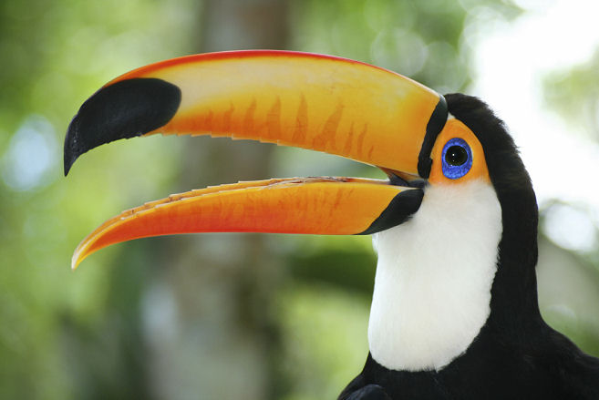
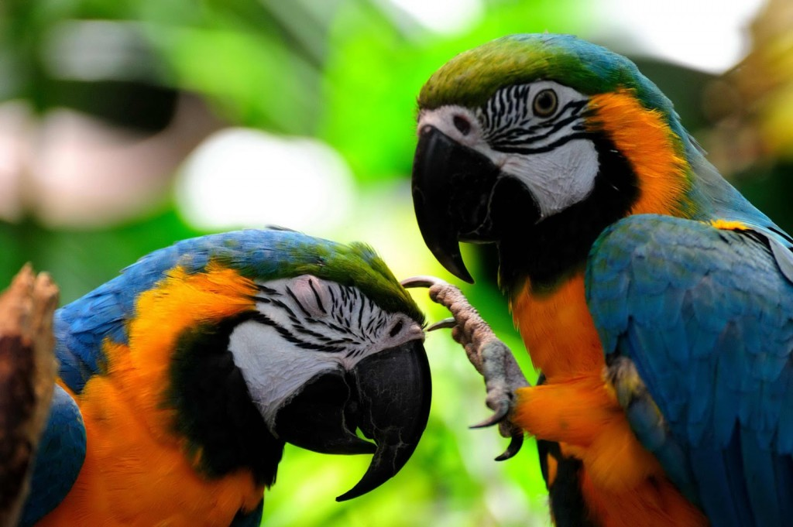
Birds such as Toucans and Parrots

Slide 13
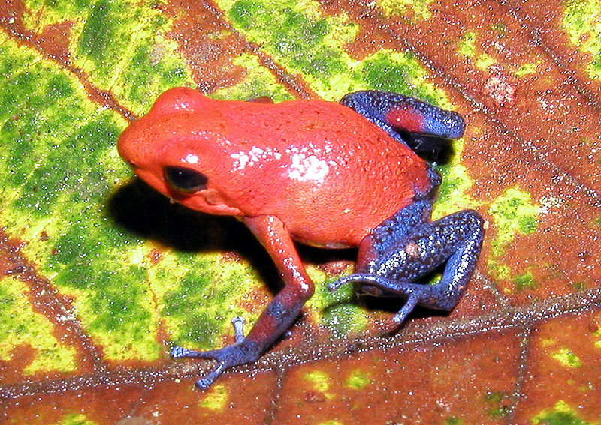
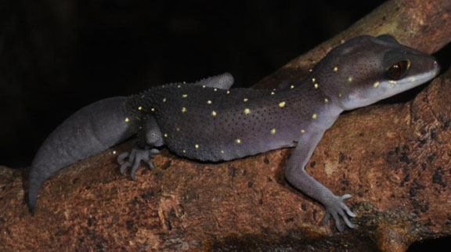
Amphibians such as frogs.

Slide 14
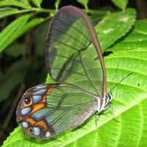
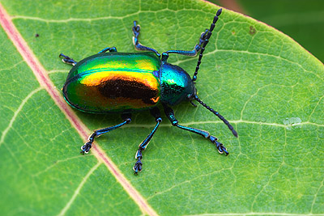
Insects such as butterflies and beetles.

Slide 15
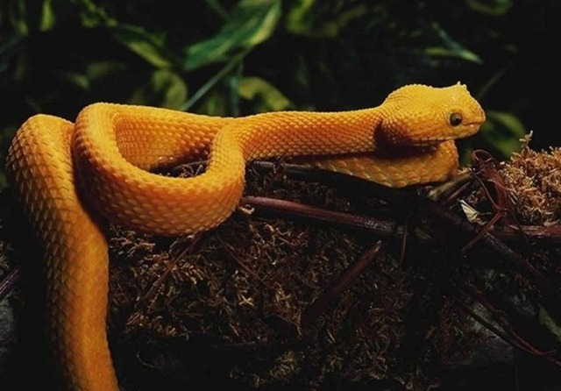
Reptiles such as snakes and lizards.

Slide 16
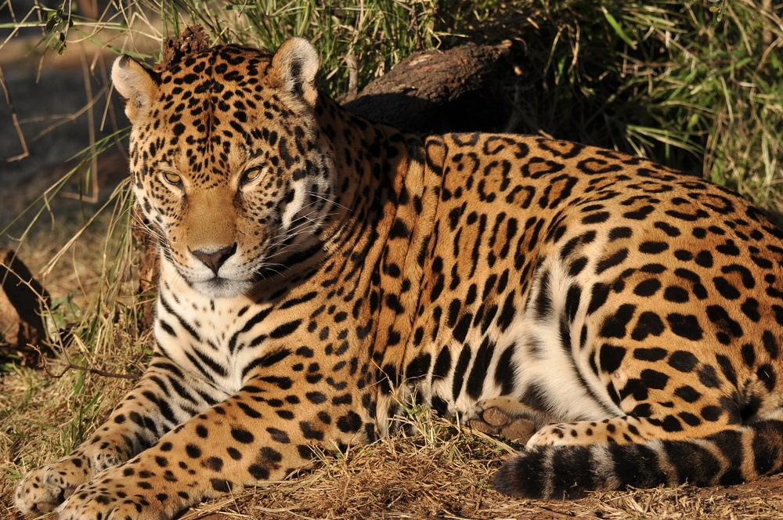
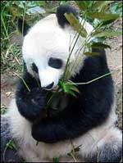

Slide 17
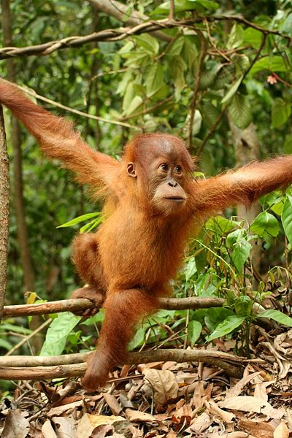
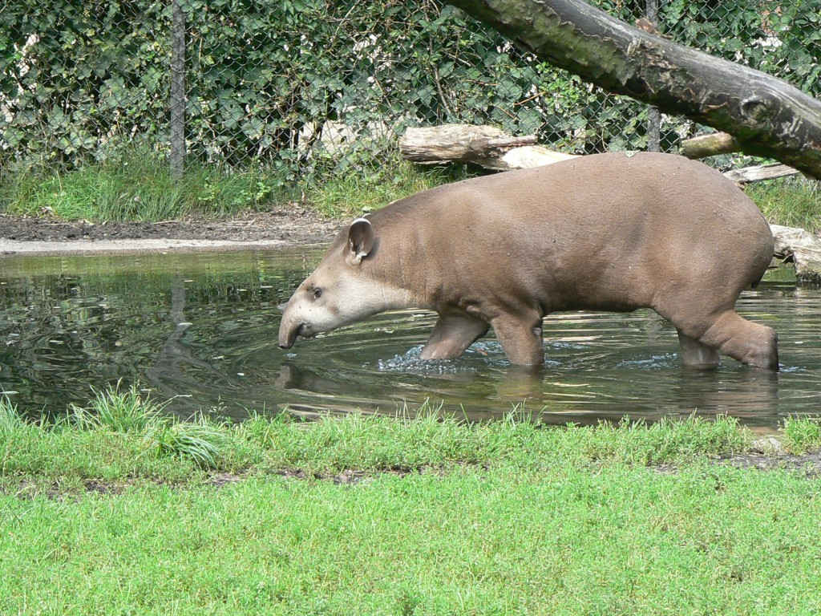
Large mammals such as jaguars and other big cats, pandas, primates like monkeys and gorillas and mammals like Tapirs (a relative of the rhino) live in the rainforest too.

Slide 18
Rainforests
http://www.neok12.com/video/Ecosystems/zX7d6b046345556a70764d51.htm

Slide 19
Why are rainforests in danger?
Every year, rainforests are disappearing.
Every second, a rainforest the same size of a football pitch disappears!
That’s about 31 million football pitches every year!
Rainforests are being cut down for wood which is used for building, burning and furniture.
They are cut down to make way for roads.
They are being cut down to make clear land for animal grazing and farming.

Slide 20
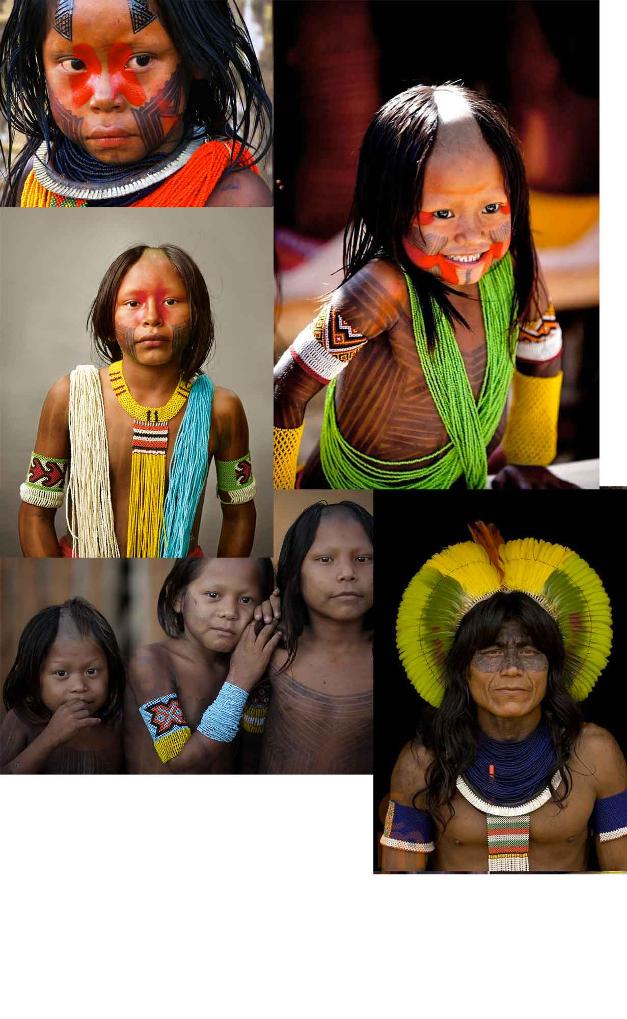
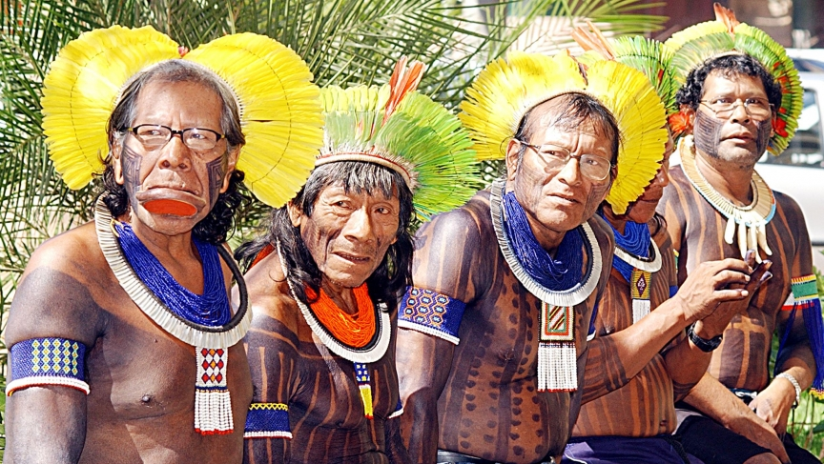
Members of the Kayapos tribe, Brazil

