Slide 1
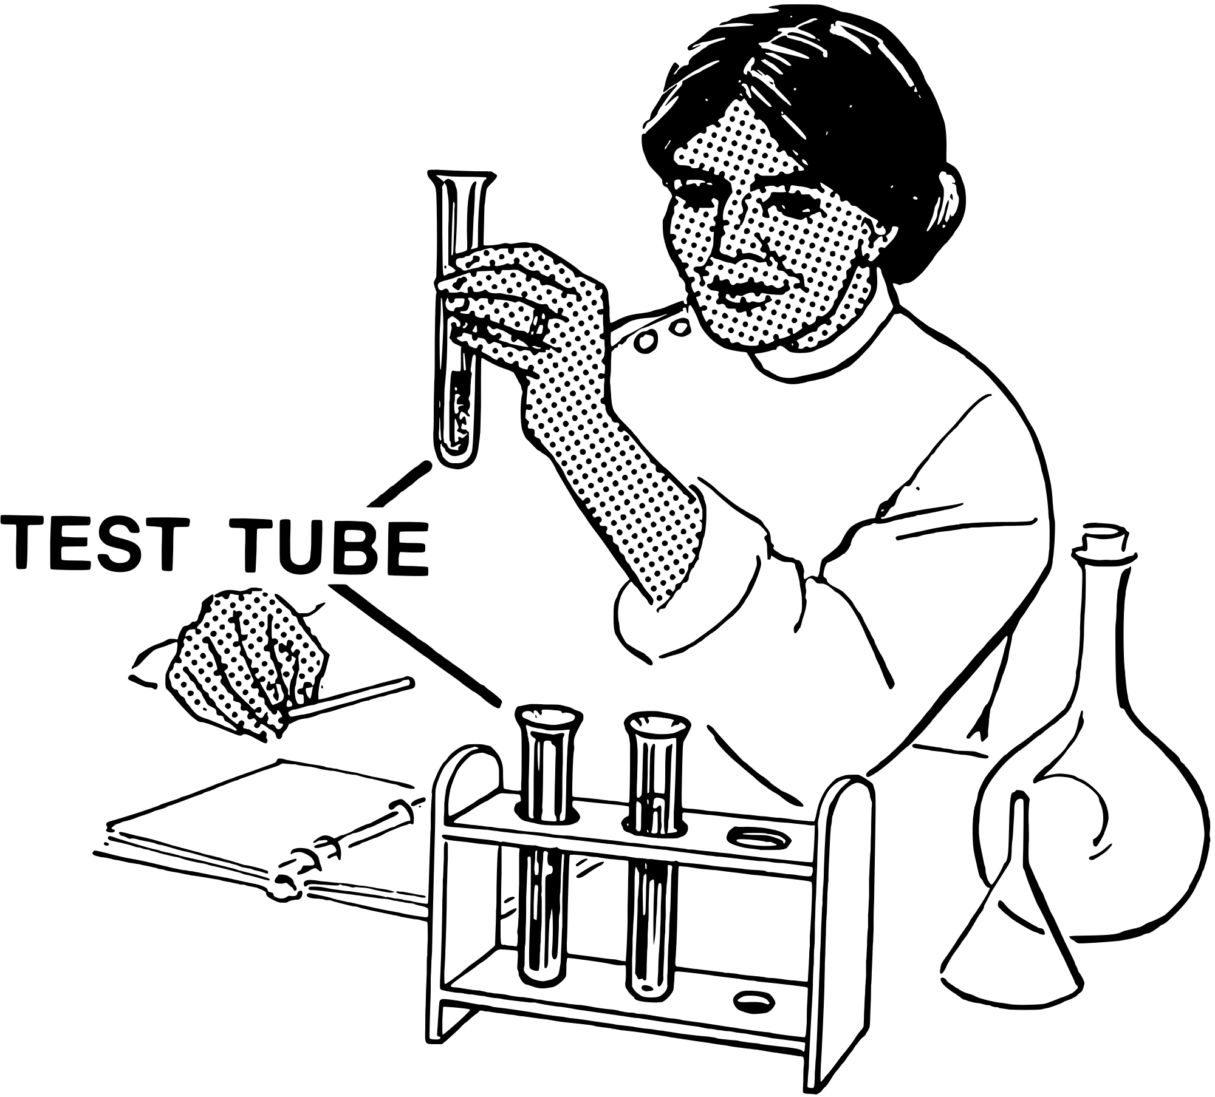

Title: Laboratory Equipment (Apparatus)
Learning Intention
To be able to identify apparatus
To be able to describe the use of each apparatus
To be able to represent apparatus using labeled diagrams

Slide 2
Task One
Each table has a selection of apparatus.
In groups, match the name to the apparatus.
Notes:
Note:
Student cards could be printed by printing the following slides 6 per page. Teacher should place different equipment on each group table. Students in each group need to match the card to the equipment.
A display with real laboratory equipment could be already matched to the associated laminate.
One student from each group could walk over to the laboratory equipment display in order to check group matching activity is correct. This student provides feedback to their group.
Once feedback provided and score marked on card. The groups should rotate to label the equipment on the next group table.

Slide 3
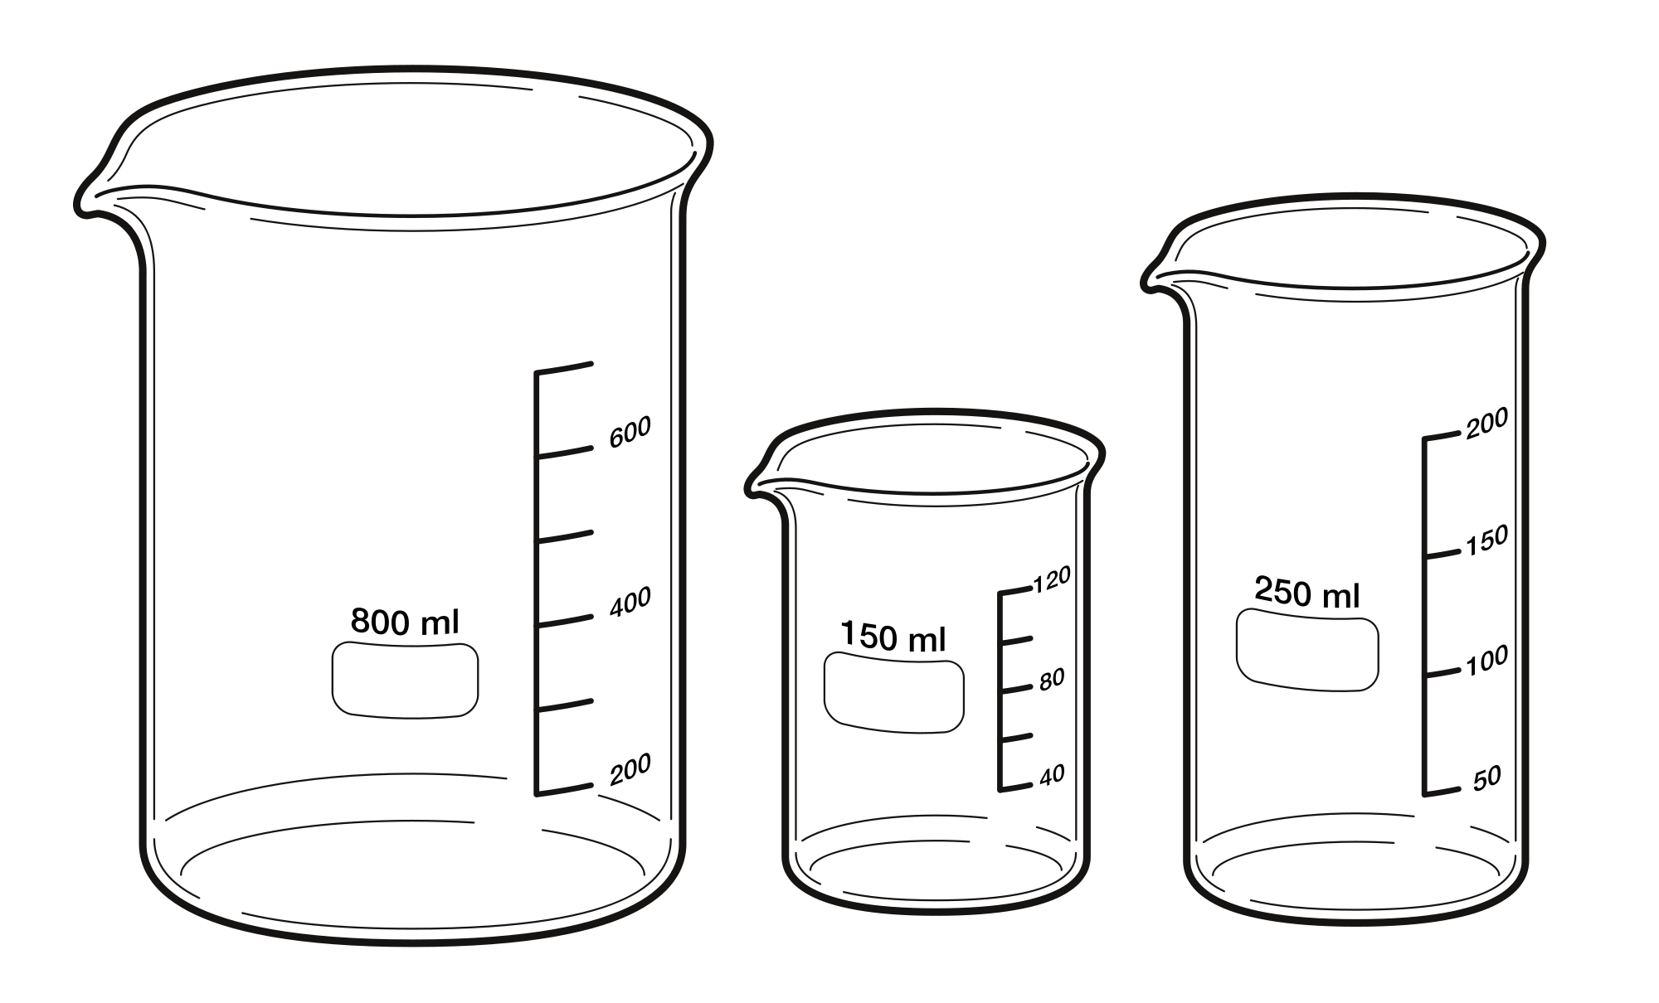
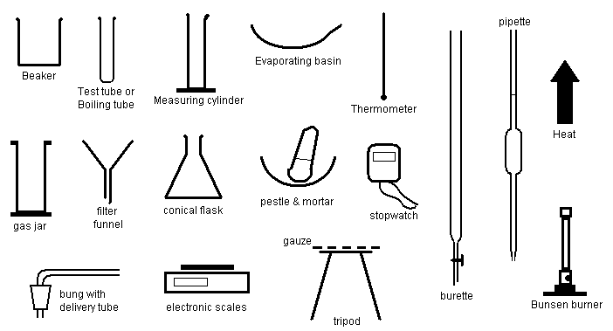
Beaker

Slide 4
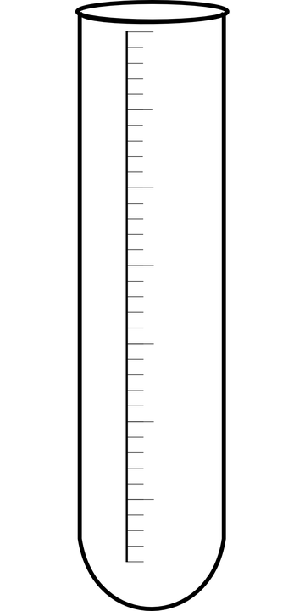
Test Tube

Slide 5
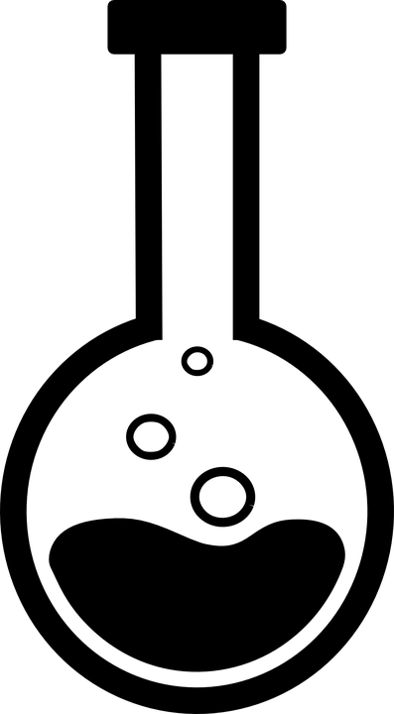
Round Bottomed Flask

Slide 6
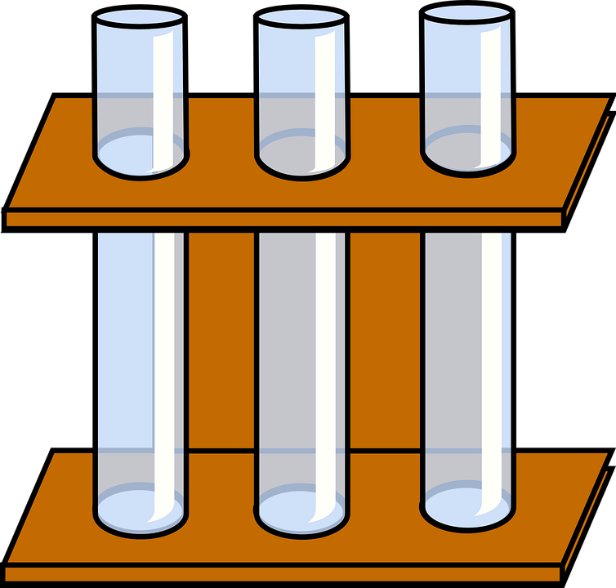
Test Tube Rack

Slide 7
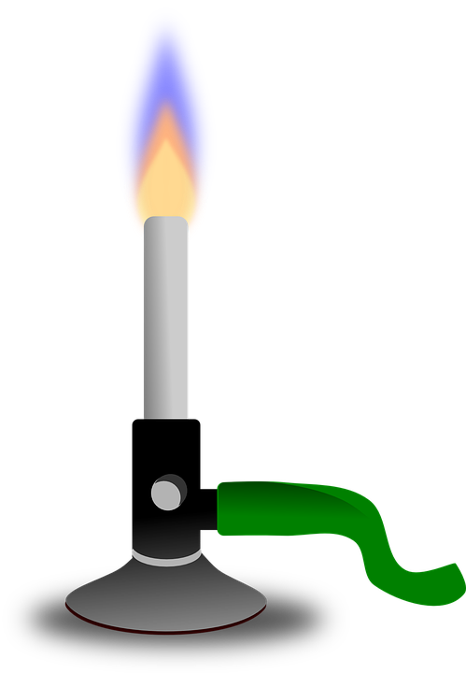
Bunsen Burner

Slide 8
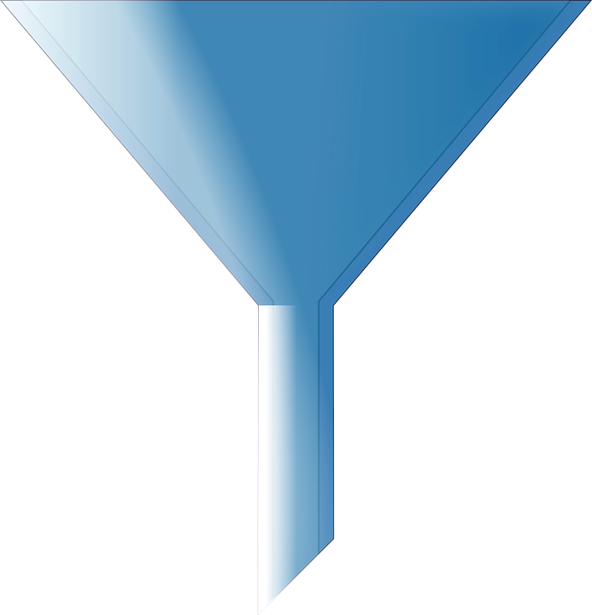
Funnel

Slide 9
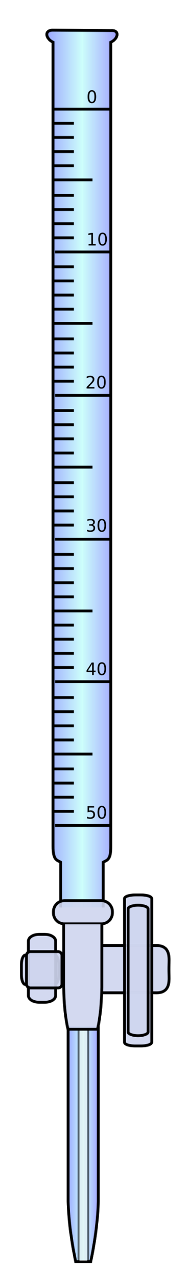
Burette

Slide 10
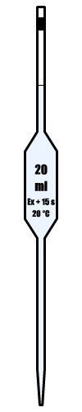
Pipette

Slide 11
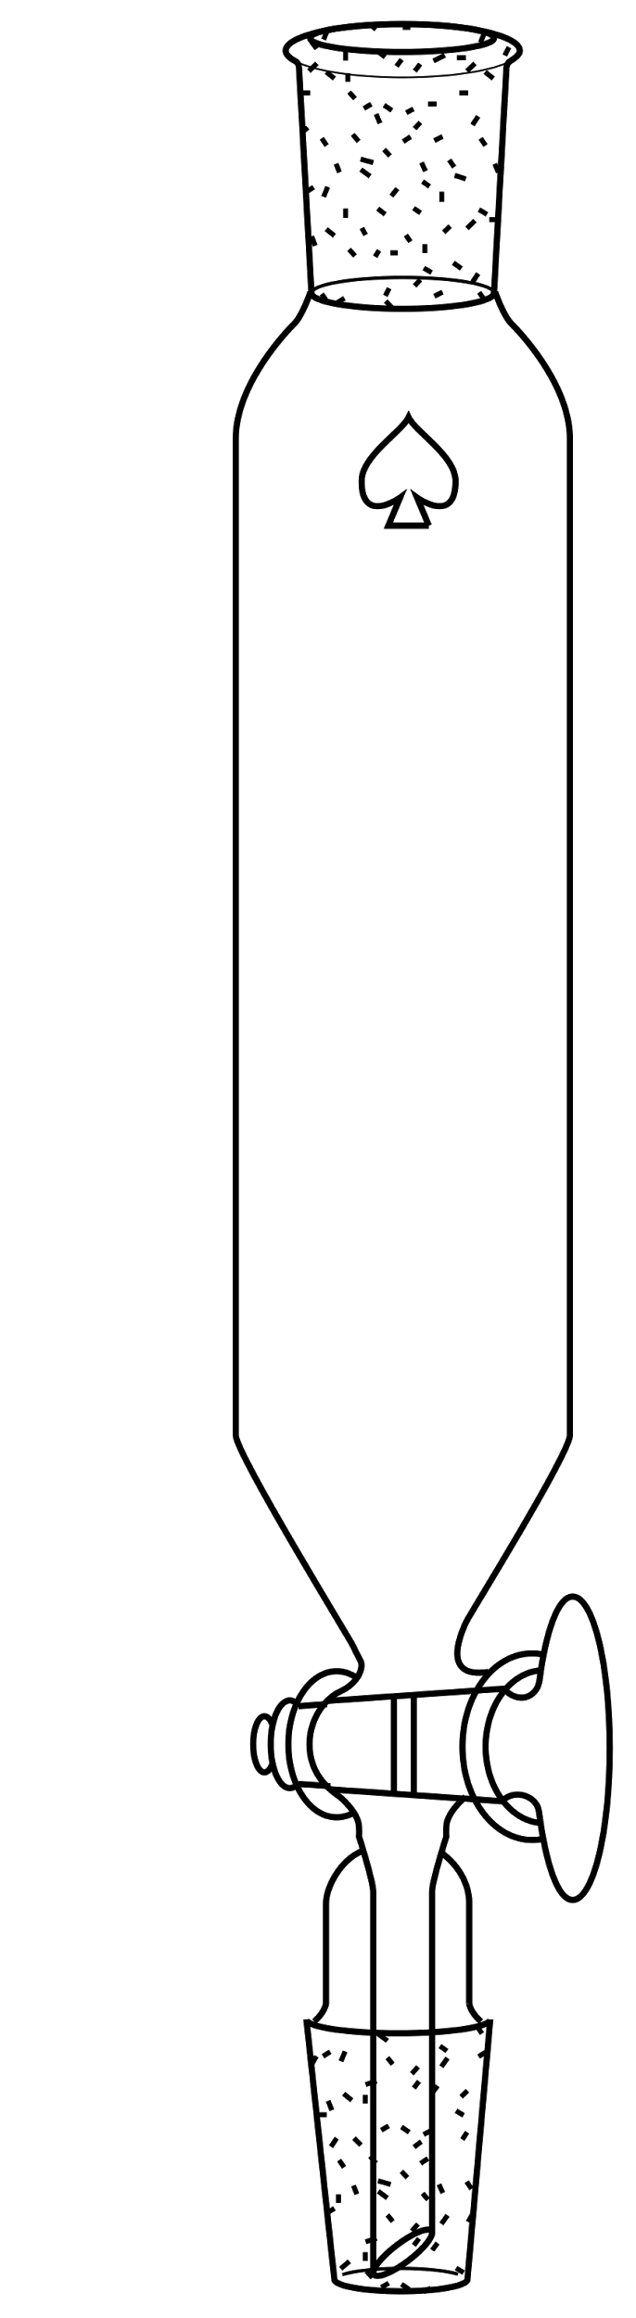
Separating Funnel

Slide 12
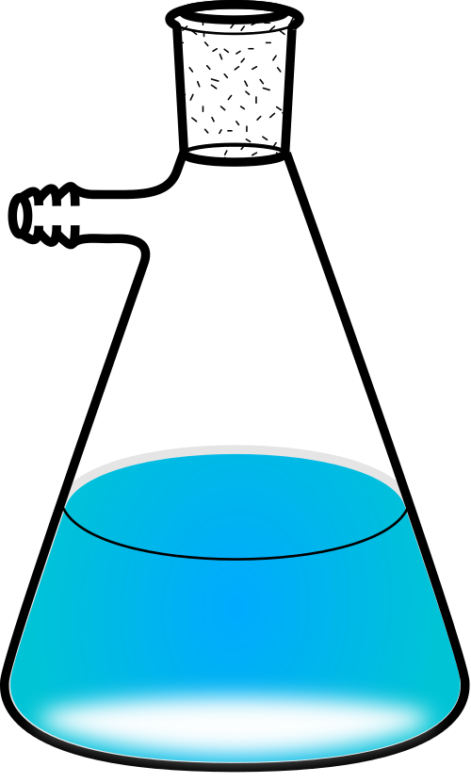
Buchner Flask

Slide 13
Electronic Scale

Slide 14
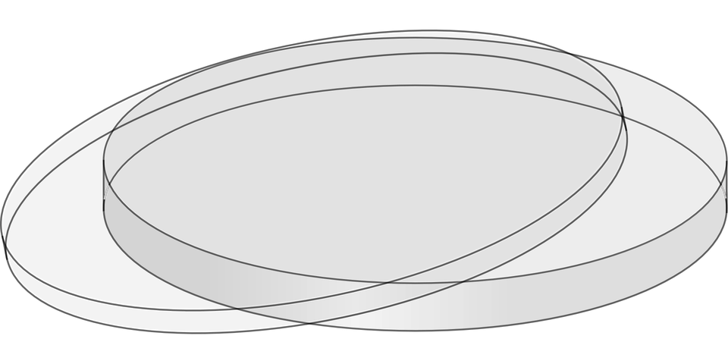
Petri Dish

Slide 15
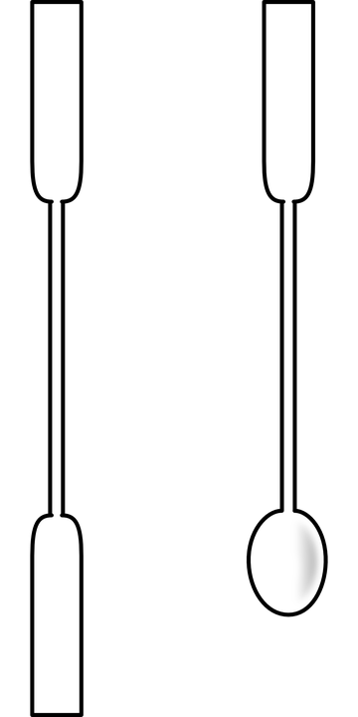
Spatula

Slide 16
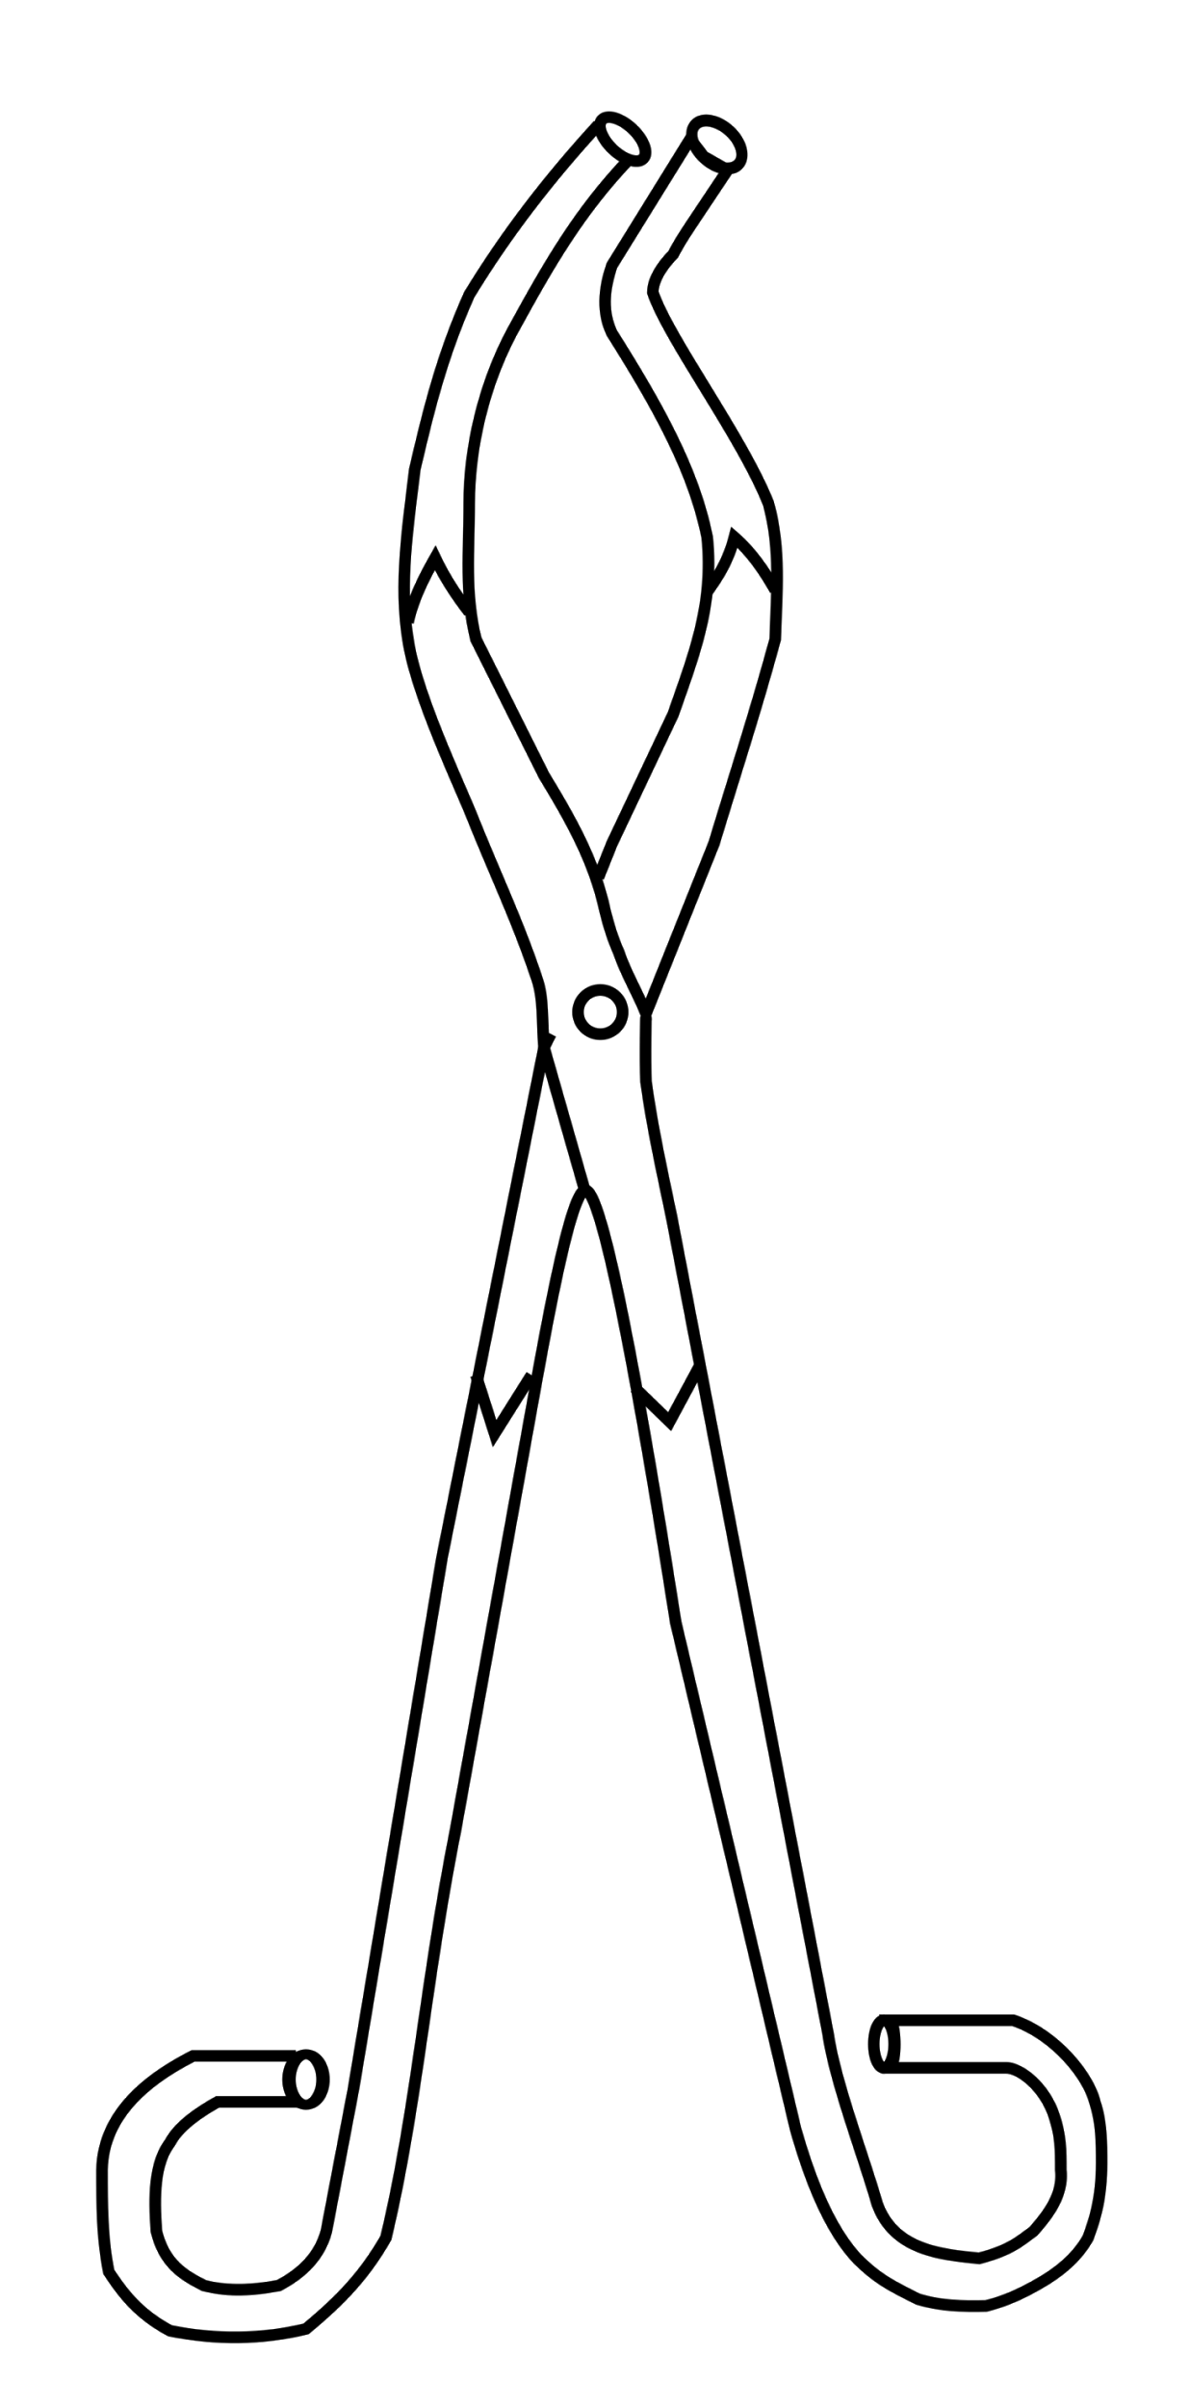
Tongs

Slide 17
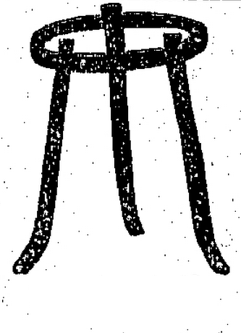
Tripod

Slide 18
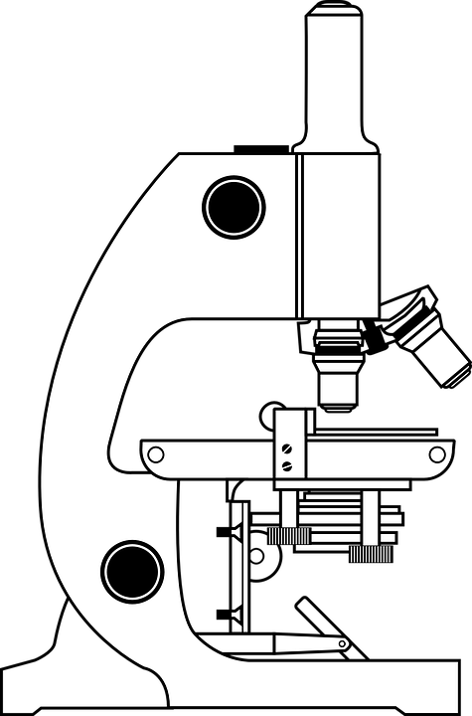
Microscope

Slide 19
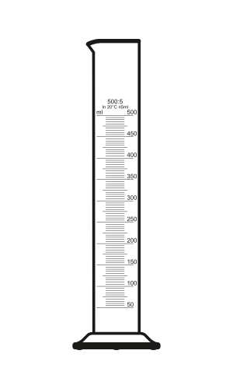
Graduated Cylinder

Slide 20
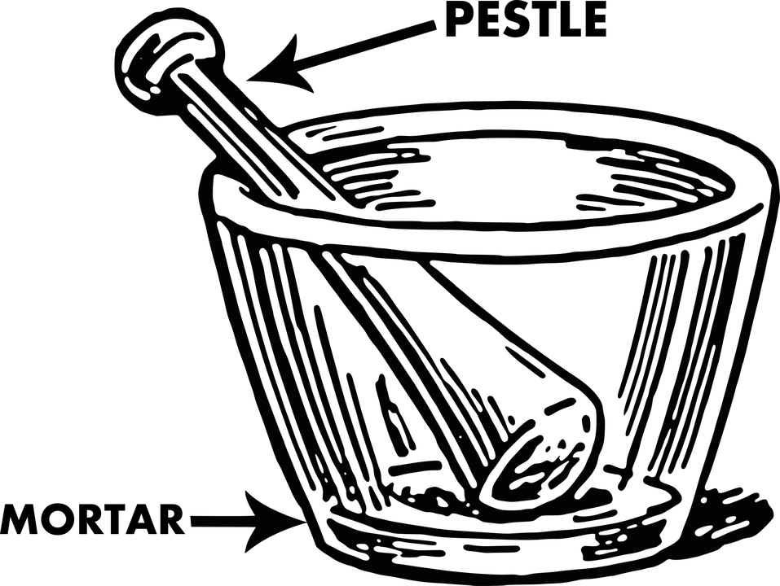
Mortar
&
Pestle

Slide 21
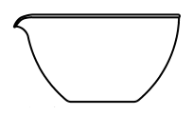
Evaporating Basin

Slide 22
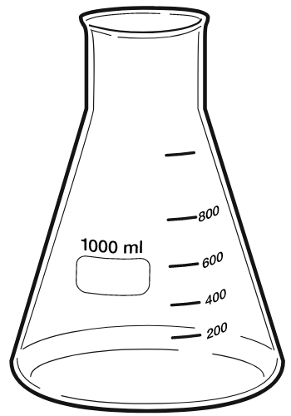
Conical Flask

Slide 23
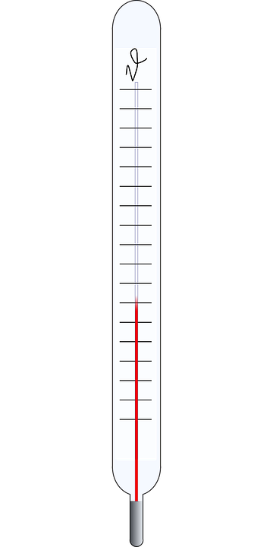
Thermometer

Slide 24
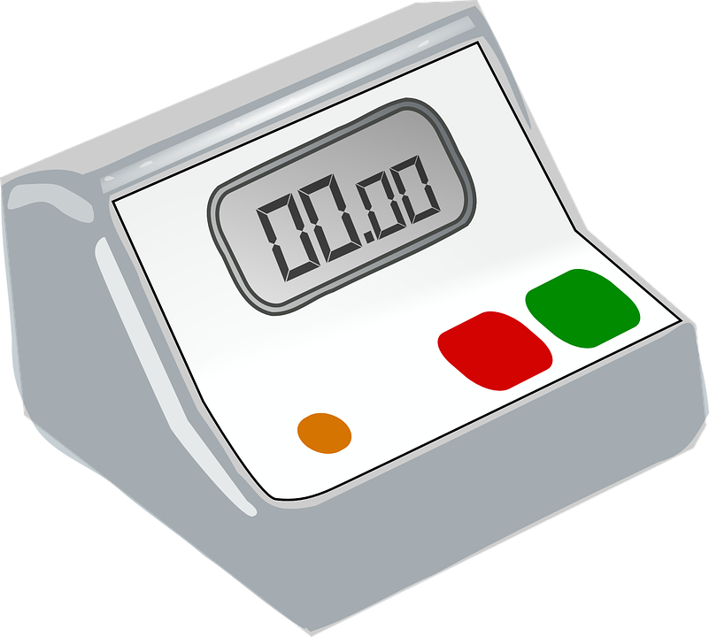
Stop Watch

Slide 25
Gas Jar

Slide 26
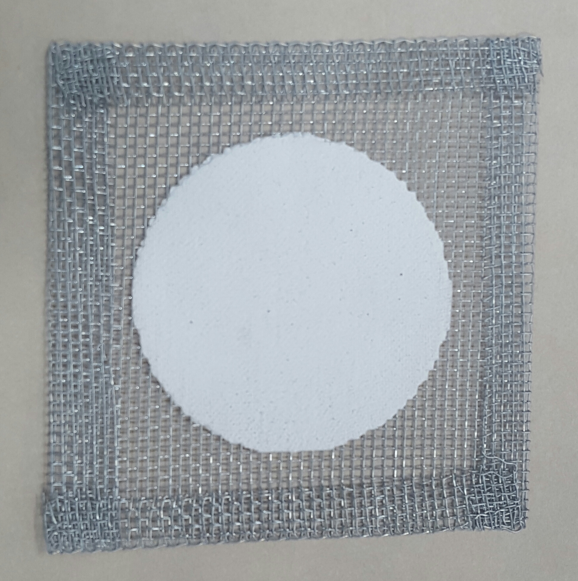
Wire Gauze

Slide 27
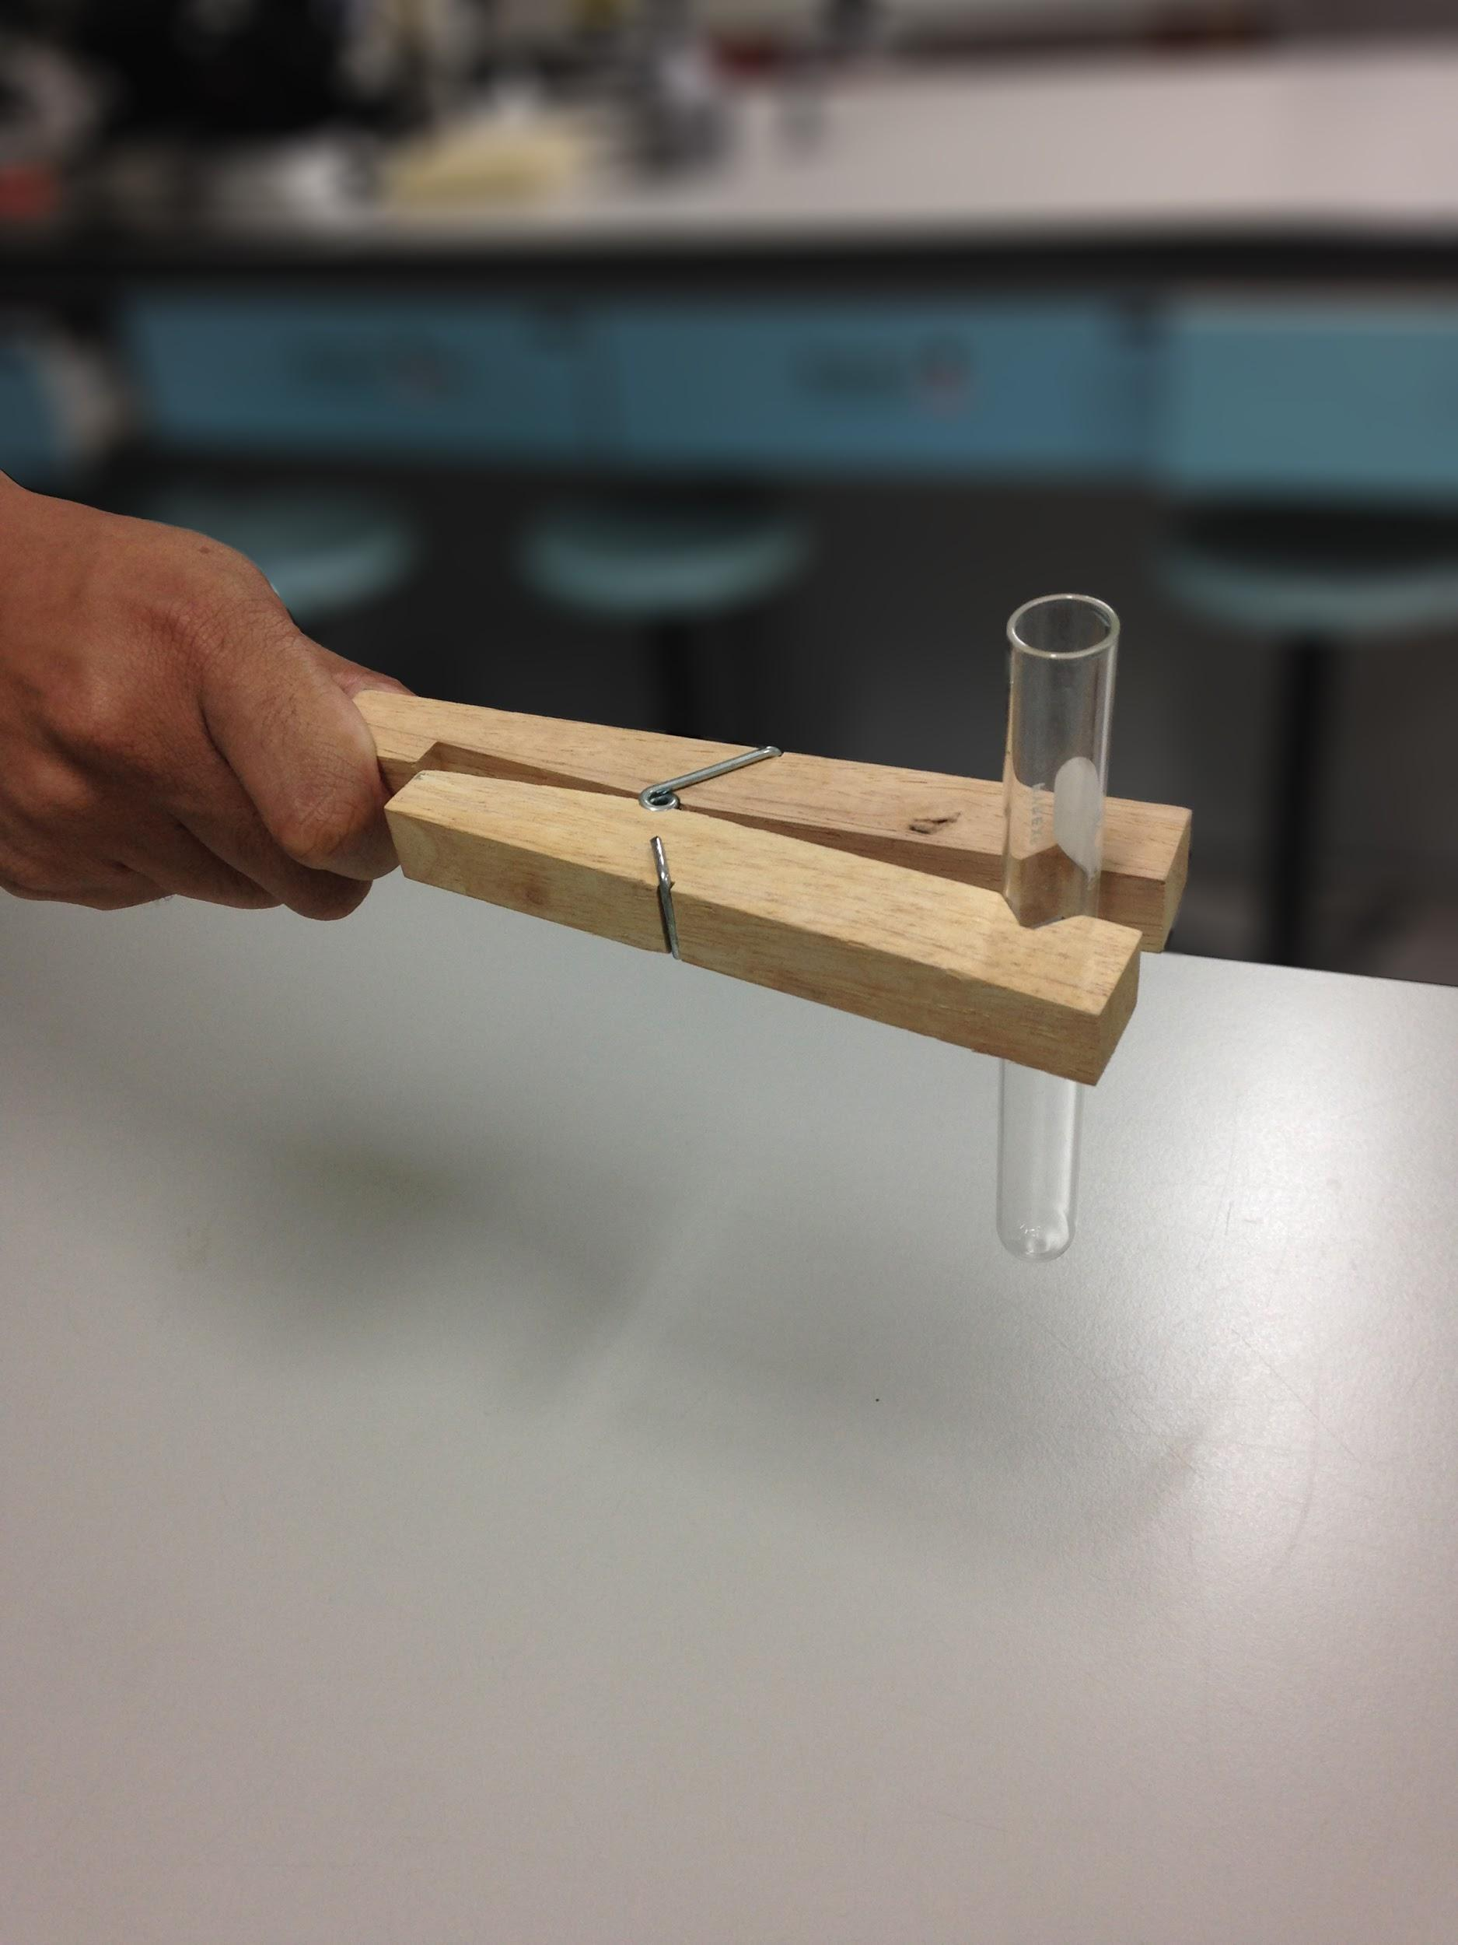
Test Tube Holder

Slide 28
Task Two
Match the apparatus cards
to their function cards.

Slide 29
Used for measuring the amount of time elapsed.

Slide 30
Used for holding a
test tube
or boiling tube.

Slide 31
Used to evaporate a liquid from a solution.
(A concentrated solution or a solid precipitate is left behind)

Slide 32
Used for collecting & holding gas from an experiment.

Slide 33
Used for holding and swirling liquids without spilling.
(The shape also reduces the loss of evaporation)

Slide 34
Used for transferring liquid into a flask.

Slide 35
Used for crushing, grinding & grounding substances.

Slide 36
Used for measuring temperature in degrees.

Slide 37
Used for holding, heating & mixing liquids

Slide 38
Used for supporting wire gauze over a bunsen burner.

Slide 39
Used to hold small quantities of liquid.

Slide 40
Used for distributing heat evenly & supporting beakers/ flasks during heating.

Slide 41
Used for gripping & lifting objects.

Slide 42
Used for measuring volumes of liquids.

Slide 43
Used for channeling liquid into a burette/ container with small opening.

Slide 44
Used for weighing substances.

Slide 45
Used for picking up and transporting small quantities of powder/solid..

Slide 46
Used for magnifying an object.

Slide 47
Used for pressure assisted filtration.

Slide 48
Used for holding liquids. The round bottom enables uniform heating of liquids.

Slide 49
Used for growing microorganisms.

Slide 50
Used for measuring & transferring a fixed volume of liquid with a controlled release.

Slide 51
Used for dispensing an accurate volume of liquid.
(0 - 50 cmз).

Slide 52
Used for holding multiple test tubes upright.

Slide 53
Used for heating, sterilisation and combustion.

Slide 54
Task Three
Draw the following 3D apparatus as 2D scientific drawings.

Slide 55
Beakers
Test Tube

Slide 56
Round Bottomed Flask
Test Tube
Rack

Slide 57
Bunsen Burner
Funnel

Slide 58
Burette
Pipette

Slide 59
Separating Funnel
Buchner Flask

Slide 60
Electronic Scale
Petri Dishes

Slide 61
Spatula
Tongs

Slide 62
Tripod
Microscope

Slide 63
Graduated Cylinder
Mortar & Pestle

Slide 64
Evaporating Basin
Conical Flask

Slide 65
Thermometer
Stop Watch

Slide 66
Gas Jar
Wire Gauze

Slide 68
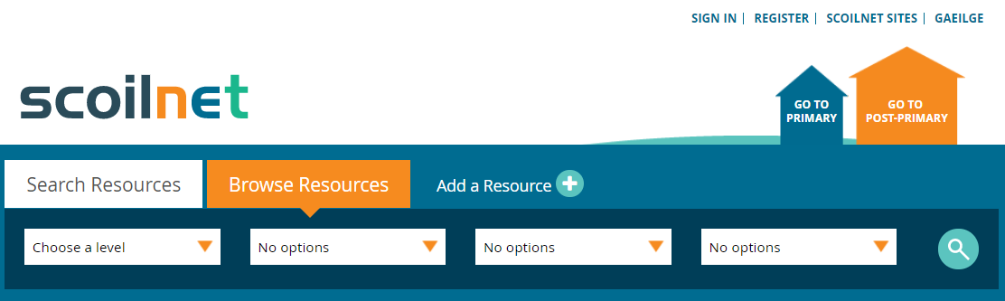
Visit www.scoilnet.ie to browse more FREE resources.
OR
Share your own resources through Scoilnet.
All images are labeled ‘non-commercial re-use with modification’ (Date accessed: 14/09/17)

