Slide 1


Slide 2
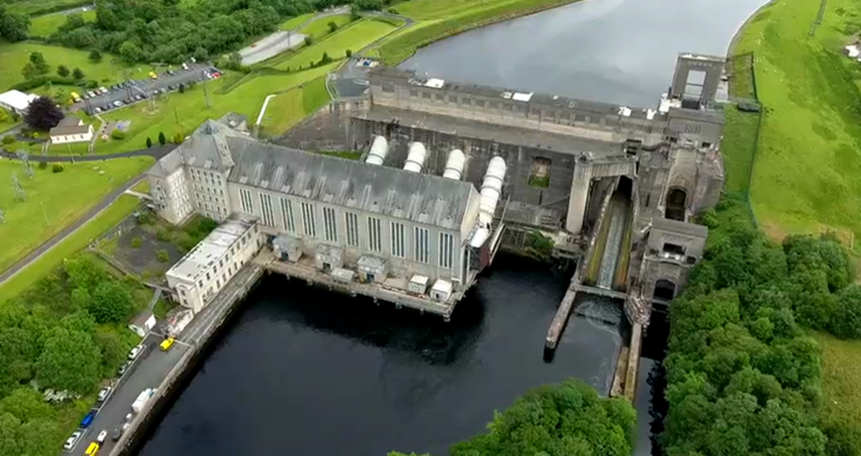

Learning Intentions:
In this unit, we will learn how to
Outline how electricity is generated in a hydroelectric power station.
Describe the way in which energy is transferred.
Design, build and test a model of a turbine.
Links to Junior Cycle Science specification:
Physical World 6,7 Earth & Space 6 Nature of Science 3,

Slide 3
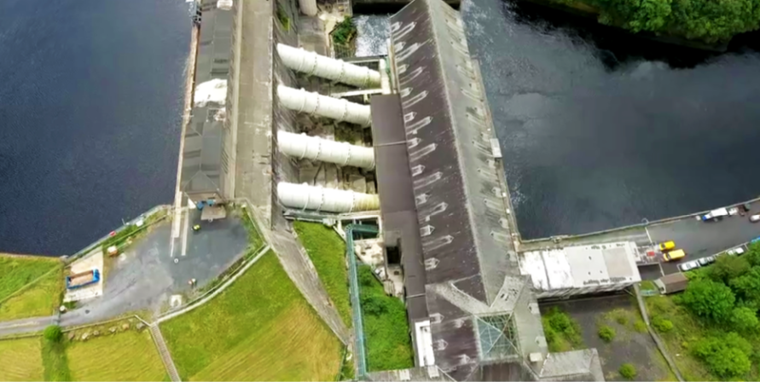


Two Truths, One Lie
Starter:
Write the two truths into your Building Ireland booklet?
The principle of conservation states that
energy changes from one form to another form.
So energy from falling water can be converted to electrical energy.
Electrical energy is a very useful form of energy but it can be dangerous.
Someone can get electrocuted if water is allowed enter a plug socket or touch a frayed cable.
Electrical energy is produced in a hydroelectric power station.
The electrical energy is produced in the turbine of the power station.

Slide 4
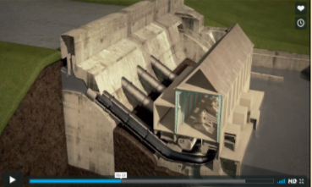
Watch the video:
After the Video:
Narrate the storyboard worksheet by including descriptions.
Descriptions should detail how the Ardnacrusha hydro-electric power station works.

Slide 5
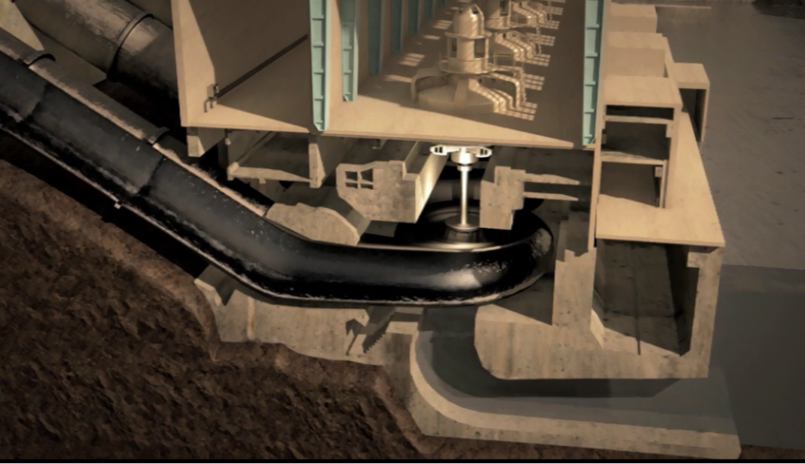
Keywords
Generator
Shaft
Penstock
Turbine
Additional Keywords:
Dam
National Grid
Ardnacrusha
Kinetic Energy
Potential Energy

Slide 6
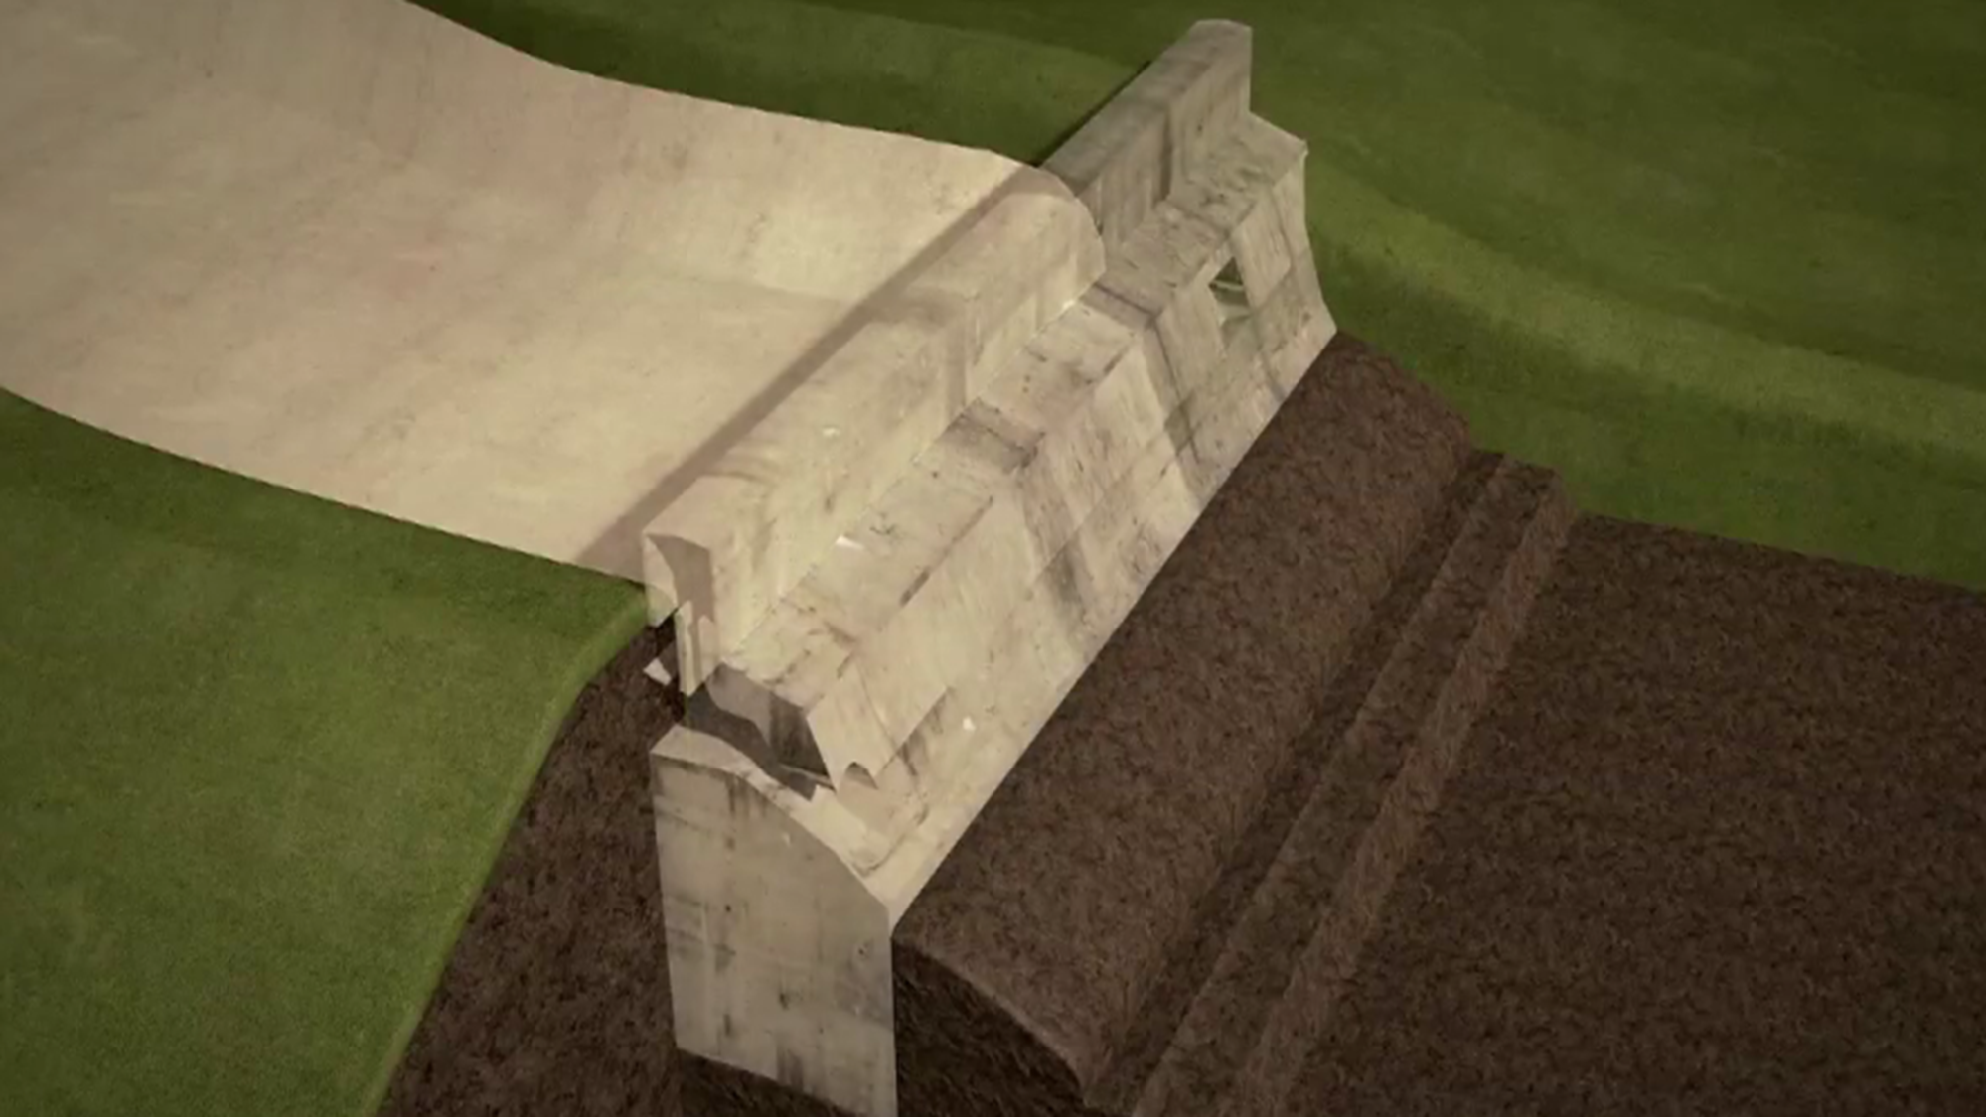
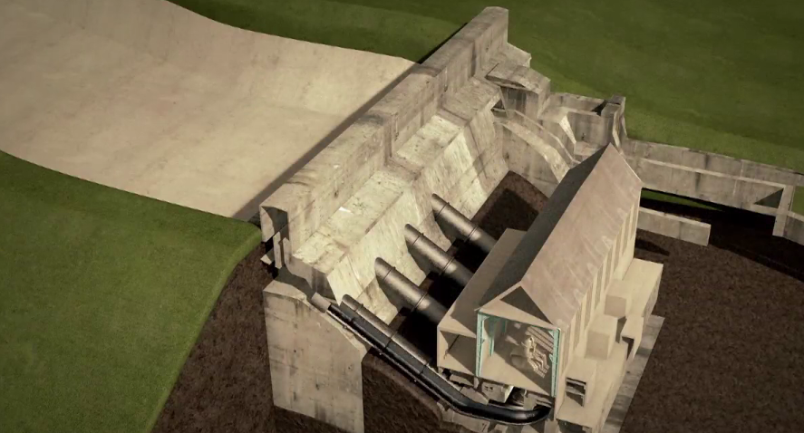
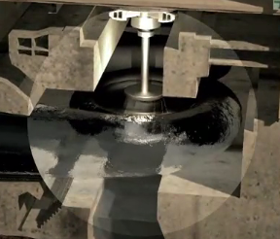
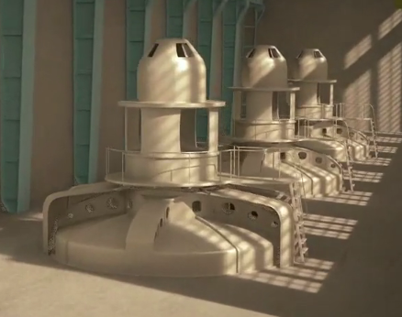
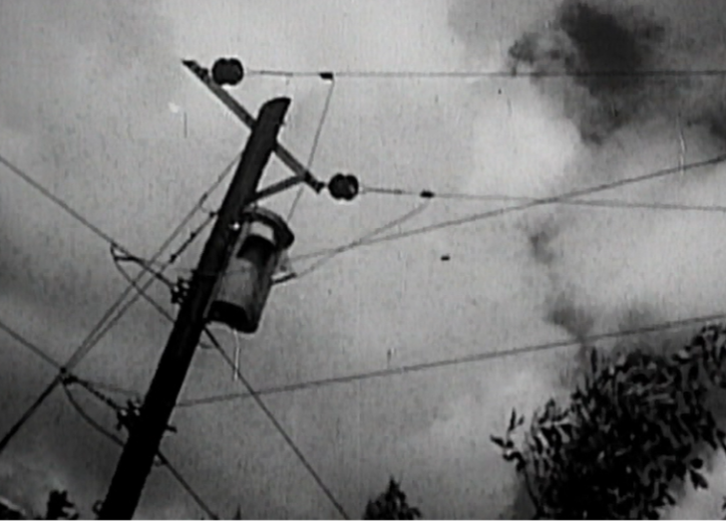
__________________________________________________________________ | __________________________________________________________________ | __________________________________________________________________
__________________________________________________________________ | __________________________________________________________________ | __________________________________________________________________
Download Storyboard Worksheet.

Slide 7
A massive 30 metre dam wall with sluice gates was built in Ardnacrusha, Co. Clare | The dam wall holds back the water and controls the flow of water. | When the sluice gates are open, the water falls down through the penstocks towards the turbine.
The water strikes and turns the large blades of the turbine. The turbine is connected to the generator by means of a shaft | Electricity is generated in the generator. | The generated electricity is then given to the National Grid to distribute around Ireland.
Sample Answers

Slide 8
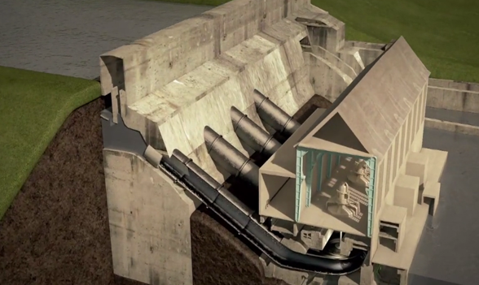
Forms of Energy
Kinetic
Q. In pairs, discuss what energy transfers are taking place in the hydroelectric power station?
Click on the words to learn more about each form of energy
ANSWER
POTENTIAL
Heat
SOUND
LIGHT
nuclear
electrical
Chemical

Slide 9
Forms of Energy
Answer:
POTENTIAL
sound
heat
LIGHT
Kinetic
electrical
nuclear
chemical
Potential Energy -> Kinetic Energy -> Electrical Energy

Slide 10
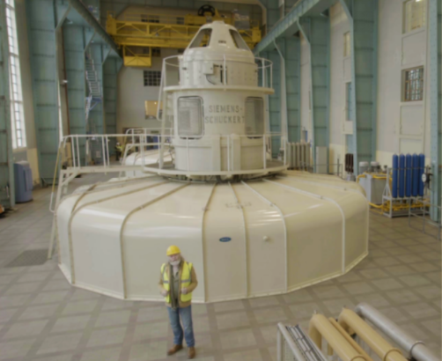
TAKE HOME ACTIVITY:
Design a turbine.
Think About:
Safety of design
Research the design of the waterwheel.
Shape of the waterwheel
Number of fins on the waterwheel
Materials used in making the waterwheel
Rotations per minute
Rate of rotations
Flow rate of the water
Challenge: In the next lesson, build and test a turbine model using the ‘Experiment Worksheet’.
Note: Teachers should complete a risk assessment for the experiment.
Download Design Worksheet.
Download Experiment Worksheet

Slide 11
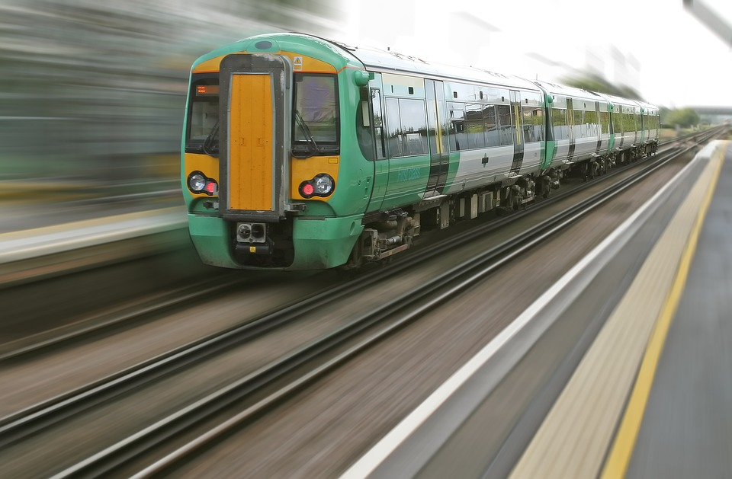
Forms of Energy
Kinetic
Any moving object has kinetic energy
POTENTIAL
Heat
SOUND
LIGHT
Nuclear
Electrical
Chemical
Return
Click on ‘RETURN’ to return to the task.

Slide 12
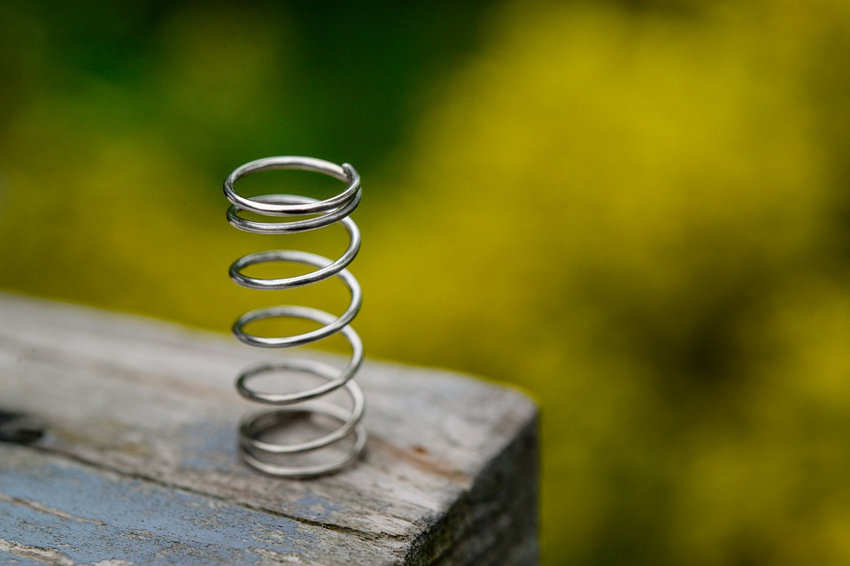
Forms of Energy
Kinetic
Stored energy due to the position of an object
POTENTIAL
Heat
SOUND
LIGHT
Nuclear
Electrical
Chemical
Return
Click on ‘RETURN’ to return to the task.

Slide 13
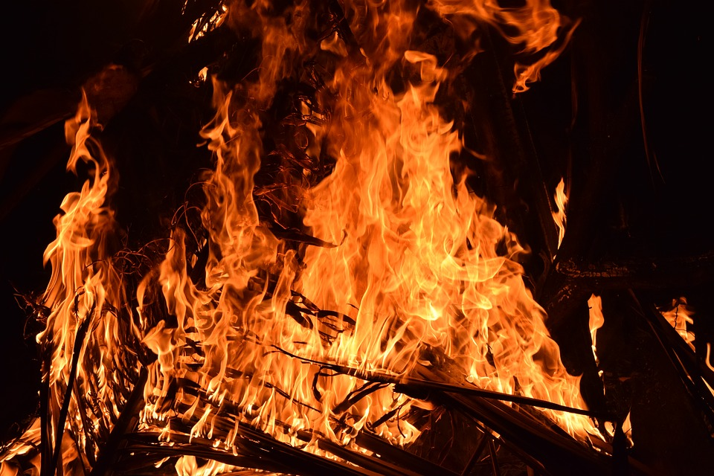
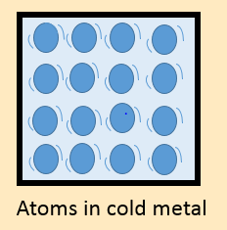
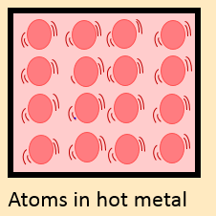
Forms of Energy
Kinetic
A form of energy that is generated by the movement of atoms and molecules.
POTENTIAL
Heat
SOUND
LIGHT
Nuclear
Electrical
Chemical
Return
Click on ‘RETURN’ to return to the task.

Slide 14

Forms of Energy
Kinetic
A form of energy produced by vibrating waves.
POTENTIAL
Heat
SOUND
LIGHT
Nuclear
Electrical
Chemical
Click on ‘RETURN’ to return to the task.
Return

Slide 15
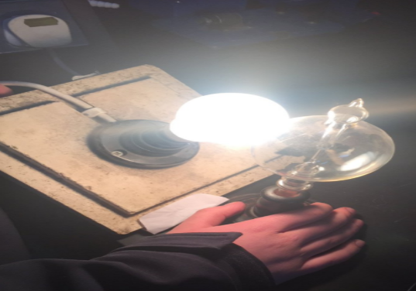
Forms of Energy
Kinetic
A form of energy that travels away from the source producing it at a speed of 300, 000, 000 m/s.
POTENTIAL
Heat
SOUND
LIGHT
Nuclear
Electrical
Chemical
Return
Click on ‘RETURN’ to return to the task.

Slide 16

Forms of Energy
Kinetic
A form of energy released by a nuclear reaction
(Fusion or fission)
POTENTIAL
Heat
SOUND
LIGHT
Nuclear
Electrical
Chemical
Return
Click on ‘RETURN’ to return to the task.

Slide 17
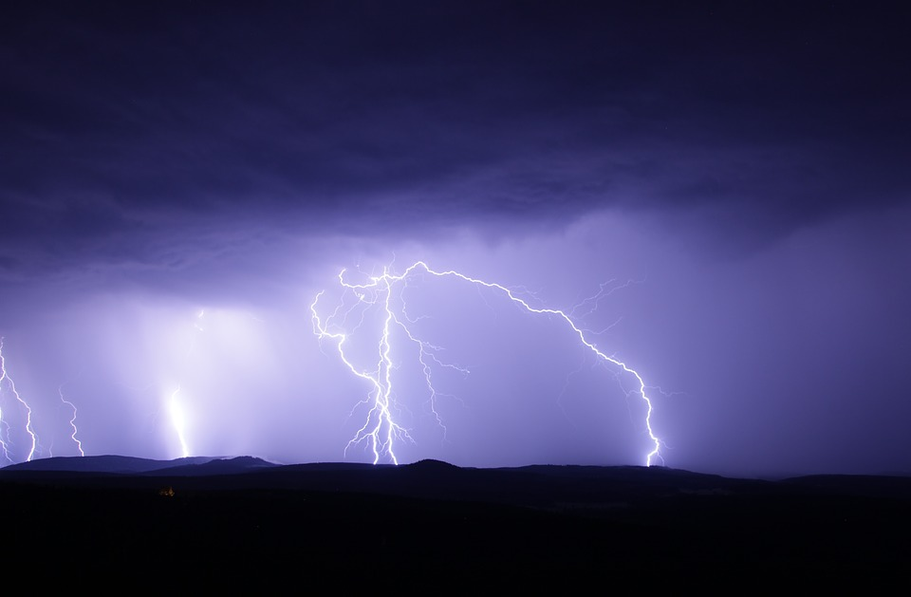
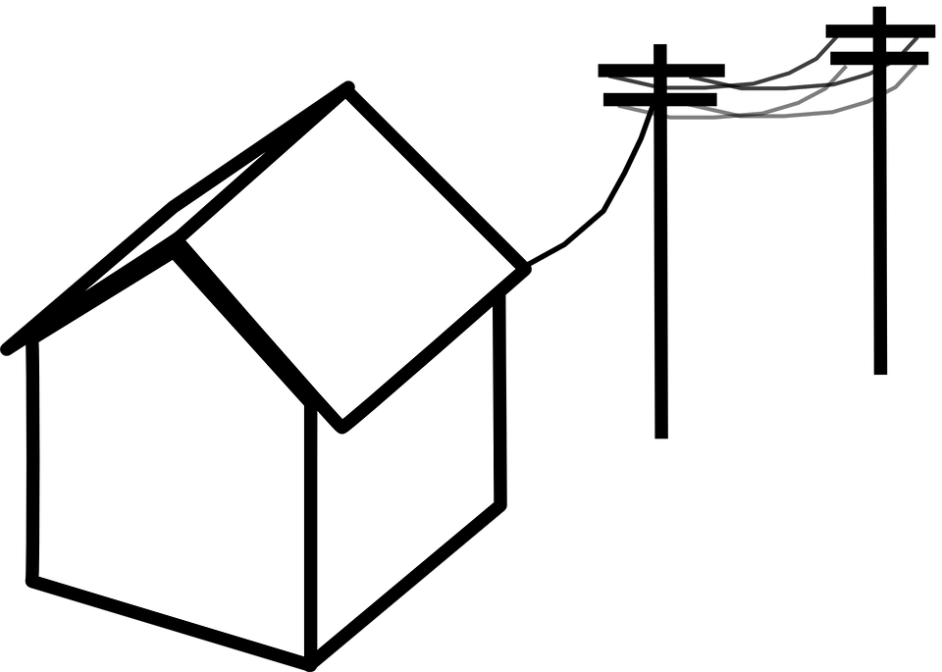
Forms of Energy
Kinetic
An example of electric energy is the movement of electrons.
POTENTIAL
Heat
SOUND
LIGHT
Nuclear
Electrical
Chemical
Return
Click on ‘RETURN’ to return to the task.

Slide 18
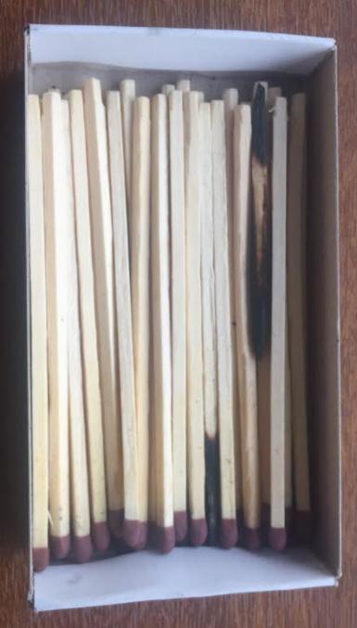
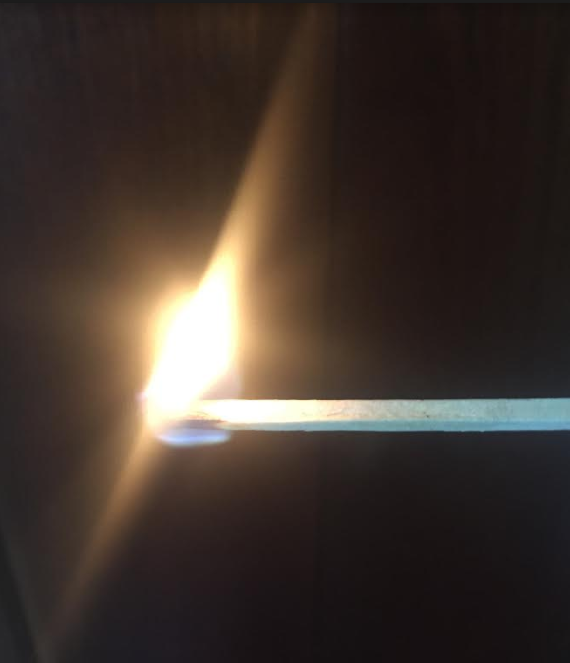
Forms of Energy
Kinetic
Stored energy in the bonds of Chemical compounds.
Chemical Energy is released during a chemical reaction.
POTENTIAL
Heat
SOUND
LIGHT
Nuclear
Electrical
Chemical
Return
Click on ‘RETURN’ to return to the task.

Slide 20
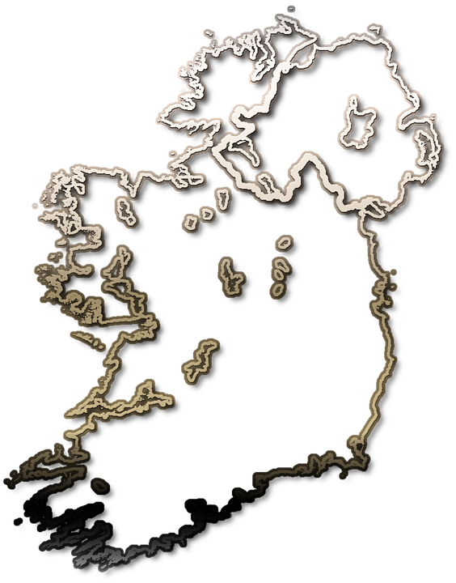
Useful Links
Look at the location of Ireland’s hydroelectric power stations using the ESB Interactive Map show.
Extension - Choose one of the hydroelectric power stations, research and present your findings on your chosen hydroelectric power station.

