Slide 1


Slide 2

Maths syllabus links:
Junior Cycle:
Strand 2.1 Synthetic geometry: Concepts
Strand 2.4 Transformation Geometry: Symmetry
Strand 2.5: Synthesis and Problem-Solving Skills
Strand 3.1 Number Systems: Ratio
Strand 4.2 Representing situations with tables, diagrams and graphs
Strand 4.3 Finding formulae: Patterns

Slide 3
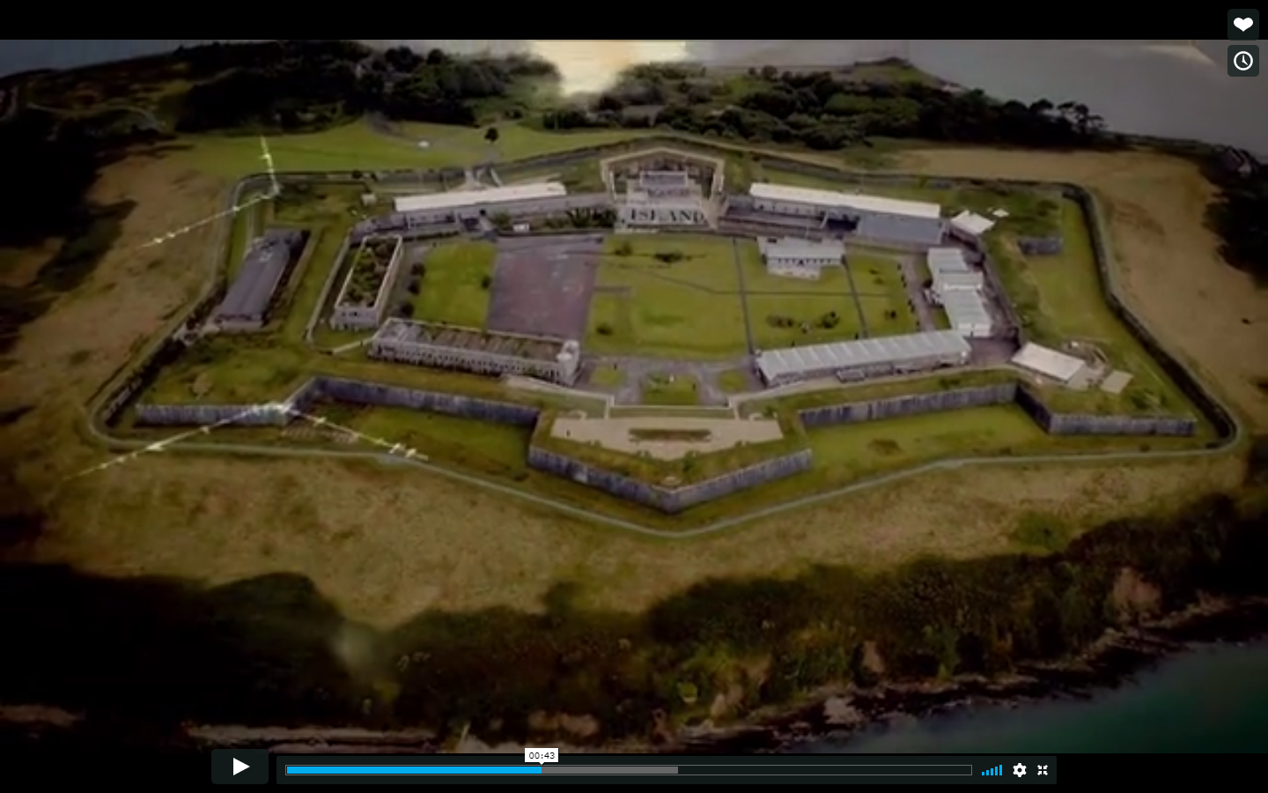
Learning Intentions:
In this unit, we will learn how to
Locate axes of symmetry
Recognise images of objects under transformations
Recognise regular polygons and their angles
Find patterns and formulae
Draw conclusions and justify your answers

Slide 4
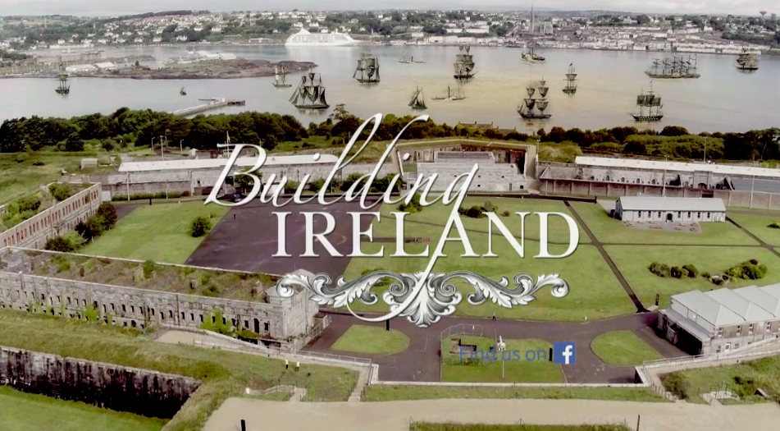
Spike Island: Symmetry
Watch the video called ‘Engineering Fortress Spike Island’
As you watch it, keep an eye out on it’s layout from above as you will be investigating symmetry and angles afterwards

Slide 5
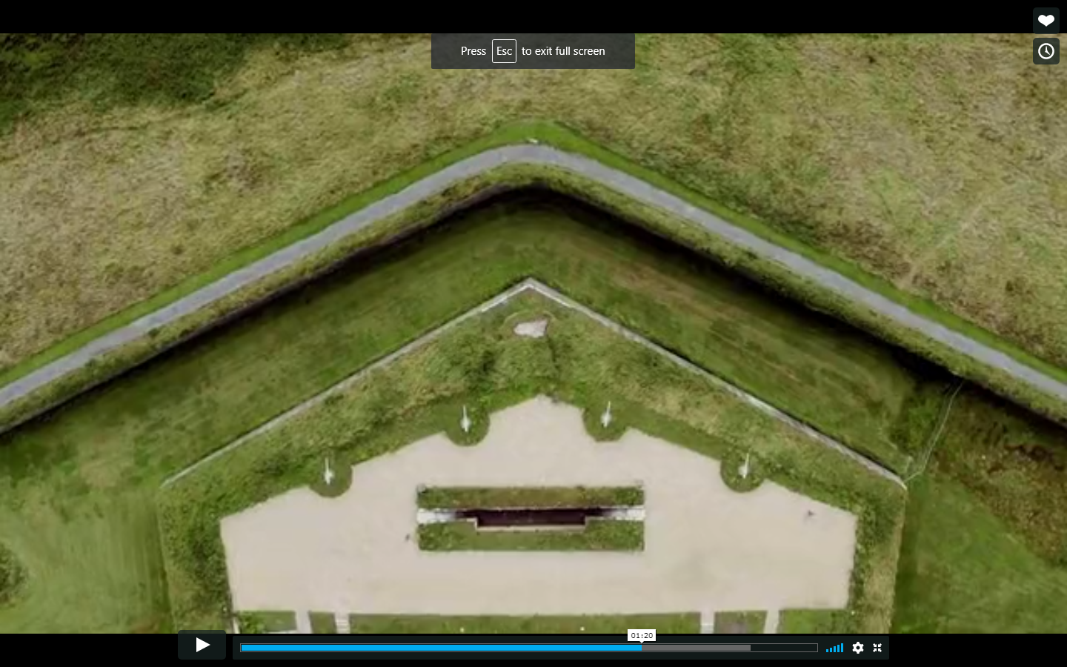
Spike Island: Angles
Spike Island is full of angles and shapes on a huge scale
What type of shape is shown here?
  Triangle
What specific type of triangle?
  Isosceles

Slide 6
Spike Island: Axes of Symmetry
How many axes of symmetry does this image have?
  One
What type of transformation maps the left side to the right side?
  Axial Symmetry through the pink line

Slide 7
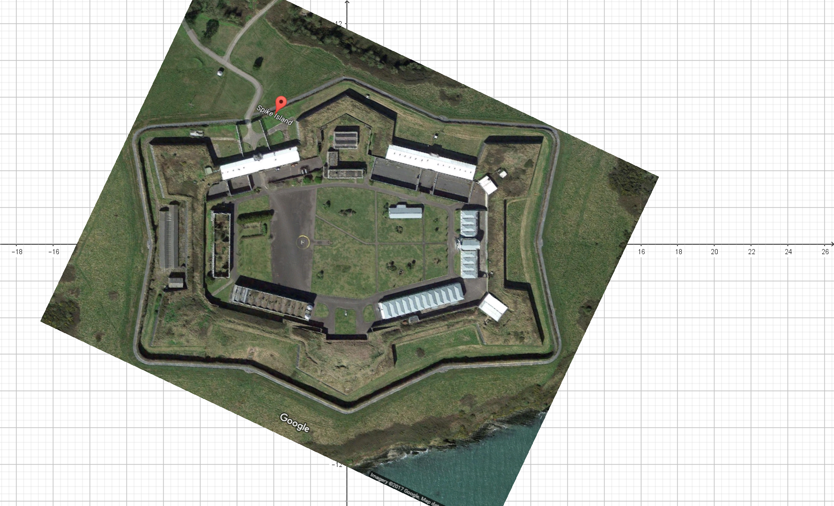
Spike Island: Transformations
This is a Google Maps view of Spike Island’s Star Fort
You can clearly see the 6 bastions mentioned in the video clip and the ‘star’ shape
(Printable version available)

Slide 8
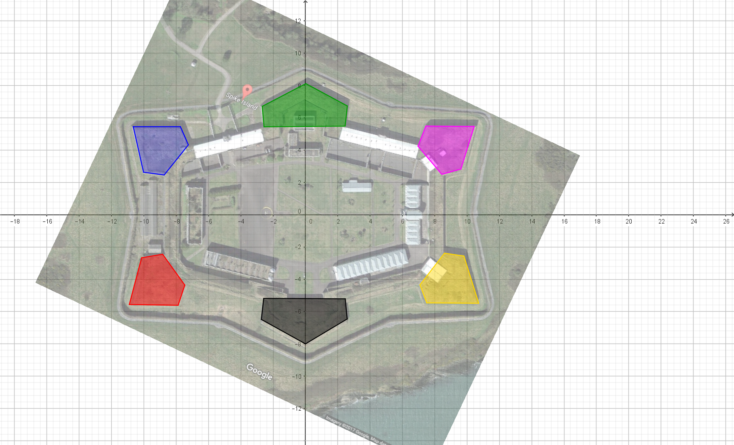
Spike Island: Transformations
Highlighted are the 6 bastions in blue, green, pink, red, black and yellow
We have placed a co-ordinate plane over the image with an x and y-axis
The symmetry is more obvious now once these sections are highlighted

Slide 9

Spike Island: Transformations
If the BLUE shape is our object:
What transformation would map it onto PINK?
  Axial Symmetry in y-axis
What transformation would map it onto RED?
  Axial Symmetry in x-axis
What transformation would map it onto YELLOW?
  Central Symmetry in Origin(0,0)
(Printable version available)

Slide 10
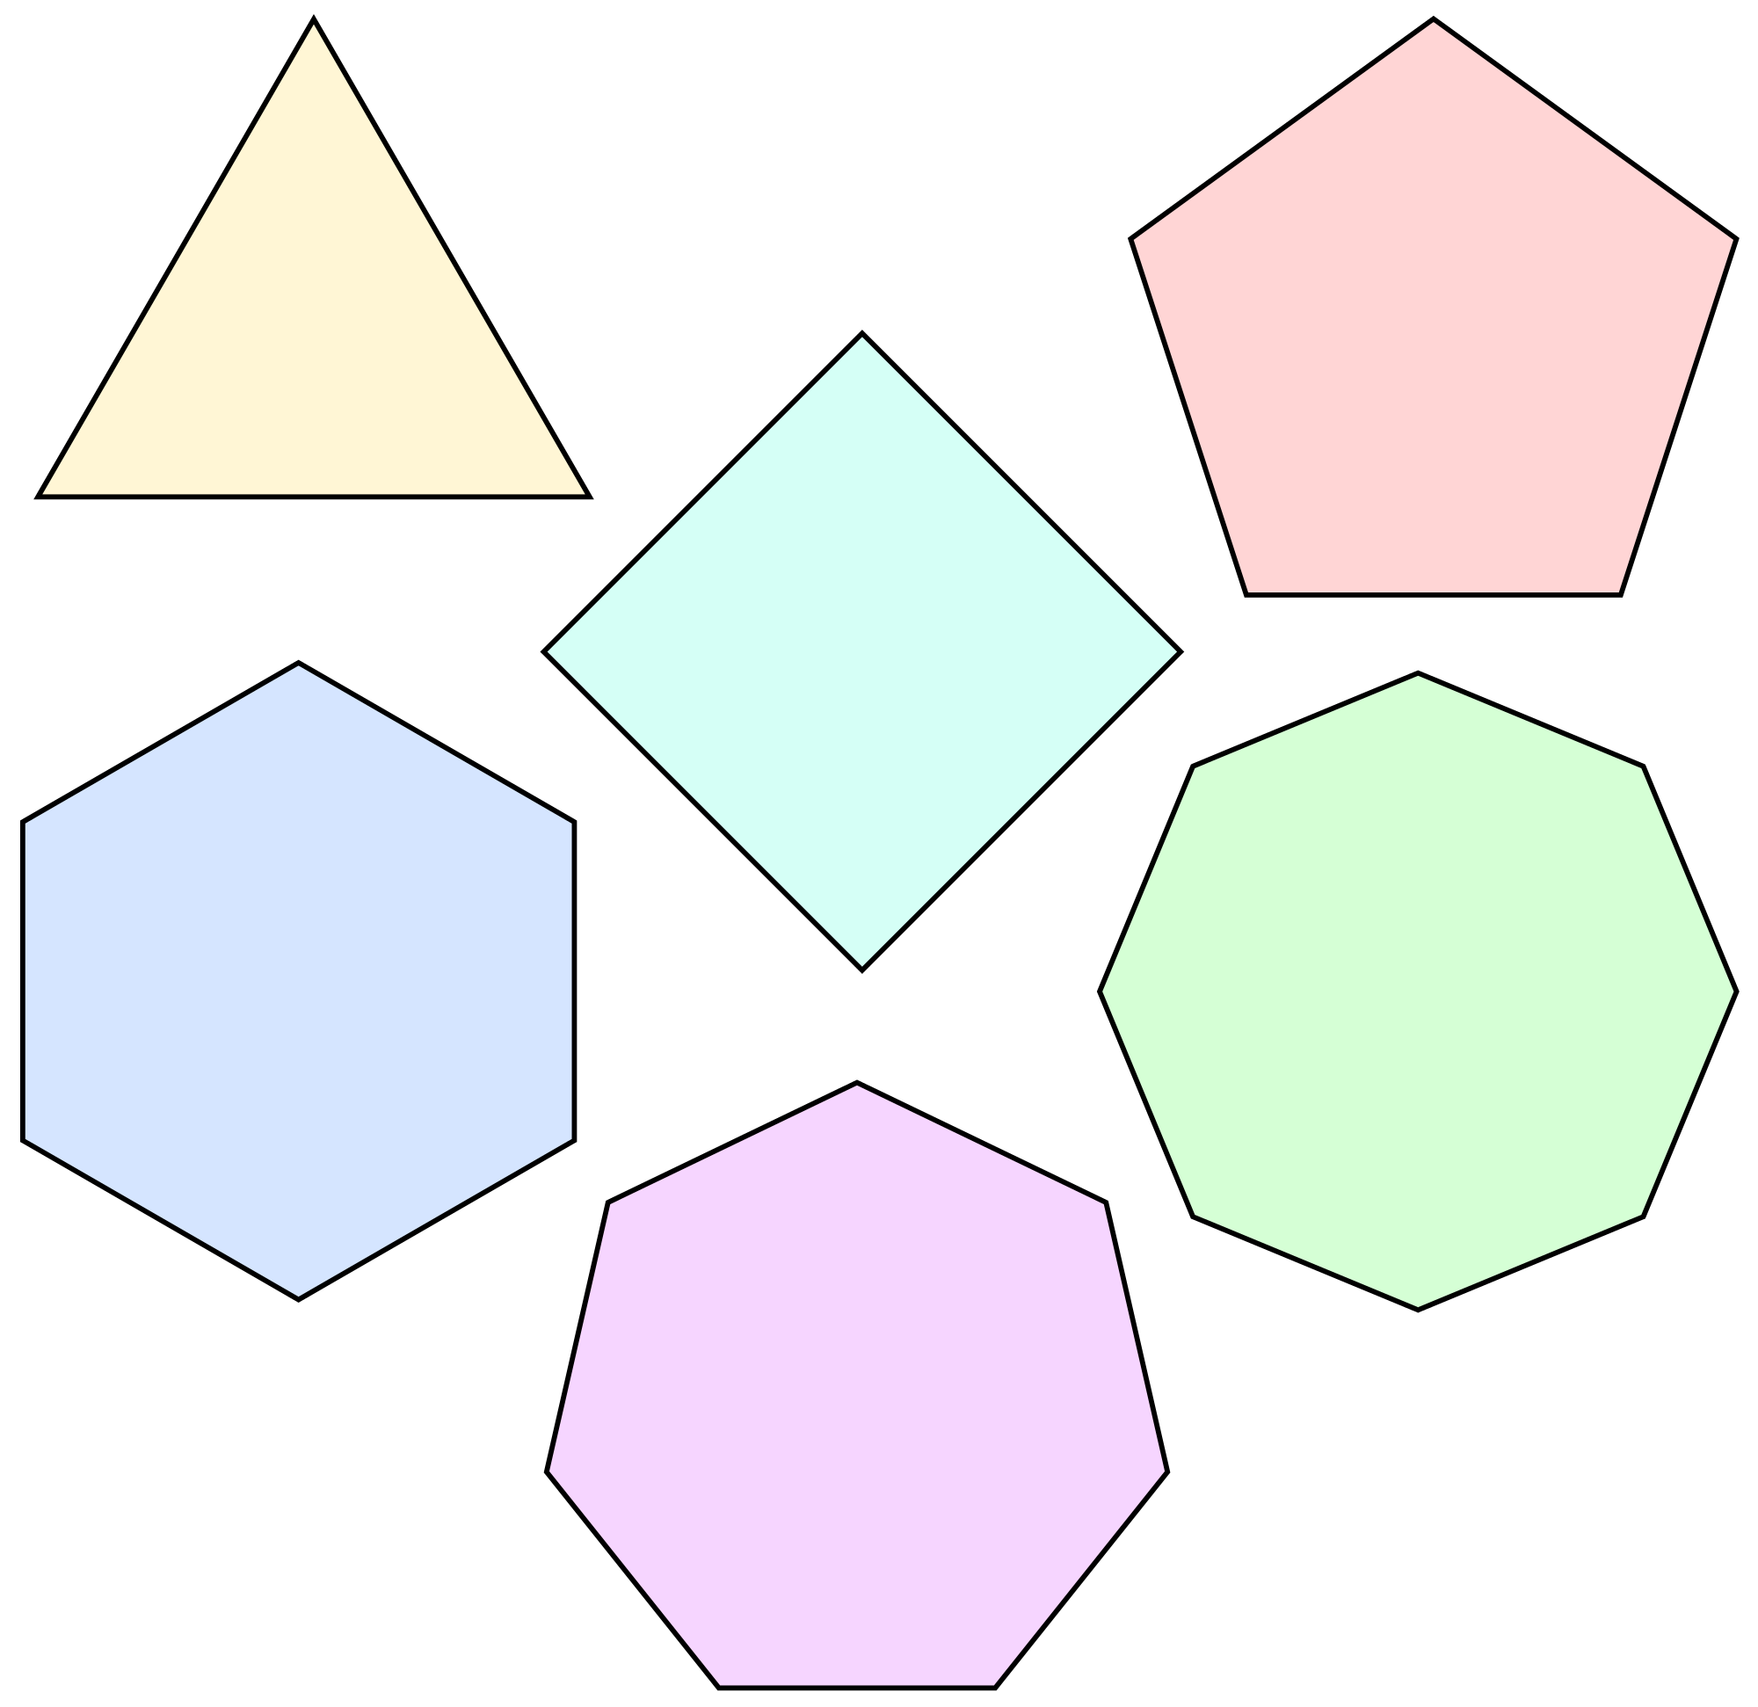
Spike Island: Shapes
5
3-sides
A regular polygon is a polygon that has all angles equal(equiangular) and all sides equal(equilateral)
Can you name each of the regular polygons shown here?
  3-sided = Triangle
  4-sided = Square
  5-sided = Pentagon
  6-sided = Hexagon
  7-sided = Heptagon
  8-sided = Octagon
How many axes of symmetry do they each have?
4
6
8
7

Slide 11
Spike Island: Shapes
5
Can you work out:
The sum of the interior angles?
Size of the angles in each of them?
  Triangle = 60°
  Square = 90°
  Pentagon = 108°
  Hexagon = 120°
  Heptagon = 128.57...°
  Octagon = 135°
Can you come up with formula for working out the size of the angles for ANY regular polygon?
3-sides
4
6
8
7
(Printable version available)

Slide 12
Spike Island: Shapes
Measure the angles on the two central bastions.
Can you find any connection between your answers and any of the regular polygons we just looked at?
  Angles of 120°
  Hexagon = 120°
(Printable version available)

