Slide 1


A Mathematics Fantasy
You’re sitting in Maths class, when a local businesswoman walks in.
She wants to offer you a job.
She is a bit sketchy about the details but she will need your services for 30 days and you won’t be able to attend school.
She gives you your choice of two payment options…

Slide 2
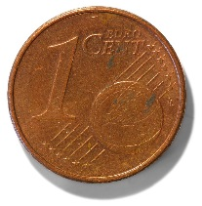

Payment Option One:
One cent on the first day,
two cents on the second day
and double your salary every day thereafter for the thirty days

Slide 3
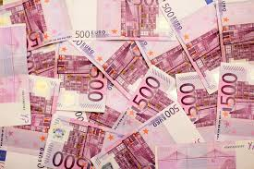
Payment Option Two:
Exactly €1,000,000

Slide 4
Which Option will you Choose
and Why?

Slide 5
PDST Manual Page 304
http://www.pdst.ie/sites/default/files/FINAL_MeasuresManual24thApril_ToPrinter.pdf

