Slide 1
judaism

Slide 2
History
Judaism is one of the oldest world religions.
People who follow the Jewish religion are called Jews.
The Jewish religion started in Israel around 1812 BC, during the Bronze Age.
It began when God promised Abraham he would protect him and his descendants and give them the land of Israel. In return for this they promised to obey God.
The Torah is the main religious book used by the Jewish people.

Slide 3
Beliefs
Jews believe that there is only one God and that he created the universe.
They believe that everyone can have an individual and personal relationship with God.
They believe that God continues to work in the world, affecting everything that people do.

Slide 4
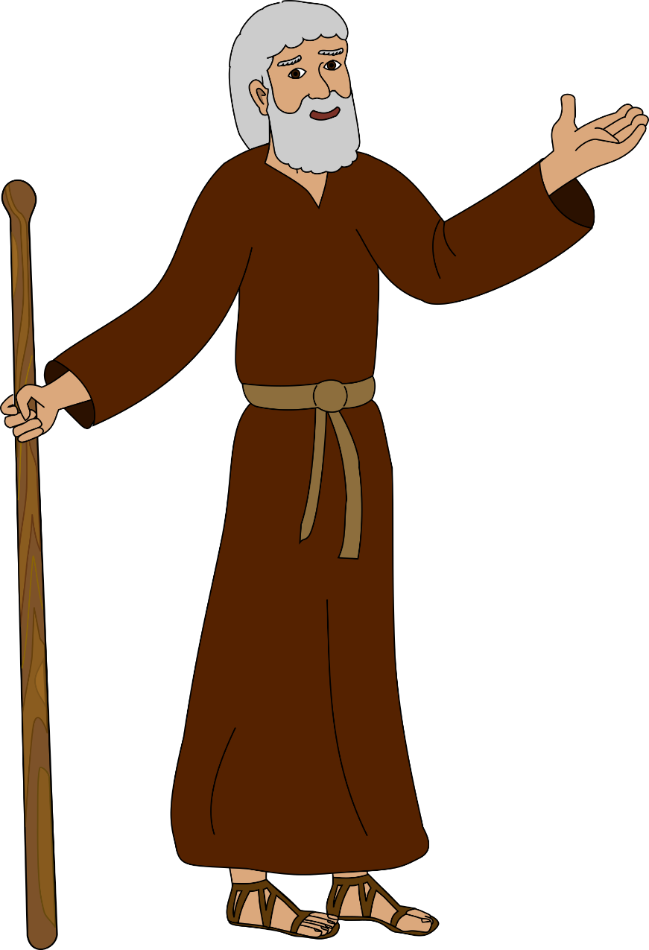
Important people
Abraham is the father of the Jewish people. Jews see Abraham as a symbol of trusting and obeying God. Abraham is also important to followers of Christianity and of Islam.
The story of Abraham is told in the Book of Genesis in chapters 12-25.

Slide 5
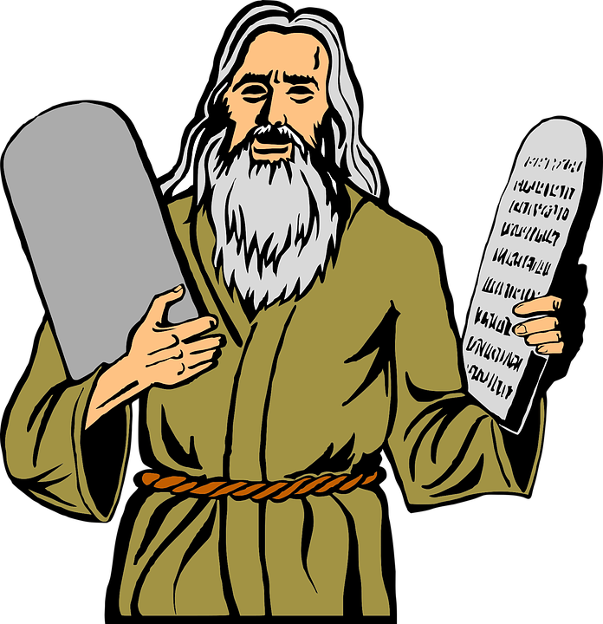
Important people
Moses, is also an important figure as he gave the Jews the Torah around 1250 B.C. The Torah contains the laws of God.
Moses is the leader who freed them from slavery in Egypt. Moses protected the Jews from the wrath of God, and negotiated with God on their behalf.

Slide 6
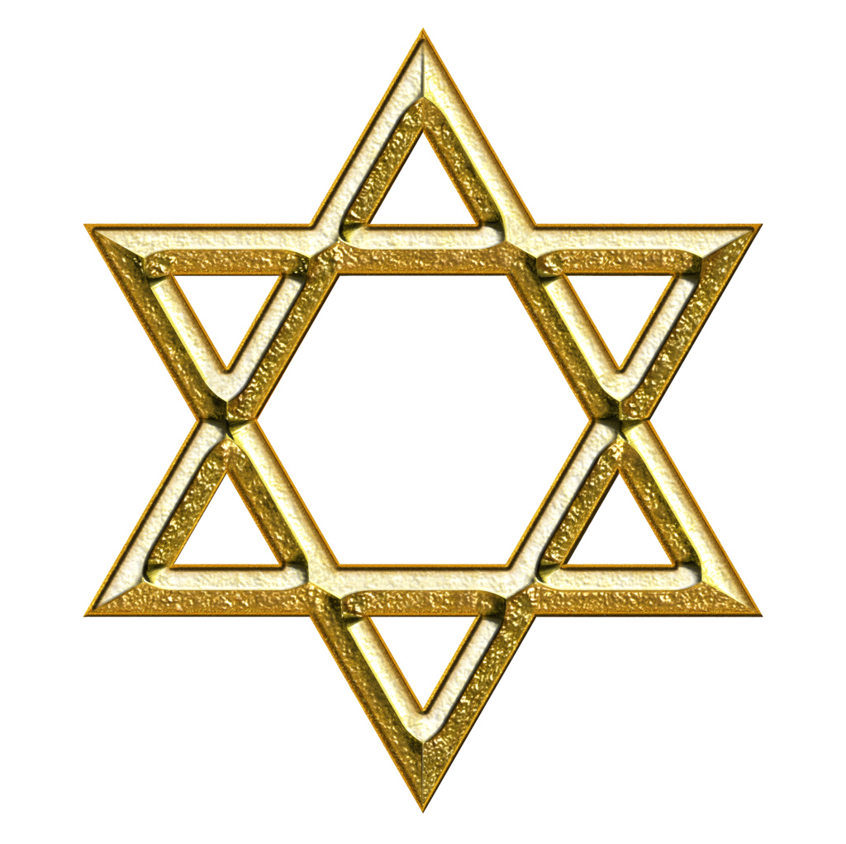
Jewish symbols
The symbol or emblem of the Jewish people is the Magen David (Shield of David), also known as the Star of David.

Slide 7
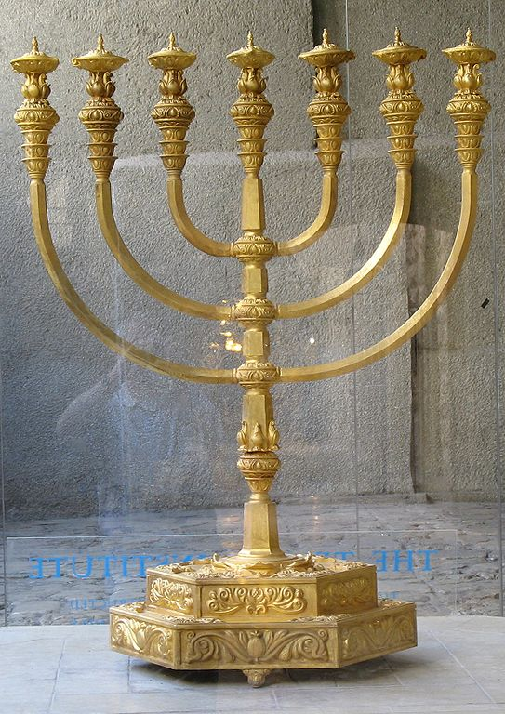
Jewish symbols
The Menorah is one of the oldest symbols of the Jewish faith. It is a candelabrum with seven candle holders displayed in Jewish synagogues. It symbolises the burning bush as seen by Moses on Mount Sinai.

Slide 8
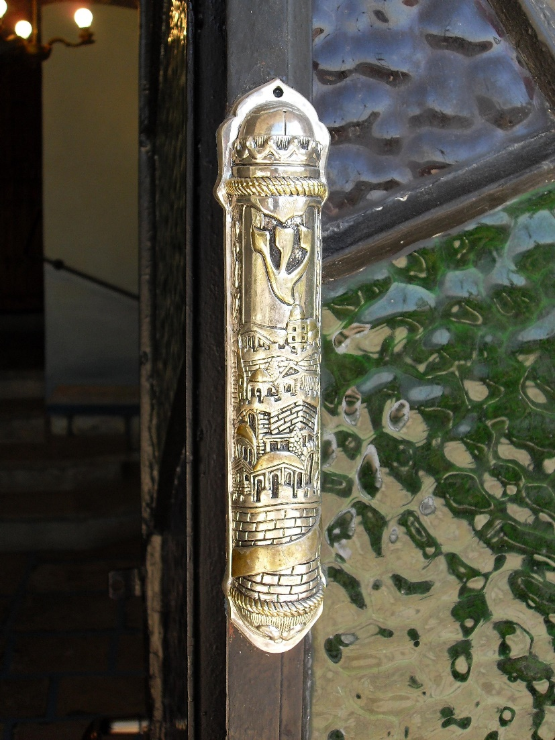
Jewish symbols
A mezuzah is found on doorposts in Jewish homes. It is a little case, containing a tiny scroll. The writing on the scroll is from the bible. It is in Hebrew and it says that Jewish people should love God and keep his rules.

Slide 9
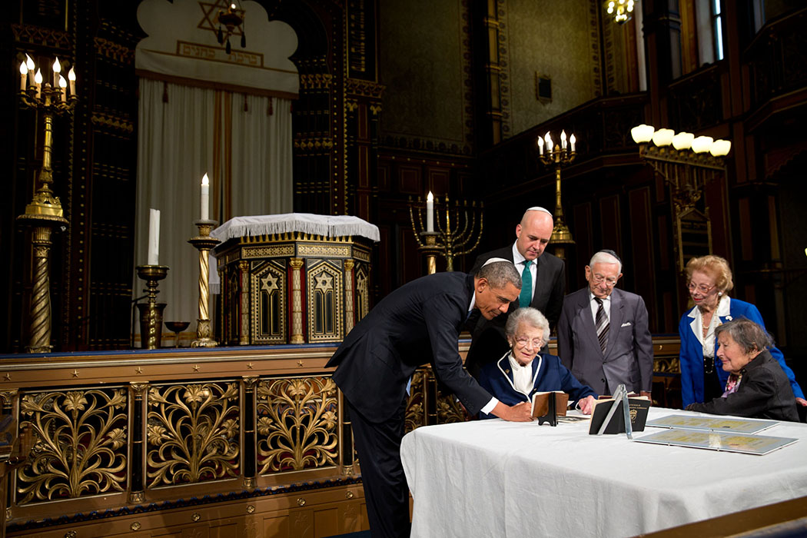
Where do Jews worship
Jews worship in Synagogues.
Men and women usually sit separately in the Synagogues.
Men must cover their heads.
The Jewish spiritual leaders are called Rabbis.
Barack Obama viewing artefacts in a Synagogue.

Slide 10
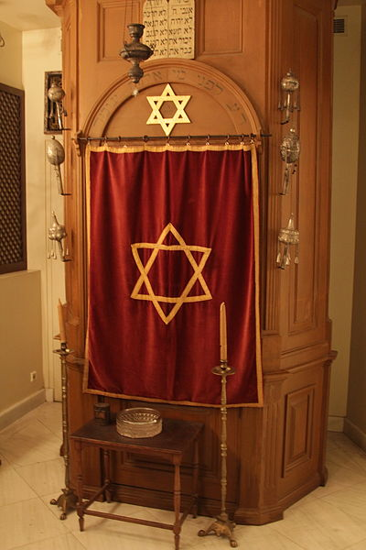
The Torah
The most holy Jewish book is the Torah which means ‘teachings’.
The Torah contains the five books revealed to Moses by God on Mount Sinai.
  Genesis
  Exodus
  Leviticus
  Numbers
  Deuteronomy
The Torah is stored inside the Ark in each Synagogue. This is the holiest place in the Synagogue.
Torah Ark in Patras Synagogue.

Slide 11
Holy Days
The most important day of the week is the Sabbath (Shabbat), which is a day made holy by refraining from weekday work.
Sabbath starts at sunset on Friday and continues until sunset on Saturday. During the Sabbath, observant Jews will do nothing that might be counted as work. Among the things that they can't do are driving and cooking.
At the beginning of Shabbat Jewish families share a meal. They eat special bread called hallah. On the Sabbath, Jews attend services at the synagogue, often led by a Rabbi.

Slide 12


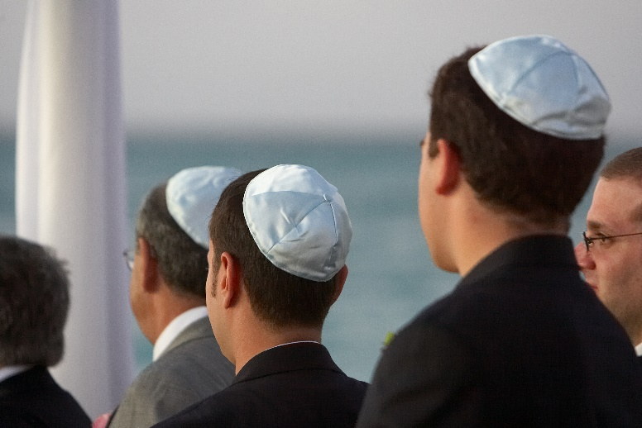
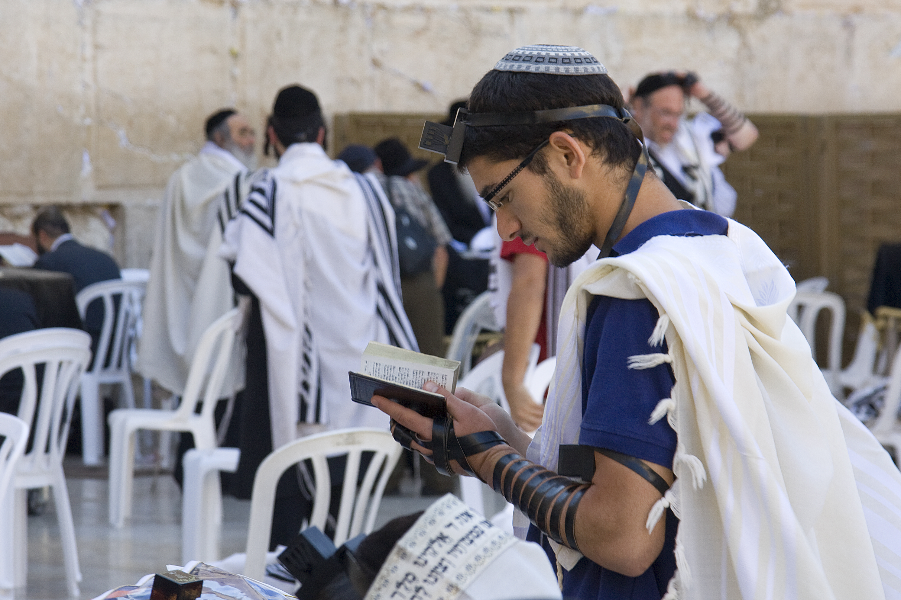
Special clothing
On their heads Jewish men wear the Kippah to remind them that God is always above them. It is a reminder to always follow the laws of God at all times and in all places.
Before beginning to worship or pray Jews will often put on a tallit. The fringes on the shawl remind them of the many commandments of the Torah.

Slide 13
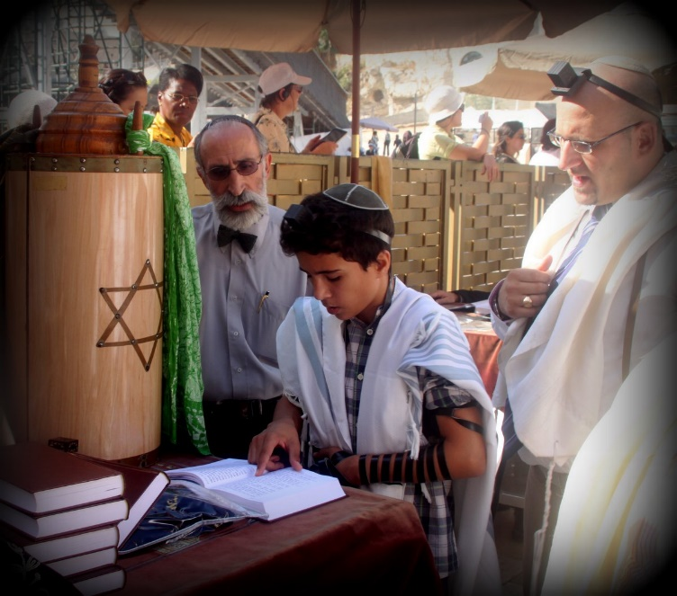
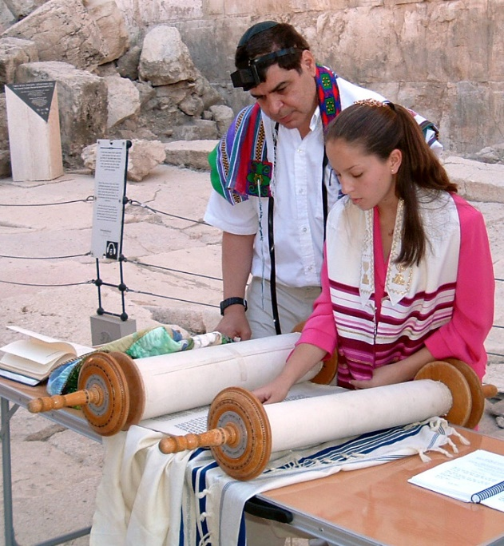
Special ceremonies
There are two special ceremonies where Jewish boys (aged 13) and girls (aged 12) can become adults in the eyes of the Jewish religion.
Bar mitzvah is for boys and means Son of the Commandment.
Bat mitzvah is for girls and means Daughter of the Commandment.

Slide 14
Quiz
Who is the founder of Judaism?
Moses
Abraham
Jesus

Slide 15
Quiz
What is their holy book called?
Torah
Bible
Quran

Slide 16
Quiz
Who did God give the Torah too?
Mary
Moses
Joseph

Slide 17
Quiz
Where do Jewish people worship?
Synagogue
Church
Mosque

Slide 18
Quiz
Where is the Torah kept in the Synagogue?
Tabernacle
Box
Ark

Slide 19
Quiz
Which two items do Jewish people sometimes wear?
Robe
Tallit
Kippah

Slide 20
Further work
Read stories about Abraham and/or Moses in the bible and do an illustration or written recount of the story.
You could also watch the film ‘The Prince of Egypt’ which tells the story of Moses.

