Slide 1


Title: Questionnaires
Take a questionnaire
Features of a good questionnaire
Answer types
Design a questionnaire
How to evaluate a questionnaire

Slide 2
Take a Questionnaire
A set of questions with a choice of answers, devised to collect information or data from individuals for the purpose of a statistical study.

Slide 3

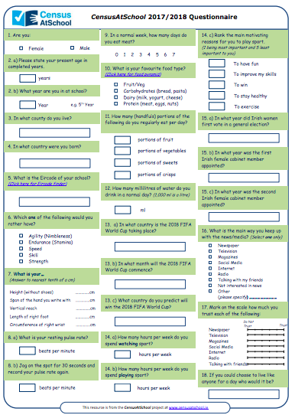
CensusAtSchool.ie
The CensusAtSchool website publishes a yearly questionnaire for students in Ireland to complete.
Task 1:
Complete this years questionnaire (paper version).
As you complete the questionnaire, focus on the style of questions asked.
Notes:
Teacher guide and measurement guide available on the CensusAtSchool website. See here http://www.censusatschool.ie/en/take-part/questionnaires/phase17-18

Slide 4
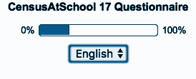
CensusAtSchool - Be Part of the Study!
The CensusAtSchool website has an online version of the questionnaire which allows instant class collection of answers.
Additionally, at the end of the school year, the CSO reports the findings from completed online questionnaires.
Task 2:
Complete the online questionnaire.
As you complete the questionnaire, focus on the format of answers.
Notes:
Teacher guide and measurement guide available on the CensusAtSchool website. See here http://www.censusatschool.ie/en/take-part/questionnaires/phase17-18. Teacher can download class data from the questionnaire. In the next lesson, students can analyse the data and use the data to present the data graphically.

Slide 5
Features of a Questionnaire
Decide which statements represent features of a
GOOD questionnaire and a BAD questionnaire.
Questions are unambiguous | Questions are personal | Questions lead to open ended answers. People can write anything. | Questions are short.
Lots of leading questions included | Questions are offensive / lead to embarrassing answers. | Order of questions - Begin with simple questions | Tick boxes provided for answers. Options cover all possible answers.
Answer boxes are clear and don’t have overlaps or gaps. | Questions are not relevant to what you are investigating. | Questions are unbiased - Don’t encourage people to a given answer. | Closed questions used - to restrict answers to certain options.

Slide 6
Features of a Questionnaire:
Features of a Good Questionnaire | Features of a Bad Questionnaire

Slide 7
Sample Questions
Look at the following questions and discuss how each question could be improved.

Slide 8
Do you agree that the CensusAtSchool questionnaire contains the best questionnaire questions? :
This is a leading question - the question is encouraging people to answer ‘Agree’.
When asking questions, try to avoid leading questions or starting questions with:
‘Don’t you agree….?’ or ‘Don’t you disagree…?’
‘Isn’t it true…? Or ‘isn’t it untrue that…?
Can you improve the question?

Slide 9
On average, how often do you shop? :
This is an ambiguous question - People may have different ideas / meanings for the word ‘average’. The word ‘Shop’ is vague/ generalised - this could be misinterpreted as shopping online or food shopping or clothes shopping.
There is more than one way to interpret the question.
The question has more than one meaning.
The question is vague or generalised.
The question is unclear.
The question could have multiple answers.
Can you improve the question?

Slide 10
How many people are in your maths class?
3 - 5
5 - 10
10 - 15
15 - 20
The tick boxes provided restrict answers - what if your class has more than 20 students? Or less than 3 students?
‘People’ - does this include the teacher?
There are overlaps within the answer options - which box do you choose if your class has exactly 10 people in the class?
Can you improve the question?

Slide 11
Do you check your social media account...
Sometimes
Occasionally
Often
The terms ‘Sometimes’ , ‘Occasionally’ and ‘Often’ mean different things to different people.
The question leads to unclear answers.
Can you improve the question?

Slide 12




Answer Types
Radio Button:
(Can only select one box)
Slide Scale:
Textbox:
(Alphanumerical)
Yes
No
Ranking:
1 being most important,
3 being least important
Checkboxes:
(Can tick multiple answers from a list)
Dropdown Menu:
(Can choose one answer from a list)

Slide 13
Design a Questionnaire
Create a questionnaire using the following criteria...
The questionnaire must only contain 8 questions using each of the answer types
Radio Buttons,
Slide Scale,
Textbox,
Ranking,
Checkboxes,
Dropdown Menu
Keep questions short, clear and unambiguous.
Begin with simple questions.
Avoid leading questions.
Ensure questions are relevant to investigation.
Avoid overlaps in answer options.
Ensure answer options are specific.

Slide 14
Testing your Questionnaire
How to run a pilot questionnaire ...
You need to select ____________ for your sample who will fairly represent the wider _____________. To do this, use the _____________________technique when selecting your ______________ group. The size of the sample is important. What happens if the size of the sample is too small?
unbiased
Sample
Representatives
Simple Random Sample
Random Sample
Population

Slide 15
Testing your Questionnaire
How to run a pilot questionnaire ...
You need to select ____________ for your sample who will fairly represent the wider _____________. To do this, use the _____________________technique when selecting your ______________ group. The size of the sample is important. What happens if the size of the sample is too small?
Download Activity on the Keywords Associated with Questionnaires
Representatives
Population
Simple Random Sample
Random Sample

Slide 16
Reflect on your learning:
Confident
Need more practice
Not yet there
What is a Questionnaire
Describe the Features of a Good Questionnaire
Identify the Various Types of Answers Used in Questionnaires
Ability to Design a Questionnaire
Evaluate the Effectiveness of a Questionnaire
Skills I have used:
Working with others
Managing Information & Thinking
Managing Myself
Staying Well
Communicating
Being Creative

