Slide 1
Islam

Slide 2
Fast Facts
Islam is the second biggest religion in the world.
It has over a thousand million followers.
Islam began in Arabia.
It was founded by the prophet Muhammad.
Those who follow Islam are called Muslims.
Muslims believe that there is only one God, called Allah.
The Qur’an is the main religious book used by Muslims.

Slide 3
Beliefs
Muslims believe that there is only one God, Allah.
They believe in angels.
They believe there were many prophets or messengers from Allah. Adam was the first, Ibrahim (Abraham), Musa (Moses), Dawud (David), Isa (Jesus) and Muhammad is the final prophet.
They believe that they must be obedient and follow Allah’s will.

Slide 4
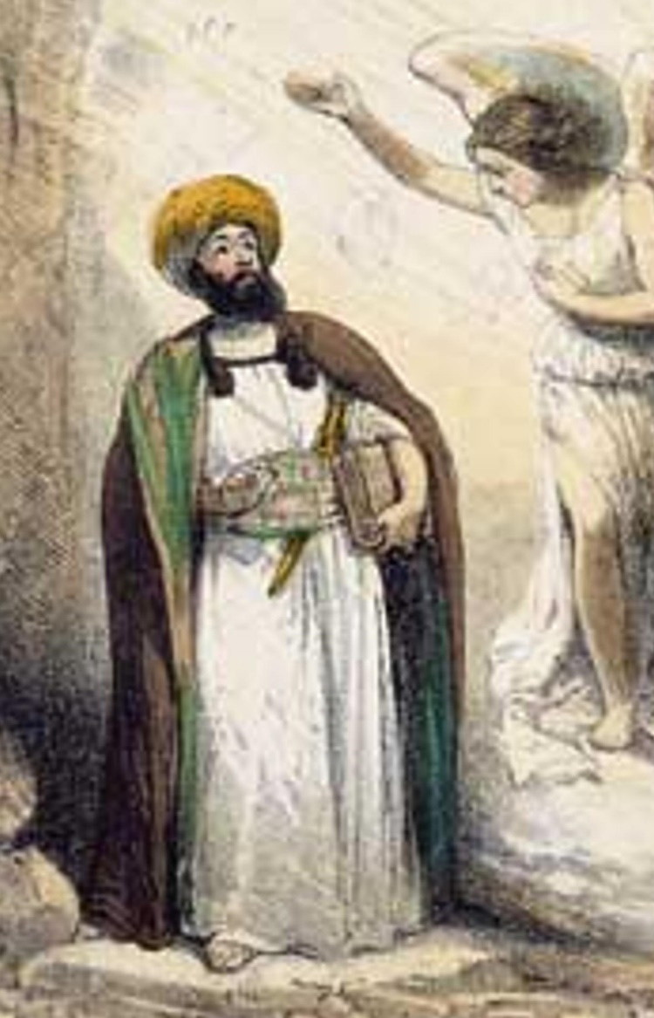
Important people
Muhammad is the last prophet in a long line of prophets that includes Moses, Abraham and Isa (Jesus).
He is the founder of the Muslim faith.
Muslims believe the angel Gabriel appeared to Muhammad and told him God’s words. Muhammad memorised the words and wrote them down – the book he wrote is the Qur’an.

Slide 5
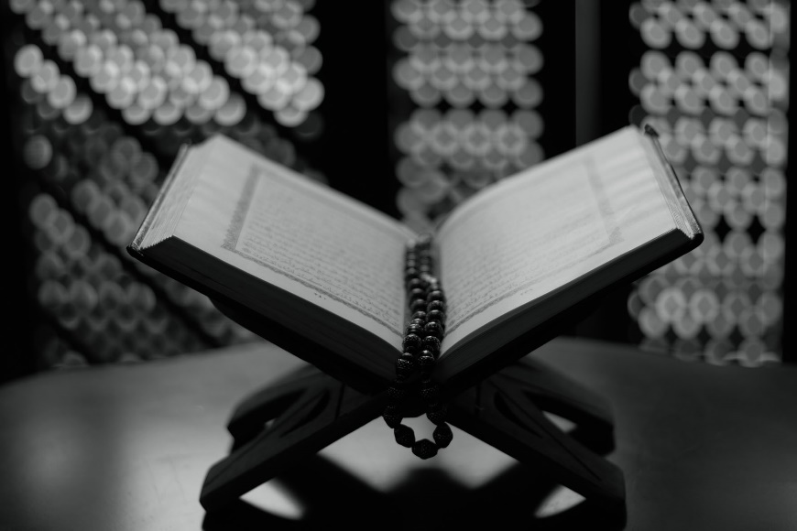
The Qur’an
The most holy Jewish book is the Qur’an.
Muslims believe it is the exact words of God, told to Muhammad by the angel Gabriel.
Muslims treat the Qur'an with great respect because they believe that the Qur'an is from Allah, and every word and every letter is sacred.
It is usually placed on a special wooden stand to be read.

Slide 6
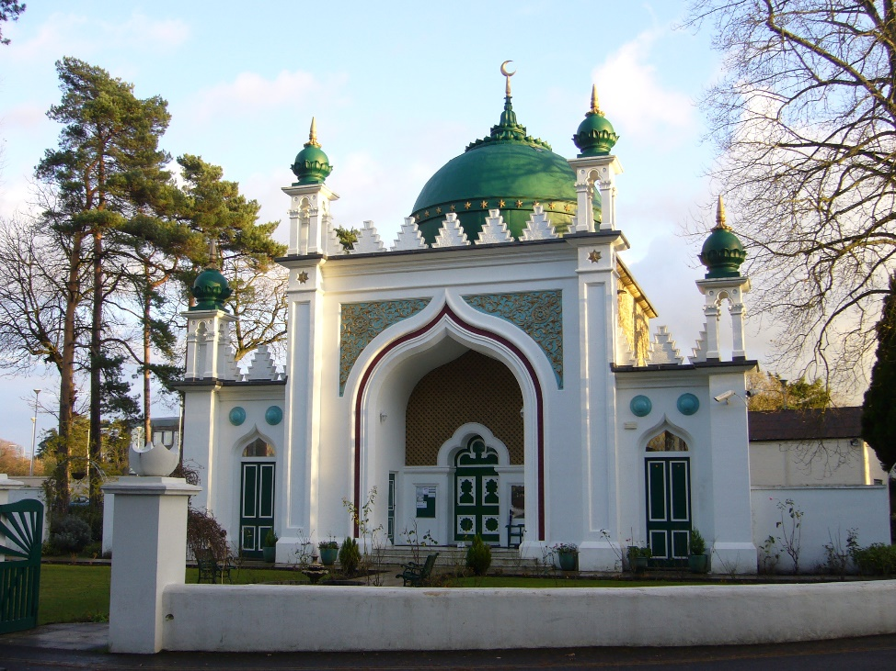
Where do Muslims worship
Muslims worship in Mosques.
Mosques often have a domed roof and a tower called a minaret. People are called to pray from the minaret.
There are no pictures or statues in a mosque. There is also little furniture because Muslims use prayer mats to pray.
When people go into the Mosque they take off their shoes. This is to keep it clean for prayer.

Slide 7
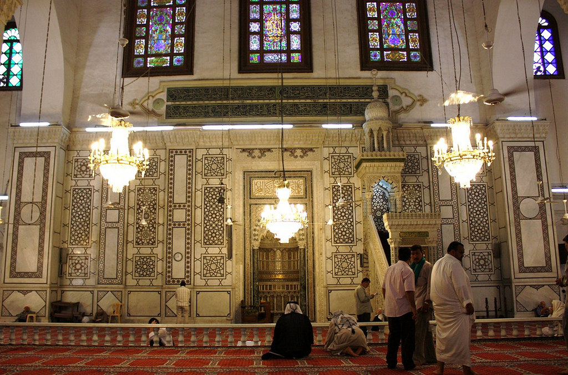
Where do Muslims worship
Mosques always have a quibla wall which faces Mecca.
It has an empty arch to show the direction.
This is important as Muslims always pray facing Mecca.
There are separate areas for men and women to pray.

Slide 8
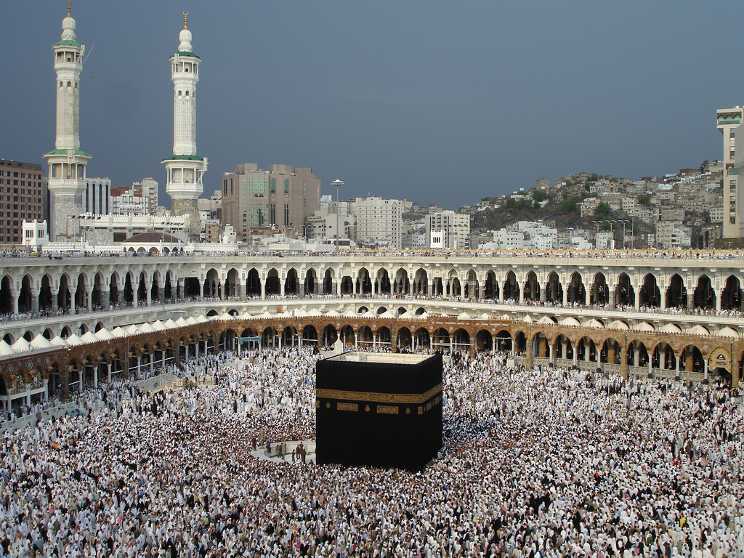
The importance of prayer
Muslims are required to pray five times a day.
They must always wash themselves before praying (to symbolise purity before God).
They must face in the direction of Mecca when praying. Mecca is where the prophet Muhammad was born and is considered the holiest place on earth by Muslims.
Every Muslim, no matter where they live, knows what direction Mecca is from their house.
The Kabba in Mecca – Muslims believe this is the holiest place on earth.

Slide 9
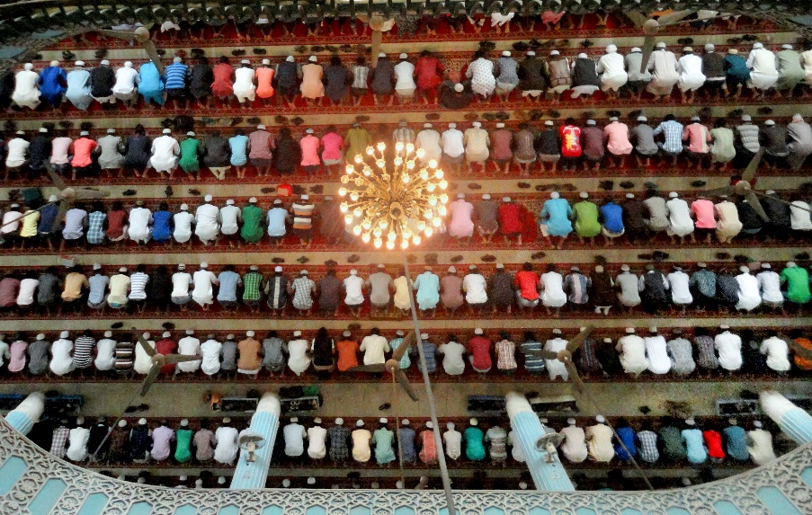
When do Muslims pray?
Muslims pray five times a day:
After first light and before sunrise (Fajr)
Between the sun reaching its height and mid-afternoon (Dhuhr)
Between mid-afternoon and sunset (Asr)
After the sun has finished setting (Maghrib)
In the dark of the night (Isha)
Muslims at prayer

Slide 10
Muslim Festivals
The most important Muslim festival is Ramadan.
It happens in the ninth month of the Islamic year.
During Ramadan Muslims fast (do not eat) during daylight hours.
It is a special time of prayer and reflection for Muslims.
During Ramadan Muslims will get up before dawn and have a light meal. This is known as Suhoor.
At the end of the day they break their fast with a meal called Iftar.

Slide 11
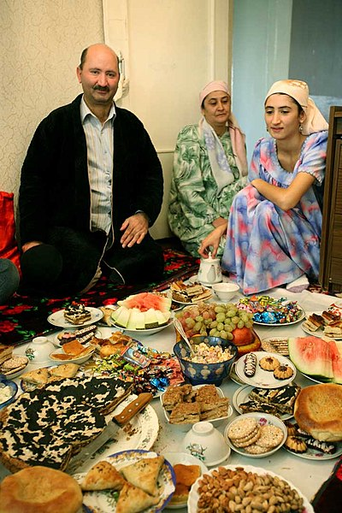
Muslim Festivals
Ramadan finishes with the celebration of Eid al-Fitr (Id-ul-Fitr).
The Eid al-Fitr celebration lasts for three days.
It is a time for family and friends to get together, for celebrating with good food and presents for children, and giving to charity.
Celebrating Eid al-Fitr

Slide 12
Quiz
Who is the founder of Islam?
Moses
Abraham
Muhammad

Slide 13
Quiz
What is their holy book called?
Torah
Bible
Qur’an

Slide 14
Quiz
Who appeared to Muhammad?
Mary
Gabriel
Joseph

Slide 15
Quiz
Where do Muslims worship?
Synagogue
Church
Mosque

Slide 16
Quiz
Where do Muslims face for prayer?
Cross
Altar
Mecca

Slide 17
Quiz
How many times a day do Muslims pray?
Four
Five
Six

