Slide 1
Buddhism

Slide 2
History
Buddhism began 2500 years ago in India.
People who follow the religion are called Buddhists.
It is the main religion in many Asian countries, for example India, Thailand and Japan.
It is different from many other religions because Buddhists do not believe in a God who created the universe.
It is based on the teachings of Siddhartha Guatama (The Buddha).

Slide 3
Beliefs
Buddhists believe that there is a cycle of birth, life, death and rebirth. This goes on and on and is called ‘Reincarnation’.
They believe that how you act in your current life will affect what you are reborn as in your next life. For example, if you are not a good person in your current life you may be reborn as an animal in your next life.
Birth
Life
Death
Rebirth

Slide 4
Beliefs
Buddhists believe that if they can gain Enlightenment they can break out of this cycle. This is called Nirvana, which means gaining perfect peace free from all suffering.
Buddhist try break out of the cycle and reach Nirvana by following the Buddha’s teachings and by meditating. Meditation means emptying the mind of all thoughts and when this happens what is important becomes clear.
Birth
Life
Death
Rebirth

Slide 5
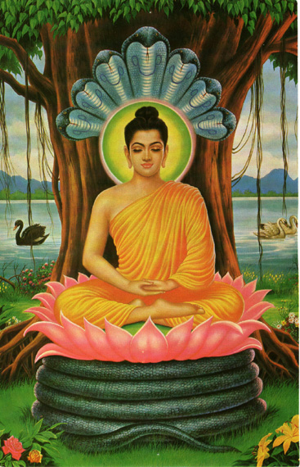
Important people
Siddhartha Gautama is also know as the Buddha.
Buddhism is based on his teachings.
He was born around the year 580 BC in Nepal.
He was born into a royal family and for many years lived with in the palace walls away from the sufferings of life; such as sickness, age, and death. He did not know what they were.
Buddha meditating

Slide 6
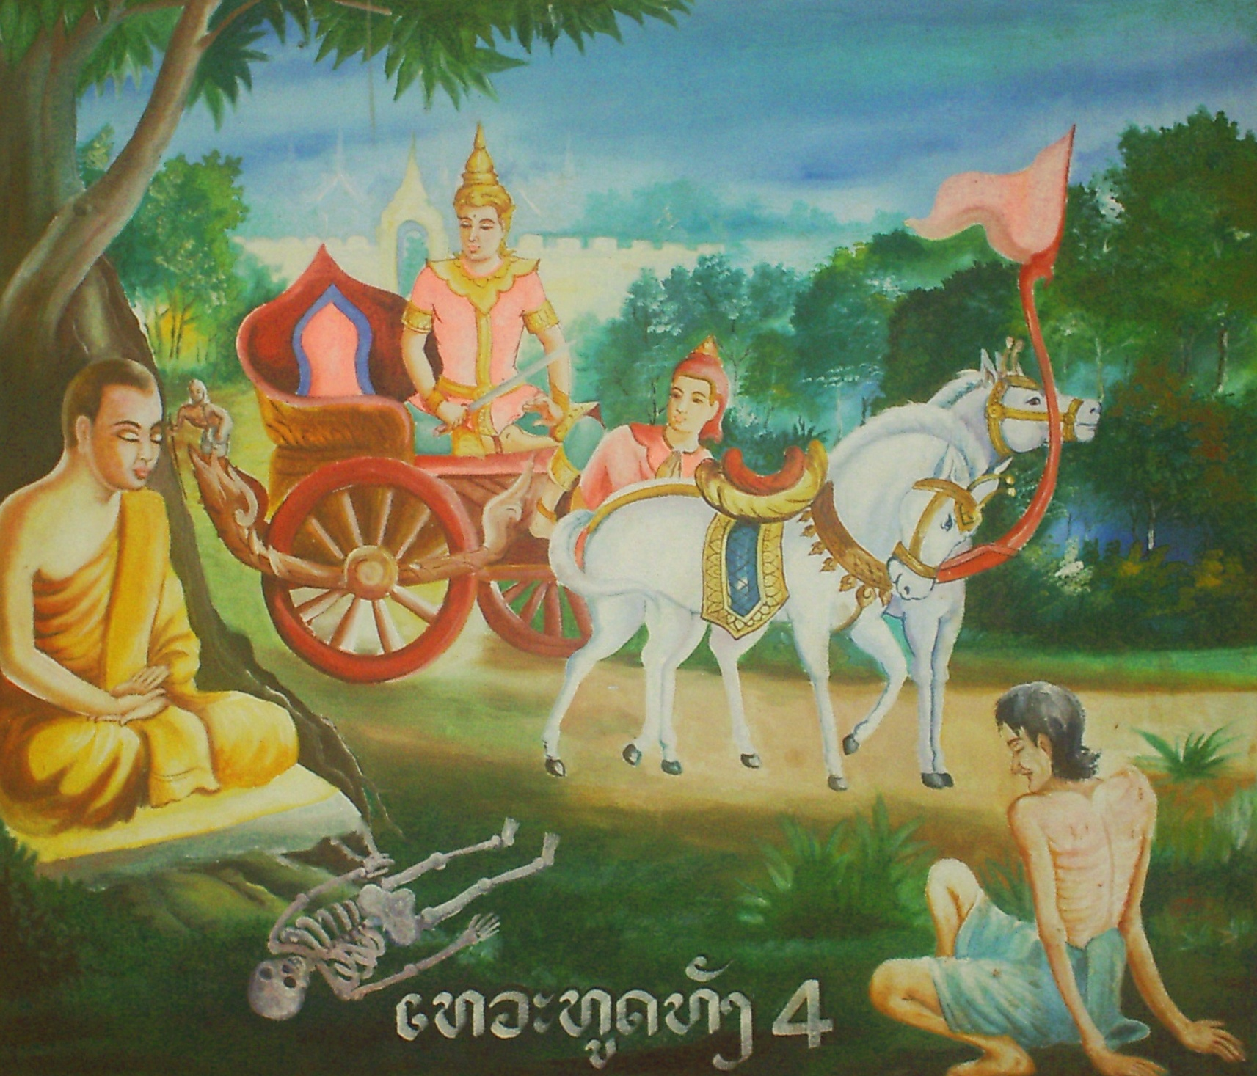
Important people
One day, after growing-up, marrying and having a child, Siddhartha went outside the royal palace and saw for the first time:
  an old man
  a sick man
  and a corpse.
He learned for the first time that sickness, age and death were inevitable for all human beings – no one could avoid these sufferings.

Slide 7
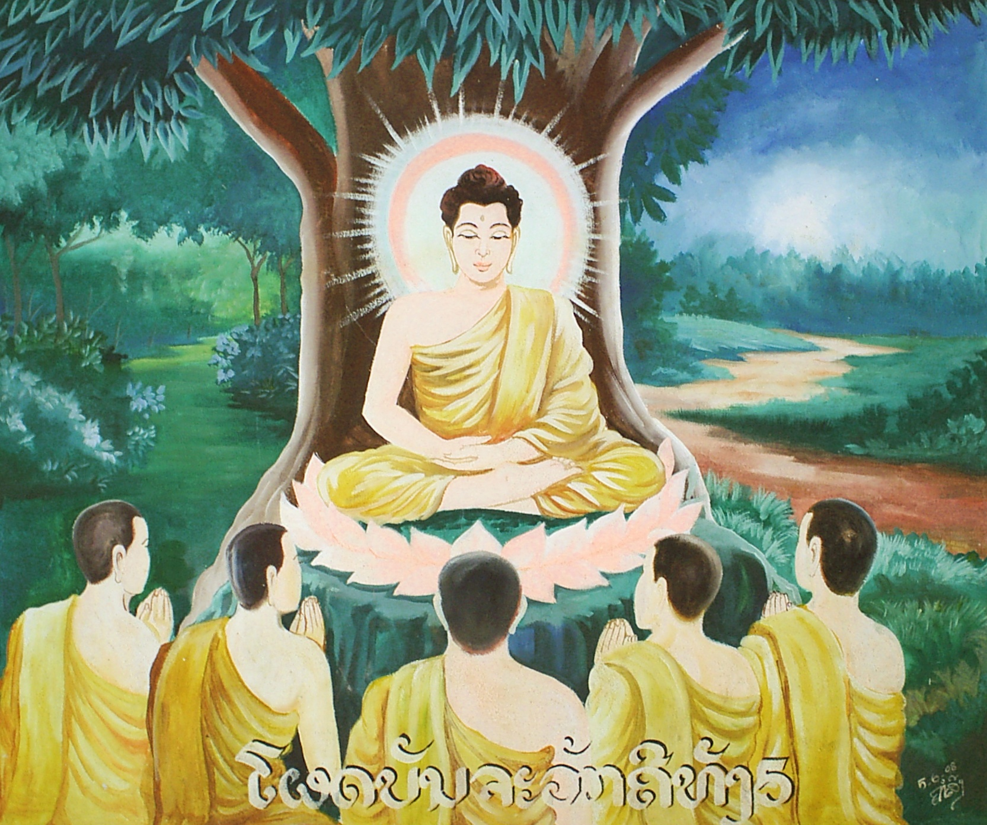
Important people
Siddhartha also saw a monk and decided this was a sign that he should become a holy man.
He travelled and saw much more suffering in the world.
He tried to find a way for people to escape sickness, old age and death – otherwise known as Nirvana.
Buddhist do not think Siddhartha was a God. He was a man just like them. But they follow his teachings because he managed to reach enlightenment.
Buddha teaching others

Slide 8
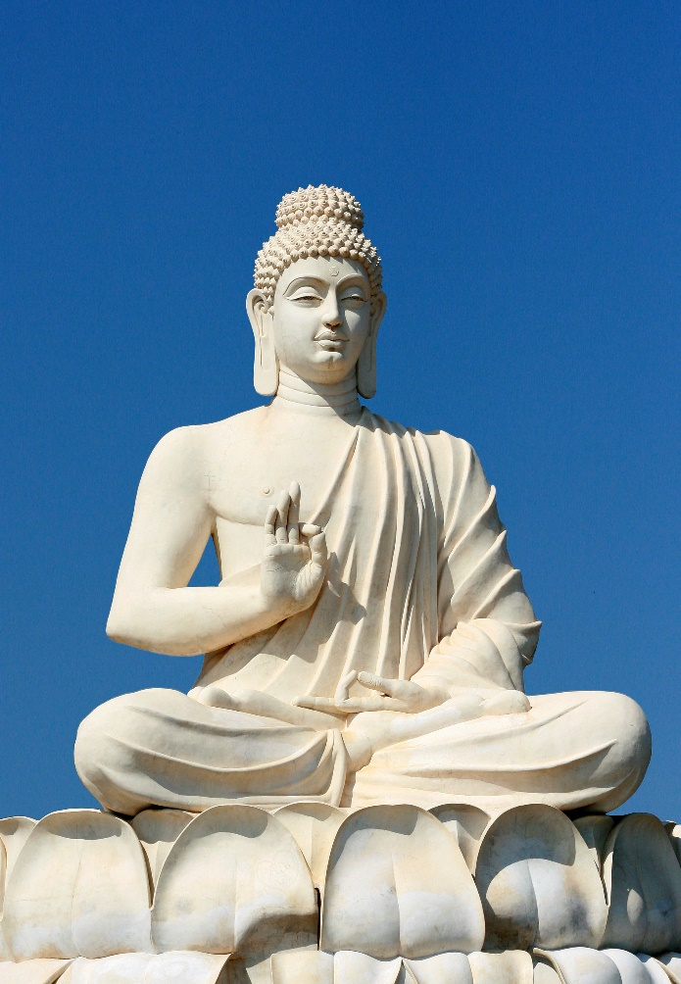
What did Buddha teach?
Buddha taught his followers that:
Nothing in life is perfect and we must learn to accept that to be happy.
Everything in life is changing all the time – nothing stays the same.
Everyone has Karma which passes on to the next life. A persons karma can be good or bad depending on how they live in this life.

Slide 9
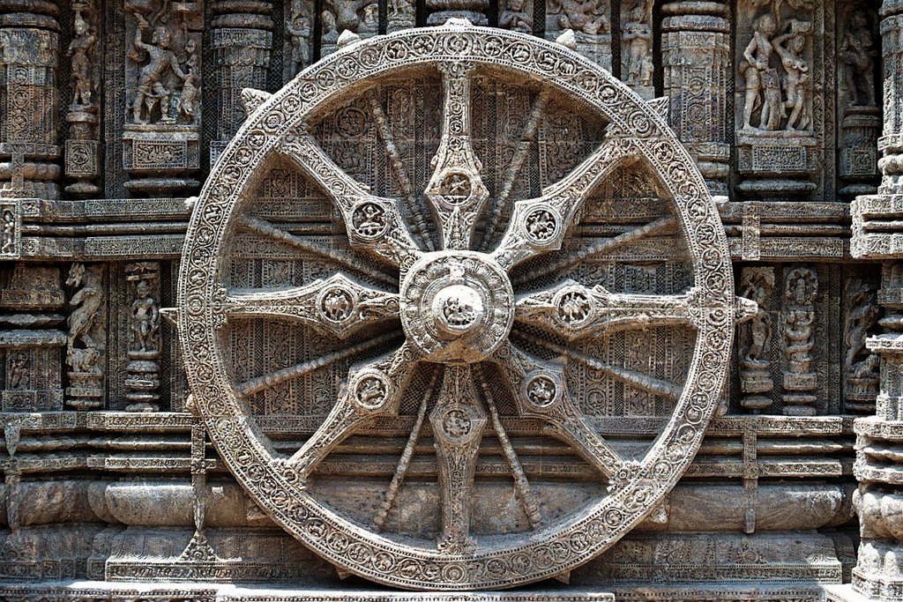
Buddhist symbols
The Wheel of Life
This symbolises the cycle of birth, life, death and rebirth.
The eight spokes remind people that Buddha taught about eight ways of life.

Slide 10
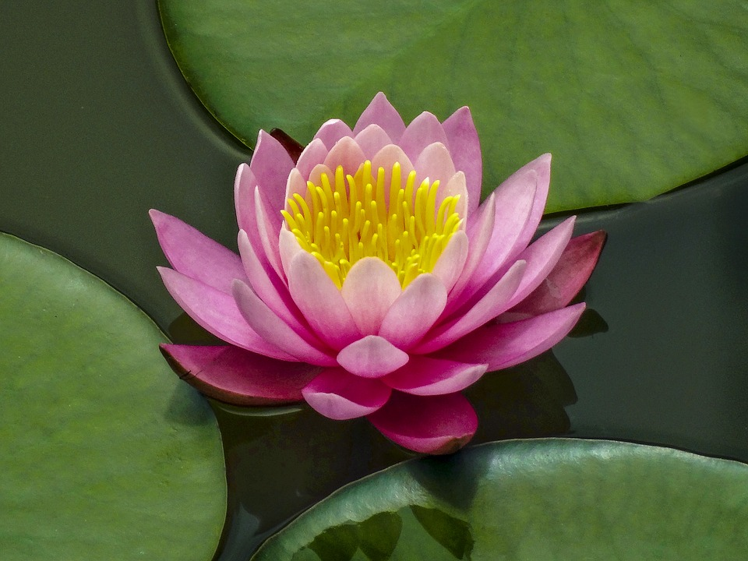
Buddhist symbols
Lotus Flower
This symbolises purity.
The lotus flower grows in mud at the bottom of a pool, but rises up above the surface to become a beautiful flower. Buddhist say this is how people should rise above all suffering and pain in life.

Slide 11
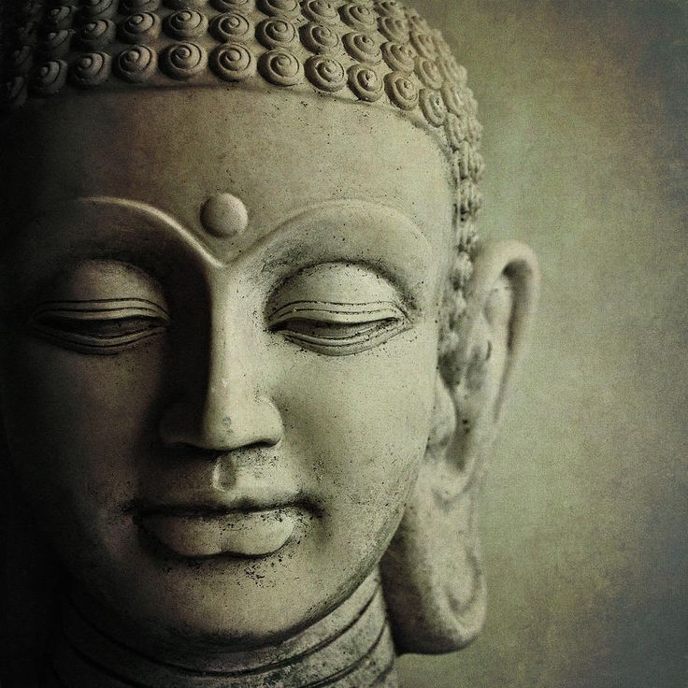
Buddhist symbols
Images and statues of Buddha
Statues of Buddha include lots of symbols. For example:
A round mark on his forehead is called the ‘Third Eye’. This means he could see things that others could not see.
Long ears are from the weight of his princely earrings. The earrings are gone as he chose to give up his wealth and live as a holy man.

Slide 12
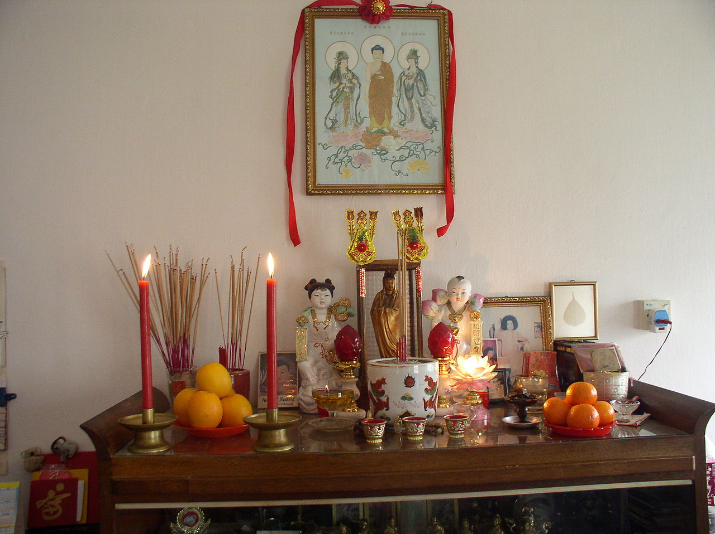
Where do Buddhists worship
Buddhist worship at home or in a temple.
They sit barefoot on a floor facing a statue of Buddha.
At home many people will have a shrine. There will be a statue of Buddha, candles and an incense burner.
Buddhist shrine in a home

Slide 13
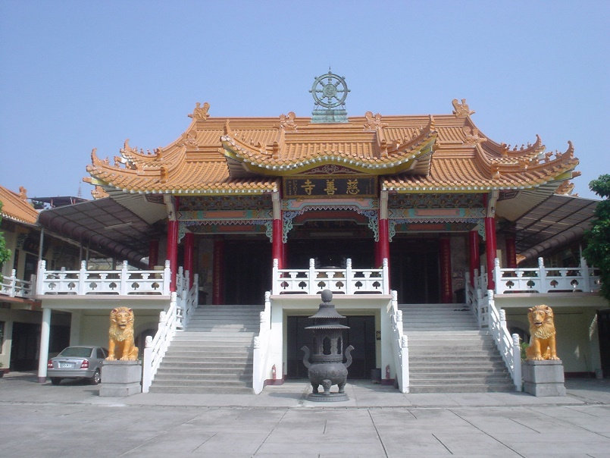
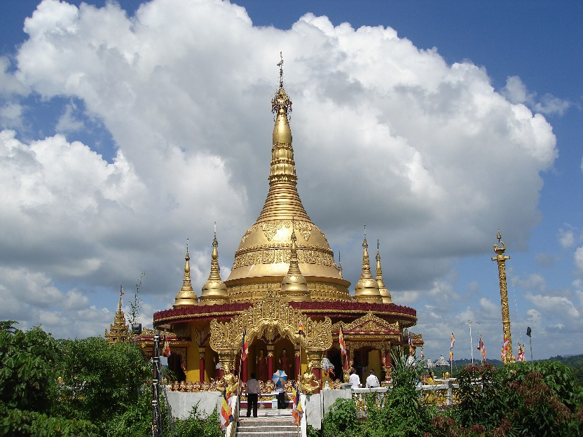
Buddhist temples
Buddhist temples come in many shapes and sizes.
All temples have a statue of Buddha.
People chant to show their love of Buddha.
They also make offerings of flowers, candles and incense.
Buddhist temples

Slide 14
Quiz
Where did Buddhism begin?
Ireland
India
China

Slide 15
Quiz
What do Buddhists call Siddhartha Gautama?
Buddha
Allah
Abba

Slide 16
Quiz
Do they believe that Buddha was a God or a man?
man
God

Slide 17
Quiz
What do they call the cycle of rebirth?
Reincarnation
Reanimation

Slide 18
Quiz
Where do Buddhists worship?
Temple
Synagogue
Mosque

Slide 19
Quiz
Which of these flowers is a Buddhist symbol?
Rose
Tulip
Lotus

