Slide 1
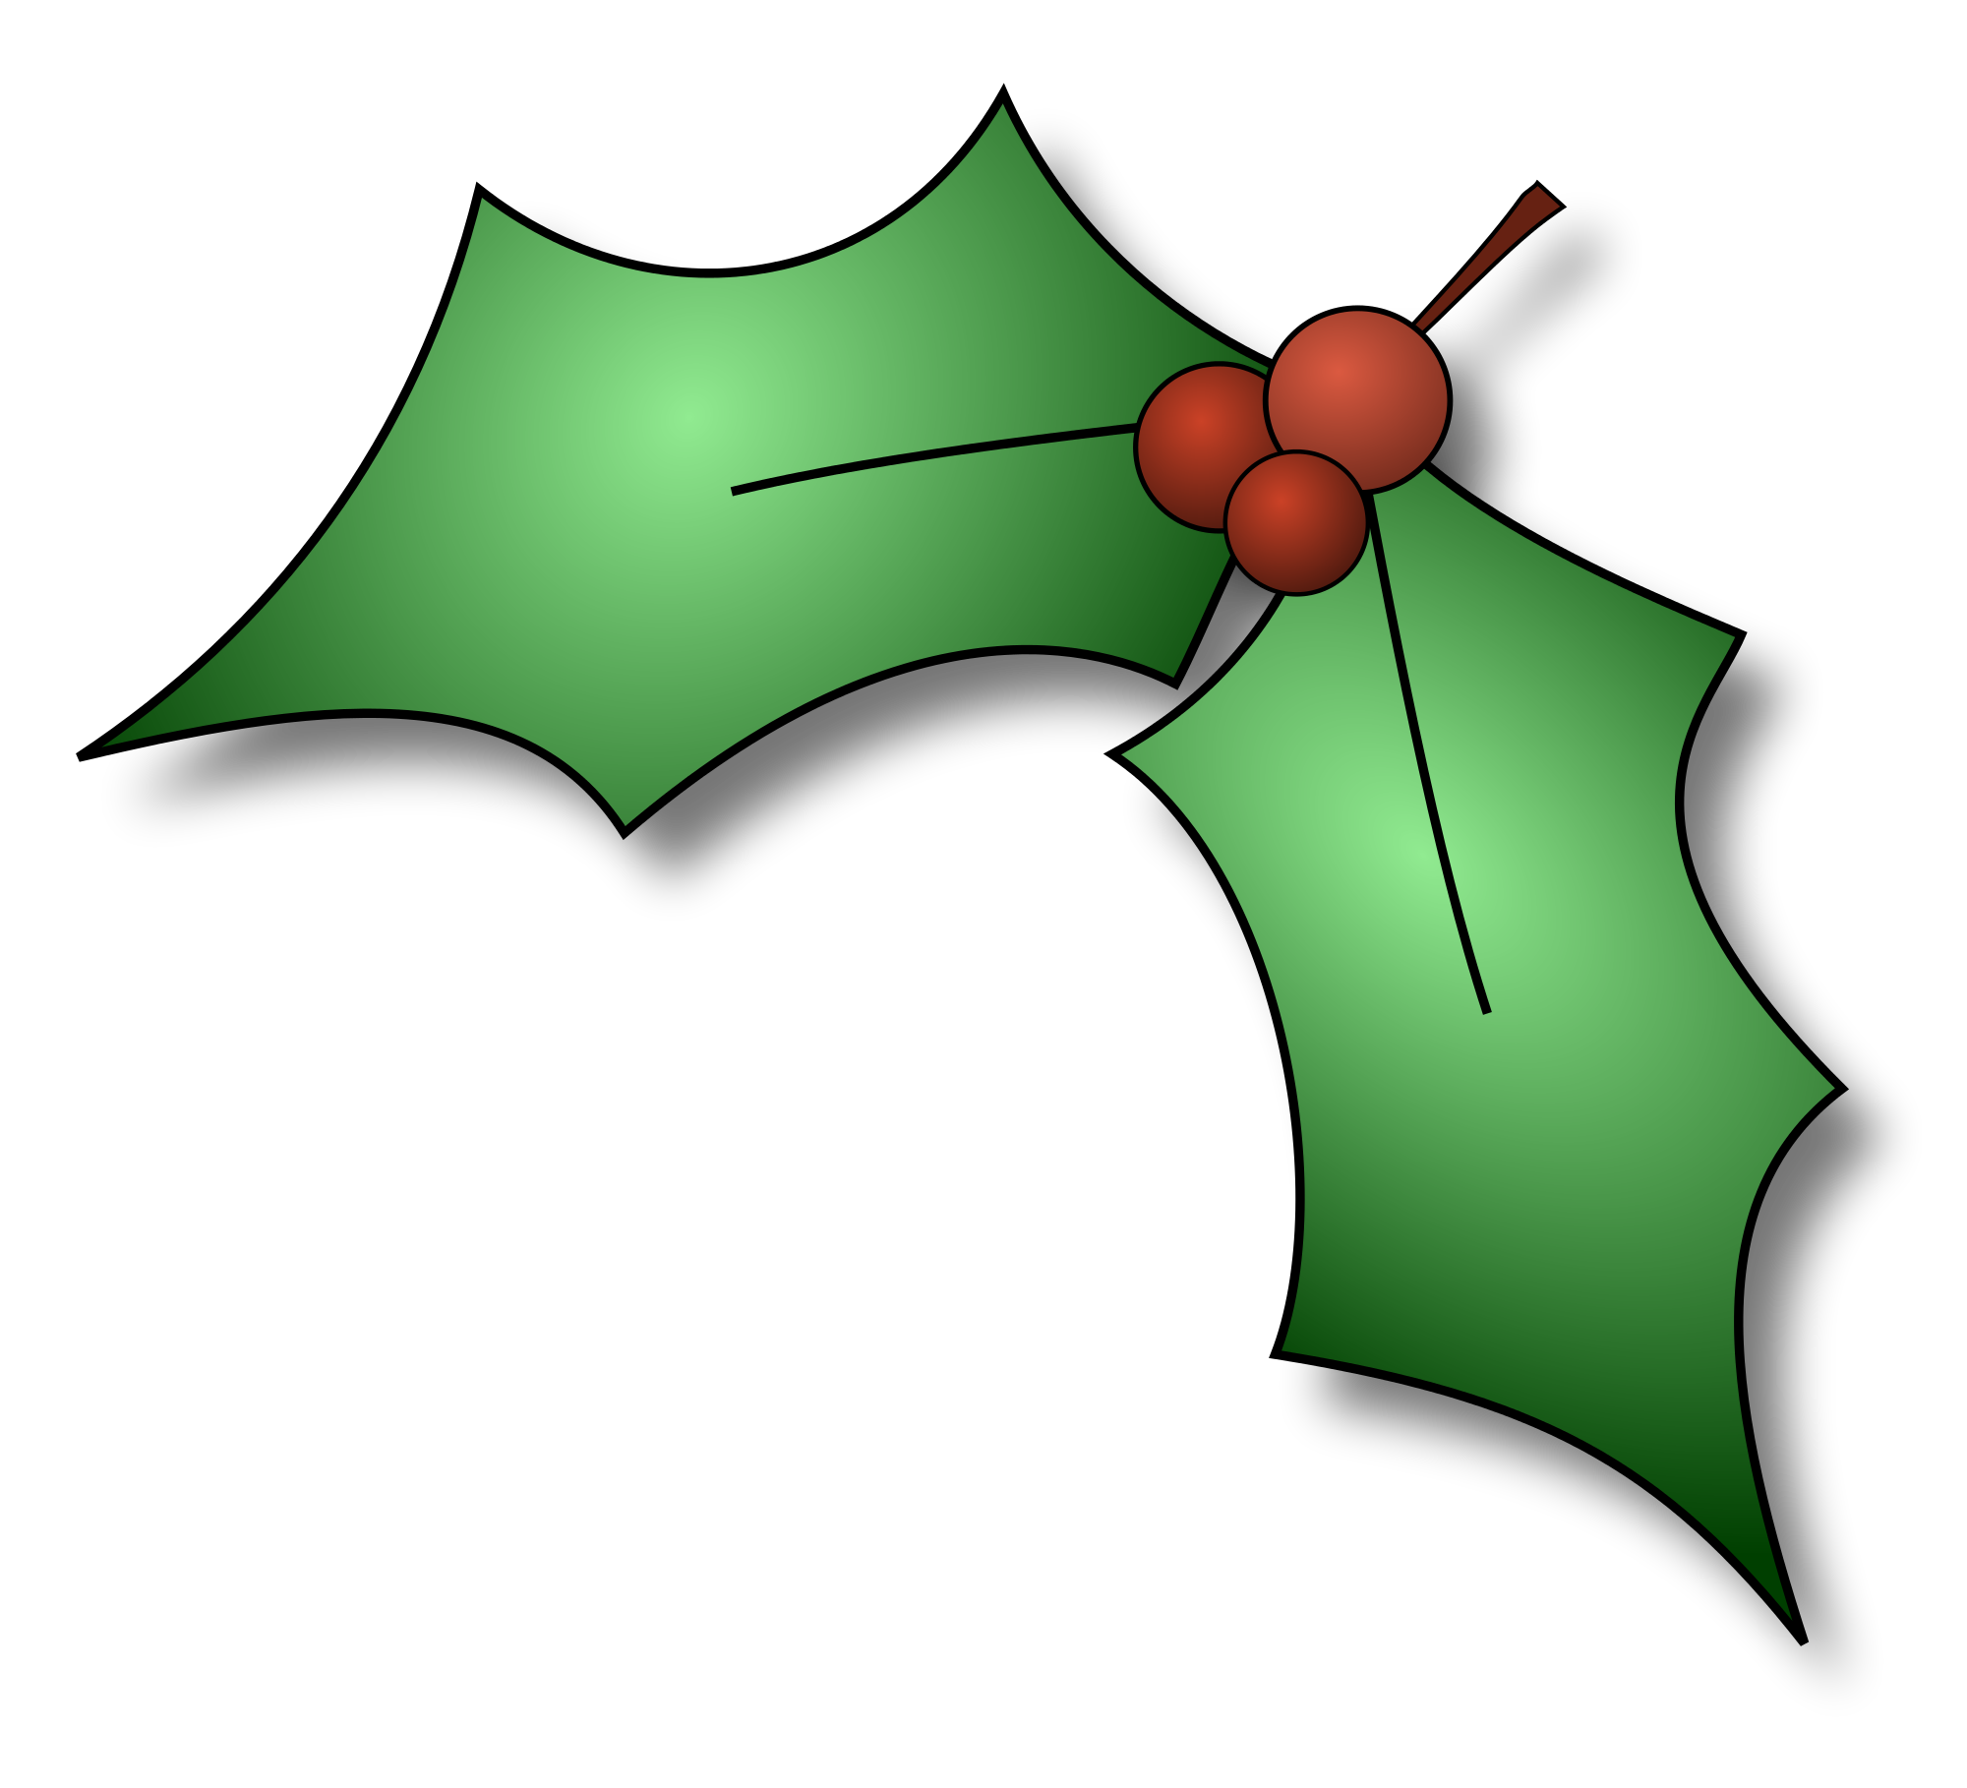
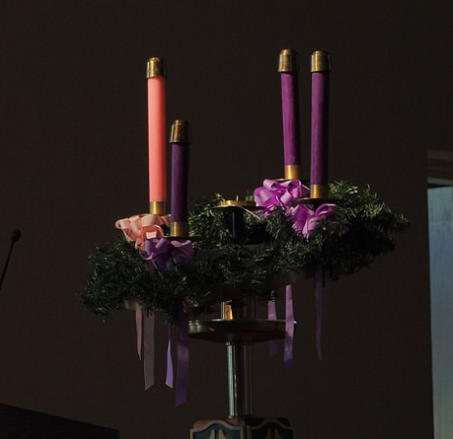
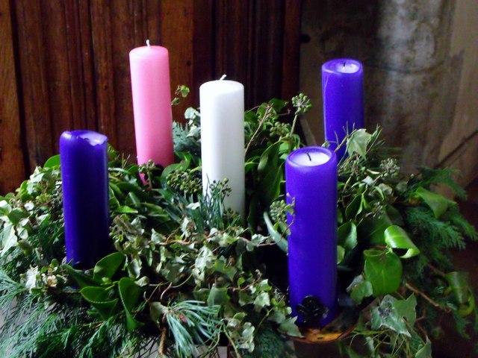

Title: The Advent Wreath
Learning Intentions:
To describe advent and the advent wreath.
To explain the meaning behind the advent wreath.
To design and create a classroom advent wreath.
Picture Credit : John Perry, Flickr
Picture Credit : nick macneill, Geograph

Slide 2
When is Advent?
Advent is the season that marks the beginning of the Christian church year. It starts on the _________nearest St. Andrew's Day (__________________), and it continues until Christmas Eve (_______________). The term comes from the Latin word adventus, which means coming or __________. The season is thus one of preparation for the celebration of the feast of the Nativity of Jesus Christ on Christmas Day.
Sunday
29th November
24th December
arrival
Sunday
24th December
arrival
29th November
Notes:
Student worksheet. Print Slide for students to complete the task.
Content Reference - World Book Online

Slide 3
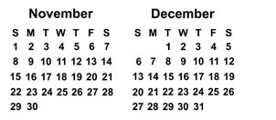
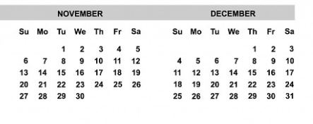
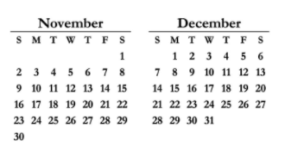
Mark the celebration of advent on the calendars?
Task:
Look at your classroom calendar.
Mark the beginning of advent and the end date for advent.
Hint:
Nearest Sunday to 30th November until Christmas Eve.
Picture Credit : Pixabay and Public Domain
Notes:
Student worksheet. Print Slide for students to complete the task.

Slide 4
Spot the difference:
First picture: 4 candles - 3 purple and 1 Rose.
Second picture: 5 candles - 3 purple, 1 rose and 1 white.
The white candle in the middle is a modern day adaptation and represents Christ. It is lit on Christmas Eve.
Picture Credit : John Perry, Flickr
Picture Credit : nick macneill, Geograph
Notes:
Student worksheet. Print Slide for students to complete the task.
Content reference - https://www.catholiceducation.org/en/culture/catholic-contributions/the-history-of-the-advent-wreath.html

Slide 5
Spot the difference:
Did you know?
Beginning in the 500’s, the advent season lasted six weeks.
The advent season was gradually reduced to four weeks.
Picture Credit : John Perry, Flickr
Picture Credit : nick macneill, Geograph
Notes:
Student worksheet. Print Slide for students to complete the task.
Content reference - WorldBook Online Article

Slide 6

Instructions for colouring
in your Advent wreath.
Keep the middle candle white.
Colour two candles purple.
Colour third candle pink.
Colour the fourth candle purple.
Colour in the Holly. (Green & Red)
Add pine, cedar tree leaves, laurel leaves or nuts to the wreath.
Picture Credit : Pixabay

Slide 7




Write a paragraph on the meaning of the Advent wreath. Use the following as a guide...
Evergreen |  | Continuous Life
Wreath Shape: Circle |  | No beginning or end. Eternity of God. Immortality of the soul.
Holly |  | Immortality. Prickly leaves are a reminder of the crown of thorns.
Pines/ nuts |  | Life and resurrection
Candles |  | Each week a candle is lit to represent the expectation and hope of the Lord’s first coming into the world. Each week represents 1,000 years to sum 4,000 years from Adam and Eve until Birth of our Saviour. Purple = Prayer, penance and preparation. Rose = Rejoicing
Picture Credit : Anerma, Pixabay
Notes:
Student worksheet. Print Slide for students to complete the task. Content reference https://www.catholiceducation.org/en/culture/catholic-contributions/the-history-of-the-advent-wreath.html

Slide 8
Design your own advent wreath using this template.
Teacher Reference
Notes:
Student worksheet. Print Slide for students to complete the task.

Slide 9
Two Stars and a Wish
Record two positives on what you now know.
Record a wish for what you want to know.
Notes:
Student worksheet. Print Slide for students to complete the task.

