Slide 1
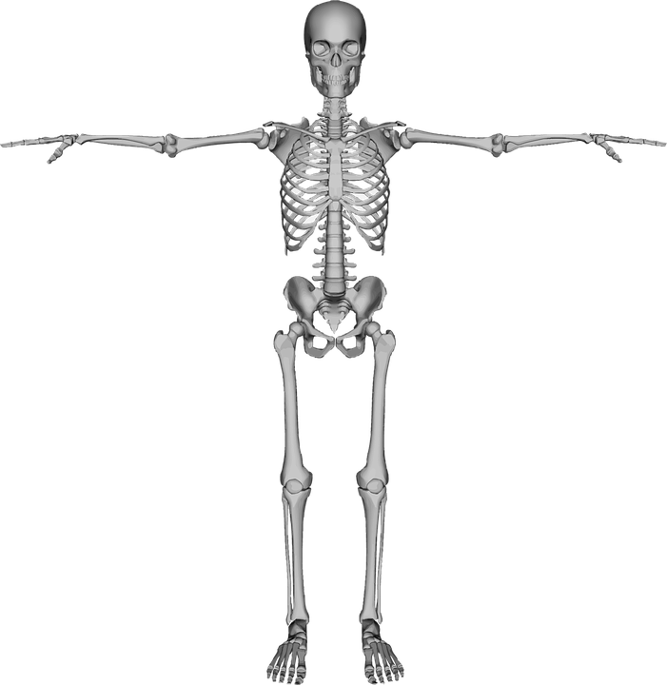


Skeletons
List 10 things you already know about skeletons. (Think-Pair-Share)
Human Life - Explore & Investigate How People Move.

Slide 2
My Ideas Write your list of ideas here. | My Partner's Ideas Listen to your partner and write their ideas here. | What We Are Sharing Talk with your partner and decide which points you will share with the class.

Slide 3
Record 10 points about skeletons from the class.
10 Points from the Class | 10 Points from the Teacher
The teacher’s 10 points will be given at the of the class.
At the end of the lesson, compare what you already knew to the new points from the teacher.

Slide 4
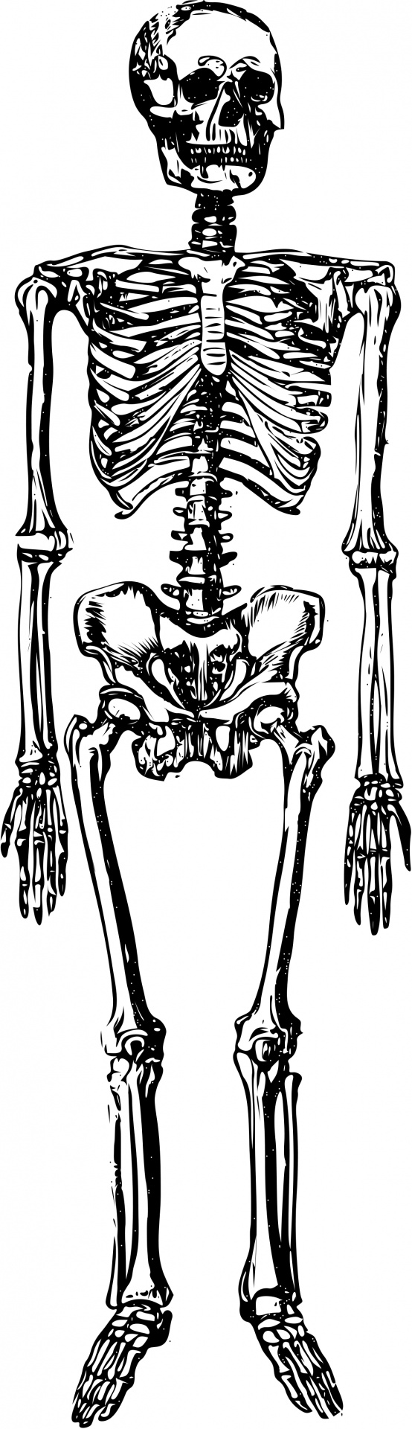
WHAT IF….?
Read the article from World Book Online (here).
Using the article information, discuss the following questions
What would happen if humans didn’t have bones?
Could you walk or stand without bones?
What would happen to humans heart/ lungs/ brain if humans didn’t have bones?
What would happen if you had more than 206 bones in your body?
Would you be able to move if you had bones but no muscles/ joints/ tendons?
What would happen if humans were invertebrates?

Slide 5
Can You Name the Skeleton?
Trace your partner onto giant poster paper.
Put the skeleton together with this worksheet. (Here)
Extension Questions:
1. Locate the longest bone in the body.
2. What is the part of the skeleton that protects the head?
3. What is the part of the skeleton that protects the heart & lungs?
4. What do you call the place where bones join together?
5. What do you call the stuff in the middle of the bones?
6. How many bones are in the body?
7. Locate the smallest bone in the body.
8. Is there bones in your nose?
Challenge:
Without looking at your skeleton, name all the parts of the skeleton.
Access online quiz here or here.

Slide 6
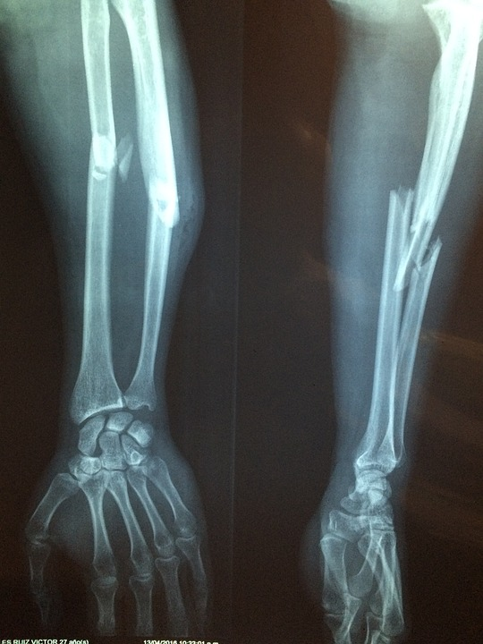
Do You Know Someone Who Broke a Bone?
Ask someone who broke a bone…
On a scale of 1 - 10, how sore was it?
How could you have prevented the break?
Who helped you with the break?
Did you need to get an X-Ray?
What was it like getting an X-Ray?
How long did it take you to recover?
Learn more about broken bones here. Flash required.

Slide 7
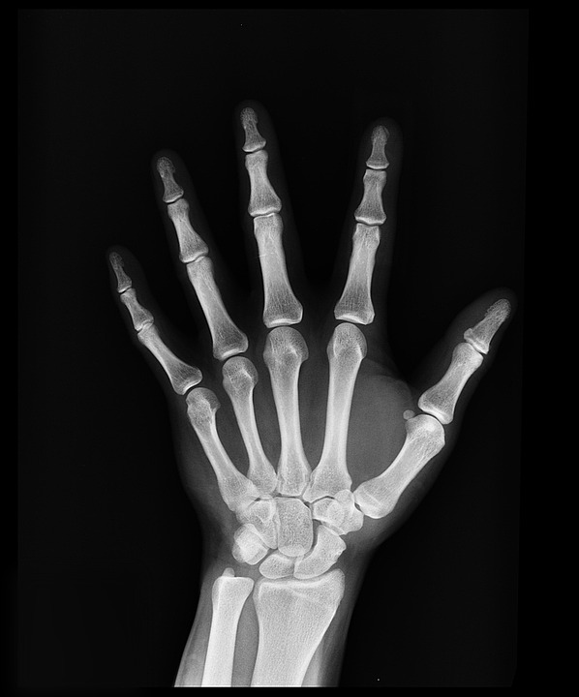
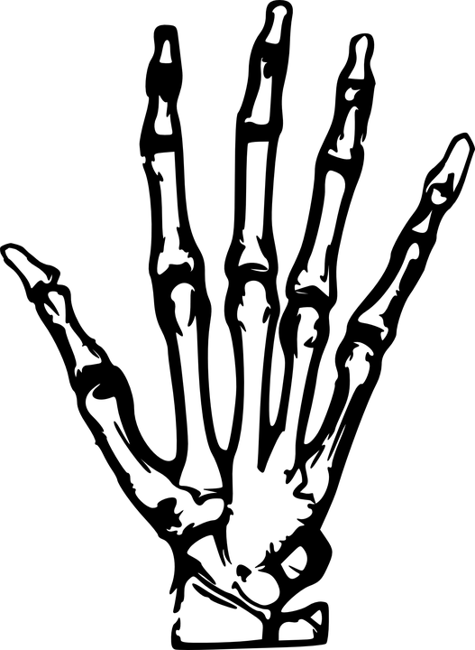
Can You See Your Bones?
Darken the room, place the palm of your hand over the flashlight...can you see the bones and joints?
Record your observation:

Slide 8
10 Points from the Class | 10 Points from the Teacher
 | The function of the skeleton is for shape, support and protecting organs.
 | Bone marrow is the soft spongy part inside many bones. It produces white blood cells, red blood cells and platelets.
 | A child has more bones than an adult. An adult has only 206 bones.
 | Bones are joined to other bones at joints. Some joints move, others do not move.
 | The longest bone in the body is the Femur in the thigh. The smallest bone is the stirrup in the ear.
 | The skull protects the brain.
 | The sternum and rib-cage protect the heart & lungs.
 | We need calcium and Vitamin D for healthy bones.
 | We get calcium from dairy products and sunlight is needed for Vitamin D
 | Osteoporosis is a condition where your bones become fragile
How many points did you know and how many points are new?

Slide 9
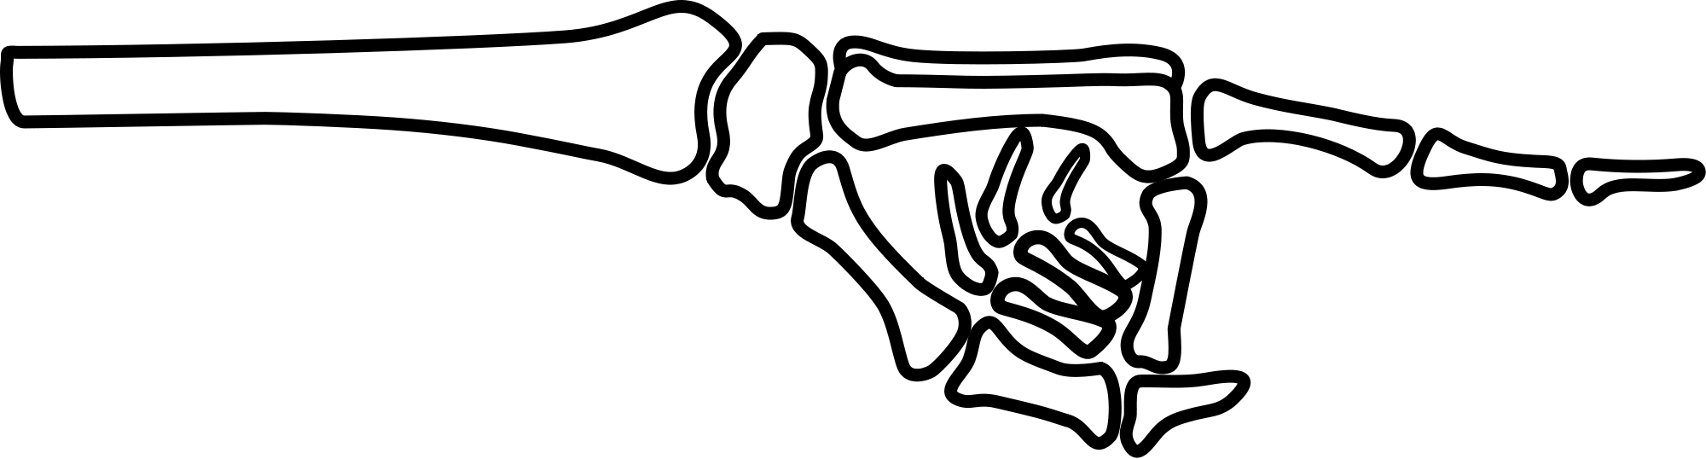

Homework
Reflect on your learning by completing this worksheet. (Here)
Project work - Research the skeleton of an animal of your choice.
(Use the following link to help you choose your skeleton)

