Slide 1
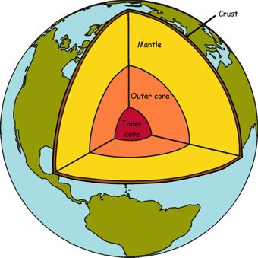

The Earth
The Earth is made of three different layers.
Using the WorldBook Online map of the World, represent the three layers by creating a flip book.
Keywords: Inner Core, Outer Core, Mantle, Crust
Human Habitat – Shaping the Earth

Slide 2
In groups, discuss the statements below and decide which statement describes the keywords. Students can use the following online interactive sites to help them decide.
Two parts the outer and the inner core Outer core made of molten metals, nickel and iron Inner core it is solid due to high pressure
Made of solid rock 10 km thick under the oceans and 60 km under the continents
Made of molten (melted) rock called magma Temperatures of 4000 ºC
This part is solid due to high pressure.
Keywords
Crust
Mantle
Inner Core
Outer Core
Two parts the outer and the inner core Outer core made of molten metals, nickel and iron Inner core it is solid due to high pressure
Made of solid rock 10 km thick under the oceans and 60 km under the continents
Made of solid rock 10 km thick under the oceans and 60 km under the continents.
This part is made of molten metals, nickel and iron.
Human Habitat – Shaping the Earth

Slide 3
Using the following interactive online website;
Label the parts of the Earth.
Record the approx. temperature of each part.
Record the approx. thickness of each part.
Human Habitat – Shaping the Earth

Slide 4
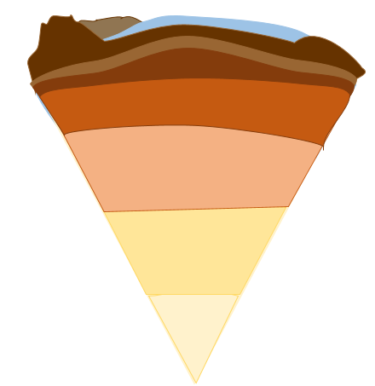
Crust
Lithosphere
Asthenosphere
Mantle
Outer Core
Inner Core
Human Habitat – Shaping the Earth

Slide 5
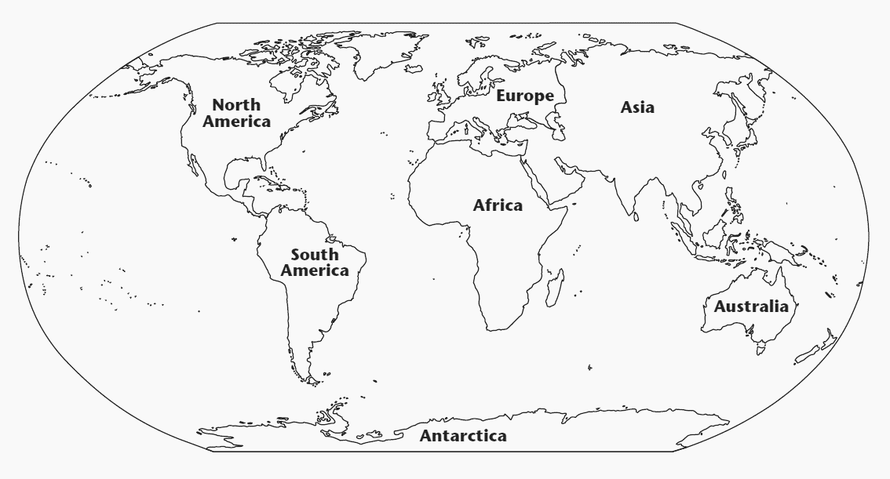
The Earth’s Crust
The crust is broken up into pieces called plates.
The edges of the plates are called plate boundaries.
Eurasian Plate
African Plate
American Plate
Australian Plate
Pacific Plate
Indian Plate
Continents sit on top of these plates.
Match the continents to the plates
Nazca Plate
Human Habitat – Shaping the Earth

Slide 6
Can Plates Move?
‘Plates move due to convection currents in the mantle.’
In groups, cut the world map up and check whether the continents fit together like a jigsaw puzzle.
Human Habitat – Shaping the Earth

Slide 7
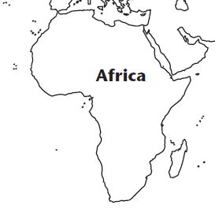
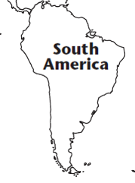
?
Human Habitat – Shaping the Earth

Slide 8
Human Habitat – Shaping the Earth

Slide 9
?
Human Habitat – Shaping the Earth

Slide 10
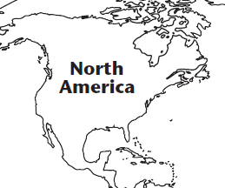
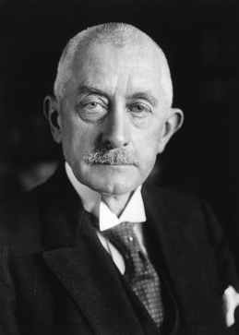
Alfred Wegener
Read the WorldBook Online article about Alfred Wegener
Human Habitat – Shaping the Earth

Slide 11
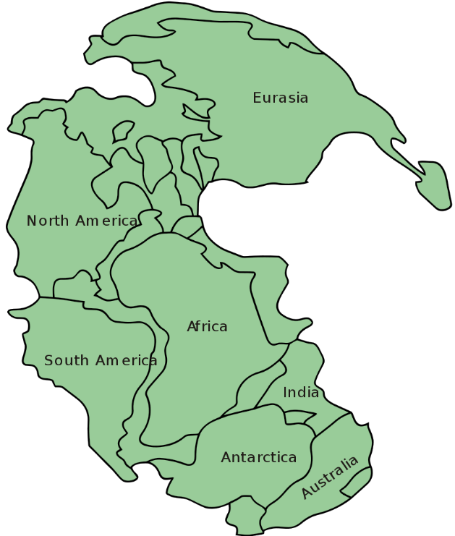
Continental Drift
Read the WorldBook Online article about Alfred Wegener.
Alfred Wegener proposed the continental drift theory in 1912, explain the theory he proposed?
What was the ‘Pangaea’?
List three ways in which Alfred Wegener supported his continental drift theory.
Millions of years ago all the continents fitted together in one large land mass called Pangea. It eventually broke up and all the continents drifted to their present-day positions. The continents are still moving today.
Human Habitat – Shaping the Earth
Timeline animation.

Slide 12
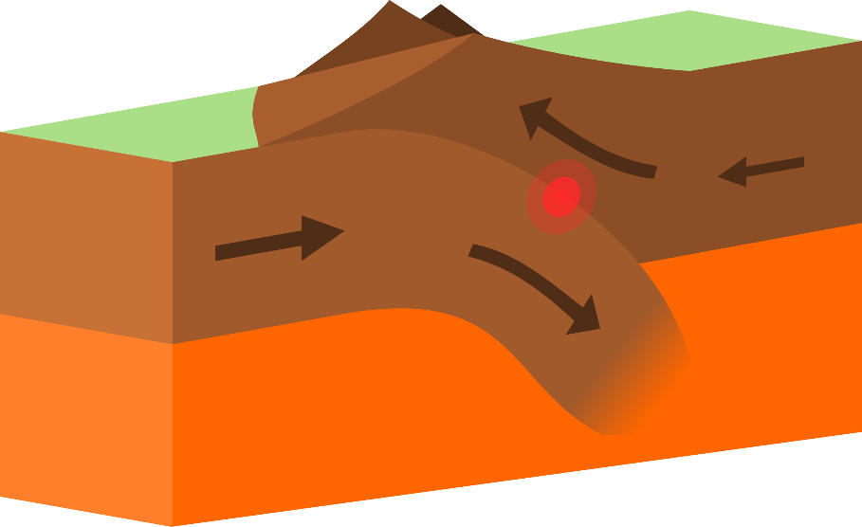
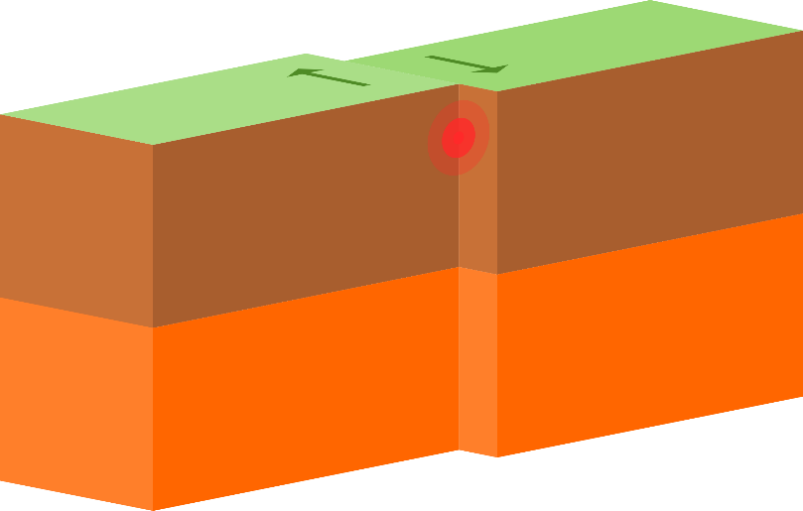
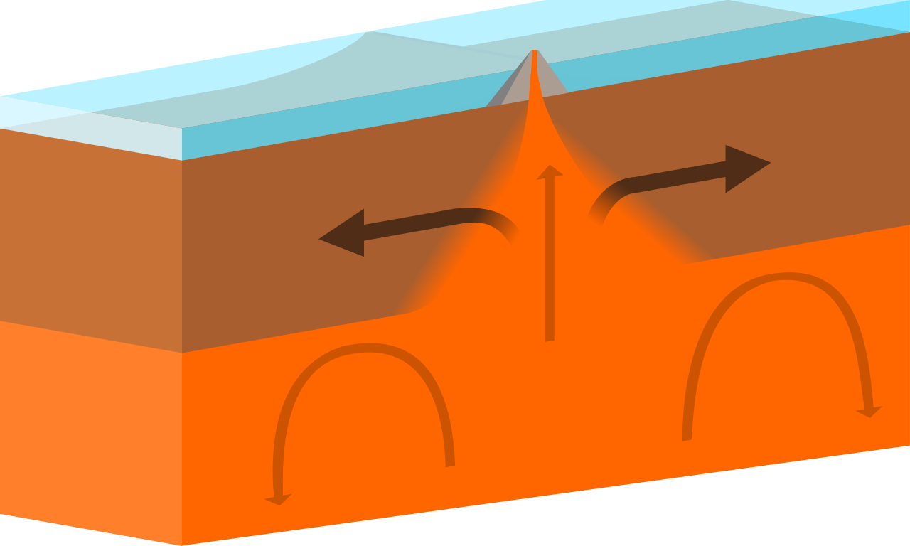
Plate Boundaries
Plates move due to convection currents in the mantle.
The edges of the plates are called plate boundaries and there are three types:
Constructive
Conservative
Destructive

Slide 13

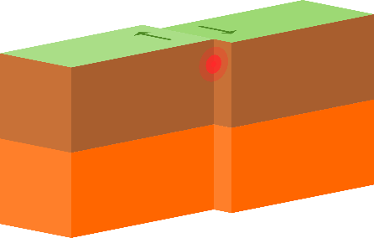

Match Activity
Match the plate boundary name, diagram and description together…
Constructive | Destructive | Conservative
Two plates push together One plate is forced down into the mantle and destroyed Land above is forced upwards forming, Fold Mountains, earthquakes and volcanic mts. | Two plates slide past each other Land is neither created nor destroyed Great build-up of pressure Causes earthquakes e.g. San Andreas Fault | When two plates pull apart Magma forces up Cools to form new crust It forms features like the Mid – Atlantic Ridge Volcanic Islands
Structure of the Earth Matching Task
Human Habitat – Shaping the Earth

Slide 14
Self Assess
Extension task: Explain how volcanoes, earthquakes and fold mountains are formed.
Constructive | Conservative | Destructive
When two plates pull apart Magma forces up Cools to form new crust It forms features like the Mid – Atlantic Ridge Volcanic Islands. | Two plates slide past each other Land is neither created nor destroyed Great build-up of pressure Causes earthquakes e.g. San Andreas Fault | Two plates push together One plate is forced down into the mantle and destroyed Land above is forced upwards forming, Fold Mountains, earthquakes and volcanic mts.
Human Habitat – Shaping the Earth

Slide 15
What I learned:
Where I learned it:
New questions:
Human Habitat – Shaping the Earth

