Slide 1
Hinduism

Slide 2
History
Hinduism began about 4000 years ago in India.
It is the world’s oldest religion.
People who follow the religion are called Hindus.
It is the world’s third most popular religion, after Christianity and Islam.
Unlike other religions Hinduism does not have a founder or prophet.

Slide 3
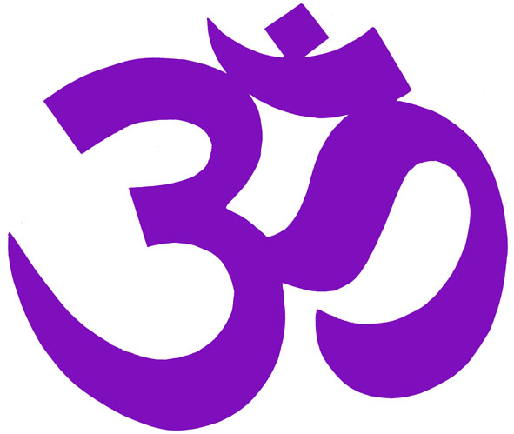
Beliefs
For Hindus religion is about practice rather than belief. It is more about what you do, than what you believe.
Hindus believe in a universal soul or God called Brahman. Brahman takes on many forms.
Hindus believe that there is a part of Brahman in everyone and this is called the Atman (or soul).
The Hindu symbol - Aum

Slide 4
Beliefs
Hindus believe in reincarnation - this means that when someone dies their soul comes back in another form or body. The soul is sometimes born in a human body, sometimes in an animal body and sometimes in a plant body. Hindus believe that all forms of life contain a soul.
Samsara means going through the cycle of repeated births and deaths (reincarnation). Hindus believe that existence of this cycle is governed by Karma.
Birth
Life
Death
Rebirth

Slide 5
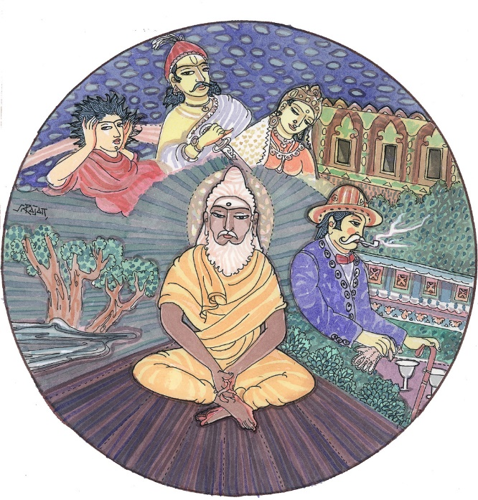
Karma
Hindus believe that what we are reborn as (human, animal or plant) is dependent on how we live our current life.
Our actions in our present lives will determine our fate in the lives that follow. This is called Karma.
Hindus therefore aim to live in a way that will cause each of their lives to be better than the life before.

Slide 6
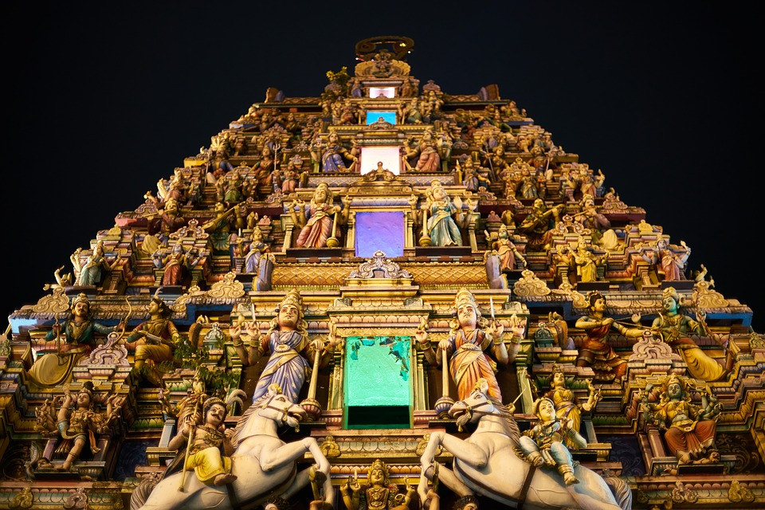
Hindu Gods
There are over 300 million Hindu gods!
However, Hindus actually only believe in one God, Brahman. The gods of the Hindu faith represent different forms of Brahman. These gods are sent to help people find the universal God (Brahman).
A temple decorated with statues of Hindu gods

Slide 7
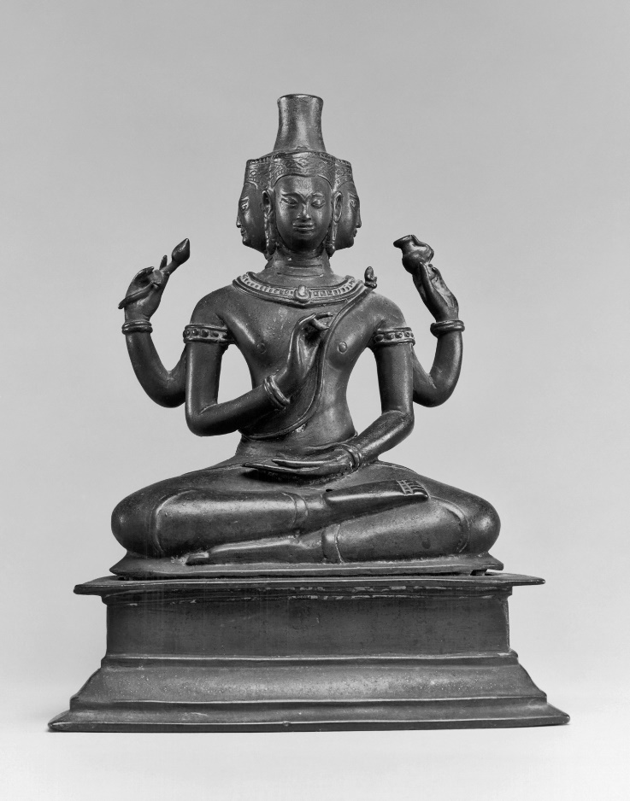
The three most important gods are:
Brahma – known as the Creator.
His job was the creation of the world and all it’s creatures.
He has four heads and four arms.
Statue of Brahma

Slide 8
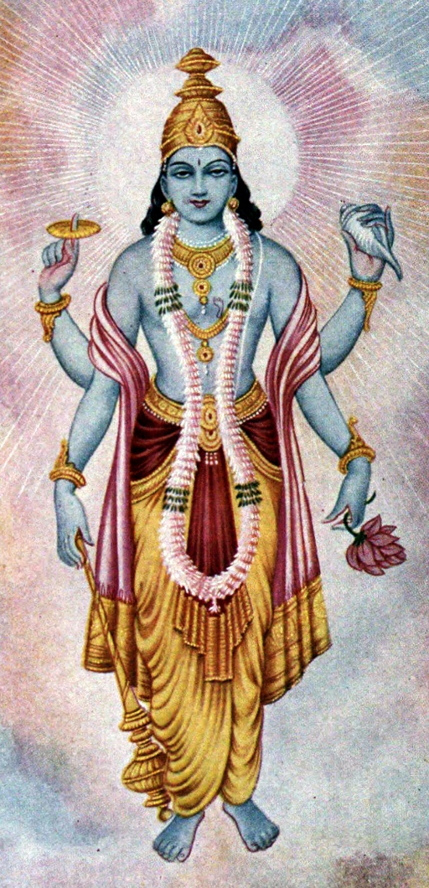
The three most important gods are:
Vishnu – known as the Preserver.
Vishnu is the protector of the universe. His job was to return to earth in troubled times and restore the balance of good and evil.
He has four arms and blue coloured skin.
Vishnu

Slide 9
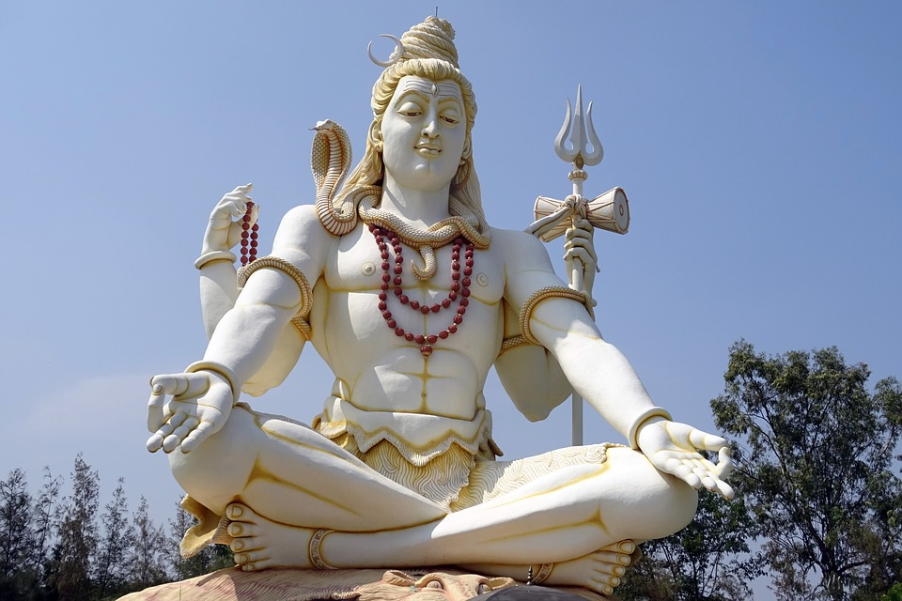
The three most important gods are:
Shiva– known as the Destroyer.
Shiva’s role is to destroy the universe so it can be recreated. Hindus believe this allows for beneficial change in the world.
Shiva always has a third eye to represent wisdom. He also has a cobra necklace to show his power.
Statue of Shiva

Slide 10
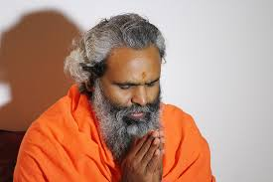
Moksha
Through meditation, prayer and working for the good of mankind Hindu’s ultimate goal is to achieve Moksha.
This means that their soul will be released from the repeated cycle of death and rebirth.
When Hindu’s achieve Moksha they believe their soul is reunited with Brahman.
Hindu swami praying.
A swami is a religious teacher

Slide 11
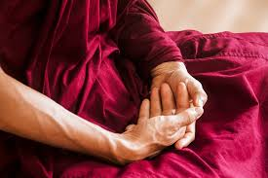
How do Hindu’s achieve Moksha?
There are four paths to achieve Moksha.
The path of knowledge - this means learning all about Brahman.
The path of meditation – practising meditation on a regular basis.
The path of devotion – praying to one of the Hindu gods daily.
The path of good works – this path involves doing good deeds throughout your life.

Slide 12
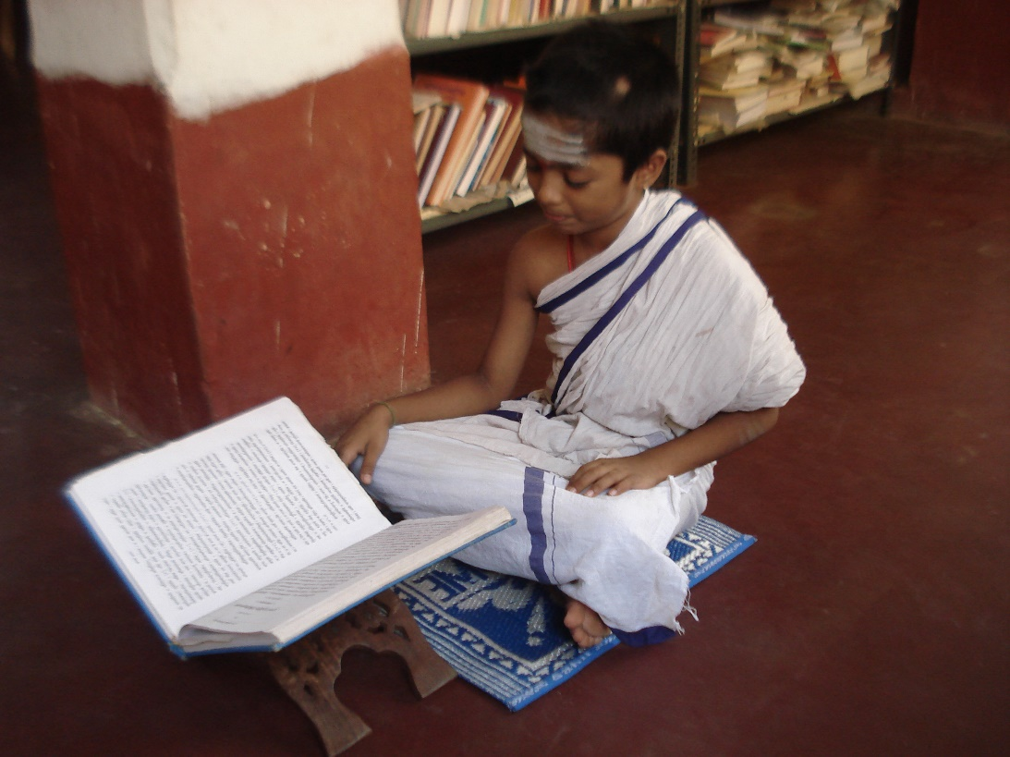
Religious text
The religious texts followed by Hindus are called the Vedas.
The word veda means knowledge.
There are four vedas and they cover lots of different subjects, from nature to everyday life and behaviour.
The books are so special they are often kept in glass cases.
Student studying the Veda

Slide 13
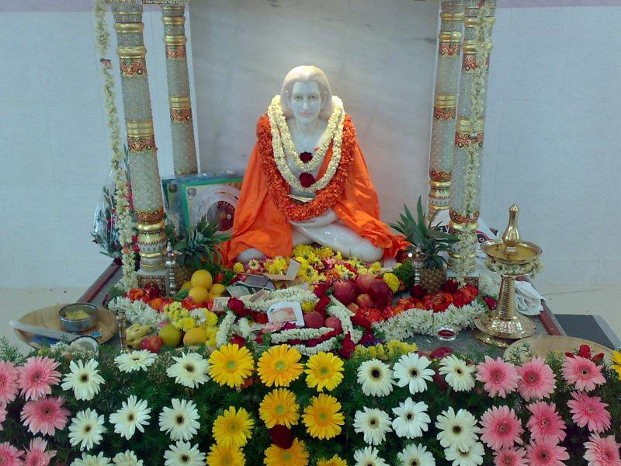
Where do Hindus worship?
Most Hindus worship (puja) every day at home and have a shrine there. A shrine can be anything from a room, a small altar or simply pictures or statues. Family members often worship together. At the shrine, Hindus make offerings to a murti. A murti is a sacred statue of God, or a god or goddess.
Hindu shrine

Slide 14
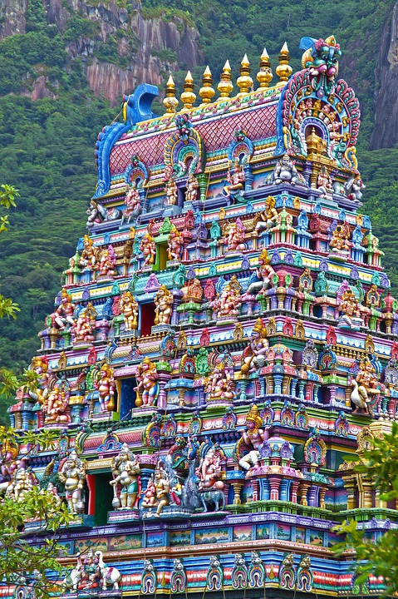
Hindu temples
The Hindu building for worship is called Mandir (Hindu Temple). The temples are dedicated to different gods. Outside India, people mainly gather at the mandir at the weekend.
Worshippers repeat the names of their favourite gods and goddesses.
Water, fruit, flowers and incense are offered to the gods.
A Hindu temple

Slide 15
Quiz
Where did Hinduism begin?
England
India
Thailand

Slide 16
Quiz
What is the main Hindu god called?
Brahman
Allah
God

Slide 17
Quiz
The belief that how we act in this life will affect how we are born in the next life…
karma
fate
destiny

Slide 18
Quiz
What do they call the cycle of rebirth?
Reincarnation
Reanimation

Slide 19
Quiz
Where do Hindus worship?
Temple
Church
Cathedral

Slide 20
Quiz
Which of these is a Hindu god?
Zeus
Loki
Shiva

