Slide 1
Co. Galway
Contae na Gaillimhe

Slide 2
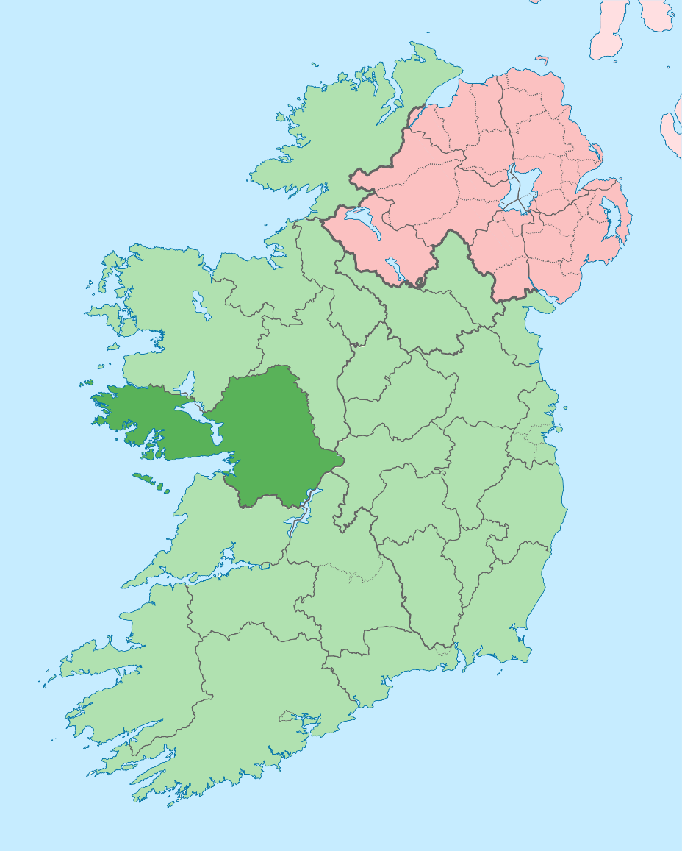
County Galway is a county in the west of Ireland.
It is in the province of Connaught.
The largest city in the county is Galway city.
In the 13th to 19th centuries there were fourteen families that held most of the power in the city of Galway. This is where the nickname ‘City of the Tribes’ comes from.

Slide 3
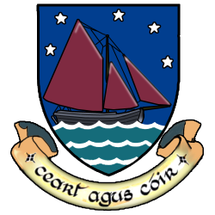
County Crest
The coat of arms depicts the Galway Hooker, the reddish sailed boat traditionally associated with the county.
Galway is a maritime county, and that fact is represented by the ship and waves.
The motto translates to: “Righteousness and Justice”

Slide 4
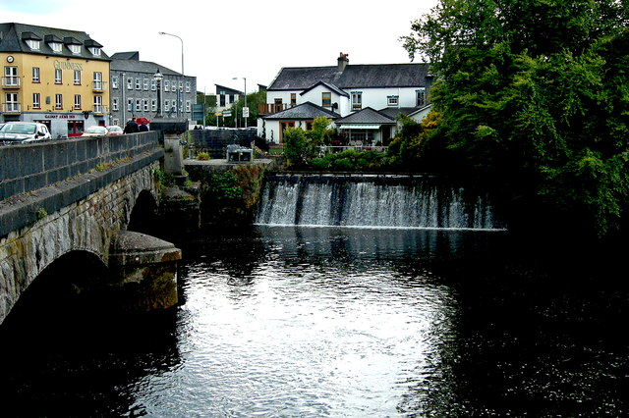
Galway city
The Irish name Gaillimh translates as “fort at the mouth of the stony river”. The city was built around the river Corrib.
But there is another local story about how the city got it’s name which goes like this. There once lived a chief in the area and his daughter was called Gailleamh. One day she drowned in the river. To mourn her death the chief founded a camp at the mouth of the river. This camp soon turned into a settlement and in honour of the chief’s daughter it was named Gaillimh.
Galway is built on the river Corrib

Slide 5
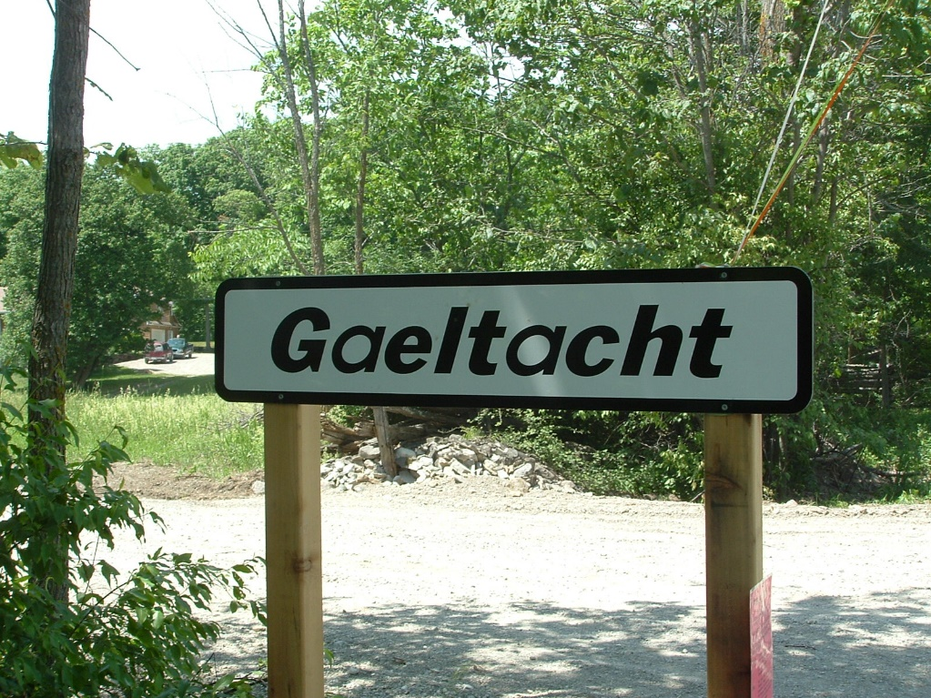
Irish language
Nearly 20% of the people of Galway live in the Gaeltacht, where Irish is still the main language.
Co. Galway is home to the largest Gaeltacht region in Ireland.
All schools in the Gaeltacht teach subjects through Irish.
TG4 is also based in Galway.

Slide 6
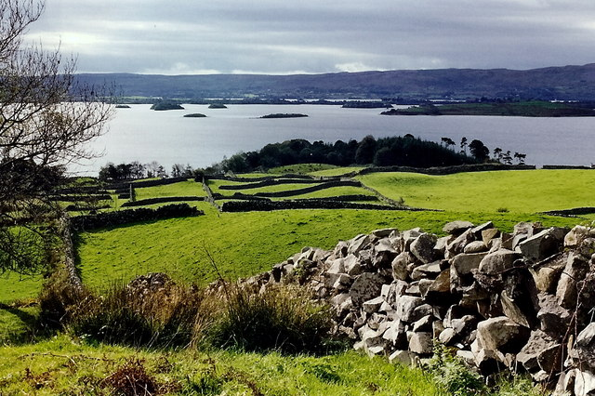
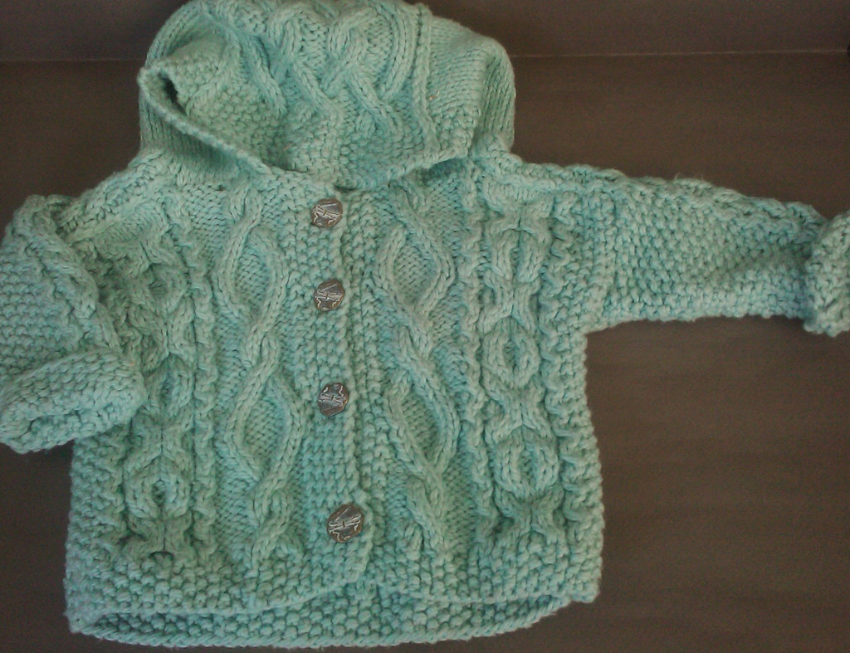
Around the county
Co. Galway is home to several of Irelands largest lakes including Lough Corrib (the largest lake in Ireland), Lough Derg and Lough Mask.
The Aran Islands are part of Co. Galway and can be reached by ferry. The islands are called Inis Mór, Inis Meaín and Inis Oírr. The islands are known for their historic sites and ruins including stone forts and churches. This is also where the Aran jumper (geansaí) came from.
Lough Corrib

Slide 7
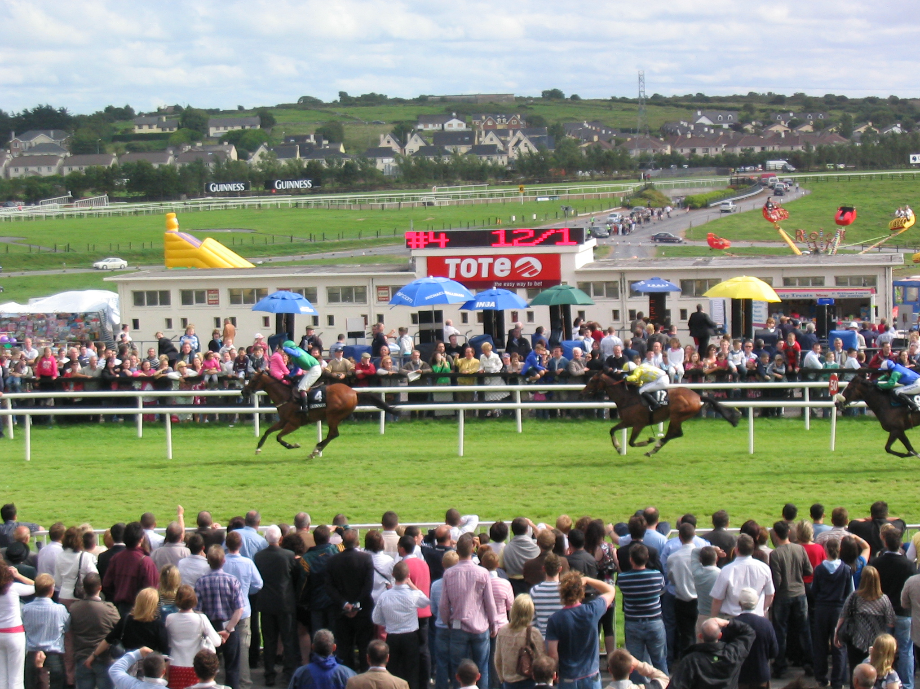
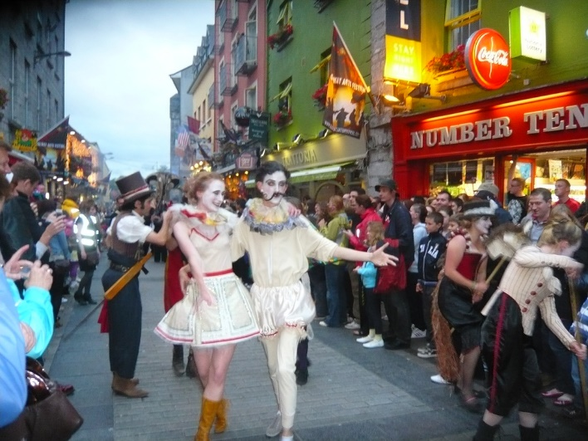
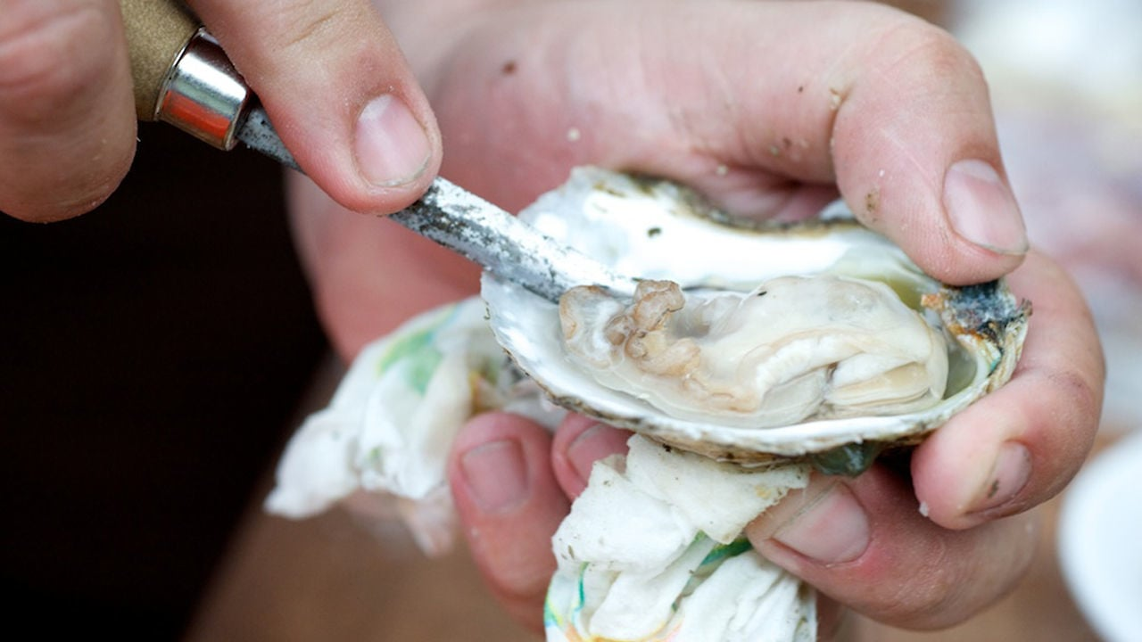
Festivals and culture
Galway is well known for it’s festivals.
The Galway Races is a horse-racing festival that takes place in July. The races are held at Ballybrit race course and are the only seven-day race meeting in Ireland.
The Galway Arts Festival takes place in Galway every July. It first began in 1978 and is now one of the biggest arts festivals in Ireland. The Festival includes parades, street performances and numerous plays, musical concerts and comedy acts.
The Galway Oyster Festival is a food festival held in September, the first month of the oyster season. The main events are two Oyster Opening Championships.

Slide 8
Quiz
Where is Ireland is Co. Galway?
North
South
East
West

Slide 9
Quiz
What province is it in?
Leinster
Munster
Connaught
Ulster

Slide 10
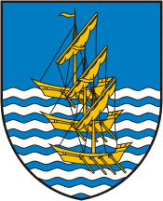
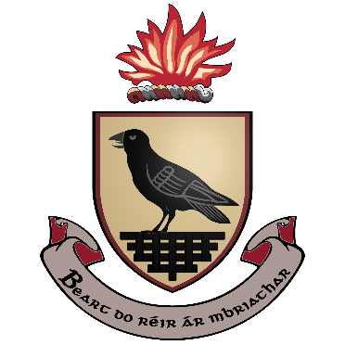
Quiz
Which of these is the county crest?

Slide 11
Quiz
What is the nickname for Galway city?
City of hurling
City of the Tribes
City on the River

Slide 12
Quiz
What river is Galway city built on?
River Corrib
River Shannon
River Liffey

Slide 13
Quiz
What Irish TV station is based in Galway
TV3
RTE
TG4

Slide 14
Quiz
Which of these seafoods is the basis for a famous Galway festival?
Prawns
Oysters
Crab

