Slide 1
Co. Mayo
Contae Mhaigh Eo

Slide 2
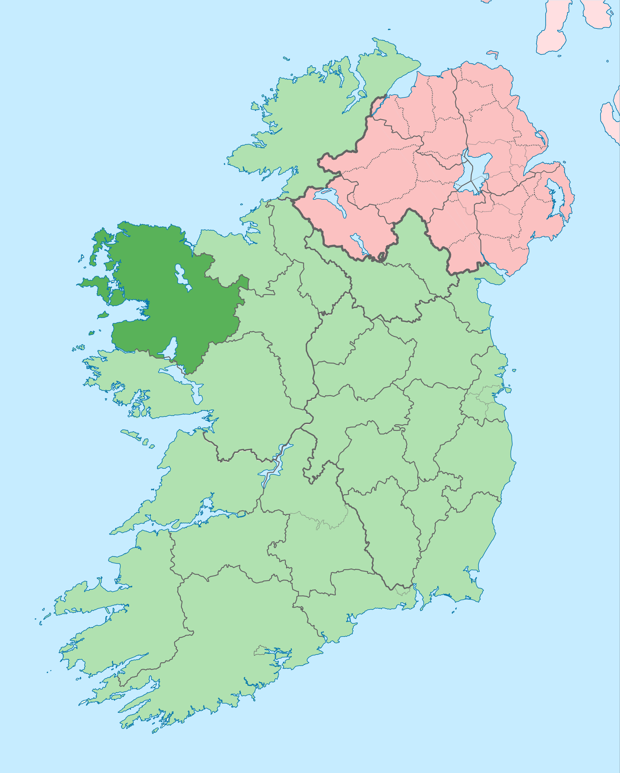
County Mayo is a county in the west of Ireland.
It is in the province of Connaught.
Mayo is the third largest county in Ireland.
Ireland’s largest island, Achill Island, lies off the west coast of Mayo.
Mayo also has Ireland’s highest cliffs at Croaghaun, Achill Island.

Slide 3
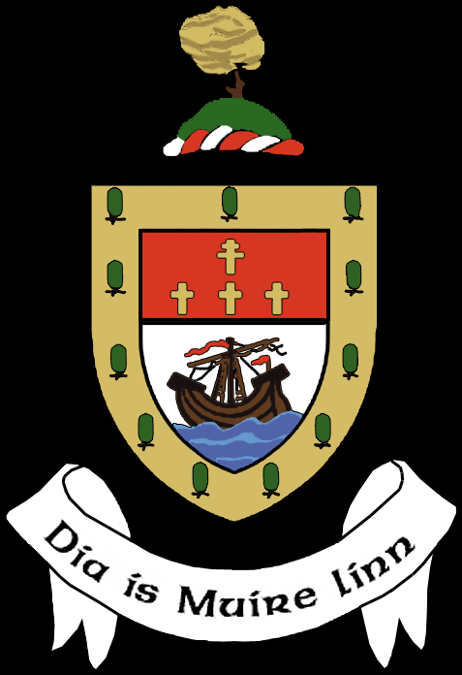
County Crest
The crest has nine yew trees as ‘Mhaigh Eo’ means “the plain of the Yew Trees”.
The Patriarchal Cross (the cross with two bars) symbolises the Catholic Archdiocese of Tuam, and the three other crosses represent the other three Catholic dioceses in Mayo.
Mayo is a maritime county, and that is represented by the ship and waves.
The apparition at Knock is represented by the rose on a crown at the top of the crest.
Motto: “God and Mary be with Us”

Slide 4
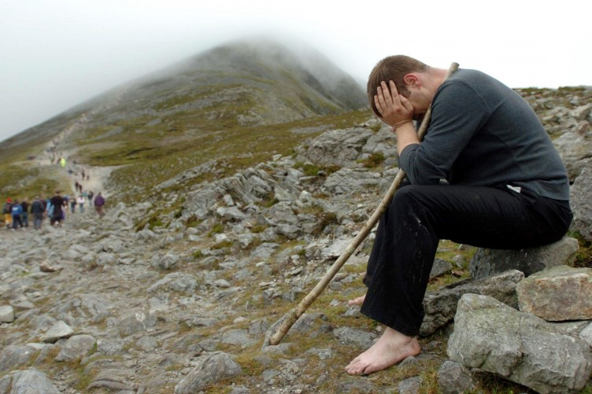
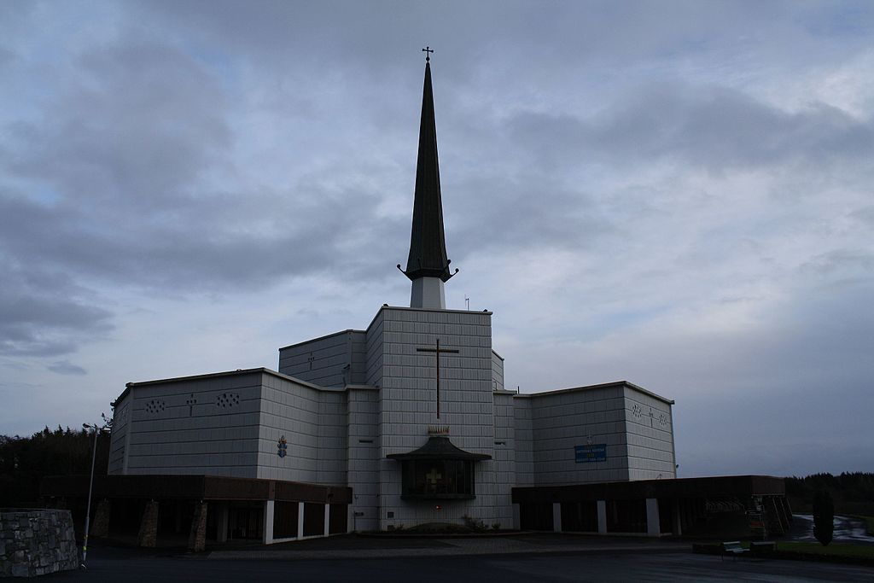
Religious sites
Mayo has two major pilgrimage sites: Croagh Patrick and the Marian Shrine of Our Lady at Knock.
Many pilgrims climb Croak Patrick barefoot.
Knock Shrine in Co. Mayo

Slide 5
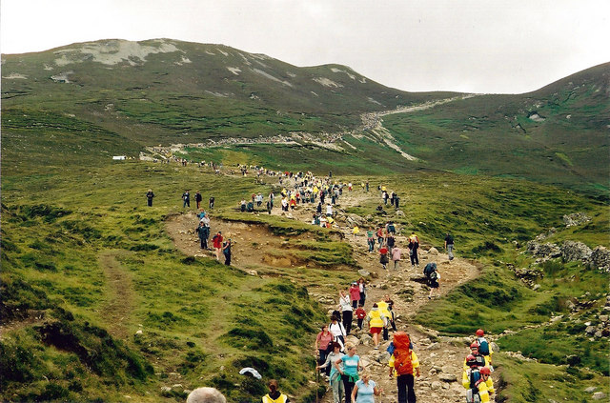
Croagh Patrick
Croagh Patrick has been a place of pilgrimage for over 5000 years. It is believed pagans gathered at the mountain during harvest time back as far as the Stone Age.
Croagh Patrick is now known for its annual pilgrimage in honour of Saint Patrick. It was on the summit of the mountain that Saint Patrick fasted for forty days in 441 AD.
Pilgrims climb Croagh Patrick (also known as ‘The Reek’) on Reek Sunday.
Every year on the last Sunday in July (‘Reek’ Sunday), over 25,000 pilgrims visit the mountain. At the top, there is church where mass is celebrated.

Slide 6
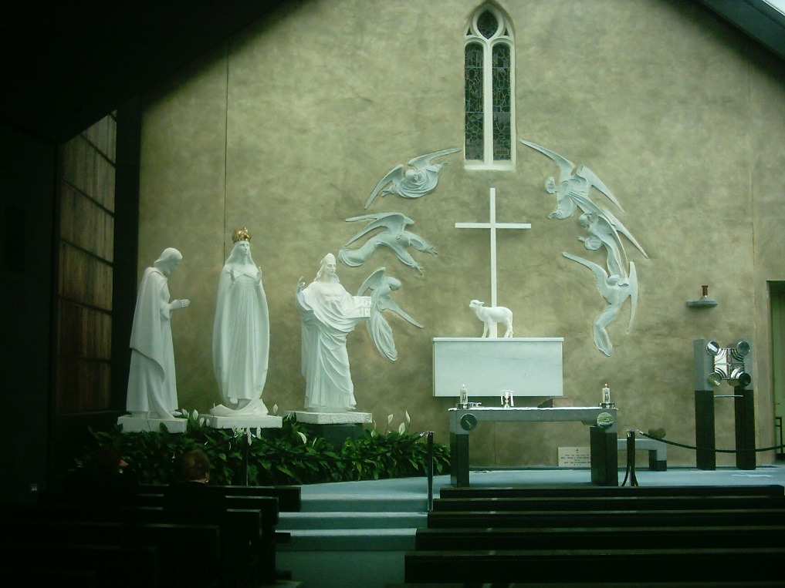
Knock Shrine
Knock Shrine (Irish: Cnoc Mhuire, "Hill of Mary") is a pilgrimage site in the village of Knock, County Mayo.
In 1879 fifteen locals from the village said they saw an apparition of the Blessed Virgin Mary, Saint Joseph, Saint John, angels, and Jesus on the wall of the parish church.
For nearly two hours the group knelt and prayed in front of the figures in the pouring rain.
The wall of the church where the apparition is said to have occurred.
Nowadays many people believe the place has healing powers. Those who claim to have been cured here still leave crutches and sticks at the spot where the apparition is believed to have occurred.

Slide 7
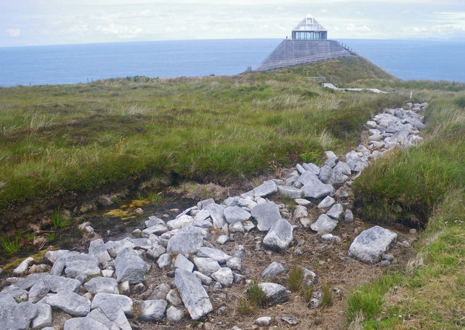
Céide Fields
The neolithic site at Céide Fields contains the oldest known stone-walled fields in the world – dating back nearly 6,000 years.
The fields were first discovered in the 1930s when a local man, schoolteacher Patrick Caulfield, noticed piles of rocks as he cut away some peat for fuel. The way the rocks were placed was not haphazard so he realised that the rocks must have been placed there by people.
Part of the stone walls discovered at the Céide Fields in Co. Mayo.
Forty years later Patrick's son, Seamus, an archaeologist, began to investigate further. Investigations revealed a complex of fields, houses and megalithic tombs concealed by the growth of blanket bogs over the course of many centuries.

Slide 8
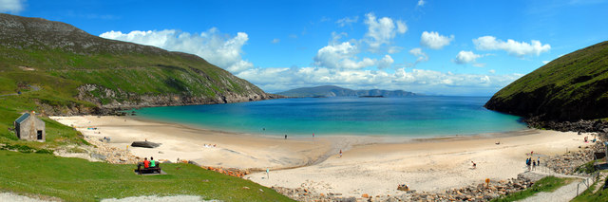
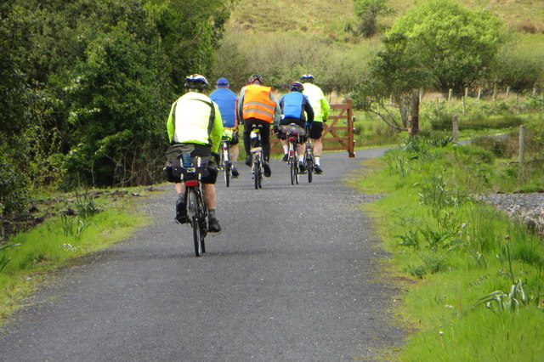
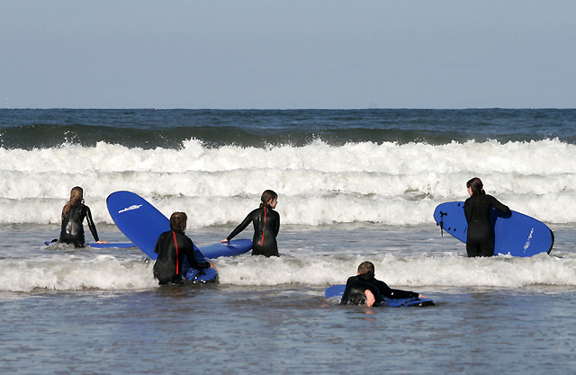
Activities
Co. Mayo is a popular holiday destination with lots of activities including:
  Water sports
  Hiking
  Cycling
  Fishing
  Golf
Keem Bay on Achill Island – the island is a popular tourist destination.
Lots of tourist cycle the Great Western Greenway.
Surfing is another popular pastime.

Slide 9
Quiz
Where is Ireland is Co. Mayo?
North
South
East
West

Slide 10
Quiz
What province is it in?
Leinster
Munster
Connaught
Ulster

Slide 11
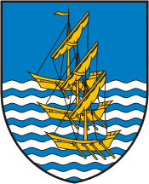
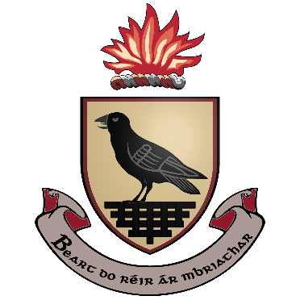
Quiz
Which of these is the county crest?

Slide 12
Quiz
Which island off the coast of Mayo is Ireland’s largest?
The Aran Islands
Achill Island
The Skellig Islands

Slide 13
Quiz
Where in Mayo was there an apparition?
Knock
Westport
Castlebar

Slide 14
Quiz
Croagh Patrick is also known as…
The Rock
The Wreck
The Reek

Slide 15
Quiz
The Céide Fields date back approximately how many years?
60
6000
600

